Slide 1
Army Credentialing Program
Credentialing Overview
Army Credentialing and Continuing Education Services for Soldiers ACCESS ArmyU

Slide 2
Army Credentialing Program
Credential
2
Notes:
Credential: evidence of authority, status, rights, entitlement to privileges, or the like, usually in written form. An umbrella term for occupational licenses and certifications.

Slide 3
Army Credentialing Program
3

Slide 4
Army Credentialing Program
Agenda
Benefits
Eligibility/Rules
Tuition Assistance (TA)/Credentialing Assistance (CA)
Where to Start
Army Credentialing Opportunities On-Line (COOL)
Self Directed Credentials (SDC)
Institutionally Delivered Credential (IDC)
The United Services Military Apprenticeship Program (USMAP)
4

Slide 5
Army Credentialing Program
Credentialing Benefits
Provides credit for military technical schools, training, and experience
Soldiers receive Industry/Nationally recognized credentials
Provides a clear and objective picture of a Soldier's competence
Capitalizes on training and development opportunities throughout their military careers
Enhances MOS proficiency
Enables Soldiers to transition into the civilian workforce “Career Ready”
5

Slide 6
Army Credentialing Program
Eligibility/Rules
Credentialing Assistance is available for voluntary, off-duty training
Soldiers who are flagged under provisions of AR 600-8-2 are not eligible for CA
Soldiers will be subject to reimbursing the Army for CA if they
fail or withdraw from a course of instruction
fail an exam
fail to sit for the exam in the timeframe required to earn the credential, and do not have an approved military withdrawal
Contact your local Education Service Center/Office
for more information
6

Slide 7
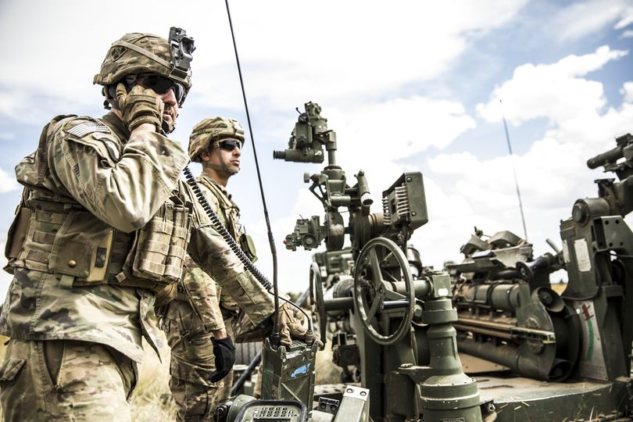
Army Credentialing Program
Tuition Assistance
Credentialing Assistance
Tuition Assistance & GI Bill Eligible
Credentialing Assistance & GI Bill Eligible
$4,000 a year (Combined TA&CA)
You can use TA&CA at the same time!!
7

Slide 8
Army Credentialing Program
Where to Start
Your Local Education Center or Office
Army Credentialing Opportunities On-Line (COOL)
https://www.cool.osd.mil/army/index.htm
8

Slide 9
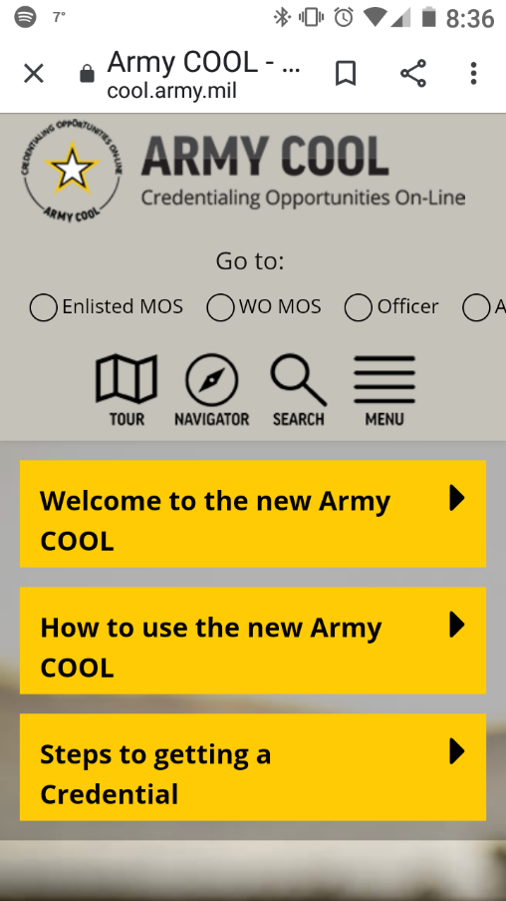
Army COOL
Full Site
Start Here!
Mobile Version
https://www.cool.osd.mil/army/index.htm
You are not required to pursue credentials aligned with your MOS. You may pursue any credential in COOL you are eligible for!!
Start Here!
9

Slide 10
Army COOL
MOS Search
Full Credential Search
10

Slide 11
Army COOL
MOS Search
68W
Full Credential Search
11

Slide 12
Army COOL
Credential in High Demand
Credential is GI Bill eligible
Credential is worth promotion points
How the credential is related to your MOS
Skill level associated with the credential
Credential is accredited
You may use CA for this credential
Star indicated the credential is MOS enhancing, “M” credential is mandatory to hold the MOS
How easy it is to obtain the credential
Credential can be earned in the institution
12

Slide 13
Self Directed Credentialing
Army Credentialing Examples
Master Fitness Course
Certified Personal Fitness Trainer
13

Slide 14
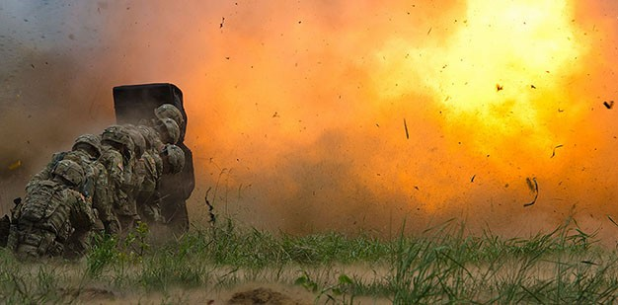
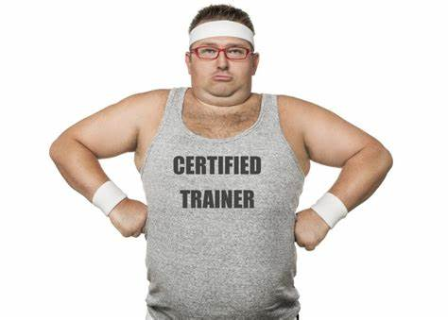
Self Directed Credentialing Examples
SGT Scott Turner,12B
Passion for physical fitness and clean eating
Contacts his local Education Office after initial research on ArmyCOOL
Applies for CA to become a Certified Personal Trainer (ACE-CPT)
In Demand, CA Eligible, Accredited
Completes credential and applies for CA to gain a Health Coach Certification
These credentials will help SGT Turner’s unit’s physical fitness program and his chance of civilian employment if he decides to transition.
14

Slide 15
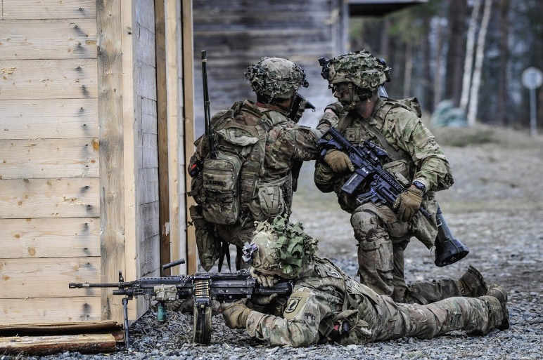
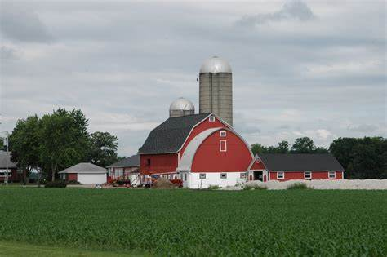
Self Directed Credentialing Examples
SFC Jacob Jones, 11B
Plans to retire in the next 18-24 months
Will return to the family farm in Wisconsin to start taking over operations
Contacts his local Education Office after initial research on ArmyCOOL
Applies for CA and obtains a credential as a Certified Manager of Animal Resources
SFC Jones also applied for CA to become a Certified Landscape Water Manager
Both these credentials will provide SFC Jones the skills to make the family farm more efficient, resulting in higher profit for the family.
15

Slide 16
Self Directed Credentialing Examples
SGT William Mack, 25B
Working on earning more points for promotion
Adds to his skillset within his MOS
Contacts his local Education Office after initial research on ArmyCOOL
Chooses to pursue CompTIA Network+ce credential due to the “High Demand” of the credential the “Most” as it relates to his MOS and the promotion points he will earn
This certification is considered in demand. The U.S. Department of Labor sponsored analysis indicates the certification is frequently mentioned in online job postings.
This credential will not only give him the promotion points that he seeks, but it also gives him additional knowledge and experience within his current MOS.
16

Slide 17
Self Directed Credentialing Examples
PFC Samantha Taylor, 88M
Plans to transition after her 3 year Enlistment
Desires to own her own rig and work for major transportation companies
Contacts her local Education Office after initial research on ArmyCOOL
Chooses to pursue a Commercial Driver's License (CDL) credential due to the “Most” as it relates to her MOS and the promotion points she will earn
With this credential, PFC Taylor is giving herself a bright outlook of opportunity as a Heavy and Tractor-Trailer Driver.
17

Slide 18
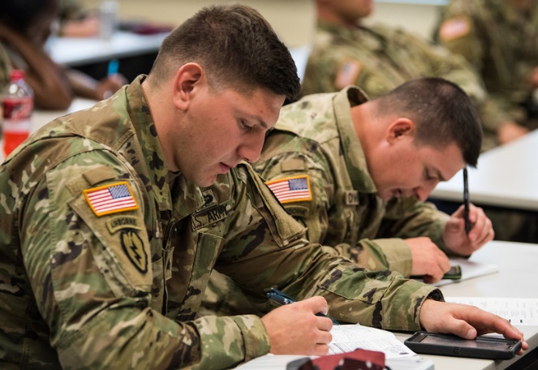
Army Credentialing Program
Institutionally Delivered Credentials
(IDC)
18

Slide 19
Institutionally Delivered Credentials
Institutionally Delivered Credentials
(IDC)
.
Credential requirements embedded in MOS training
Credential partially taught as part of PME
Paid for by the Schoolhouse…not from your annual $4000 TA/CA benefit
Contact your Schoolhouse POC before you attend any PME for IDC opportunities!!
https://www.cool.osd.mil/army/costs_and_funding/army_proponent_funding.htm

Slide 20
Institutionally Delivered Credential Example
SPC Joseph Blackwell, 31E
Is attending BLC in a few months
Learned the MP Schoolhouse offers the Certified Corrections Officer (CCO) credential
Plans to contact the IDC POC for more information before attending BLC
Paid for by the Schoolhouse…not from his annual $4000 TA/CA benefit
This credential will give SPC Blackwell additional knowledge in his MOS as well as promotion points.
20

Slide 21
The United Services Military Apprenticeship Program (USMAP)
The United Services Military Apprenticeship Program (USMAP)
21

Slide 22
The United Services Military Apprenticeship Program (USMAP)
The United Services Military Apprenticeship Program
(USMAP)
Free to the Soldier.
Must be in your MOS
Soldier pursues completely while on duty, hourly credit for executing your MOS duties
Does not require use of Soldier benefits or funds
Minimum of one year left on current enlistment
National recognition in the form of a Department of Labor Certificate of Completion lasts for a lifetime and never needs to be renewed
Follow site steps to register!
https://usmap.netc.navy.mil/usmapss/static/index.htm
22

Slide 23
Apprenticeship Example
SSG Henry Davis, 92G
Plans to transition in the next 18 months
Desires a job as a Chef within the Hotel and Restaurant Industry
Has already taken advantage of the Army Credentialing program and is a Certified Culinarian
Learned about The United Services Military Apprenticeship Program (USMAP) at his local Education Center
Enrolled in the Cook (Hotel and Restaurant) apprenticeship and will log the required 1000 hours before leaving the service, resulting in a DOL Certification of Completion
The combination of a credential and the DOL Certification will give SSG Davis a leg up on the competition when applying for jobs.
23

Slide 24
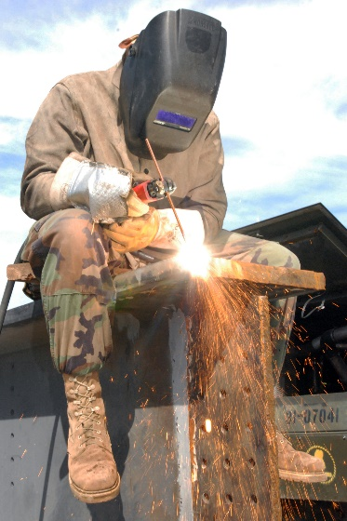
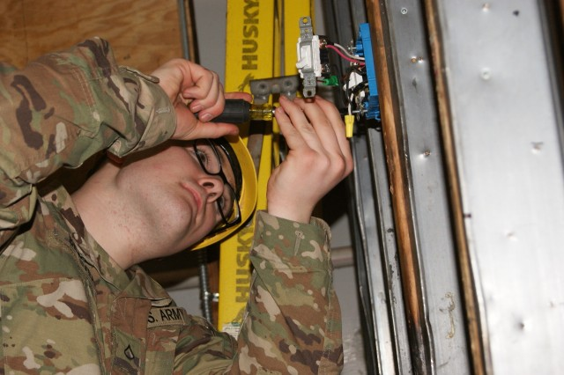
The United Services Military Apprenticeship Program (USMAP)
Value of a DOL Certificate
JOB CATEGORY OF WORK | WITHOUT CERTIFICATE | WITH CERTIFICATE
Security and Protective Services | $35,000 | $60,000
Installation, Maintenance, or Repair Worker | $40,000 | $55,000
Manager, Executive, or Official | $54,000 | $65,000
Food Preparation or Service | $18,000 | $25,000
Transportation Worker | $45,000 | $54,000
Legal | $53,000 | $60,000
Healthcare | $30,000 | $35,000
24

Slide 25
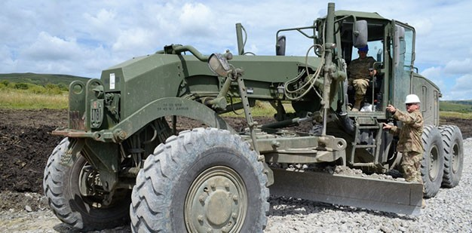
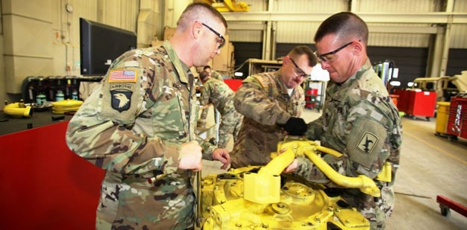
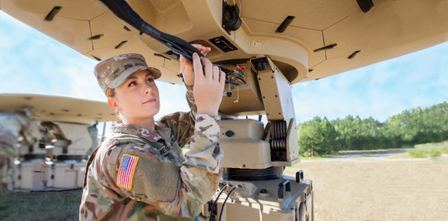
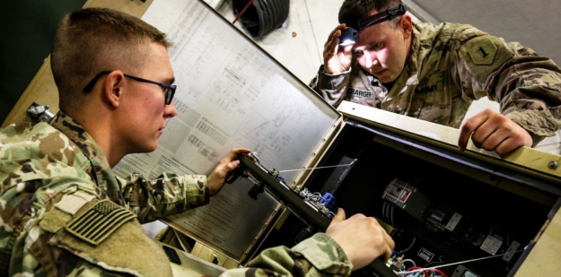
Army Credentialing Program
How will you use this information in the future?
25

Slide 26
Army Credentialing Program
Check on Learning
Your Local Education Center or Office
Self Directed Credentialing
Institutionally Delivered Credentialing Program
$4,000 a year (Combined TA&CA)
26

Slide 27
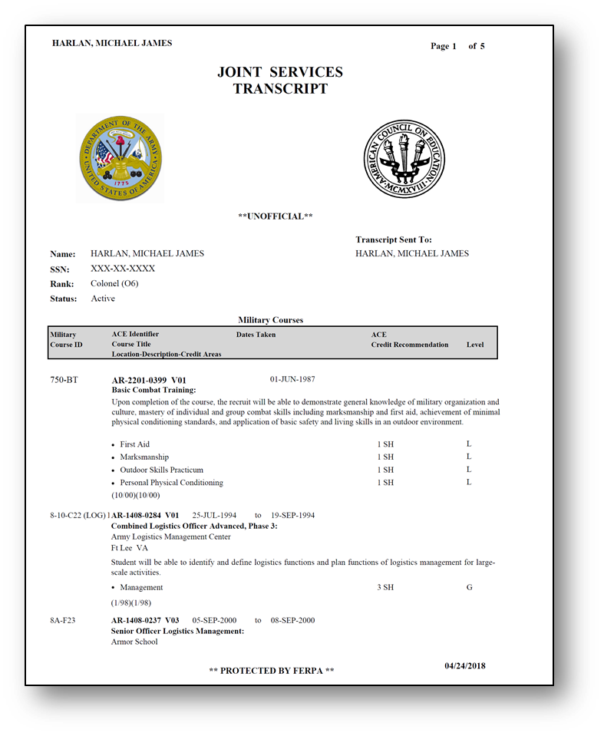
Useful Links
Army University https://www.armyuniversity.edu/
Joint Service Transcript https://jst.doded.mil/
Credentialing Opportunities Online https://www.cool.osd.mil
TA/CA Portal https://www.goarmyed.com/
United Services Military Apprenticeship Program https://usmap.netc.navy.mil/
Army Career Tracker https://actnow.army.mil/
O*NET OnLine https://www.onetonline.org/
27

Slide 28
Army Credentialing Program
Questions?
Credentialing Overview
Army Credentialing and Continuing Education Services for Soldiers ACCESS ArmyU
28

