Slide 1
30 September 2021

Slide 3
Examples of China’s Global Expansion
U.S. and its allies strategic interests are challenged by China in different regions of the world, mostly through ‘soft power’ venues of influence.
Over the past few years, China’s economic presence has grown globally, paving the way for an increase in Beijing’s geopolitical influence.
As first signs of China’s position on post-Taliban takeover in Afghanistan “China is poised to make an exclusive entry into post-Western led Coalition Afghanistan with its Belt and Road Initiative (BRI)…. with an extension of the $62 billion China-Pakistan Economic Corridor (CPEC)—the flagship project of BRI…”1. (Syed Fazl-e-Haider, “Beijing just can’t wait for the U.S. to get out of the way,” Daily Beast, Jul. 04, 2021, accessed on August 22, 2021.)
World Bank and International Monetary Fund’s data is also showing the same trend in terms of Inward Direct Investment Positions (FDI) in millions of US dollars, even towards relatively remote regions of the world, such as South Caucasus (note: FDI might have disadvantages, mostly geo-political. For instance, FDI can hinder domestic investments, risk political changes and influence exchange rates, depending on investor’s agenda)

Slide 4
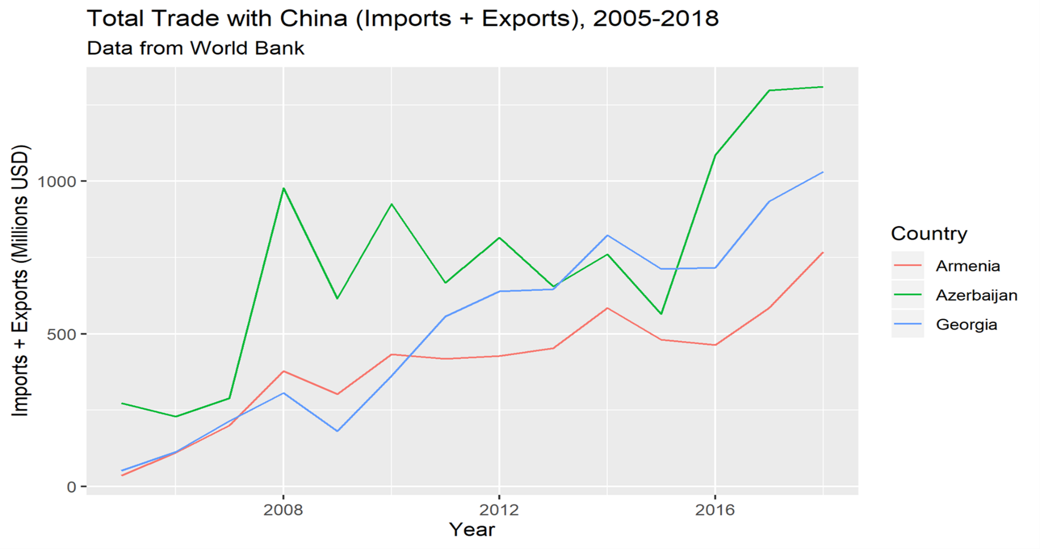
2. (Daniel Shapiro “US Should Keep an Eye on Rising Chinese Investment in the South Caucasus” “Russia Matters,” Harvard Kennedy School, Belfer Center for Science and International Affairs, October 01, 2020. https://www.russiamatters.org/analysis/us-should-keep-eye-rising-chinese-investment-south-caucasus (accessed 18 August, 2021)
3. (https://data.imf.org/regular.aspx?key=61227424 accessed 23 Aug., 2021.)

Slide 5
Great Power Competition in the Pacific: Is Conflict Imminent?
Dr. Roger Cliff
Strategic Studies Institute
Presentation for the
Cultural and Area Studies Office
U.S. Army Command and General Staff College

Slide 6
China’s International Disputes
Legitimacy of Communist Party of China based on restoring China to its traditional position as one of wealthiest and most powerful nations in world
As a result of China’s period of weakness during the 19th and early 20th century, China lost control of multiple territories regarded as part of China
Hong Kong
Taiwan
South China Sea islands
Senkaku/Diaoyu Islands
“Southern Tibet”
Beijing’s failure to recover most of these areas so far is a reminder of how China has not yet regained its former position in the world order

Slide 7
China’s Foreign Policy Becoming More Assertive
Until recently, China’s external strategy has largely been defensive
Legitimacy of CPC since 1978 based on rapidly improving standards of living
Military conflict would disrupt economic growth, undermining legitimacy of CPC
Result: Principal goal was to prevent permanent loss of disputed territories
More recently, however, China has been becoming more assertive:
PLA has become increasingly capable
Chinese public has become increasingly nationalistic and jingoistic
New leader (Xi Jinping) has come to power
Result: Growing “grey zone” aggression since 2012

Slide 8
Prospects for Conflict in Coming Years
China’s leadership will still prefer to achieve its goals without military conflict
BUT
China’s economy less dependent on foreign trade and investment than in years past
Economic growth has been slowing down
If China’s economy were to go into recession, legitimacy of leadership would be threatened
ALSO
If a severe enough provocation were to occur, China’s leadership would feel compelled to respond with force, regardless of costs
Possible Wildcard: Regime collapse or civil war in North Korea

Slide 9
UK’s Recent Integrated Review of Defense and Security:
How it Has Positioned to Compete in the Indo-Pacific
COLONEL JIM WALKER
BRITISH ARMY
U.S. Army Combined Arms Center
Presentation for the
Cultural and Area Studies Office
U.S. Army Command and General Staff College
30 September 2021
unclassified

Slide 10
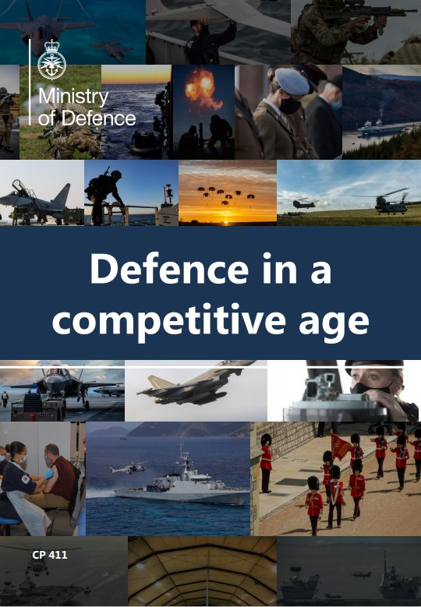
Competition in the indo-pacific
UNCLAS
The UK’s defence command paper
The Integrated Review
'Global Britain'
combines the UKs soft and hard power
Defence Command Paper
more present and active around the world
below the threshold of open conflict
"partner our friends and enable our allies, whether they are in the Euro-Atlantic, the Indo-Pacific, or beyond.”
‘push back to protect our values and global interests’
designed for permanent and persistent global engagement.
Aims:
Integrated across all 5 domains
Integrated nationally
Engaged Internationally
More Assertive
Information-led
Ministry of Defence Integrated Review Command Paper - GOV.UK (www.gov.uk)
UNCLAS
Notes:
The Prime Minister’s vision for the UK in 2030 sees a stronger, more secure, prosperous and resilient Union, better equipped for a more competitive age, as a problem-solving and burden-sharing nation with a global perspective. To become so requires Britain’s soft and hard power to be better integrated.
Russia continues to pose the greatest nuclear, conventional military and sub-threshold threat to European security. Modernisation of the Russian armed forces, the ability to integrate whole of state activity and a greater appetite for risk, makes Russia both a capable and unpredictable actor.
The rising power of China is by far the most significant geopolitical factor in the world today. China poses a complex, systemic challenge. As the Integrated Review makes clear, we need to be prepared to push back to protect our values and global interests, while maintaining our ability to cooperate in tackling global challenges such as climate change and the mutual benefits of our economic relationship.
The significant impact of China’s military modernisation (which is proceeding faster than any other nation) and growing international assertiveness within the Indo-Pacific region will pose an increasing challenge.
In an era of global competition and security threats, we must be ready to bring military support to our allies and partners wherever that might be needed. Britain’s ability to project power in this way remains a defining feature of our defence policy. Demonstrating our capability, and operating effectively alongside partners, is the best way to ensure stability and avoid conflict occurring.
DCP Aim: Combining the UKs soft and hard power
“no longer be held as a force of last resort, but become more present and active around the world, operating below the threshold of open conflict to uphold our values and secure our interests, partner our friends and enable our allies, whether they are in the Euro-Atlantic, the Indo-Pacific, or beyond.”
‘push back to protect our values and global interests’
Evolving from a force that is primarily designed for the contingency of a major conflict and warfighting, to one that is also designed for permanent and persistent global engagement. To succeed in the era of systemic competition we will need to be front-footed. We and our allies and partners must drive the tempo of strategic activity rather than responding to others.
Aims:
Integrated across all 5 domains
Integrated nationally
Engaged Internationally
More Assertive
Information-led

Slide 11
Competition in the indo-pacific
UNCLAS
Indo-pacific regional focus
The Indo-Pacific region matters to the UK: it is critical to our economy, our security and our global ambition to support open societies. .
At least 1.7 million British citizens live across the region.
Defence will:
Increase capacity building
Maximise regional engagement as part of the Carrie Strike Group (CSG) 21 deployment
Increase our Maritime presence
Pursue closer defence cooperation with the ASEAN nations
Partners:
Partnership with India is a key pillar.
Japan is our closest security partner in Asia
Pakistan
ROK
Basing – Royal Navy persistent Offshore Patrol Vessels and Littoral Response Group
UNCLAS
Notes:
The Indo-Pacific region matters to the UK: it is critical to our economy, our security and our global ambition to support open societies. At least 1.7 million British citizens live across the region and our trading relationships continue to grow. In the decades to come it will be the crucible for many of the most pressing global challenges – from climate and biodiversity to maritime security and geopolitical competition linked to rules and norms. The Integrated Review highlights the growing importance of the IndoPacific for the UK’s security and prosperity and sets a framework for increased UK engagement.
Defence is an essential part of the UK’s integrated offer to the region and, as such, we will be strengthening our regional defence cooperation in the Indo-Pacific, in support of the Government’s efforts to build wider security partnerships. Our aim will be to mitigate growing threats to our security, working with Indo-Pacific partners to build resilience and capacity, tackle shared security challenges and uphold freedom of navigation and international law. We will develop capability partnerships and support UK prosperity by strengthening defence exports. More specifically, we will:
• Increase our capacity building and training across the Indo-Pacific, delivered through longer and more consistent military deployments and by better leveraging our existing regional facilities.
• Maximise regional engagement as part of the Carrier Strike Group deployment in 2021.
• Increase our maritime presence in the IndoPacific region through the deployment of Offshore Patrol Vessels from 2021, Littoral Response Group from 2023 and Type 31 frigates later in the decade, including to uphold freedom of navigation.
• Make a bigger and more consistent contribution to the Five Power Defence Arrangements (FPDA).
• Pursue closer defence cooperation with the Association of Southeast Asian Nations (ASEAN) member states.
• Guarantee our regional access through existing UK bases, including the British Indian Ocean Territory, access to allied facilities, and the development of an enhanced training facility at Duqm, Oman.
• Deepen and expand defence industrial relationships in the region, including with Australia, Japan, Republic of Korea and India, underpinned by co-operation on science and technology. We will also enhance our programmes of exercises, exchanges and capability development with these key partners.
• Expand our Defence Attaché and Advisor network and build a new British Defence Staff in Canberra to work alongside the existing Defence Staff in Singapore and coordinate Defence activity across the region.
5.23. Our partnership with India is a key pillar of the UK’s tilt to the Indo-Pacific. We will establish a maritime partnership with India in support of mutual security objectives in the Indian Ocean. We will enhance our industrial cooperation, uplift our defence education, training and reform relationship to enable us to work together more effectively. We will carry out integrated joint exercising, increase our understanding of the maritime environment, and sign key agreements to increase interoperability. Indo-Pacific 32All our activity will be underpinned by strategic dialogues to promote high-level alignment and a strong programme of military education and exchanges.
5.24. Our Defence relationship with Japan has deepened significantly in recent years with an enhanced programme of exercises, training exchanges, security arrangements and capability development programmes that span all five domains. The next decade will see further development with our closest security partner in Asia. We will deepen cooperation between the Japanese Self Defence Forces and the British armed forces towards a free and open IndoPacific.
5.25. The UK has a longstanding relationship with Pakistan in support of shared regional security and stability objectives. Its diaspora links with the UK. Disputed borders and a complex security environment mean that Pakistan’s defence relationship with the UK will continue to be important. Our cooperation encompasses military exercising, professional military education and exchanges, training and visits.
5.26. Our defence relationship with the Republic of Korea (ROK) is a highly significant area of focus for the UK, as it is a like-minded democracy with similar views on regional security priorities and the rules, norms and standards that shape the international system overall. We will build on the enduring strategic partnership established during the Korean War by enhancing opportunities for exchanges of personnel, training, education and information sharing. We will seek to improve our interoperability through integrated joint exercises and further strengthen our common commitment to work in third countries on global peacekeeping initiatives. The ROK has a modern, well-funded military force with aspirations to further contribute to global security. Their defence budget is projected to soon exceed our own, and the UK will support mutual prosperity through closer industrial cooperation underpinned by military expertise, particularly through their indigenous Light Aircraft Carrier programme.
With support from partners in the Indo-Pacific, Offshore Patrol Vessels will be persistently deployed and a Littoral Response Group (LRG) in 2023 will complement the episodic deployment of our Carrier Strike Group; contributing to regional security and assurance.
pre-empt and deter sub-threshold activity, and counter state threats. This will be enabled by the deployment of two Littoral Response Groups; the first in 2021 will be deployed to the Euro-Atlantic under a NATO and JEF construct, while a second will be deployed to the Indo-Pacific region in 2023. They will also be able to deliver training to our partners in regions of the world where maritime security is most challenging.

Slide 12
Great Power Competition in the Pacific: Is Conflict Imminent?
Dr. John H. Modinger
Department of Joint, Interagency and Multinational Operations
U.S. Army Command & General Staff College.
Presentation for the
Cultural and Area Studies Office
U.S. Army Command and General Staff College
30 September 2021
unclassified

Slide 13
The storm is coming. When will Taiwan take it seriously and what should the U.S. do?

Slide 14
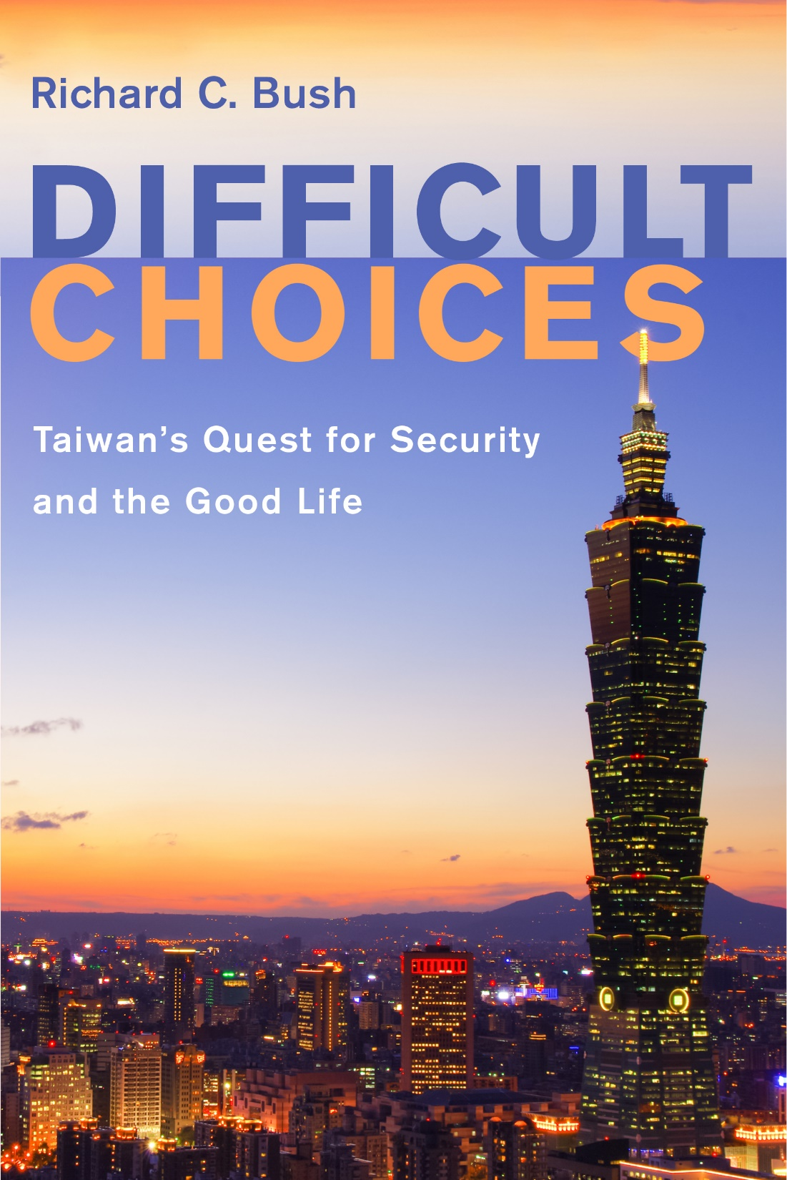
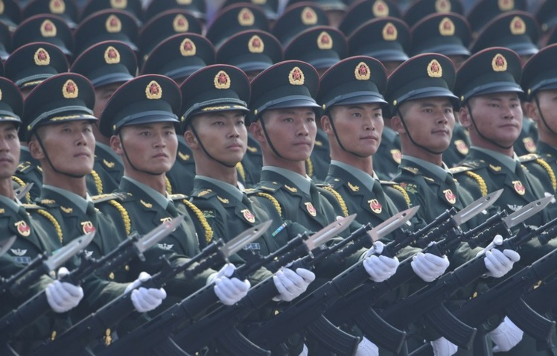
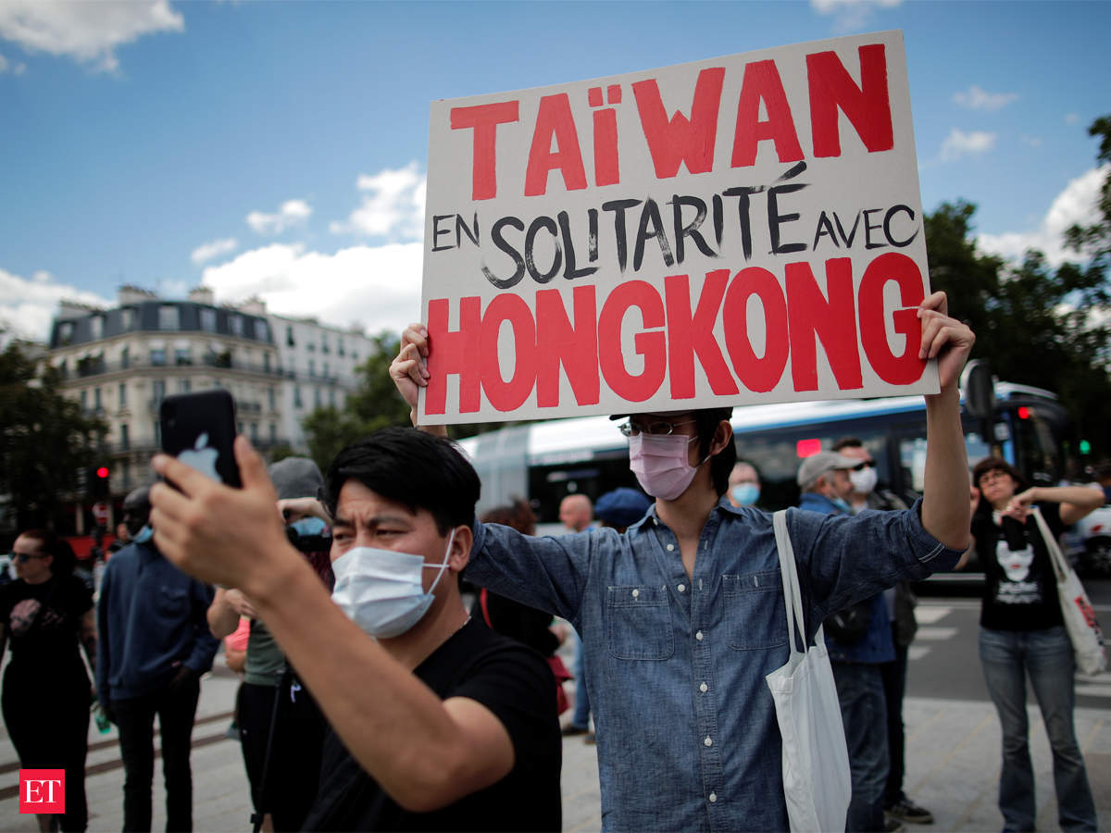
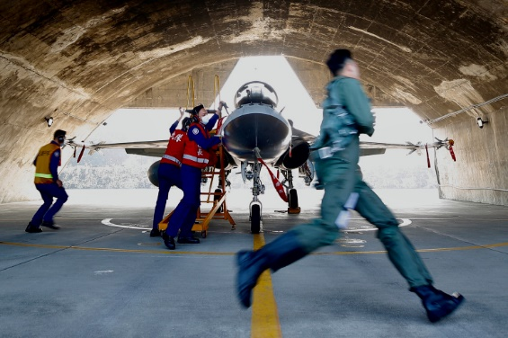

Slide 15
Taiwan’s fate and U.S. involvement
“No room for compromise or concessions” … warns US to stop “playing with fire.”
Re: China’s threats to Taiwan … “might be surprised to see how little visible impact the situation seems to be having on the everyday lives of the island’s 23 million inhabitants.”
PLA active forces now outnumber Taiwan’s by a factor of 12!
“The strongest driver of increased Chinese assertiveness is the conviction that the Western system, and the US in particular, is in decay.”
The US should insist any new commitments to the island are contingent upon Taipei’s continued willingness to invest in truly asymmetric capabilities.
The US needs to give Taiwan the external push it needs to reintroduce two-year compulsory military service—sends powerful message that the Taiwanese are willing to make a major sacrifice to provide for their own defense.

Slide 16
Great Power Competition in the Pacific: Is Conflict Imminent?
Lt.COL. Paul Mostafa
Australian Army
Department of Joint, Interagency and Multinational Operations
US Army Command & General Staff College.
Presentation for the
Cultural and Area Studies Office
U.S. Army Command and General Staff College
30 September 2021
unclassified

Slide 17
Competition continuum through a different lens
Competition continuum
Cooperation
Competition
Conflict
Interest continuum
Mutual
Diverging
Opposed
Values continuum
Shared
Separate
Incompatible
Intent continuum (Currently - Interests x Values = Intent)
Benign
Divided
Malign

Slide 18
How do the Great Powers view conflict?
A spectrum of States
Utopian Democracy
Totalitarian Regime
Sun Tzu – Subjugating the enemy’s army without fighting is the true pinnacle of excellence.
Clausewitz – Political warfare is warfare without the use of force.
Mao – Warfare is politics with bloodshed; politics is warfare without bloodshed.
George Kennan – Political warfare uses every means at a nation’s command – short of war – to achieve national objectives.

Slide 19
How and why do things move?
Decisive Conflict
Cooperation
Competition
Conflict
Loss of will/capacity to compete
Limited Conflict
Issue of significant mutual interest

Slide 20
Questions/Answers/Comments

Slide 22
Contact:
Dr. Mahir Ibrahimov
Director, Cultural & Area Studies Office (CASO)
U.S. Army Command and General Staff College (CGSC)
Fort Leavenworth, KS 66027-2300
Phone: (913) 684-3345
CASO website: http://usacac.army.mil/organizations/cace/lrec
YouTube link: https://www.youtube.com/playlist?list=PLkGvnfy3IadNRMPT-sNHpAsz8a3npWBH8
CGSC Facebook: https://www.facebook.com/USACGSC
Contact:
Dr. Mahir Ibrahimov, Director, CREL Management Office (CRELMO)
Fort Leavenworth, KS 66027-2300
Phone: (913) 684-3345
DSN: 552-3345Contact:
Dr. Mahir Ibrahimov, Director, CREL Management Office (CRELMO)
Fort Leavenworth, KS 66027-2300
Phone: (913) 684-3345
DSN: 552-3345
CRELMO website: http://usacac.army.mil/organizations/cace/lrec
ATN: https://atn.army.mil/dsp_template.aspx?dpID=102
https://atn.army.mil
YouTube link: https://www.youtube.com/playlist?list=PLkGvnfy3IadNRMPT-sNHpAsz8a3npWBH8
CRELMO website: http://usacac.army.mil/organizations/cace/lrec
ATN: https://atn.army.mil/dsp_template.aspx?dpID=102
https://atn.army.mil
YouTube link: https://www.youtube.com/playlist?list=PLkGvnfy3IadNRMPT-sNHpAsz8a3npWBH8

