Slide 1
27 April 2021

Slide 3
Great Power Competition: A View from Central Asia
Dr. Robert Baumann
Uzbekistan Armed Forces Academy
Ministry of Defense Advisor, DSCA
Presentation for the
Cultural and Area Studies Office
U.S. Army Command and General Staff College
27 April 2021
unclassified

Slide 4
Scenes from the Global Culture War

Slide 5
Narrative Construction Russian Style

Slide 6
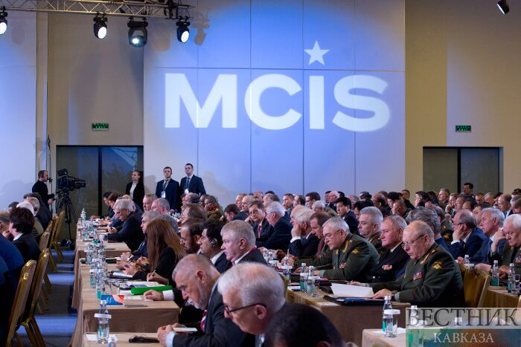
Managing the Agenda: The Moscow Conference on International Security (MCIS)
Dr. Mark R. Wilcox
Department of Joint, Interagency and Multinational Operations
U.S. Army Command and General Staff College
Presentation for the
Cultural and Area Studies Office
U.S. Army Command and General Staff College
27 April 2021
unclassified

Slide 7
MCIS – 2012-2019 Moscow’s Agenda
Annual catalogue of threats, challenges, opportunities
Correlation to Putin and Defense Minister Sergey Shoygu’s tenures
Reflective of the ascendancy of the armed forces and relative diminution of the MFA
Information warfare tool against NATO and the U.S.
“the Kremlin considers the United States and NATO to be far greater threats to Russian security than international terrorism or other transnational security threats”

Slide 8
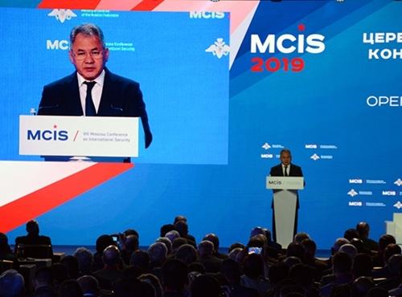
MCIS – Defense Minister Sergey Shoygu’s Agenda
Tool of Russia’s (and Defense Minister Shoygu’s) soft power in relations with “the rest” versus the West
More speakers from Asia and Africa
More bilateral meetings on the margins
One component of Shoygu’s public relations campaign

Slide 9
21st Century Short-lived Revolutions: Tweets from Tahrir 2011 Themes – A Comparison with Egypt’s Political Reality
LTC Rafael Linera-Rivera, MCCoE/CAC Commander's Assessment Program Directorate (CAPD)
Presentation for the
Cultural and Area Studies Office
U.S. Army Command and General Staff College
27 April 2021
unclassified

Slide 10
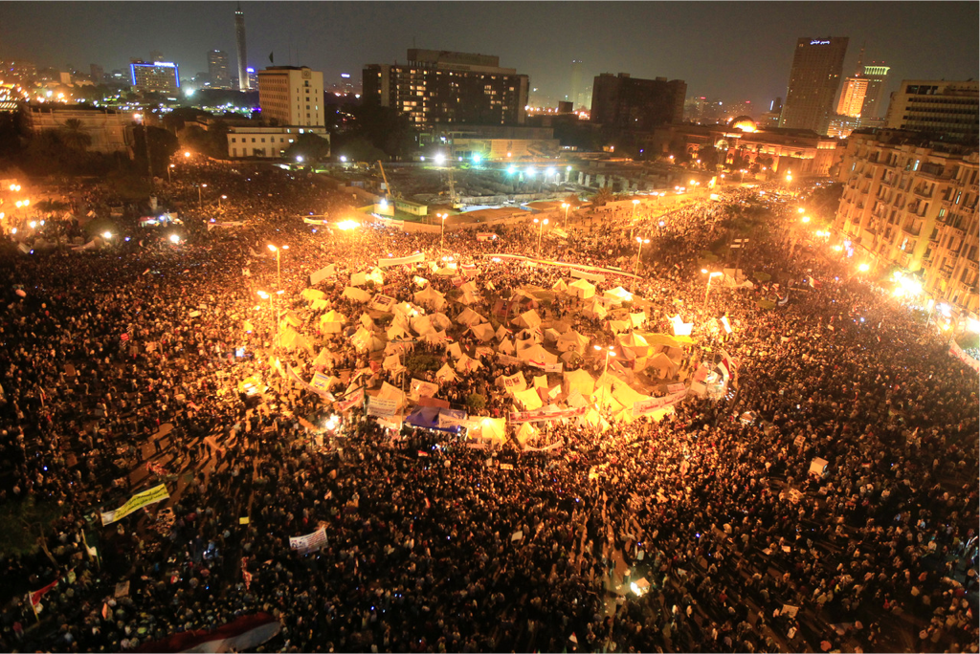
21st Century Short-lived Revolutions
Tweets from Tahrir 2011 Themes – A Comparison with Egypt’s Political Reality
@linerare https://www.linkedin.com/in/rafalinera/

Slide 11
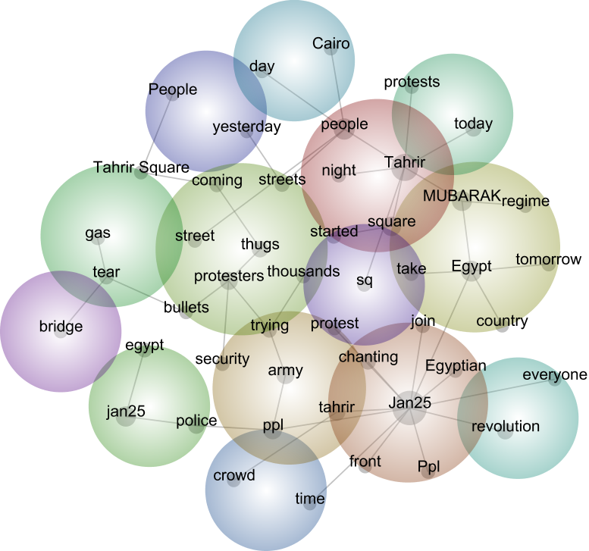
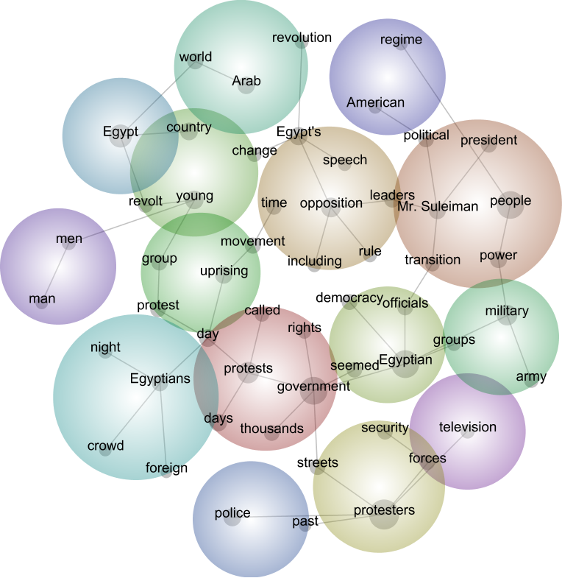
Concept Maps
Tweets 25 Jan – 11 Feb
NYT 26 Jan – 12 Feb

Slide 12
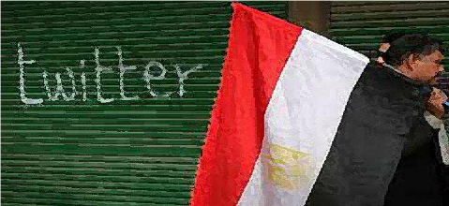
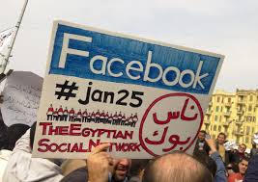
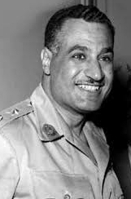
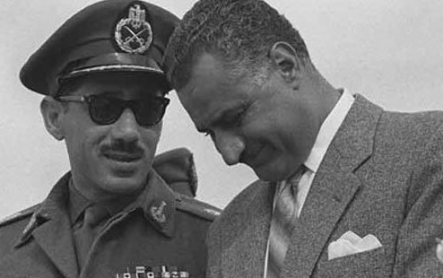
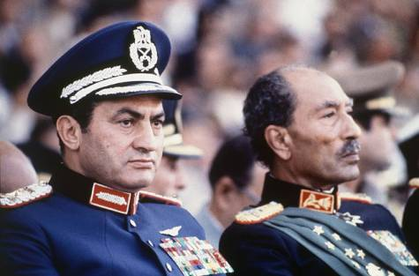
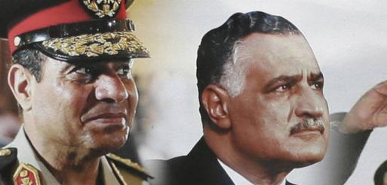
Summary
Tweets
Egypt’s Political Reality
- Evidence of self regulatory function of cognition: logistics, aspirations, and critical awareness
- Integration & differentiation of themes at the level of individual tweet when compared to traditional media

Slide 13
Contemporary Russian Power Projections in Nicaragua
Major Nicole L. Hash
Battalion S3, 303d Military Intelligence Battalion
Presentation for the
Cultural and Area Studies Office
U.S. Army Command and General Staff College
27 April 2021
unclassified

Slide 14
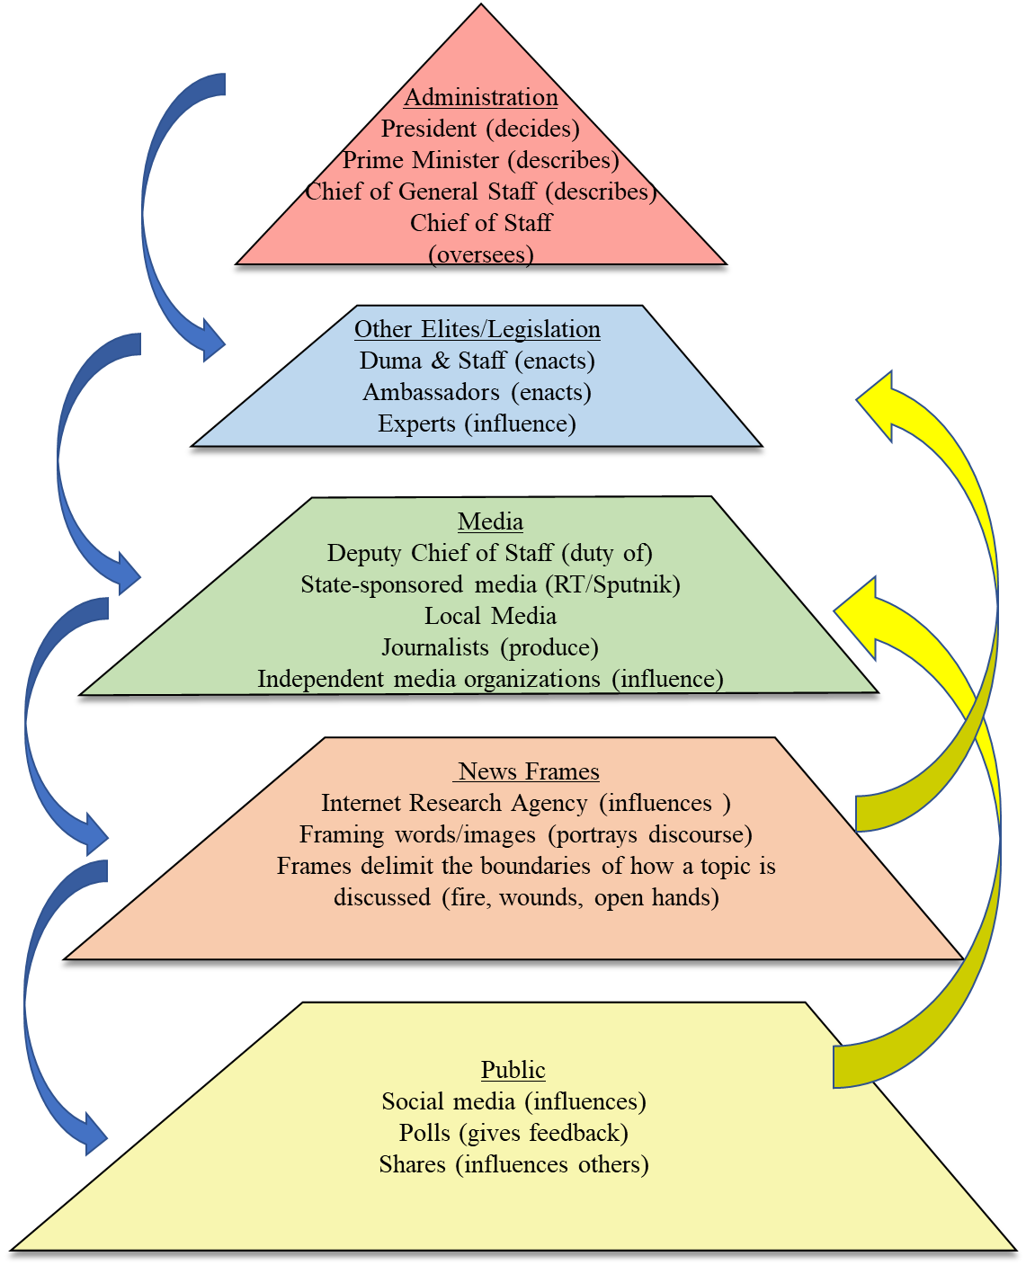
Cascading Network Activation: Russian Expression in Nicaragua
Discourse - how someone thinks about people, things, and society and the relationship between them
OR
The transmission of power and ideology through cognitive processing of information that produces mental models and societal interpretations.
In short: Words Have Meaning
Institutions – govern behavior and set customs and norms.
Media as an institution influences discourse.
Therefore, power is projected through discourse via media
Notes:
Entman’s Framework for Cascading Network Activation. Entman, Robert M. “Framing: Toward Clarification of a Fractured Paradigm.” Journal of Communication 43, no. 4 (December 1, 1993): 51–58.

Slide 15
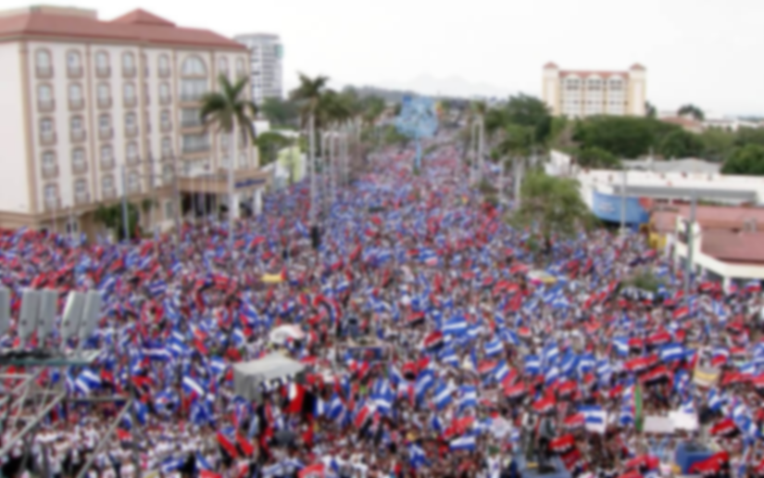
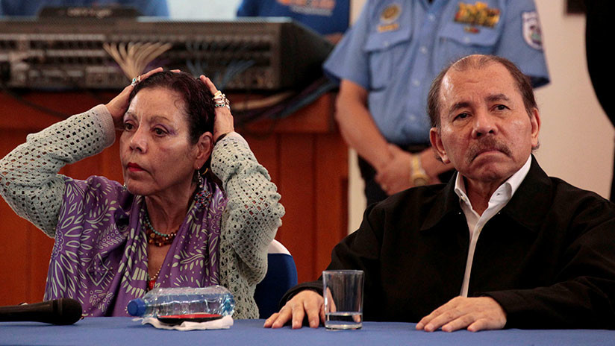
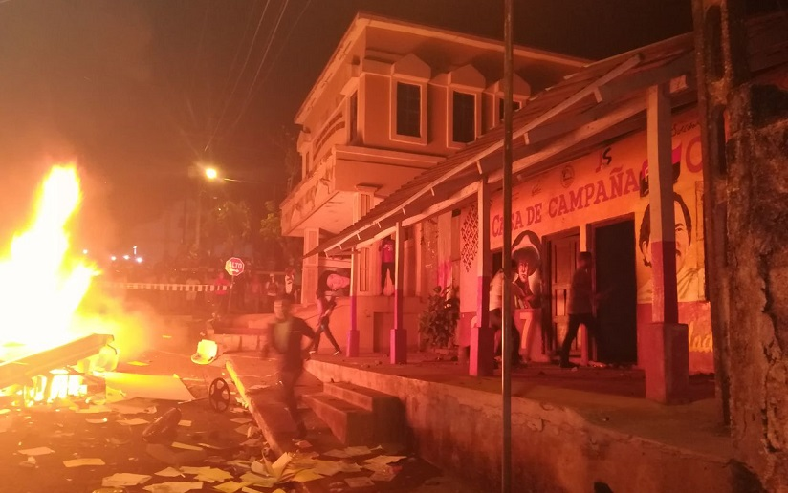
Discursive Themes and Protests: How to Use Sharp Power
Russian Foreign Policy and National Security Strategy Themes: prevent a color revolution; generate alternatives
Ambassador: correct a one-sided narrative
Sputnik & RT: “primary source of alternative information.” Responsible for framing the US in an alternate way.
El 19 Digital: Nicaraguan state-sponsored media; editor is VP and wife of President Ortega
Public: Protests
Notes:
Source: Nazareth Balbás, “La herida de Nicaragua: ¿Qué esperar del diálogo entre gobierno y oposición? RT en Espanol, May 18, 2018.

Slide 16
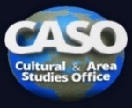
Summary of Main Points: “For When Western Power Fails”
Words (discourse) matters.
“Sharp” power forces a proper opinion, compels through arguments laced with logical fallacies and eliminates contrary facts.
When Russia’s narrative of preventing color revolutions and generating alternatives to the West become attractive to Nicaragua, Nicaragua adopted this discourse.
Discourse, even when seemingly latent represents potential power. When activated, it can force seemingly “sudden” changes.
In short, strategists should consider Russian information activities, even when they seem ineffective on the surface, as potential power.

Slide 17
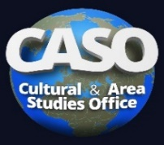
Commentator
Dr. Katherine Dahlstrand
Team Chief
Books and Research Team
Army University Press

Slide 18
Summary
Dr. Mahir Ibrahimov
General Editor/Author
Director
Cultural & Area Studies Office
U.S. Army Command and General Staff College
https://www.armyupress.army.mil/Books/CSI-Press-Publications/Contemporary-Operations/#great-power-competition
https://go.usa.gov/xH594

Slide 19
Questions/Answers/Comments

Slide 20
Contact:
Dr. Mahir Ibrahimov
Director, Cultural & Area Studies Office (CASO)
U.S. Army Command and General Staff College (CGSC)
Phone: (913) 684-3345
CASO website: http://usacac.army.mil/organizations/cace/lrec
YouTube link: https://www.youtube.com/playlist?list=PLkGvnfy3IadNRMPT-sNHpAsz8a3npWBH8
CGSC Facebook: https://www.facebook.com/USACGSC
ATN: https://atn.army.mil/cultural-area-studies-office-(formerly-crelmo)/cultural-area-studies-office-(formerly-crelmo)
Contact:
Dr. Mahir Ibrahimov, Director, CREL Management Office (CRELMO)
Fort Leavenworth, KS 66027-2300
Phone: (913) 684-3345
DSN: 552-3345Contact:
Dr. Mahir Ibrahimov, Director, CREL Management Office (CRELMO)
Fort Leavenworth, KS 66027-2300
Phone: (913) 684-3345
DSN: 552-3345
CRELMO website: http://usacac.army.mil/organizations/cace/lrec
ATN: https://atn.army.mil/dsp_template.aspx?dpID=102
https://atn.army.mil
YouTube link: https://www.youtube.com/playlist?list=PLkGvnfy3IadNRMPT-sNHpAsz8a3npWBH8
CRELMO website: http://usacac.army.mil/organizations/cace/lrec
ATN: https://atn.army.mil/dsp_template.aspx?dpID=102
https://atn.army.mil
YouTube link: https://www.youtube.com/playlist?list=PLkGvnfy3IadNRMPT-sNHpAsz8a3npWBH8

