Slide 1

28 October 2020

Slide 2
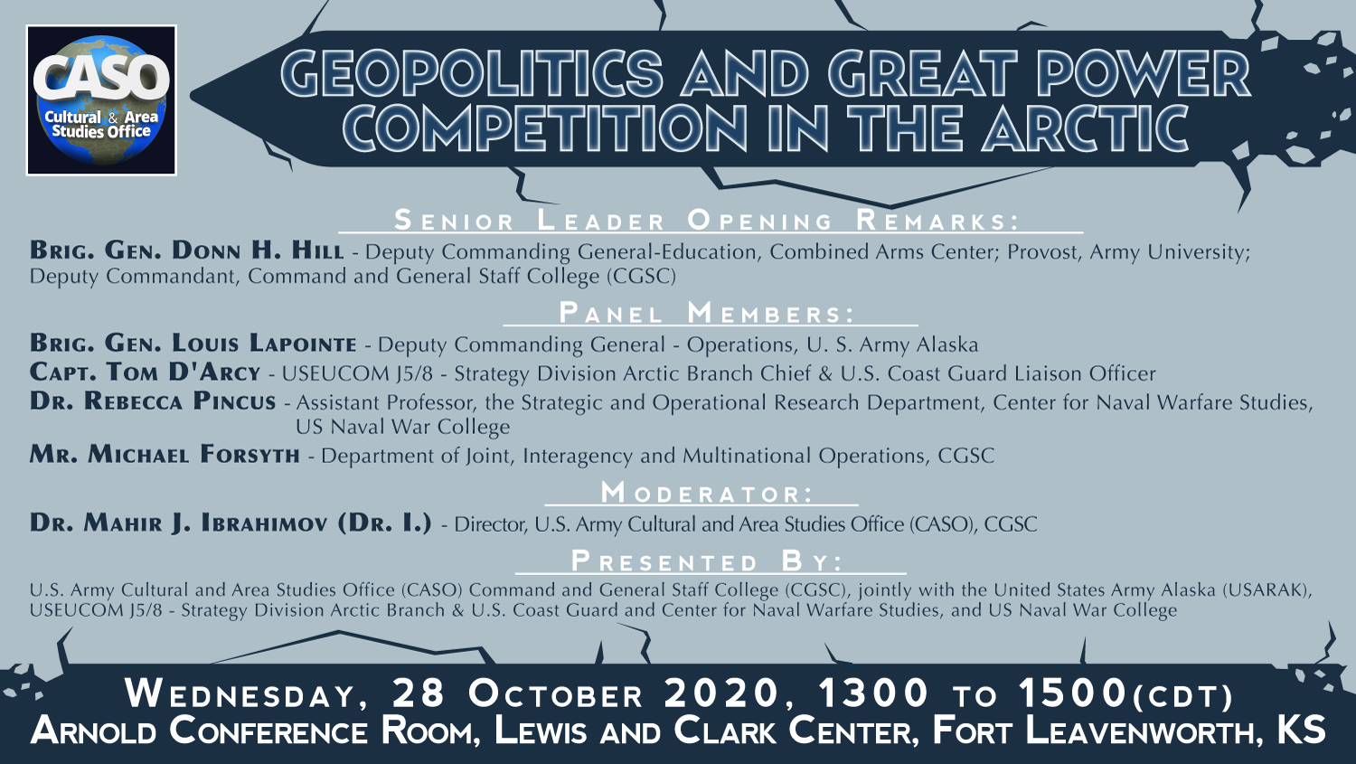

Slide 3


“Russian New Generation Warfare”
(President Vladimir Putin signed Russia's new military doctrine on December 26, 2014 and The National Security Strategy on December 31, 2015)
The main highlights of the documents include:
*A more aggressive stance toward NATO’s expansion into former Soviet satellites and Warsaw Pact countries.
* Setting up a joint missile defense systems by Russia and its allied countries in response to efforts by NATO to extend air and anti-missile defense over Europe.
* Ensuring the national security interests of the Russian Federation in the Arctic (Military Doctrine of the RF, section 32). The leadership in exploring of resources of the World Ocean and the Arctic is of particular importance (National Security Strategy of the RF, section 13). These are followed by boosting military presence in the Arctic as “the region which has always been a sphere of "special interest" to Russia.”
* Strengthening cooperation with India and China and other BRICS countries, which stands for Brazil, Russia, India, China and South Africa.
* The documents identify the situation in and around Ukraine as a potential threat on the Russian borders.
* Russia’s nuclear capabilities remain an important tool to deter global and regional military conflicts.

Slide 4
UNCLASSIFIED
United States Army Alaska
Geopolitics and Great Power Competition in the Arctic
Brigadier General Louis M. Lapointe
Deputy Commanding General – Operations
United States Army Alaska

Slide 5
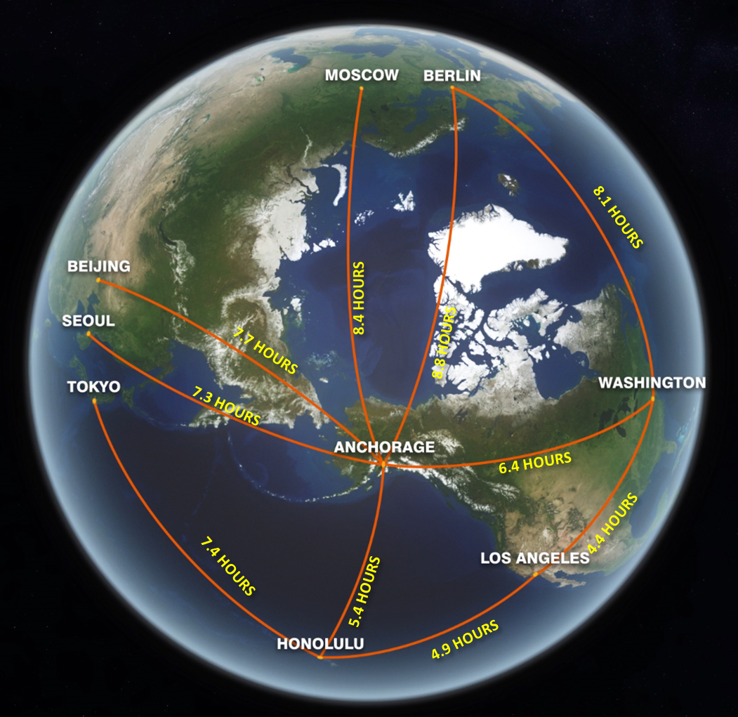
Threats to the Homeland
UNCLASSIFIED
“The Arctic is growing as an economic and strategic hot spot, as well as an area that requires military deterrence.”
Russia
Senator Dan Sullivan
Readiness Subcommittee Hearing
May 2020
Russia continues to promote militarization of the Arctic, improving its cold weather capabilities, expanding infrastructure and increasing presence
NORAD conducts triple intercept of Russian aircraft amid rise in Alaskan incursions (August 2020)
Norway blames Russia for cyber attack on their parliament’s email system (October 2020)
Russia has deployed a Bastion coastal defense cruise missile unit directly across the Bering Sea from Alaska (September 2019)
ALCOM JOA
Pollock trawlers within U.S. economic exclusion zone in the Bering Sea were confronted by Russian ships & aircraft conducting major military exercise (August 2020)
Russian military research ship returns after months on secret Arctic mission (September 2020)

Slide 6
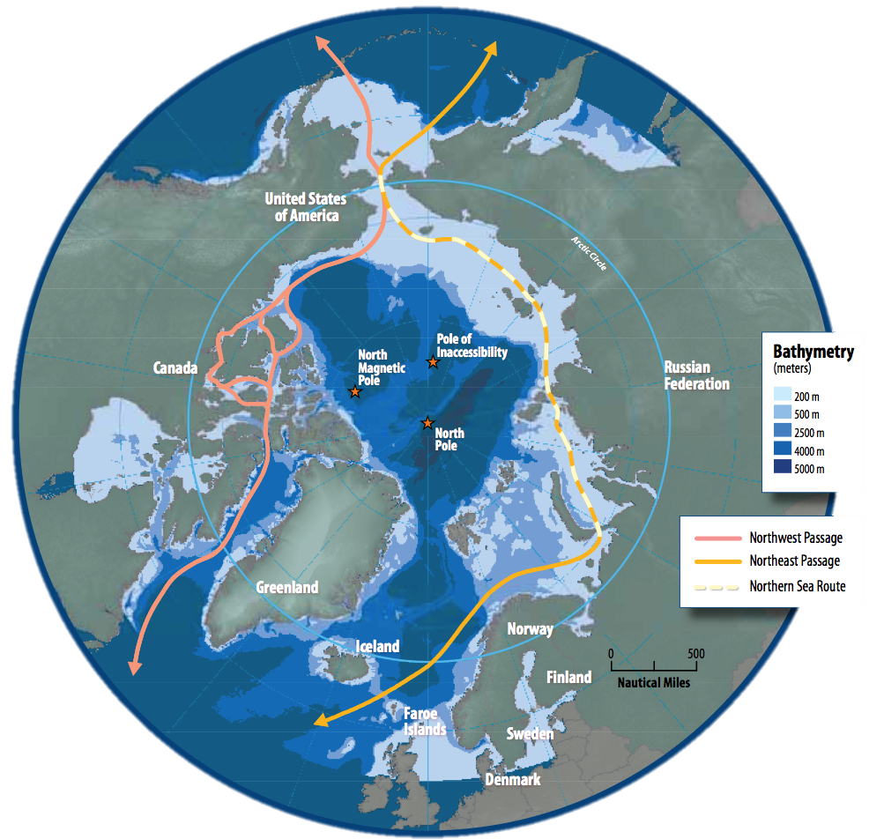
Threats to the Homeland
UNCLASSIFIED
“The Arctic is no longer a fortress wall and the Arctic Ocean is no longer a protective moat. They are now avenues of approach to the homeland.”
GEN O’Shaughnessy – SASC hearing on the Arctic 3/5/2020
Two Chinese icebreakers return home after historic 6-month Arctic deployment (April 2020)
China
China continues to extend its influence in the Arctic, establishing economic ties to Arctic nations and conducting yearly exploration
VEO
Non-state actors could exploit ungoverned space in Arctic through international smuggling and terrorism
Chinese submarine fleet operating more frequently in the Arctic (September 2020)
Chinese spy ship monitored Alaskan Terminal High Altitude Area Defense system test (2017)
Polar Silk Road expands Chinese influence worldwide, part of a growing web of diplomatic and economic commitments (July 2020)

Slide 7
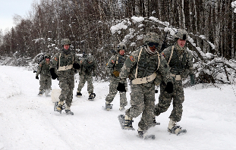
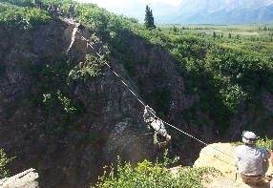
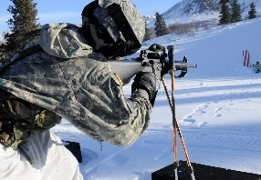
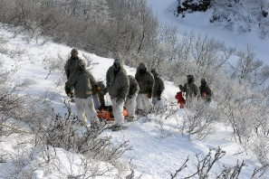
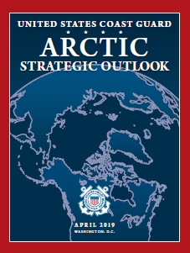
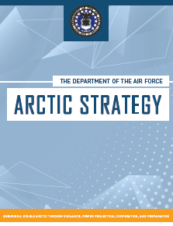
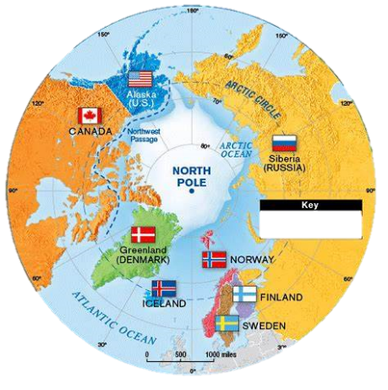
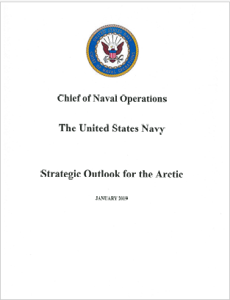
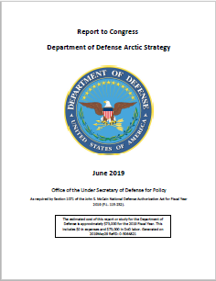

UNCLASSIFIED
Challenges, Opportunities, and Future Arctic Strategies
Develop Cold Weather and Mountainous Capabilities for Future Operations
Conduct DOTMLPF cold weather assessment
Focused on equipment, terrain, snow, elevation, latitude and temperature
Refining tactics, techniques and procedures to inform strategies
Strategy Moving Forward
Partners and Allies

Slide 8
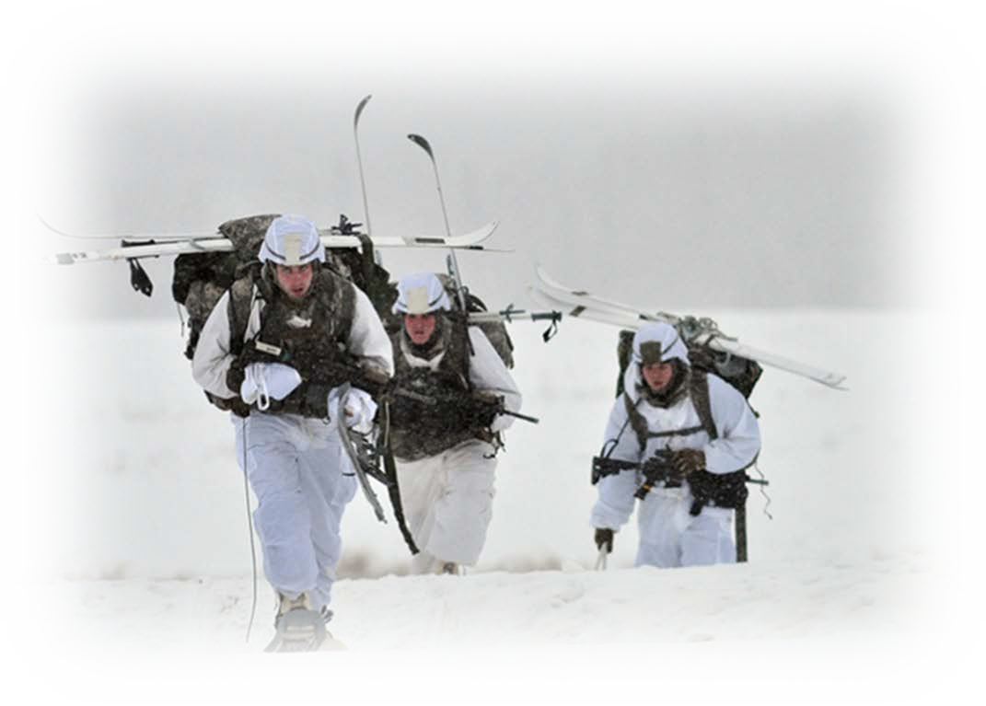
UNCLASSIFIED
Arctic Warriors
Arctic Tough

Slide 9


United States
European Command
CASO Panel - Geopolitics and Great Power Competition in the Arctic
CAPT Tom D’Arcy, USCG
United States
European Command

Slide 10
A Dynamic Arctic
Security Environment
Changing Environment
Multilateral Forums & International Agreements
Respect for Sovereign Interests
Status of Arctic Sea Routes
Increased Military Activity
Attempts to Alter Arctic Governance
  The immediate prospect of conflict in the Arctic is low, but the deepening of certain strategic trends could adversely affect U.S. national security interests, promote instability, and ultimately degrade regional governance and security. - 2019 DOD Arctic Strategy

Slide 11
The Arctic & US Strategy
“A range of international institutions establishes the rules for how states, businesses, and individuals interact with each other, across land and sea, the Arctic, outer space, and the digital realm. It is vital to U.S. prosperity and security that these institutions uphold the rules that help keep these common domains open and free.” – 2017 National Security Strategy
“The 2019 DoD Arctic Strategy is anchored in the priorities of the National Defense Strategy (NDS), focusing on great power competition as the principal challenge to long-term U.S. security and prosperity. It describes the Department’s desired end-state for the Arctic as ‘a secure and stable region where U.S. national interests are safeguarded, the U.S. homeland is defended, and nations work cooperatively to address shared challenges.’” – Dr. James H. Anderson’s Congressional Testimony March 2020.

Slide 12
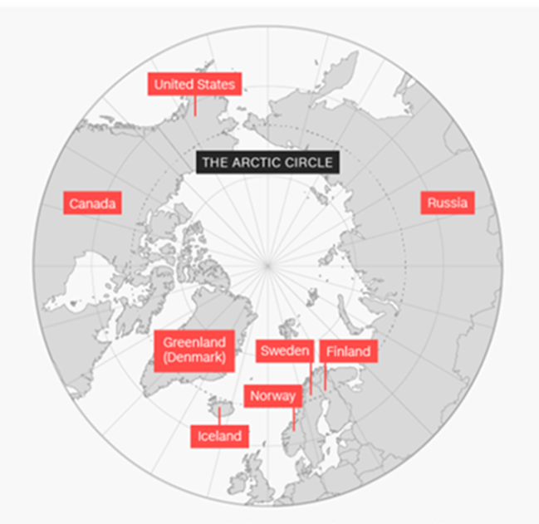
U.S. DoD Arctic Strategy 2019
Arctic Objectives
Strategic Approach
Defend the Homeland Defense of U.S. sovereignty & northern approaches to U.S is first priority in Arctic.
Allies and Partners Cooperation is the cornerstone of U.S. approach to the Arctic.
Deterrence
Sustain the Joint Force’s competitive global advantage; maintain a credible deterrence for Arctic Region
Compete when Necessary Deter competitors’ malign or coercive Arctic activities to maintain favorable balance of power in all regions.
Competition
Protect US national security interests; prudently address risks without fueling strategic competition.
Ensure Common Domains Remain Free and Open With Allies & partners ensure continued access to Arctic for legitimate civilian, commercial, and military purposes.

Slide 13
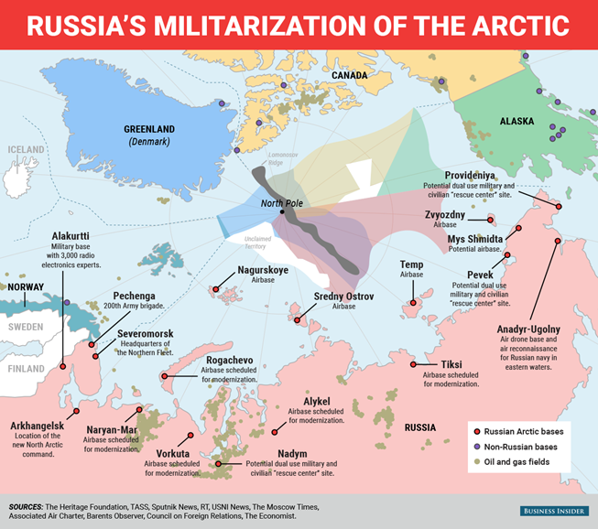
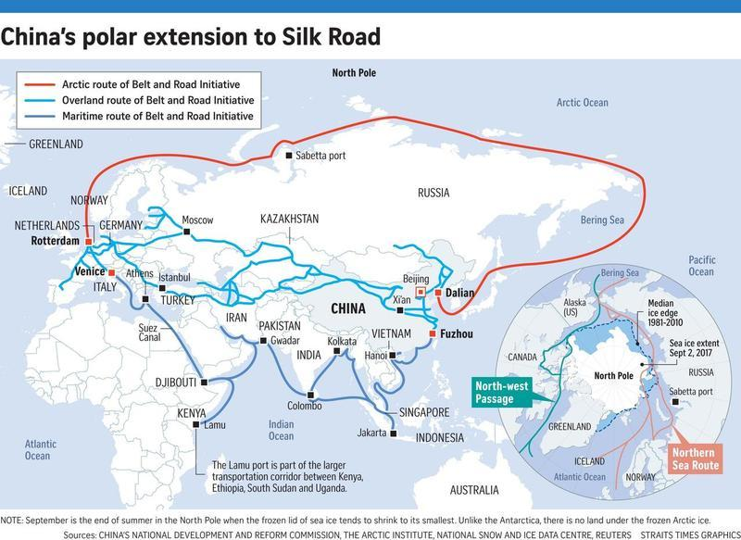

Slide 14


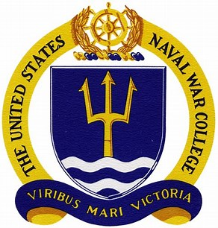
Dr. Rebecca Pincus
Strategic and Operational Research Department
Center for Naval Warfare Studies
Rebecca.Pincus@usnwc.edu
(401) 841-2625
Presentation for the
Cultural and Area Studies Office
U.S. Army Command and General Staff College
Fort Leavenworth, KS
28 October 2020
unclassified

Slide 15
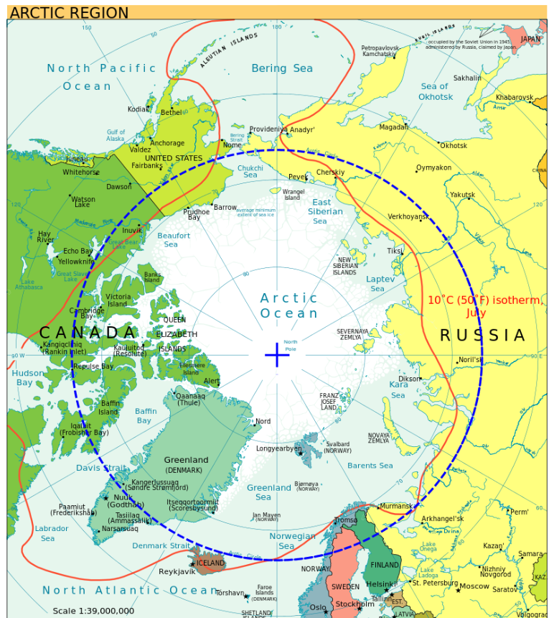
Multiple definitions of "the Arctic" but 66.5 degrees north is widely used.
Geographically, Russia dominates the Arctic region.
Eight Arctic states: Canada, Denmark (Greenland), Finland, Iceland, Norway, Russia, Sweden, USA.
Arctic Council and Arctic Coast Guard Forum are key governance regimes: Russia will take over the chair of both in 6 months.

Slide 16
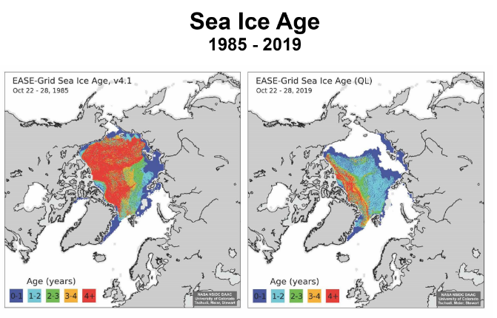
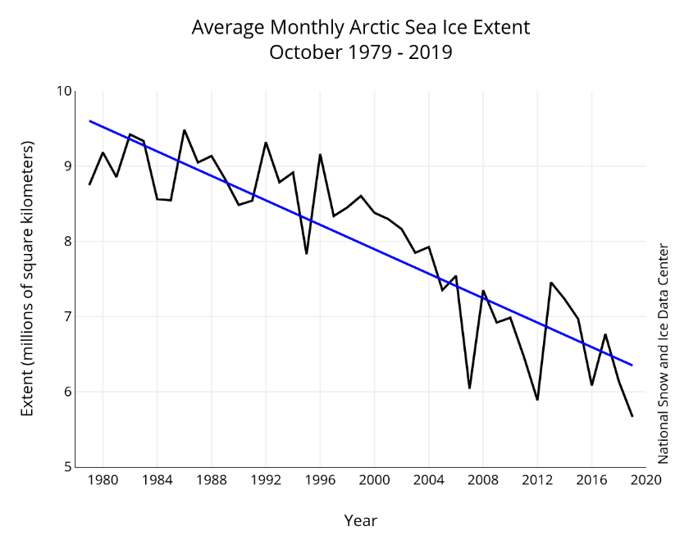
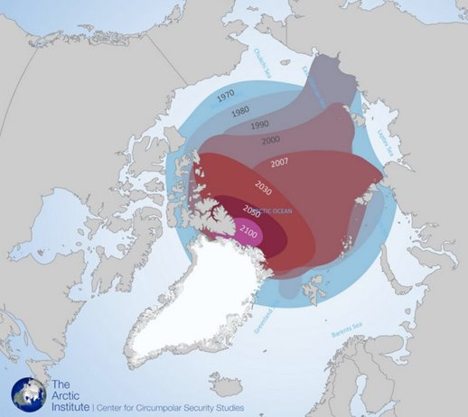
Arctic sea ice is decreasing in 3 dimensions: space, depth, and time
Ice retreat is occurring faster than most models predict
"Arctic amplification" feedback loop
Atlantification of Barents Sea and Arctic Ocean (warming and salinification)

Slide 17
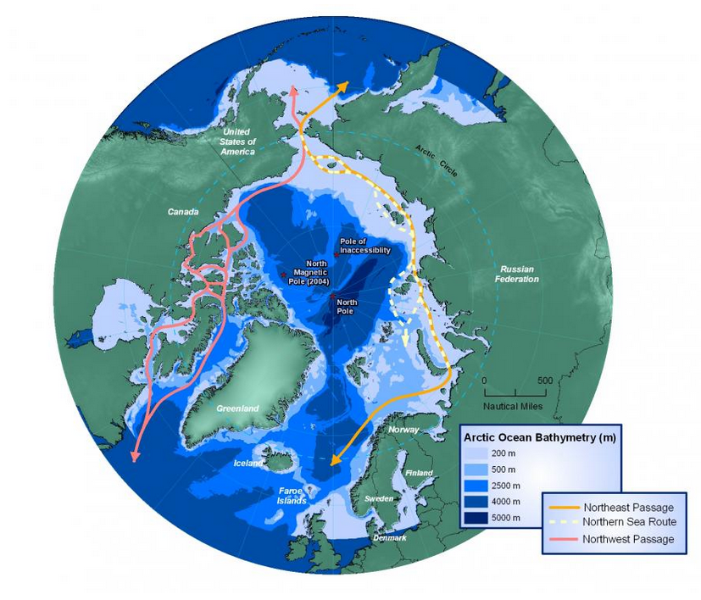
Arctic shipping lanes are opening: Northwest Passage, Northeast Passage (of which Northern Sea Route is an administrative element), and Transpolar Route.
Canada and Russia make similar claims: straight baselines and internal waters

Slide 18
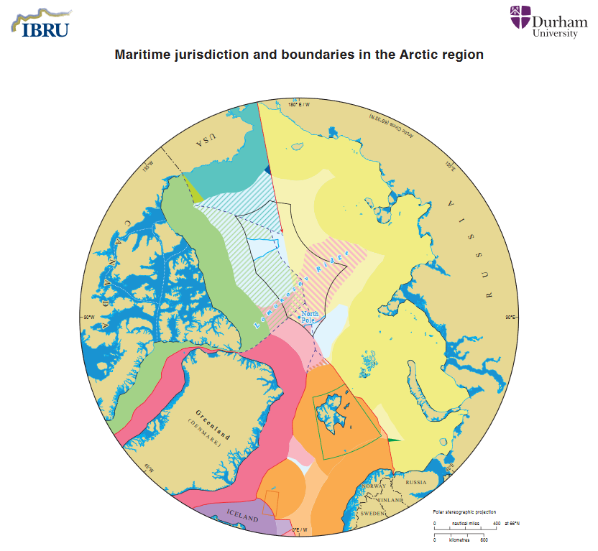
Most of the Arctic Ocean falls under state jurisdiction (EEZs)
3 states have submitted overlapping ECS claims to the CLCS (Lomonosov Ridge)

Slide 19
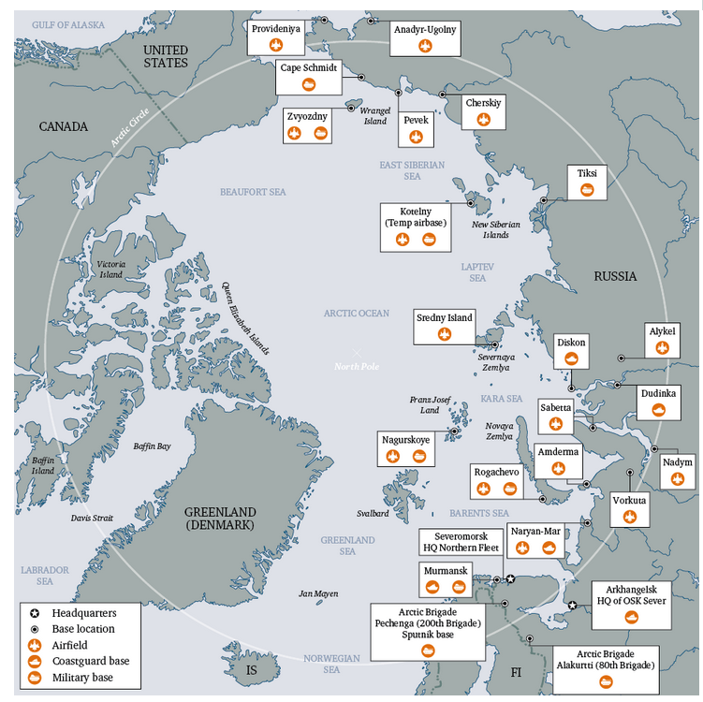
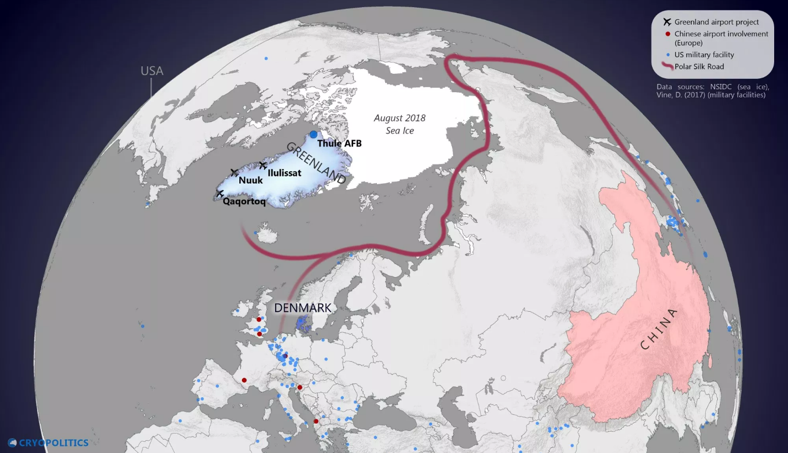
Russia and China have overlapping interests in the region. Their ends, ways, and means differ.

Slide 20
U.S. Army Command and General Staff College
(Department of Joint, Interagency, and Multinational Operations)
Mr. Michael J. Forsyth
Presentation for the
Cultural and Area Studies Office
U.S. Army Command and General Staff College
Fort Leavenworth, KS
28 October 2020
unclassified

Slide 21
What are Great Power
Interests in the Arctic?
Economic
  Shipping Lanes
  Resources
Political (Diplomatic)
Military

Slide 22
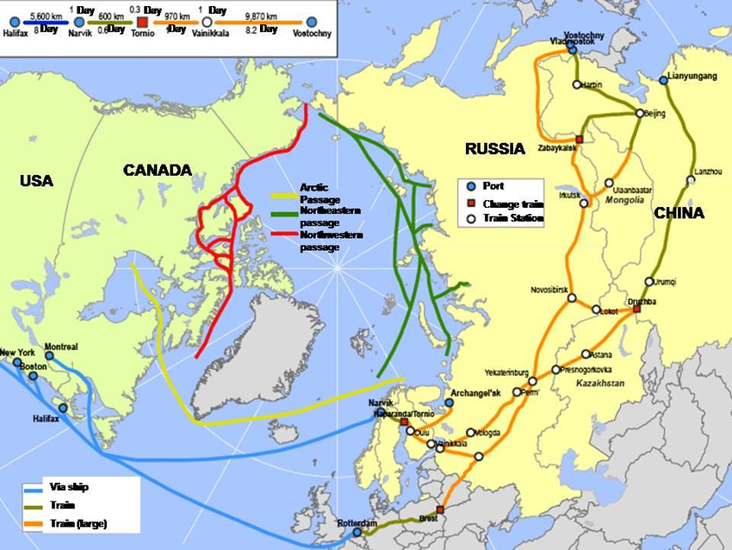
Arctic Shipping Lanes
Note the Chokepoint at the Bering Strait

Slide 23
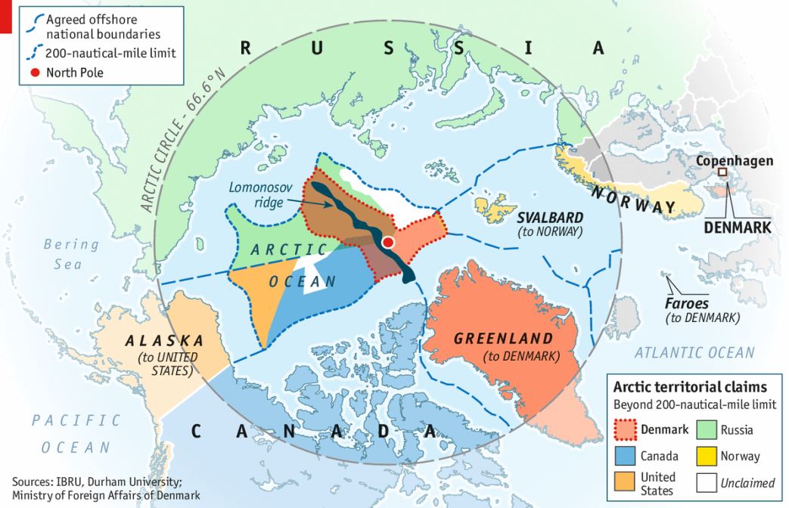
(Source: Ministry of Foreign Affairs of Denmark used in the Alaskan Command and Alaska NORAD Region command briefing.)
Map depicting the overlapping claims of the several Arctic nations

Slide 24
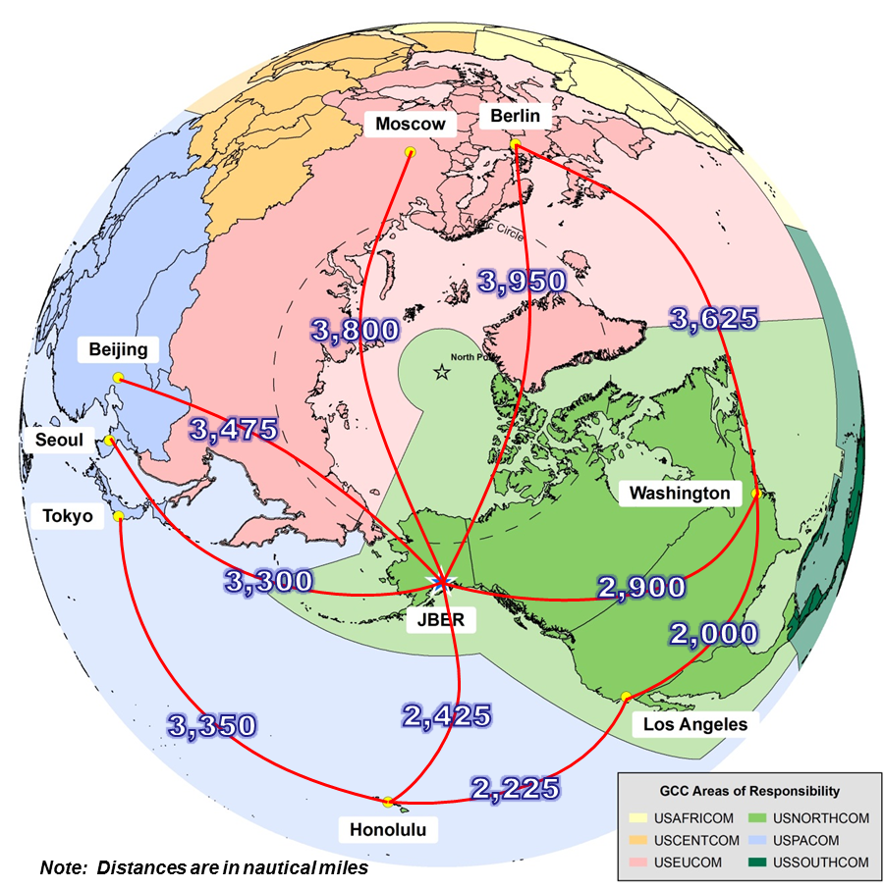
Note that Alaska is close to the center of the hemisphere and that Joint Base Elmendorf-Richardson (JBER) is uniquely positioned to project power. The distances depicted are to select world capitals from JBER. The color coded areas represent the Global Combatant Command areas of responsibility. (Source: Alaskan Command and Alaska NORAD Region command briefing.)
The Northern Hemisphere from the perspective of the North Pole

Slide 25
Recent Activities
Chinese Research (building of icebreakers)
Russian re-occupation and refurbishment of Cold War bases
Development of Northern Sea Route
Russian gas pipeline from Arctic region to China
Continued exploration for natural resources
Russian claims on islands and extended Continental Shelf
Sino-Russo Cooperation
Chinese Presence in Greenland
Chinese build Port in Iceland while underwriting sovereign debt
Chinese Naval Activity in the vicinity of Alaska
Chinese Submarine Activity and use of Russian Ports
Recent voyages through Northwest Passage
Canadian concerns for its sovereignty in Arctic

Slide 26
Implications for
US National Security
Overlapping Claims are a source of friction among nations in Arctic
Leverage over Greenland and Iceland to press for concessions or favored status in trade, transportation, basing
  Sovereignty claims?
Bering Strait – the new Malacca Strait?
Sino-Russo Military Cooperation in Arctic
Are there also opportunities?

Slide 27

Questions/Answers/Comments

Slide 28
Contact:
Dr. Mahir Ibrahimov
Director, Cultural & Area Studies Office (CASO)
U.S. Army Command and General Staff College (CGSC)
Fort Leavenworth, KS 66027-2300
Phone: (913) 684-3345
CASO website: http://usacac.army.mil/organizations/cace/lrec
YouTube link: https://www.youtube.com/playlist?list=PLkGvnfy3IadNRMPT-sNHpAsz8a3npWBH8
Contact:
Dr. Mahir Ibrahimov, Director, CREL Management Office (CRELMO)
Fort Leavenworth, KS 66027-2300
Phone: (913) 684-3345
DSN: 552-3345Contact:
Dr. Mahir Ibrahimov, Director, CREL Management Office (CRELMO)
Fort Leavenworth, KS 66027-2300
Phone: (913) 684-3345
DSN: 552-3345
CRELMO website: http://usacac.army.mil/organizations/cace/lrec
ATN: https://atn.army.mil/dsp_template.aspx?dpID=102
https://atn.army.mil
YouTube link: https://www.youtube.com/playlist?list=PLkGvnfy3IadNRMPT-sNHpAsz8a3npWBH8
CRELMO website: http://usacac.army.mil/organizations/cace/lrec
ATN: https://atn.army.mil/dsp_template.aspx?dpID=102
https://atn.army.mil
YouTube link: https://www.youtube.com/playlist?list=PLkGvnfy3IadNRMPT-sNHpAsz8a3npWBH8

