Slide 1
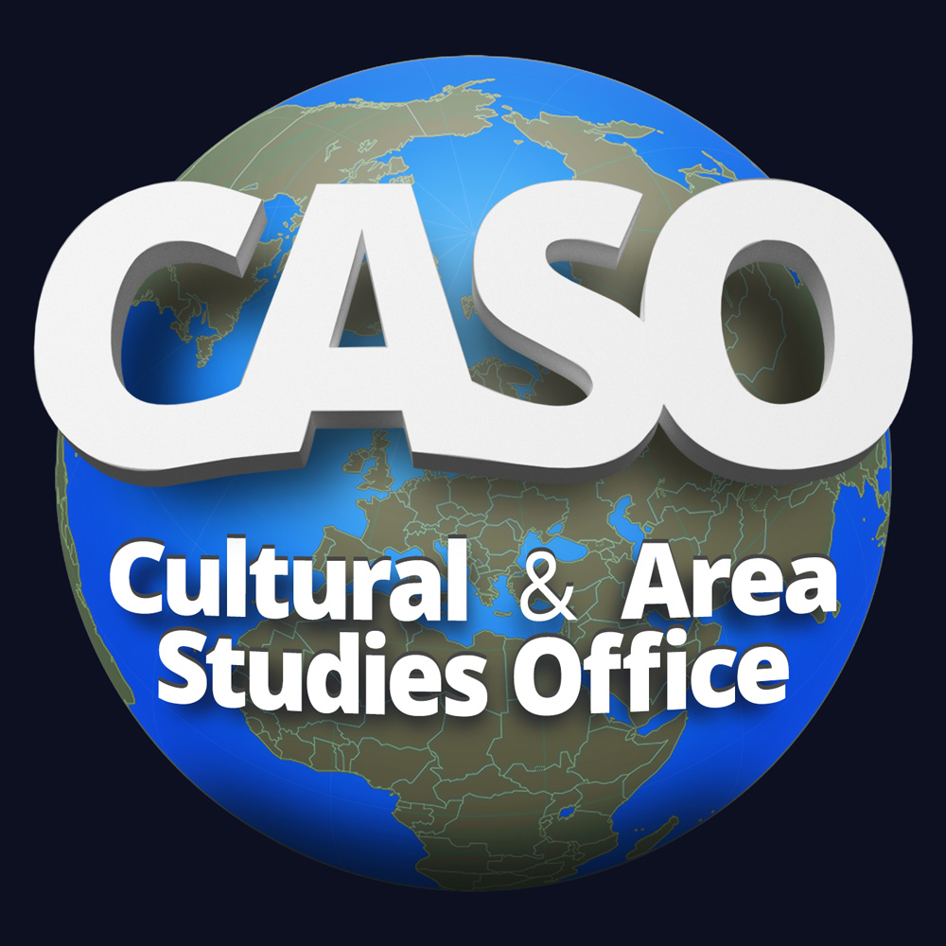
2 February 2021

Slide 3
Peace Between Azerbaijan and Armenia (Lessons from the Balkans for the South Caucasus)
Ambassador Richard Kauzlarich
Former US Ambassador to Azerbaijan, Bosnia and Herzegovina
Distinguished Visiting Professor
Schar School of Policy and Government
George Mason University
Presentation for the
Cultural and Area Studies Office
U.S. Army Command and General Staff College
2 February 2021
unclassified

Slide 4
Starting Points
2 February 2021
unclassified

Slide 5
25 Years After Dayton
Need for the International Community. The parties to the war in BiH alone could not bring peace. The ethnic hatreds were too deep. Persistent external intervention was required. No single country could play the role of peacemaker. There were three aspects of this intervention:
Dayton's military aspects required an international (but NATO-led) force of 50,000 troops for an effective PKO. Annex 1-A covered the military elements.
Civilian implementation was covered in Annex 10. A High Representative was designated "consistent with relevant UN Security Council resolutions" to coordinate/facilitate the agreement's civilian aspects. Later this role was amplified with the Peace Implementation Council structure.
Independent of the Dayton process, a Stability Pact was created later to bring together regional powers (except Serbia) and the international community to address Balkans-wide political, economic, and security challenges.
War crimes and reconciliation. Even before Dayton, the world recognized the extent of war crimes committed during the conflict. The parties alone could not address these issues. The UN Security Council authorized an international war crimes tribunal. Cooperation with that tribunal was one of the four critical elements of the General Framework Agreement. Annex 8 of Dayton created a commission on the preservation of national monuments, including religious structures.
Rights of refugees and displaced people. Annex 7 of the agreement created a Commission for Displaced persons and Refugees to ensure the right to return home and regain lost real property (or just compensation). The PKO was key to enabling the right of return for all who wished to do so.
International monitoring. Annex 10 created the Office of the High Representative, later supported by the Peace Implementation Council that oversaw Dayton's civilian implementation. In addition to interested states and the UN, a key actor in this oversight was the OSCE.
Interethnic boundaries. A key aspect of Dayton was the inter-ethnic boundary between the warring parties. That wasn't easy. The Brcko region's status was unsettled under Dayton, placed under international supervision until determined by arbitration.

Slide 6
Dayton-lite in the South Caucasus
Need for the international community. The OSCE Minsk Group should remain the umbrella framework for addressing. It will need enhanced powers to set deadlines for achieving the steps necessary to reach a final agreement that ends the negotiations. There must be an international PKO/monitoring mission to guarantee the ceasefire is maintained, the right of the safe return of all refugees and IDPs, and the safe clearing of all mines and unexploded ordnance.
War crimes and reconciliation. Through the existing International Criminal Court or a specific UNSC-established tribunal for the Armenia-Azerbaijan war, investigate, try and punish those committing war crimes before and after the ceasefire. This international process would be independent of whatever national law provides in Azerbaijan or Armenia for legal penalties for those found guilty of war crimes. Besides, there must be an internationally supervised peace and reconciliation process that encourages people to people contacts aimed at erasing the enemy-connotation of the other.
Refugee and IDP returns are critical for the establishment of permanent peace. Armenians and Azerbaijanis must have the right to return. Not all eligible will want or be able to return. There must be a mechanism for compensating just claims for compensation for lost land or real property for those choosing not to return. This process may include opportunities for swapping land and real property of equal value. This process should be under the joint supervision of the OSCE and appropriate UN organizations.
International monitoring. Finally, there must be a special representative of the international community to coordinate the civilian and military aspects of international engagement, especially refugees' and IDPs' return.
Interethnic boundaries. The November 9, 2020 statement of the Presidents of Russia and Azerbaijan and the Prime Minister of Armenia left part of Nagorno-Karabakh not under Azerbaijan's control. Before any final peaceful settlement between Armenia and Azerbaijan, Armenia and Azerbaijan's boundary must be mutually recognized. As with Brcko under the Dayton process, addressing the status remainder of Nagorno-Karabakh requires international supervision and intervention. First, a special OSCE representative is needed to supervise this region, especially the right to return. Second, either the OSCE or the UN should establish a special arbitration panel to determine the boundary within a specific period (say one year) if the parties cannot agree on this point through face-to-face negotiations.
A Stability Pact for the South Caucasus. A permanent peace settlement between Armenia and Azerbaijan requires a region-wide approach to political and economic stability. Armenia, Georgia, and Azerbaijan must function as an economic union to enjoy the benefits of peace. Outside powers and organizations like the EU, the international financial institutions, and potential bilateral donors could support a process for regional infrastructure integration.

Slide 7
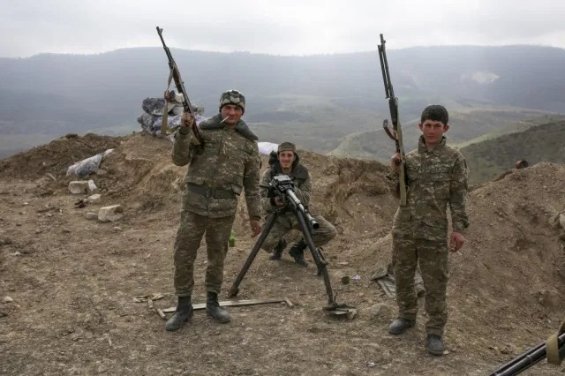
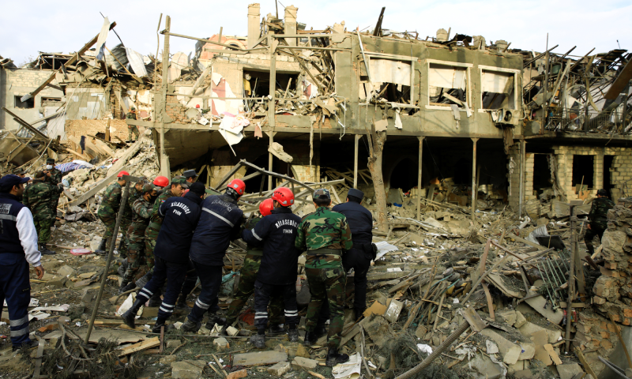
Nagorno-Karabakh Diplomacy
Ambassador Carey Cavanaugh
Former US Special Negotiator for Eurasian Conflicts
Professor of diplomacy, the University of Kentucky
Chairman of International Alert, (London)
2 February 2021
unclassified

Slide 9
OSCE’s 1st Mediation
1992 Mission: Peace —Stability
USSR cannot resolve internally
Russia alone cannot resolve
UN doesn’t want it
Can’t use NATO here
OSCE takes responsibility
Creates Minsk Group process

Slide 10
OSCE structures for NK
Chairman in Office (CiO)
Minsk Group Co-chairs: evolves to be Russia, US, France
Minsk Group Members: Belarus, Germany, Italy, Sweden, Finland, Turkey, Armenia, Azerbaijan, plus the 3 Co-Chairs & OSCE Troika
Personal Representative of CiO
High Level Planning Group

Slide 11
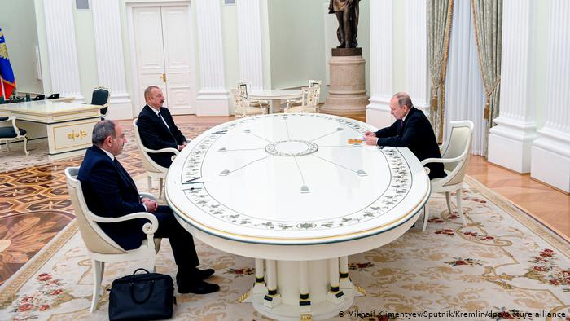
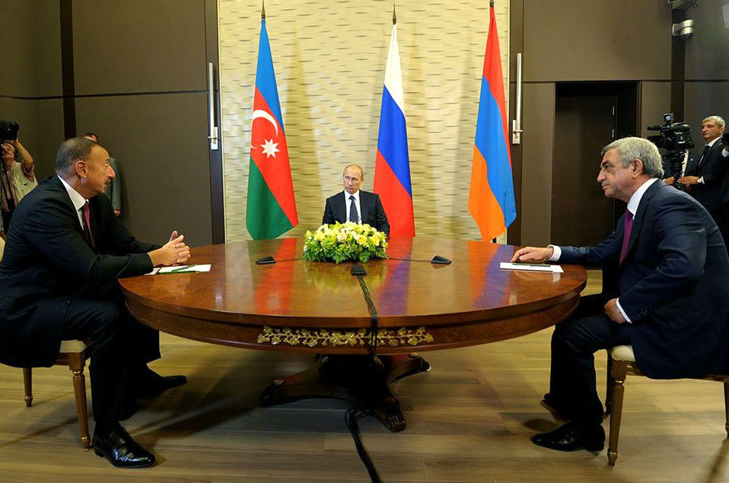
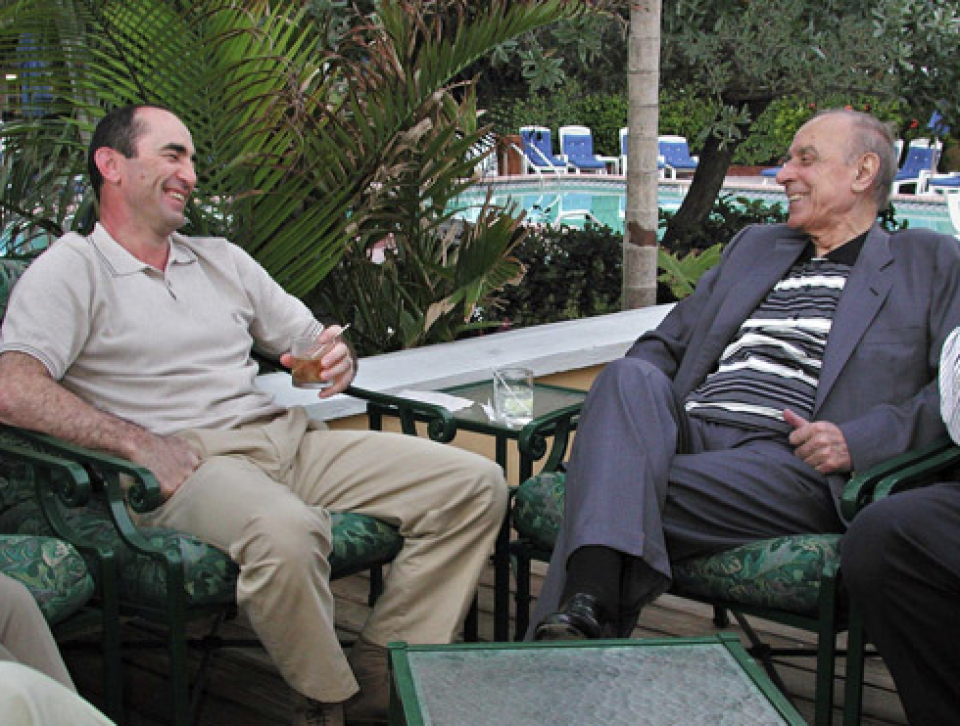
SOLUTIONS
Common State
Step by Step
Goble Plan
Package
Lavrov Plan
Kazan
Key West
Madrid Principles
Territorial Swap

Slide 13
“Geopolitics and Great Power Competition in the South Caucasus”
Mr. Paul Goble
Former Special Advisor to the Secretary of State
Voice of America and Central Intelligence Agency
Professor
The Institute of World Politics/Boston University
Presentation for the
Cultural and Area Studies Office
U.S. Army Command and General Staff College
2 February 2021
unclassified

Slide 14
Examining the Nagorno-Karabakh War
Mr. Matthew Stein
Foreign Military Studies Office
Fort Leavenworth, Kansas
Presentation for the
Cultural and Area Studies Office
U.S. Army Command and General Staff College
2 February 2021
unclassified

Slide 16
Azerbaijan
Nagorno Karabakh
Armenia
Iran
Territorial Changes After April 2016 Clashes

Slide 18
Summary

Slide 19
Geopolitical and Military Lessons Learned
10 Nov 2020 trilateral peace deal is not a full-fledged legal agreement, rather a statement of intent from legal authority and mandate perspective.
US and the West should convey a clear message to Russia and Iran, that they do not have a unilateral mandate for settlement of the Nagorno-Karabakh problem in violation of the international law.
US jointly with its European and regional allies need to act with one voice in the South Caucasus.
Iranian role in new emerging geopolitical landscape and U.S. national security interests in the region.
US Army Chief of Staff Gen. James McConville: “…the conflict does highlight a priority in developing air defense systems to defeat drones,… When we take a look at future warfare, we believe that we will be contested in every single domain. … We’re certainly going to be challenged on the land.”1.
Unlike in prior conflicts, aerial capabilities can be employed effectively by any military regardless of size or funding.
Baku was provided with Israeli loitering missile munitions (LM) IAI Harop (also known as “suicide” or “kamikaze” drones) and Turkish Bayraktar TB2 reconnaissance drones.
The new generation warfare is likely to be more relegated to standoff engagements, rather than troop-on-troop kinetic fights.
1. (https://www.armytimes.com/news/your-army/2020/10/11/conflict-in-the-caucasus-recent-exercise-reinforce-modernization-needs-army-chief-says/, accessed 21 January, 2021)

Slide 20
https://www.bing.com/images/search?view=detailV2&ccid=zMeJko4A&id=799854110A70599CF1D363CE207A938462ED2CEC&thid=OIP.zMeJko4AAuEXoR-fprcubgHaEh&mediaurl=https%3a%2f%2fcdni0.trtworld.com%2fw960%2fq75%2f34598_TransAnatolianNaturalGasPipelineTANAP_1528201290301.jpg&exph=587&expw=960&q=Tanap+Pipeline+Map&simid=608032658085842086&ck=BFA7EA5C94A77698BAC9650A3461E030&selectedIndex=18&FORM=IRPRST&ajaxhist=0 (accessed 27 January 2021.)

Slide 21
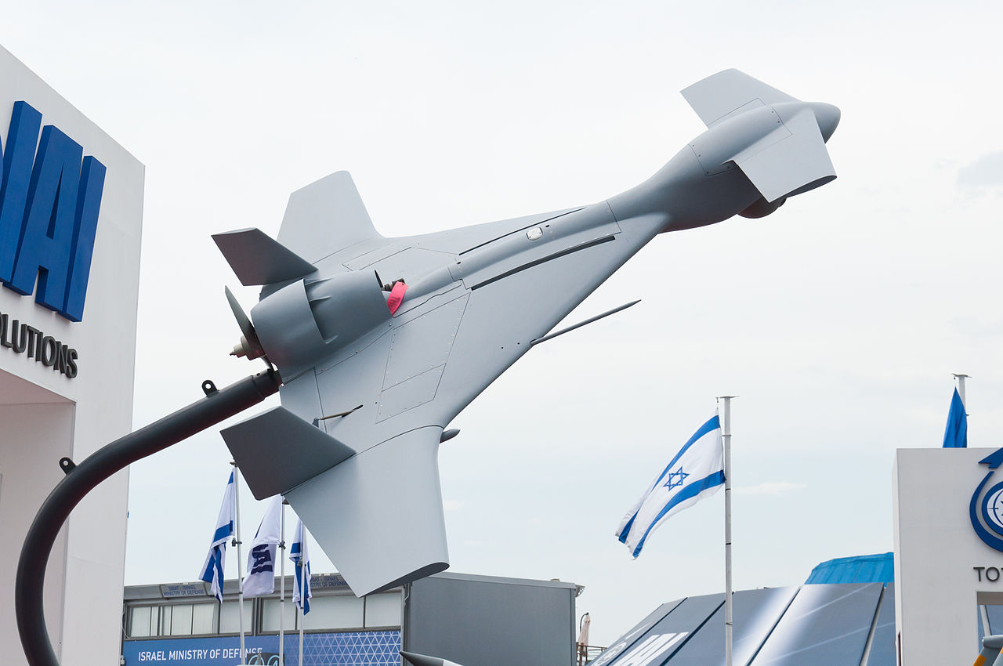
Israeli (LM) IAI Harop
Turkish Air Force Bayraktar TB2 UCAV
“Azerbaijan praises 'very effective' Israeli drones in fighting with Armenia". Times of Israel. 2 October 2020, (accessed 19 Jan., 2021.)
www.MilitaryFactory.com, (accessed 19 Jan., 2021.)

Slide 22
Questions/Answers/Comments

Slide 23
Contact:
Dr. Mahir Ibrahimov
Director, Cultural & Area Studies Office (CASO)
U.S. Army Command and General Staff College (CGSC)
Fort Leavenworth, KS 66027-2300
Phone: (913) 684-3345
CASO website: http://usacac.army.mil/organizations/cace/lrec
YouTube link: https://www.youtube.com/playlist?list=PLkGvnfy3IadNRMPT-sNHpAsz8a3npWBH8
CGSC Facebook: https://www.facebook.com/USACGSC
Contact:
Dr. Mahir Ibrahimov, Director, CREL Management Office (CRELMO)
Fort Leavenworth, KS 66027-2300
Phone: (913) 684-3345
DSN: 552-3345Contact:
Dr. Mahir Ibrahimov, Director, CREL Management Office (CRELMO)
Fort Leavenworth, KS 66027-2300
Phone: (913) 684-3345
DSN: 552-3345
CRELMO website: http://usacac.army.mil/organizations/cace/lrec
ATN: https://atn.army.mil/dsp_template.aspx?dpID=102
https://atn.army.mil
YouTube link: https://www.youtube.com/playlist?list=PLkGvnfy3IadNRMPT-sNHpAsz8a3npWBH8
CRELMO website: http://usacac.army.mil/organizations/cace/lrec
ATN: https://atn.army.mil/dsp_template.aspx?dpID=102
https://atn.army.mil
YouTube link: https://www.youtube.com/playlist?list=PLkGvnfy3IadNRMPT-sNHpAsz8a3npWBH8

Slide 24
Backup

