Slide 1
24 July 2020

Slide 2
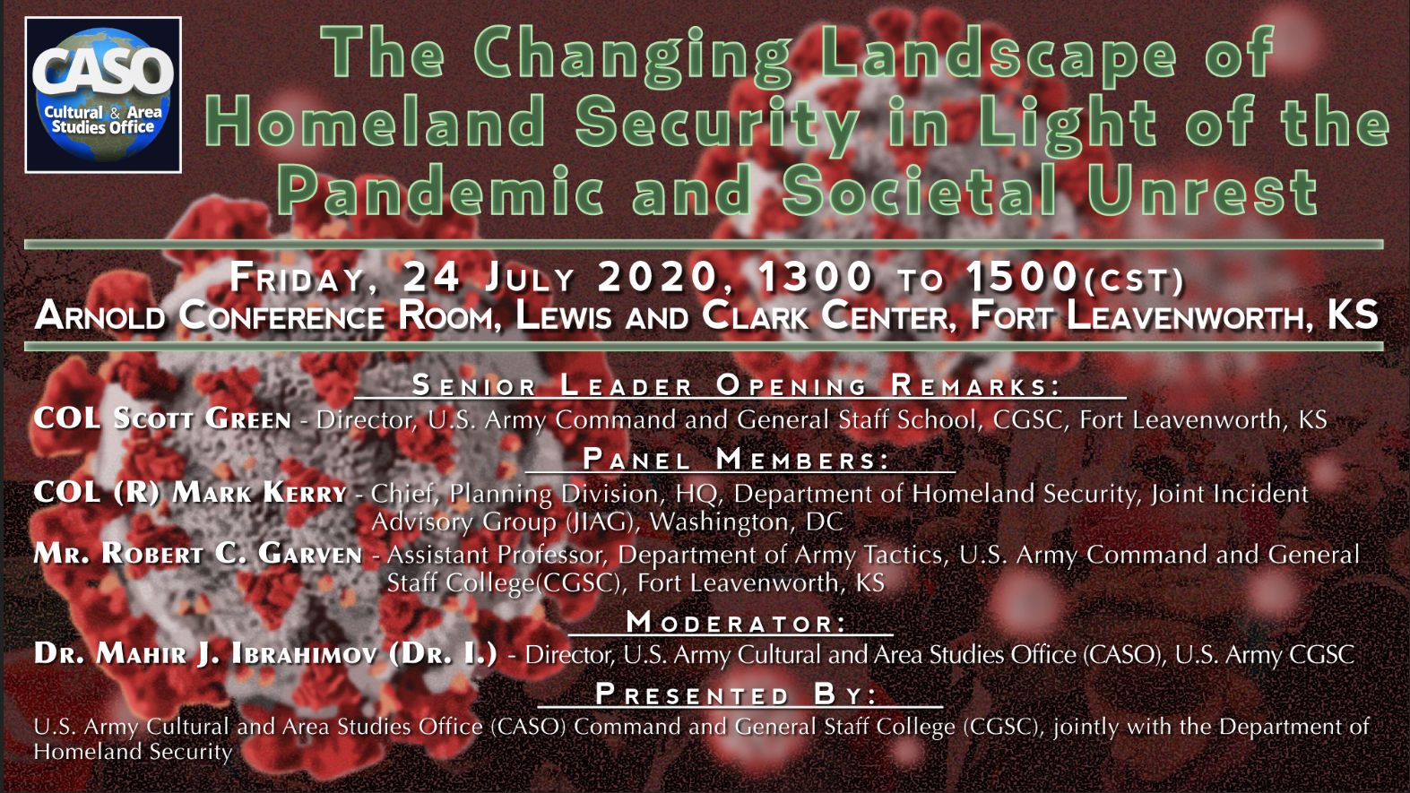

Slide 3
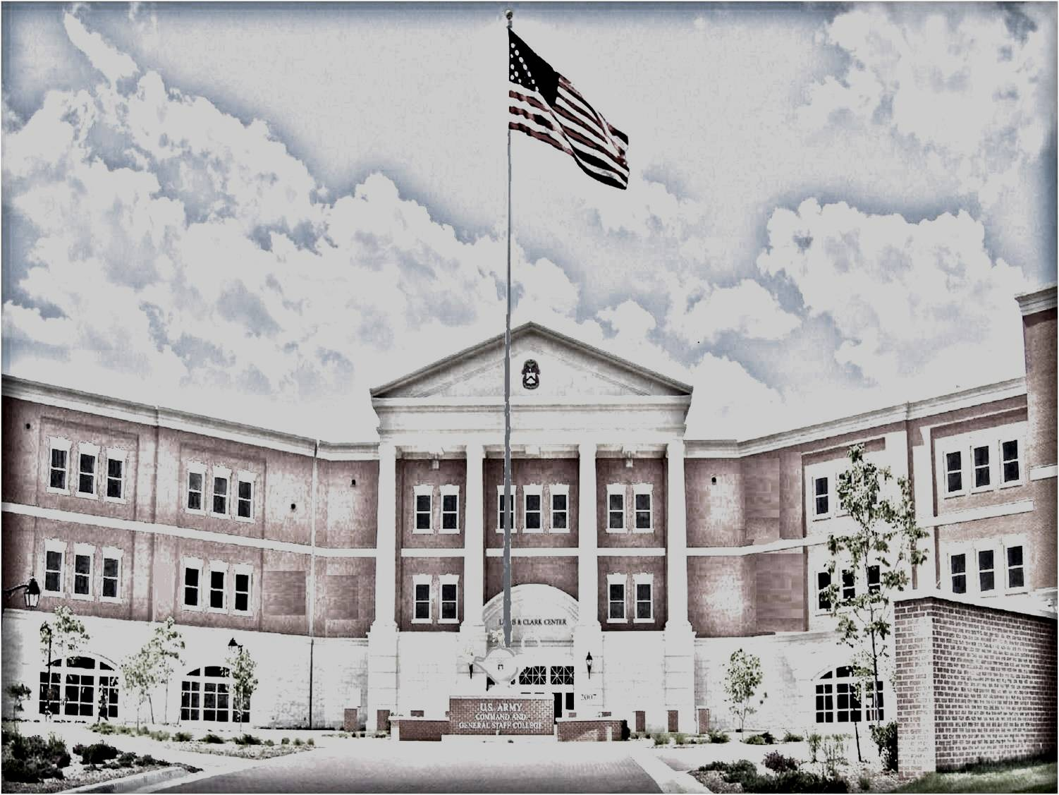
U.S. Department of Homeland Security
(Office of Operations Coordination)
Mr. Mark Kerry
Presentation for the
Cultural and Area Studies Office
U.S. Army Command and General Staff College
Fort Leavenworth, KS
24 July2020
unclassified

Slide 4
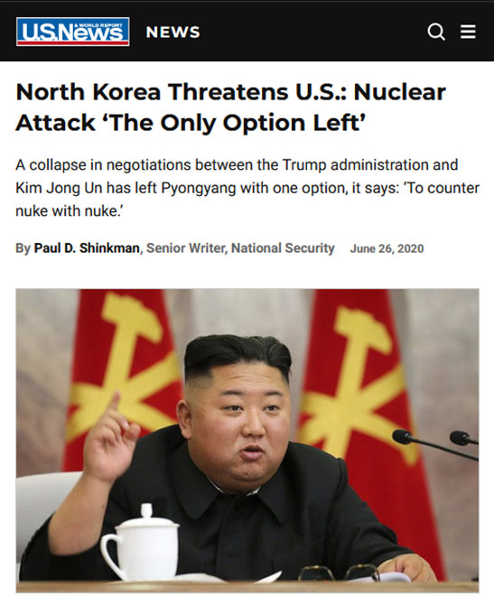
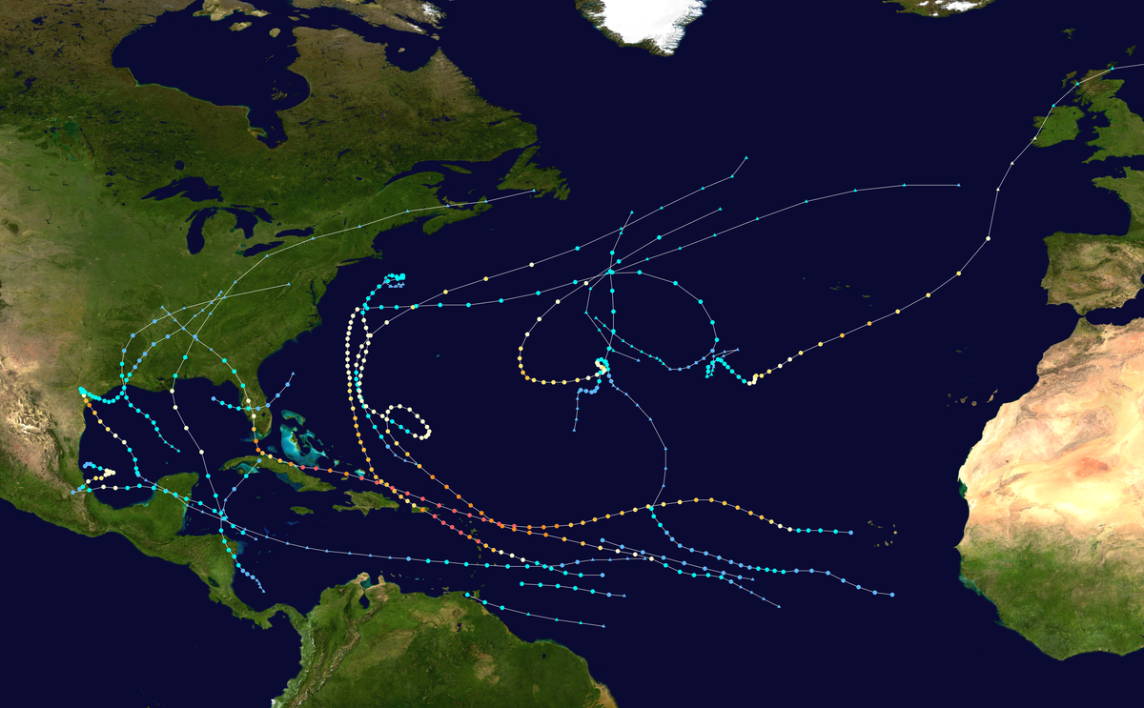
Impact of the 2017 Hurricanes and DPRK Threat
17 named storms, 10 hurricanes, and 6 major hurricanes.
Multiple Category 5 hurricanes.
Costliest season on record.
4

Slide 5
Pandemic Issues
Reduced capacity of U.S. Departments/Agencies.
COVID-19 has highlighted the shortage of national resources.
Added difficulty in carrying out statutory mission (e.g. U.S. Secret Service protection).
COVID tested Defense Production Act authorities and highlighted over reliance on DOD assets for domestic disaster response operations.
COVID causes serious issues when coupled with a land mass migration on the U.S. Southwest Border or a maritime mass migration in the Caribbean Sea.
Reduced support and cooperation from Mexico (and other countries) because of the pandemic.
5

Slide 6
Civil Unrest Issues
Increase social divisions within the U.S.
Worsened mental health.
High unemployment.
Governments retaining powers/erosion of civil liberties.
Some industries failing to recover.
Bankruptcies.
Political dissent and government distrust.
Less retirement/pension savings and associated economic security fears.
Higher anti-business sentiment.
6

Slide 7
The Challenge for the U.S. Government
How do we address National Security Events in the future when they will become more challenging as the country’s economic growth is inextricably tied to globally interconnected markets, supply chain fragility, and technology proliferation?
How do we address complex issues not just through agency perspectives and not as discrete pieces?
How do we do whole of government planning and create the compelling function that shepherds integration and synchronization of planning efforts?
How do we create a mechanism and an organizational architecture to support a whole-of-government response in a National Security Event?
7

Slide 8
U.S. Government Options for Consideration
Create an enduring, dedicated, systemic interagency planning cell with the following:
Linkages to Science & Technology, Research & Development to address future planning scenarios,
A compelling function that shepherds integration and synchronization of U.S. Government planning to achieve a whole of government approach.
Create a mechanism and organizational architecture to support a whole-of-government response in a National Security Event.
Empower the DHS Secretary and streamline Congressional oversight of DHS.
8

Slide 9
Summary
Two Revealing Incidents - 2017 Hurricanes and DPRK
Additional Issues Posed by Pandemic and Civil Unrest
U.S. Government Challenges
Potential Options to Consider
9

Slide 10
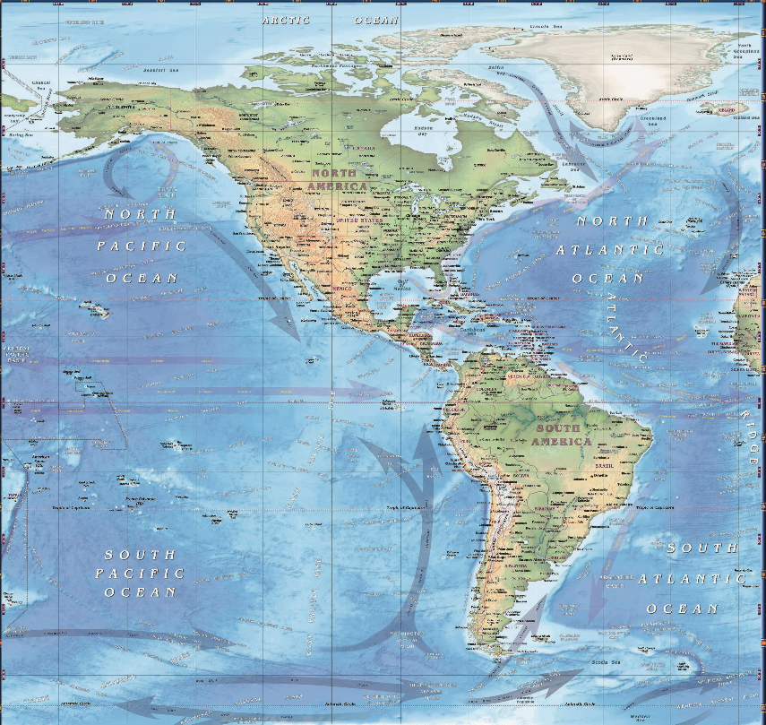
Potential COVID-19 Impacts to Homeland Security
Impacts to U.S. Departments/ Agencies.
Constrained resources.
Effect on combat readiness of U.S. forces.
Effect on readiness of departments.
Nation State threats.
U.S. Population potential reactions to propaganda (violent reactions to conspiracy theories circulating about the pandemic, including the branding of the deadly virus as a government hoax, and militia extremists preparing for a potentially violent response).
Attacks via its proxy militias.
Adversary could take advantage of U.S. preoccupation with internal challenges to behave more aggressively.
Coercion of Taiwan, or increasing activity in the South China Sea.
Terrorists and Violent Extremist Groups.
Increase recruitment and sympathizers among the vulnerable and terrified.
Encourage conventional and biological attacks.
Violent extremists like white supremacists seeking to exploit the COVID-19 crisis.
Impact on other nations.
Failed states - evacuation/ repatriation of US citizens.
Mass migrations to U.S. (land or maritime).
ICE detention populations.
USBP holding facilities.
Nonstate actors capitalize on chaos.
Remote cyber-attacks.

Slide 11
CGSOC Homeland Security Studies Program
Mr. Bob Garven, DTAC DSCA SME
Presentation for the
Cultural and Area Studies Office
U.S. Army Command and General Staff College
Fort Leavenworth, KS
24 July2020
unclassified

Slide 12
Defense Support of Civil Authorities
and
Homeland Security Studies Programs
The HSSP is an interdepartmental initiative to provide students concentrated homeland security curriculum and encourage research by exploiting the diverse capabilities of CGSC faculty, staff, and students. HSSP curriculum spans the spectrum of homeland security, homeland defense, and defense support of civil authorities activities at tactical, operational, and strategic levels.
Individual Electives
Homeland Security MMAS
Certificate Programs

Slide 13
Homeland Security Electives
DJIMO
A504 Homeland Security
A505 Insider Threats
A506 Homeland Security Planning
A507 Domestic Terrorism
A508 Selected Readings on Mexico
DTAC
A325* Combating Transnational Organized Crime
A326 Planning for Disaster
A327*** Non-Lethal Weapons
A328 Defense Support of Civil Authorities
A329 Critical Infrastructure Protection
DMH
A648 Homeland Security: US Historical Perspective
DSFM
A430 Sustainment of DSCA Operations
CGSS
Special Staff
A231 Thesis Completion, Research Methods III**
A252*** Homeland Security Law A525 Countering Weapons of Mass Destruction
CGSC
* in development
**HS topics only approved by Dr Cupp
*** Not available in AY2020

Slide 14
Guest Speaker Support
Customs and Border Protection
JTF North
Department of Energy
Department of Homeland Security
Department of Justice
Federal Emergency Management Agency
Health and Human Services
Immigration and Customs Enforcement
Johnson and Leavenworth County Emergency Managers
Kansas City Joint Terrorism Task Force
Kansas Division of Emergency Management
Kansas State University
Kansas/Missouri/Nebraska National Guard
Transportation Security Administration
US NORTHCOM

Slide 15
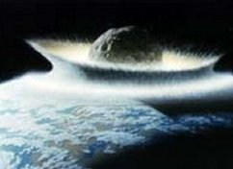
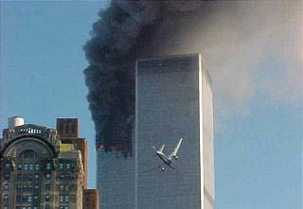
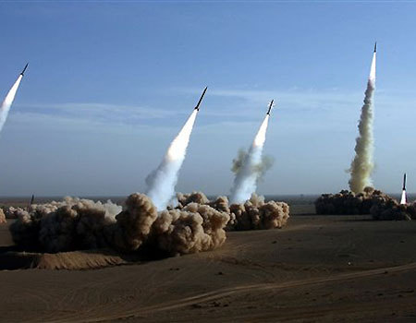
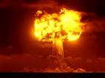
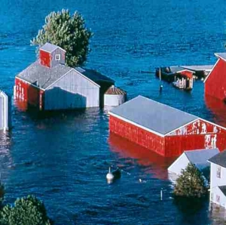
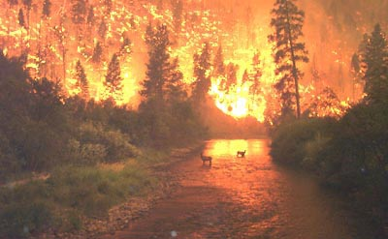
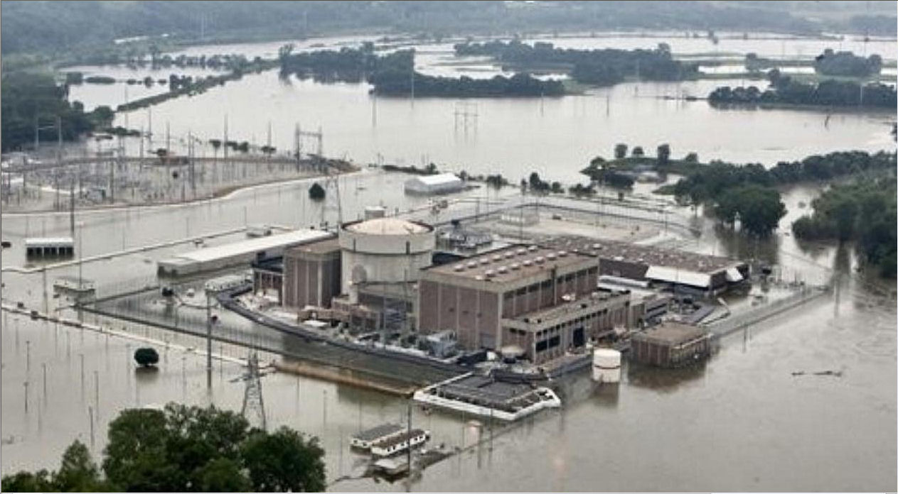
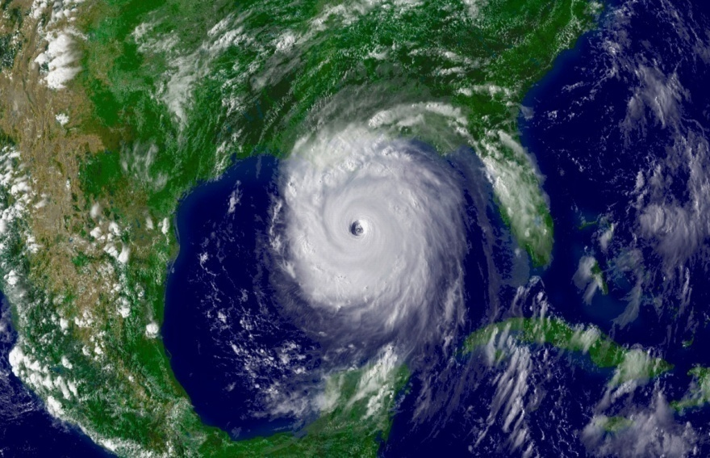
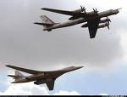
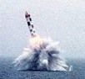
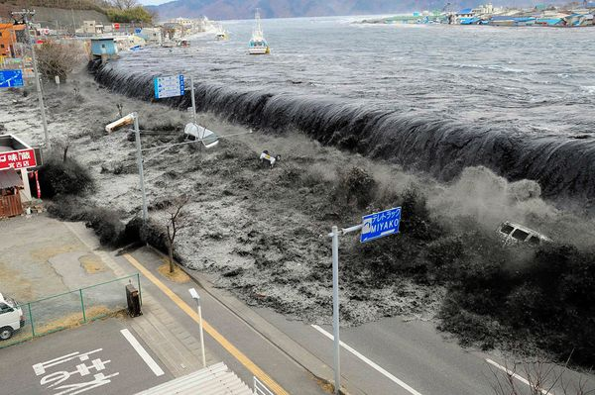
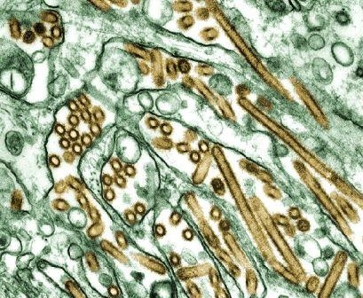
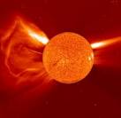
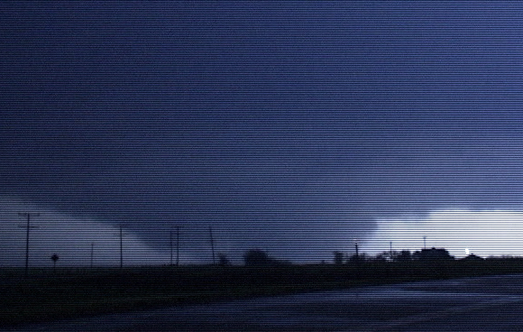
What could be the cascading impacts
That would potentially result in a Request
For DoD Assistance in the following
situations?
What types of Missions might DoD
Be asked to perform?
Notes:
This and the next two slides are the Concert Experience for C424. My recommendation is to show the slide show without asking questions until you have progressed through all of the slides. This first slide is oriented on threats to the homeland that might require the use of military capabilities to support civil authorities.
All photos are built by clicking the mouse to add emphasis to each photo.
1st- Midwest flooding, Ft. Calhoun Nuclear Power Plant, Missouri River
2nd- Microscopic view of the H5N1 Avian Flu Virus
3rd- Tornado
4th- Wildfire in Yellowstone
5th- Hurricane Katrina
6th-Earthquake and Tsunami (tsunami in Japan as the result of an earthquake.)
7th-Hi-jacked plane 9-11
8th-American Nazi Party
9th- Iranian Shehab 3 Missile firing
10th-AQ Underwear Bomber of NW Flt 243 Amsterdam to Detroit
11th- Russian TU 95 Bear Bomber and TU 160 Backfire
12th- Russian Submarine launched ballistic missile
13th-Improvised Nuclear Device Detontation
14th-Massive Solar Flare (01 SEP 1859 Carrington Event, Largest solar flare in the past 500 yrs, if it happened today damage estimates range up to $2 Trillion and loss of PWR and Comms for up to 6 months)
15th-Meteorite/Asteroid/Comet Strike (30 JUN 1908 Tunguska Event, explosive force of a 10-15 Mg Ton Nuclear detonation impacted an area of 830 sq miles, an object exploded mid-air at an estimated altitude of between 5-10km, the blast has created an estimated trillion carats of industrial grade diamonds in the crater.) (13 AUG 1930 Perseids Meteor shower, NW Brazil, three bright balls of fire struck the jungle that burned for 3 months)

Slide 16
DSCA Review
DSCA is part of Decisive Action
Primary Army Tasks
Role of U.S. Northern Command in Civil Support Operations
Role of the Department of Homeland Security
Legal Considerations
Tiered and Range of Response

Slide 17
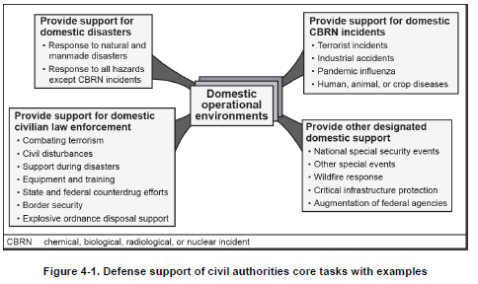
Decisive Action--DSCA
A328
A326
A328
A329
Notes:
This is from ADRP 3-0, Jun 2013, Table 4-1
Remind students that DSCA is a decisive action task.
Discuss similarity of DSCA tasks to stability tasks.
Discuss differences between stability tasks and DSCA tasks.
Opportunity to discuss Other designated support – ask for student experiences
Wildfire – MOA with DOI, Dept of Ag.. Battalion BPT mission. Done under Economy Act.
NSSE – Olympics, Presidential Inaugural, Major sporting events, etc.
CIP – NG QRF is example
Augmentation – ATC Strike and USPS are examples
We will not really discus CBRN Enterprise – part of WMD Class

Slide 18
Fundamentals for Civil Support (ADP 3-28, CH 1)
The core purposes of Army units supporting civil authorities are to save lives, restore essential services, maintain or restore law and order, protect infrastructure and property, support maintenance and restoration of local government, shape the environment for intergovernmental success.
The four defining characteristics of DSCA are:
State and Federal laws define how military forces support civil authorities.
Civil authorities are in charge, and military forces support them.
Military forces depart when civil authorities are able to continue without military support.
Military forces must document costs of all direct and indirect support provided.
Notes:
Chapter one and two of ADP 3-28 establishes the purpose and functional characteristics of DSCA
Purpose is paragraph 2-1, 2-2
Functional Characteristics is paragraph 1-5
Key Legal Considerations Discussion is CH II ATP 3-28.1 and CH 2 ADRP 3-28. Use bullet 2 to illicit discussion
Federal authority
Governor’s authority
Important law
Intel oversight

Slide 19
32 CFR Part 185 - Defense Support of Civil Authorities
§ 185.4 para e. Evaluation of Requests: All requests from civil authorities and qualifying entities for assistance shall be evaluated for:
(1) Legality (compliance with laws).
(2) Lethality (potential use of lethal force by or against DoD Forces).
(3) Risk (safety of DoD Forces).
(4) Cost (including the source of funding and the effect on the DoD budget).
(5) Appropriateness (whether providing the requested support is in the interest of the Department).
(6) Readiness (impact on the Department of Defense's ability to perform its primary mission).

Slide 20
NORAD/NORTHCOM--Two Commands
Bi-national…Combined
Armed Interceptors 24/7
National…Joint…Unified
Regional
Combatant Command
MINISTER OF NATIONAL DEFENCE
SECRETARY OF DEFENSE
CHIEF OF DEFENCE STAFF
CHAIRMAN JOINT CHIEFS OF STAFF
COMMANDER, NORAD and USNORTHCOM
NORAD
USNORTHCOM
DEPUTY COMMANDER NORAD
DEPUTY COMMANDER USNORTHCOM
Component Commands
NORAD Regions
U.S. ARMY NORTH
(Fifth Army)
ALASKAN NORAD REGION
(ANR)
INTEGRATED N-NC STAFF
Chief of Staff
Personnel (J1)
Intelligence (J2)
Logistics & Engineering (J4)
Strategy, Policy & Plans(J5)
Cyberspace Operations (J6)
Training & Exercises (J7)
Requirements, Analysis & Resources (J8)
Interagency Coordination (J9)
Science and Technology
JOINT TASK FORCE CIVIL SUPPORT
CANADIAN NORAD REGION
(CANR)
AIR FORCES NORTHERN
(First Air Force)
CONTINENTAL U.S. NORAD REGION (CONR)
U.S. MARINE FORCES NORTH
(MARFORRES)
NORAD Ops
(N/J3)
USNORTHCOM Ops (NC/J3)
U.S. NAVAL FORCES NORTH
(USFF)
U.S. SPECIAL OPERATIONS
COMMAND NORTH
Subordinate Commands
JOINT TASK FORCE ALASKA
JOINT FORCE HQ NCR
JOINT TASK FORCE NORTH
Notes:
20
NORAD has been a unique bi-national command between Canada and the U.S. since 1958. The commander of NORAD not only reports to the U.S. President through the Secretary of Defense, but also to the Prime Minister of Canada via the Canadian Chief of Defence Staff and the Minister of National Defence.
USNORTHCOM is a combatant command and its components are sized for the supporting mission. Our Joint Task Forces are located in key terrain for rapid and effective response.
I’d like to point out U.S. Special Operations Command, North, also known as SOCNORTH. This is a new subordinate unified command under USNORTHCOM. SOCNORTH enhances command and control of special operations forces throughout USNORTHCOM’s area of responsibility. It will also improve USNORTHCOM’s support to interagency counterterrorism operations.
Here within our headquarters, we work as an integrated team. Virtually all aspects of the Commands’ organizations are integrated, with the exceptions being our two deputy commanders and the operations directorates, which function separately, but liaise closely on matters of complementary concern.
Although NORAD and USNORTHCOM have separate operations directors, our command center is a unified arrangement, with personnel working side by side.
Although not depicted here, Canadian Joint Operations Command (CJOC) is the Canadian counterpart to USNORTHCOM. NORAD and USNORTHCOM have an established Tri-Command link and relationship with CJOC which promotes enhanced military cooperation on the continent.

Slide 21
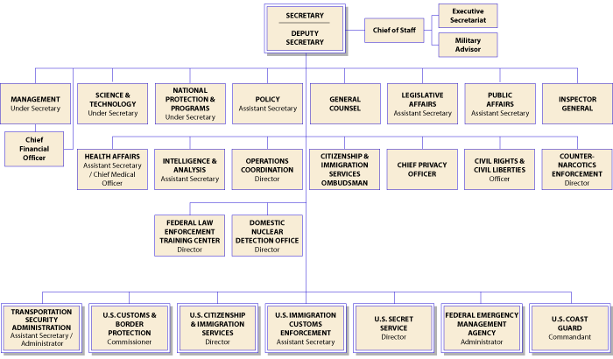
DHS Organization
Notes:
Emphasize to the students that the following three organizations are now part of DHS:
US Coast Guard (Title 14 of the US Code). USCG moved from the Department of Transportation to DHS in 2002 under the Homeland Security Act of 2002.
A good on-the-spot question is to ask the students:
Do you know what Title 14 is and what organization is covered by it?
Answer: Title 14 of the US Code states “The Coast Guard as established January 28, 1915, shall be a military service and a branch of the armed forces of the United States at all times. The Coast Guard shall be a service in the Department of Homeland Security, except when operating as a service in the Navy.”
US Secret Service moved from the Treasury Department to DHS.
FEMA is now a subdirectorate under DHS with its own funding line separate from DHS. This is a result of Hurricane Katrina.

Slide 22
Legal Considerations
Insurrection Act – 1807
Posse Comitatus Act – 1878
Economy Act—1982
The Robert T. Stafford Act –1993

Slide 23
Tiered Domestic Response
Event Ascendancy
Catastrophic Major Routine
PRESIDENT
Federal Declaration
Dept of Homeland Security (FEMA)
Federalized
National Guard
Other Military Resources
Active Duty Forces
Emergency Management Assistance Compacts (EMAC)
From Supporting States
- National Guard
- State Agencies
DISASTER
Nearly all missions are accomplished below this level!
GOVERNOR
State Declaration
- National Guard
- State EOC
- County EOC
- Mutual Aid
City Emergency
Operations Center (EOC)
- Second/Third alarm
- Arriving Responders
99.999% of the time
Notes:
23
In the vast majority of events, the response is handled below the top dotted line with minimal federal involvement.
Explain Mutual aid.
Explain EMAC – Emergency Management Assistance Compacts.
If there is a military response, most of the time it will be fro NG in state or T32 status.
If there is a Federal response, most of the time it will not include T10 military forces.
Only catastrophic disasters like Hurricanes Katrina and Andrew have T10 force involvement.

Slide 24
Range of Response
Governor commands
President commands
National Guard Civil Support (NGCS)
Defense Support of Civil Authorities (DSCA)
National Guard in State Active Duty status
National Guard in Title 32 Duty status
All Regular; Reserve; and National Guard forces in Title 10 status
Notes:
Key discussion points:
Different status, who commands military forces in a given status

Slide 25
Questions/Answers/Comments

Slide 26
Selected References
FEB 19 2020: Empty Cities and Stalled Industrial Production, New Analysis Shows Coronavirus Has Cut China's Carbon Emissions by 100 Million Metric Tons https://time.com/5786634/coronavirus-carbon-emissions-china/
JAN 31 2020: The Geopolitical Consequences of the Coronavirus Outbreak: Will China be forced into “hibernation” amid the epidemic? https://thediplomat.com/2020/01/the-geopolitical-consequences-of-the-coronavirus-outbreak/
FEB 25 2020: An ‘October Surprise’ From North Korea? - North Korea’s plans remain unclear amid the coronavirus outbreak. https://thediplomat.com/2020/02/an-october-surprise-from-north-korea/
FEB 14 2020: North Korea’s Bizarre Strategies for Tackling the Coronavirus Outbreak: Pyongyang claims there have been no cases of the virus in the country. So why is it taking increasingly desperate measures? https://thediplomat.com/2020/02/north-koreas-bizarre-strategies-for-tackling-the-coronavirus-outbreak/
Feb 26 2020: Coronavirus Sparks Talk of Global Recession and 'Economic Pandemic' as Stock Markets Dive https://www.newsweek.com/coronavirus-china-recession-pandemic-stock-markets-economy-1489218
Geopolitical consequences of Coronavirus outbreak https://www.msn.com/en-xl/news/other/geopolitical-consequences-of-coronavirus-outbreak/ar-BBZA93a

Slide 27
Contact:
Dr. Mahir Ibrahimov
Director, Cultural & Area Studies Office (CASO)
U.S. Army Command and General Staff College (CGSC)
Fort Leavenworth, KS 66027-2300
Phone: (913) 684-3345
CASO website: http://usacac.army.mil/organizations/cace/lrec
YouTube link: https://www.youtube.com/playlist?list=PLkGvnfy3IadNRMPT-sNHpAsz8a3npWBH8
Contact:
Dr. Mahir Ibrahimov, Director, CREL Management Office (CRELMO)
Fort Leavenworth, KS 66027-2300
Phone: (913) 684-3345
DSN: 552-3345Contact:
Dr. Mahir Ibrahimov, Director, CREL Management Office (CRELMO)
Fort Leavenworth, KS 66027-2300
Phone: (913) 684-3345
DSN: 552-3345
CRELMO website: http://usacac.army.mil/organizations/cace/lrec
ATN: https://atn.army.mil/dsp_template.aspx?dpID=102
https://atn.army.mil
YouTube link: https://www.youtube.com/playlist?list=PLkGvnfy3IadNRMPT-sNHpAsz8a3npWBH8
CRELMO website: http://usacac.army.mil/organizations/cace/lrec
ATN: https://atn.army.mil/dsp_template.aspx?dpID=102
https://atn.army.mil
YouTube link: https://www.youtube.com/playlist?list=PLkGvnfy3IadNRMPT-sNHpAsz8a3npWBH8

Slide 28
Back-up Slides

Slide 29
Notes:
This is an example of models developed by the US Army Corps of Engineers to estimate Hurricane effects. This particular model is from Hurricane Ike landfall near Galveston, Texas on 13 September 2008 as a Category 2 storm.
The dark red areas of the model represent 1 Million + cubic yards of debris estimates. The boundaries are counties in Texas.
The word Galveston on this slide covers the Bolivar Penesula, which is where Chrystal Beach and Gilchrist are located.
The next three slides illustrate the effects of that landfall from east to west.

Slide 30
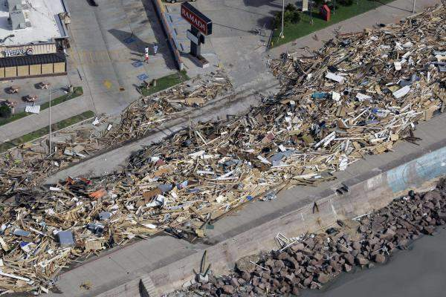
Galveston, TX Seawall 77550

Slide 31
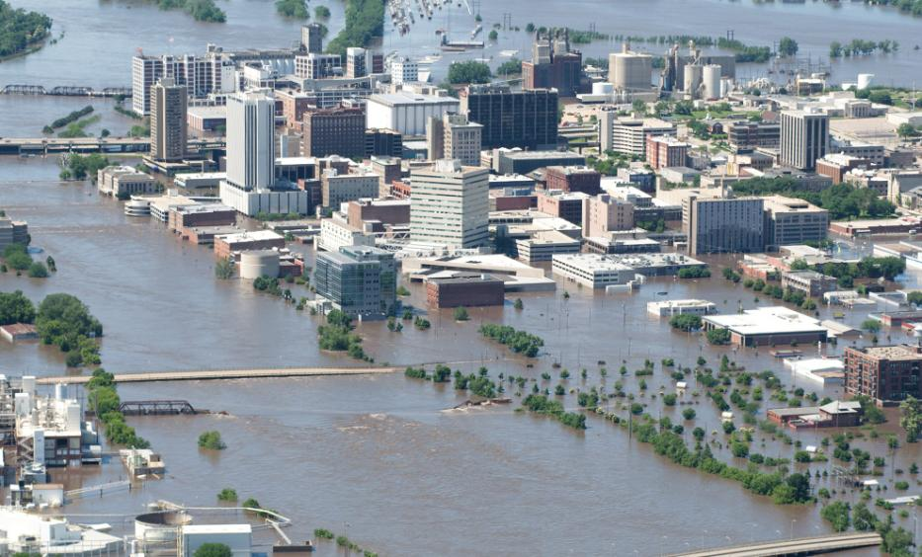
Downtown Cedar Rapids
Notes:
An aerial image of downtown shows flood-affected areas June 13, 2008 in Cedar Rapids, Iowa. Flooding along the Cedar River was expected to crest today. (Photo by David Greedy/Getty Images)

Slide 32
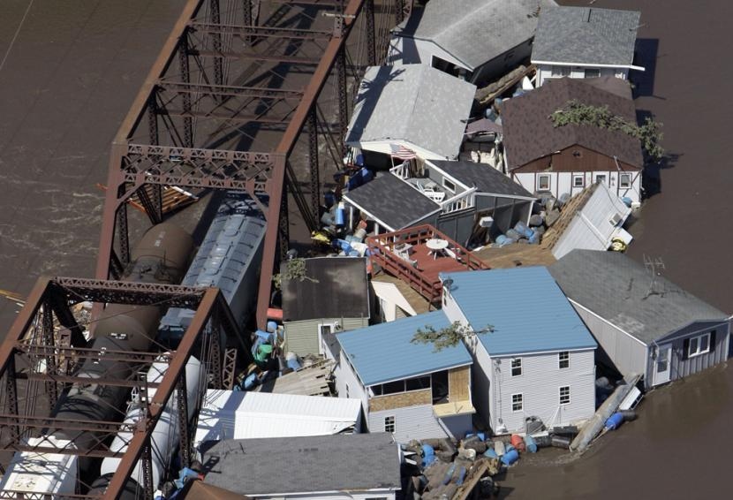
Iowa Flooding, Zip Code Unknown
Notes:
Buildings and debris are seen floating in the Cedar River against a railroad bridge Saturday, June 14, 2008, in Cedar Rapids, Iowa. Days after it rose out of its banks on its way to record flooding in Cedar Rapids, the Cedar River has forced at least 24,000 people from their homes, emergency officials said Saturday. (AP Photo/Jeff Roberson)

Slide 33
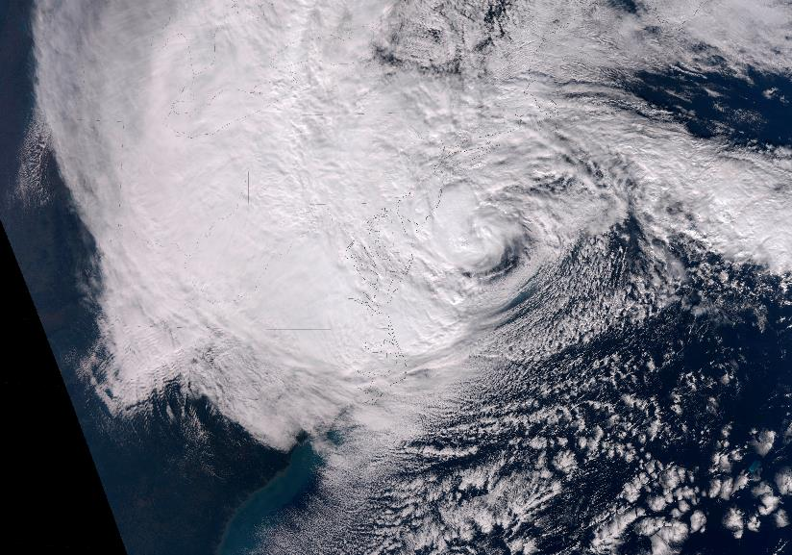
2012 Super Storm SANDY
Notes:
OCT-NOV 2012

Slide 34
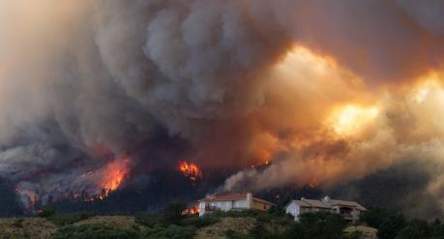
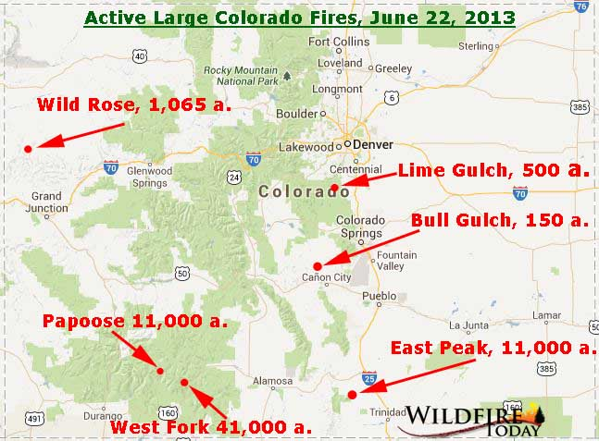
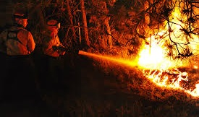
2013 Colorado Fires
Notes:
This is a collection of pictures from the Colorado Wildfires in 2013. These wildfires destroyed homes, and threatened communities north of Colorado Springs in the Black Forrest region.
The Colorado National Guard was activated to support and while in the midst of standing up a new Aviation Brigade for 4th Infantry Division, 2-4 General Support Aviation Battalion (GSAB) was tasked to provide aerial water bucket and

Slide 35
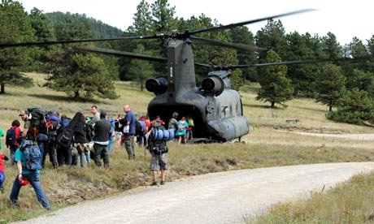
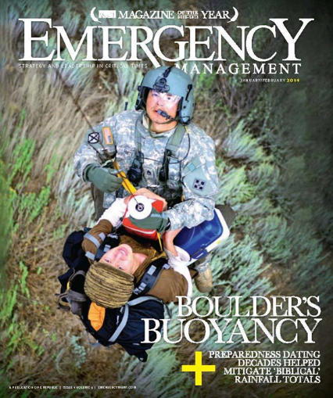
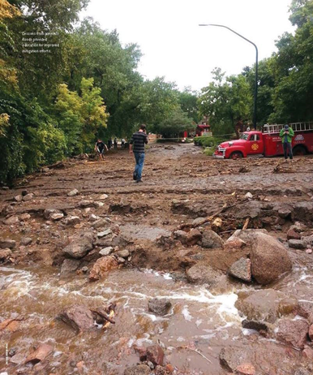
Boulder, CO 80301
Notes:
The Colorado National Guard and U.S. Army crews that helped evacuate more than 2,000 people from the Boulder County foothills during September's floods
Boulder County had the most aerial rescues since Hurricane Katrina.
In my aircraft alone, over the five days, I think I brought over 400 people out,” United States Army chief warrant officer James Dowdy said. The military vehicles and ground support vehicles that were used during rescue operations, as well as local police and fire vehicles, will be on display at the airport. Crews performed roughly 1,200 aerial evacuations and 800 ground evacuations, according to city officials.
http://kdvr.com/2014/06/14/flood-rescue-crews-honored-at-boulder-airport-day/
http://www.dailycamera.com/news/boulder-flood/ci_25885430/military-crews-that-rescued-hundreds-during-septembers-floods
Photos from Emergency Management Magazine January/February 2014

Slide 36
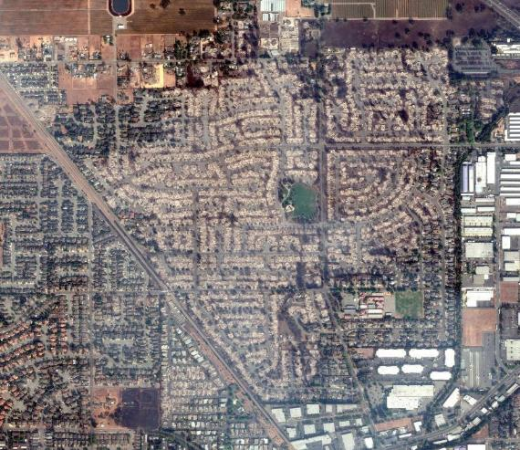
2017 CA Fires - Santa Rosa, CA 95403
https://www.nytimes.com/interactive/2017/10/14/us/california-fire-building-damage.html
Notes:
Northern California Fires Have
Destroyed at Least 5,700 Buildings
OCT. 14, 2017
SANTA ROSA, Calif. — State officials announced Friday that the wildfires across Northern California have destroyed at least 5,700 buildings. An analysis by The New York Times using satellite images in combination with its own ground surveys found that one fire in particular incinerated at least 5,100 structures, which would make it the most destructive wildfire in the state’s history.
The inferno, known as the Tubbs fire, began Sunday, Oct. 8, and, as of Friday morning, was not expected to be fully contained until next Friday, Oct. 20.
About 2,800 buildings in Santa Rosa were destroyed. The Coffey Park neighborhood and Fountaingrove area were among the hardest hit. There was another concentration of incinerated homes in the Larkfield-Wikiup area, about a mile north of the city, where about 500 buildings were destroyed.
About 1,300 destroyed homes are visible in this satellite image of the Coffey Park neighborhood of Santa Rosa.

Slide 37
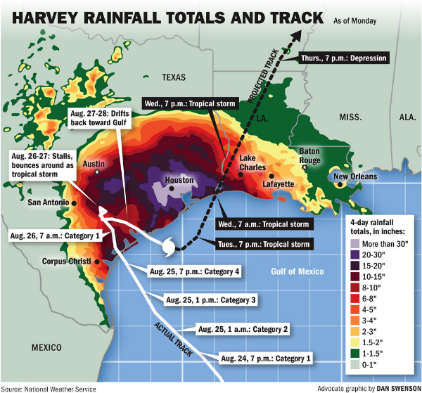
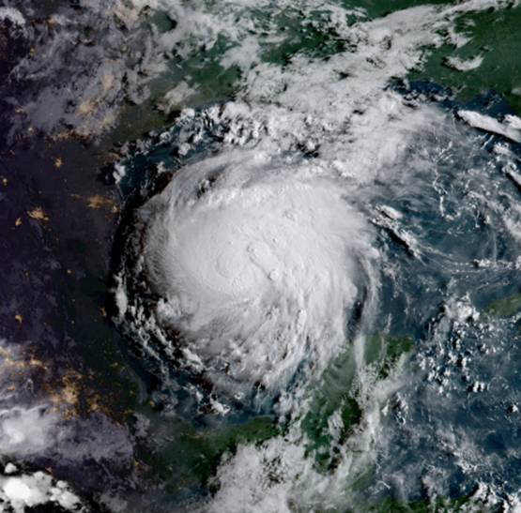
Hurricane Harvey, Houston, TX 77251
Notes:
http://ucdsoftware.maps.arcgis.com/apps/View/index.html?appid=8350c2f309bb49f8865a44cb972024c2

Slide 38
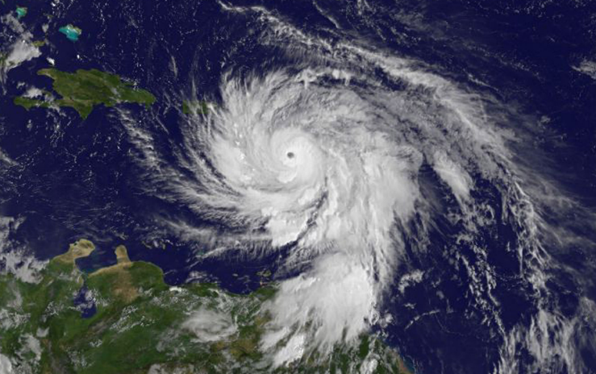
Hurricane Maria, Puerto Rico

Slide 39
2007 Greensburg, KS 67054
Notes:
Time (UTC) Megan Gardiner’s timeline of observations
0237 Winds picked up with quarter sized hail
~ 0248 Hail increased to ~ golf ball size
0249 Wind ferocious and power went out
~ 0249 Pressure drop with intense pain for ~ 15 s
0250 Wind & hail "horrible"
~ 0250:45 Deathly quiet, "freaky"
~ 0251:+ Windows exploded
~ few seconds later house tearing apart
0252:+ shirt and blanket start to fly up
~ 0253 Still going, horrible roar, screaming
~ 0254 Wind overpowering
~ 0255 Comes to an end, just rain

Slide 40
Insurrection Act - 1807

Slide 41
The Insurrection Act
An exception to the Posse Comitatus Act (Title 10 USC, Sections 331-335).
Allows the President to use US military personnel at the request of a state legislature or governor to suppress insurrections.
Also allows the President to use federal troops to enforce federal laws when rebellion against the authority of the US makes it impracticable to enforce the laws of the US.
Notes:
Title 10 USC, Section 331, authorizes the President to use the military to suppress an insurrection at the request of a state government, which is meant to fulfill the federal government’s responsibility to protect states against “domestic violence.”
Section 332 delegates Congress’ power under the Constitution, Art. I, § 8, cl. 14, to the President, authorizing him to determine that “unlawful obstructions, combinations, or assemblages, or rebellion against the authority of the United States make it impracticable to enforce the laws of the United States” and to use the armed forces as he considers necessary to enforce the law or to suppress the rebellion.
Section 333 permits the President to use the armed forces to suppress any “insurrection, domestic violence, unlawful combination, or conspiracy” if law enforcement is hindered within a state, and local law enforcement is unable to protect individuals, or if the unlawful action “obstructs the execution of the laws of the United States or impedes the course of justice under those laws.” This section was enacted to implement the 14th amendment and does not require the request or even the permission of the governor of the affected state.

Slide 42
Posse Comitatus Act - 1878

Slide 43
18 U.S. Code § 1385 - Use of Army and Air Force as Posse Comitatus
Whoever, except in cases and under circumstances expressly authorized by the Constitution or Act of Congress, willfully uses any part of the Army or the Air Force as a posse comitatus or otherwise to execute the laws shall be fined under this title or imprisoned not more than two years, or both.
Enacted 18 June 1878. Amendments made as follows:
1994: Substituted “fined under this title” for “fined not more than $10,000”.
1959: Struck out provisions from 1899 which made section inapplicable in Alaska.
1956: Adds prohibition on use of the Air Force
1899: Made provisions that the act did not apply in Alaska
1879: Portion of the original act related to fiscal matters expires, leaving only criminal law.
Additionally, Navy and Marine Corps restricted by regulations adopted by DoD.

Slide 44
31 U.S. Code § 1535 - The Economy Act
Authorizes federal agencies to provide supplies and services to each other.
Mandates cost-reimbursement.
Notes:
The Economy Act contains the statutes that require each federal agency to budget for its own programs and pay other federal agencies for any services received.
Most notably, the use of services like airlift must be reimbursed.

Slide 45
The Stafford Act
The Robert T. Stafford Disaster Relief and Emergency Assistance Act, Public Law 93-288, as amended:
Authorizes the President to issue major disaster declarations--authorizes federal agencies to provide assistance to states overwhelmed by disasters.
Responsibility for administering delegated to FEMA by Executive Order.
Assistance available to individuals, families, state and local governments and certain non- profit organizations.
Funds provided through the Disaster Relief Fund.
Notes:
The most important legislation for DSCA is the Stafford Act, passed in 1989.
It gives the President the authority to plan for and respond to emergencies.
It provides some funding and planning, and lays out the process for bringing the federal government to the aid of the states, when requested.
It authorizes the use of an emergency support team to respond to disasters and provides for reimbursement to each agency for resources it provides to a declared disaster.
The Stafford Act is the primary legal authority for federal emergency and disaster assistance to state and local governments.
There are four ways for the federal government to become involved in providing assistance and/or relief under the Stafford Act (the Act):
The President may declare the area a major disaster under §5170 of the Act.
Major disaster is defined as “any natural catastrophe (including any hurricane; tornado; storm; high water; wind-driven water; tidal wave; tsunami; earthquake; volcanic eruption; landslide; mudslide; snowstorm; or drought) or, regardless of cause, any fire, flood, or explosion, in any part of the United States, which, in the determination of the President, causes damage of sufficient severity and magnitude to warrant major disaster assistance under this chapter to supplement the efforts and available resources of states, local governments, and disaster relief organizations in alleviating the damage; loss; hardship; or suffering caused thereby.” (42 U.S.C. §5122(2))
Major disaster assistance is a more comprehensive grant of federal aid for long-term consequence management.
In order to receive federal assistance under this provision, a governor must tell the President that their state does not have the capacity or resources to mount an effective response, then furnish information on the measures that they have taken to mitigate the effects of the disaster; and certify that they will comply with cost-sharing provisions of the Act.
After declaring a major disaster, the President’s power includes authority to provide to states and localities the following aid and assistance (detailed at §§ 5171-5186 of the Act):
Specified technical and advisory assistance;
Temporary communications services;
Food;
Relocation assistance;
Legal services;
Crisis counseling assistance and training;
Unemployment assistance;
Emergency public transportation in affected areas; and
Fire management assistance on publicly or privately owned forest or grassland.
The President may declare the area an emergency. (42 U.S.C. § 5191)
The President’s 10-Day Emergency Authority. The President may send in DoD assets on an emergency basis to “preserve life and property.” 42 U.S.C. § 5170b(c)
Areas under federal control. The President may send in federal assets when an emergency occurs in an area “which, under the Constitution or laws of the U.S., the US exercises exclusive or preeminent responsibility and authority.” (42 U.S.C. § 5191 (b))

Slide 46
Provide Other Support as Required
Wildland Firefighting Support
Protection of Critical Infrastructure
Community assistance:
Public works, youth programs, medical readiness programs, air ambulance participation, band and color guard performances
State and local events:
Common interest in providing mutual assistance
National events:
Olympics, Super Bowl, political events
Considerations:
Memoranda of agreement or understanding
Liaison
Laws and regulations

