Slide 1
30 November 2021

Slide 3
U.S.INDOPACOM AOR
https://www.pacom.mil/About-USINDOPACOM/USPACOM-Area-of-Responsibility/ (accessed on 15 November 2021)

Slide 4
“Understanding INDOPACOM’s Geopolitical and Military Environment”
Dr. Geoff Babb
Department of Military History
U.S. Army Command & General Staff College
Presentation for the
Cultural and Area Studies Office
U.S. Army Command and General Staff College
30 November 2021
unclassified

Slide 5
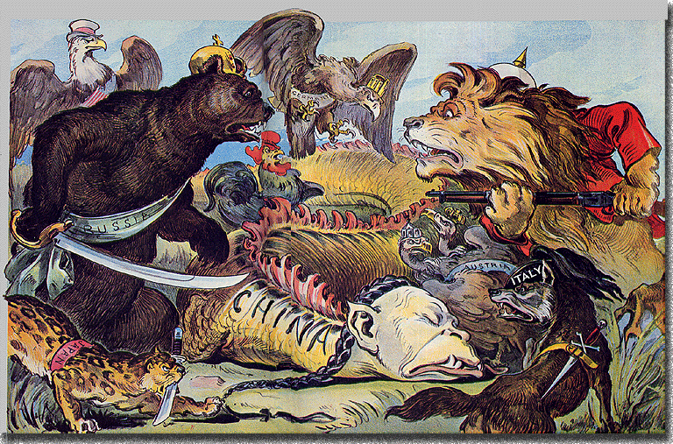
Key Historical Events in Chinese-Russian-US Relations:
From the Qing Dynasty to the Establishment of the PRC
Dr. Geoff Babb, Department of Military History, USACGSC

Slide 6
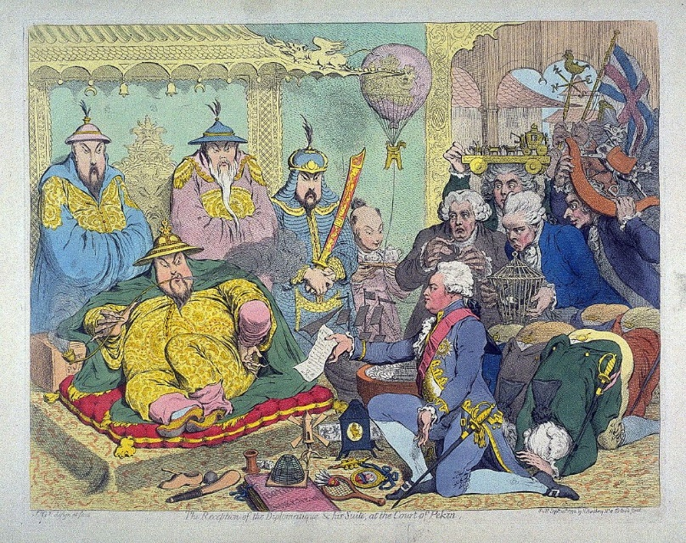
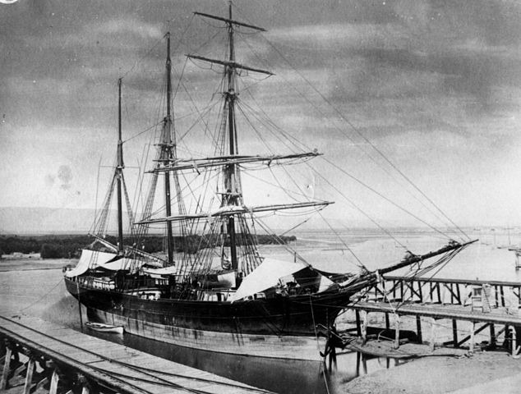
Key Events in Chinese-Russian-US Relations:
The Early Qing Dynasty (1644-1853)
Russia
1689
Treaty of
Nerchinsk
1728
Treaty of
Kyakhta
1796-1804
White Lotus Rebellion
1813
8 Trigrams Uprising
Anti-Qing
Rebellions
China
1784
US-China Trade
Opened
1844
Treaty of
Wangxia
1853-54
Opening
of Japan
Diplomacy:
Equal & Un-Equal
US
Trade and Territorial Expansion
1793
Macartney Mission
Beijing(CN/UK)
1842
Treaty of
Nanjing (CN/UK)
Other Countries—UK/JP/FR)

Slide 7
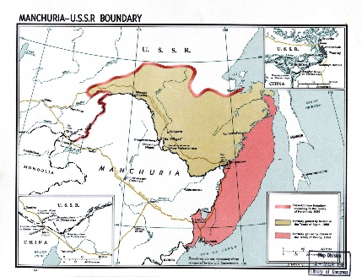
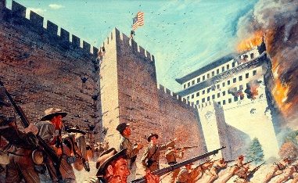
Key Events in Chinese-Russian-US Relations in Asia:
The Late Qing Dynasty (1854-1911)
Russia
1858
Treaty of Aigun
(RFE & Manchuria)
1881
Treaty of Ili
(Xinjiang)
1898
Lease of Liaodong
Peninsula
Un-Equal Diplomacy and Territorial Adjustments
1901
Boxer Rebellion/Allied Invasion
JP/RU/UK/FR/US/IT/GE/AT-HU
1854-1864
Taiping Rebellion
1911
Revolution
China
Internal Turmoil, Foreign Wars, and Humiliating Treaties
US
2nd Opium War (UK/FR)
Treaty of Tianjin
(UK/FR/RU/US)
1884-1885
Sino-French
War
1894-1895
1st Sino-Japan War
Treaty of Shimonoseki
Taiwan Ceded to Japan
1904-05
Russo-Japanese
War
Treaty of Portsmouth
Other Countries

Slide 8
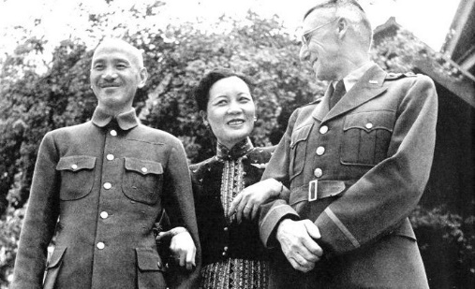
Key Events in Chinese-Russian-US Relations:
From the Republic to Revolution to Global War (1912-1945)
1929
Sino-Soviet War
Manchuria
1924-1927
Soviet Advisors
to the KMT
1939
Battle of Nomonhon
Manchuria JP/RU
1945
Invasion of
Manchuria JP/RU
Russia
1924-1945 Soviets as Allies-Neutrals-Enemies-Allies Again
1921-1924
Birth of the Chinese Communist Party
1st United Front
1927-36
The Northern Expedition &
5 Extermination
Campaigns
1917-1919
WWI
Chinese
Labor
1936
The Xian Incident
2nd United Front
1937-1945
The 2nd Sino-Japanese War
China
Chiang is the Central Figure
Mao the Rising Figure
1918-1922
The US Siberian
Expedition
Neutrals-Reds-Whites
1941-1945
China-Burma-India
Theater US/UK/CN
US Advisors (KMT/CCP)
US
1918-1922
The Siberian
Intervention
CH/JP/UK/FR+5
1927-1937
German Advisors
to the KMT
1940-45
SEA Occupation
JP & Vichy FR
Other Countries

Slide 9
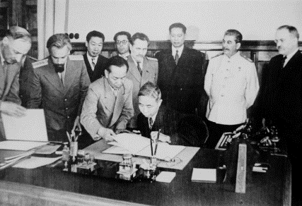
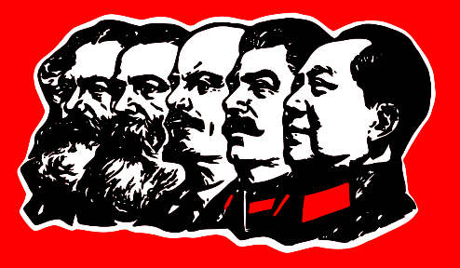
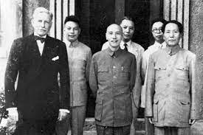
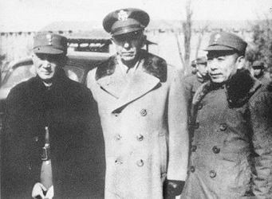
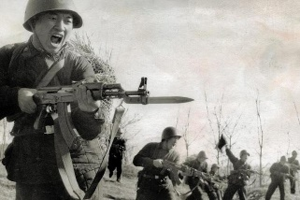
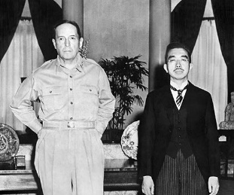
Key Events in Chinese-Russian-US Relations:
From VJ Day to the Establishment of the PRC (1945-1950)
Situational Diplomacy and a Watchful Eye
14 August 1945 (KMT)
Sino-Soviet Treaty of Friendship and Alliance
1950 (CCP)
Sino-Soviet Treaty of Friendship, Alliance, and Mutual Assistance
Russia
1945-1947
The Chinese
Civil War
Fight-Talk-Fight
1947-1949
The Chinese
Civil War
Fight-Fight-Flee
Oct 1949
Zhongguo Ren Min
Zhan Qi Lai Le
The PRC Established
Oct 1950
War with the UN
Lead by the US
China
1945
The Hurley Mission
1946-1947
The Marshall Mission
1947-1949
JUSMAAG-
China
US
Failed Diplomacy
Support to the KMT
War with the PRC/CCP/CPV
1945-
Occupation of Japan (SCAP)
1945-
Occupation of Korea US-RU
1950-53
The Korean War
US/UN/KS—KN/CN/RU
Other Countries

Slide 10
The Historical Bottom Line on Current Chinese-Russian-US Relations:
Is it “too soon to tell?” Six Questions--
The China-Russia Relations have never been better in history. Will it last?
The US-China Relationship has rarely been worst. Will there be war over Taiwan?
The US-Russia Relationship is larger than Europe. Will Putin the Strong go into Asia like Peter the Great?
The China-Japan and China-India Relationships have never been good. But is the Quad viable long term?
US/UK/AU Relations—Allies in Asia, but is it more than Submarines?
Is it the Economy and Trade, Stupid or are we seeing inevitable China’s decline?
It's the nature of historical thinking that we reach consensus on the markers far before we can agree on their import. The classic Chinese view of history has its set dynastic cycles: founding, glory, decline and fall — the meaning of eras can be evident only in long retrospect. As Zhou Enlai said when asked 200 years after the French Revolution what its impact was: "Too soon to tell.”
Rachel Dewoskin
Keep your gunpowder dry and a wary eye.
Ba Jiefu
https://www.npr.org/templates/story/story.php?storyId=104649913

Slide 11
“Understanding INDOPACOM’s Geopolitical and Military Environment”
LTC David C. McCaughrin
Department of Joint, Interagency and Multinational Operations
U.S. Army Command & General Staff College
Presentation for the
Cultural and Area Studies Office
U.S. Army Command and General Staff College
30 November 2021
unclassified

Slide 12
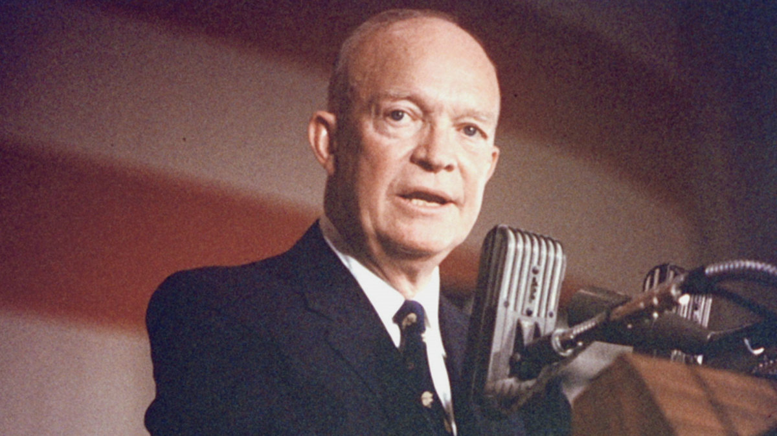
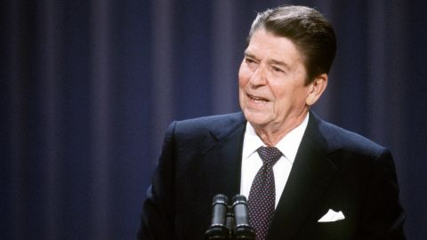
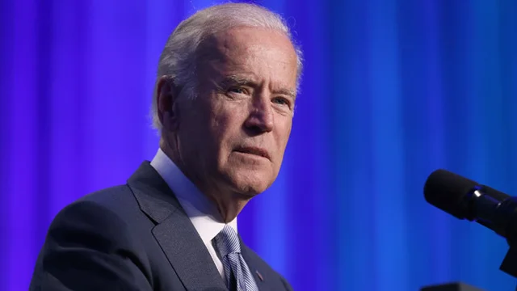
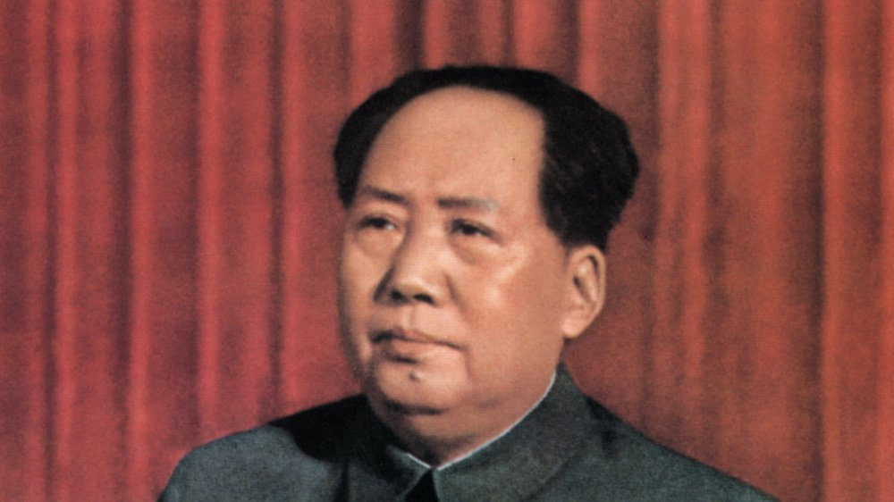
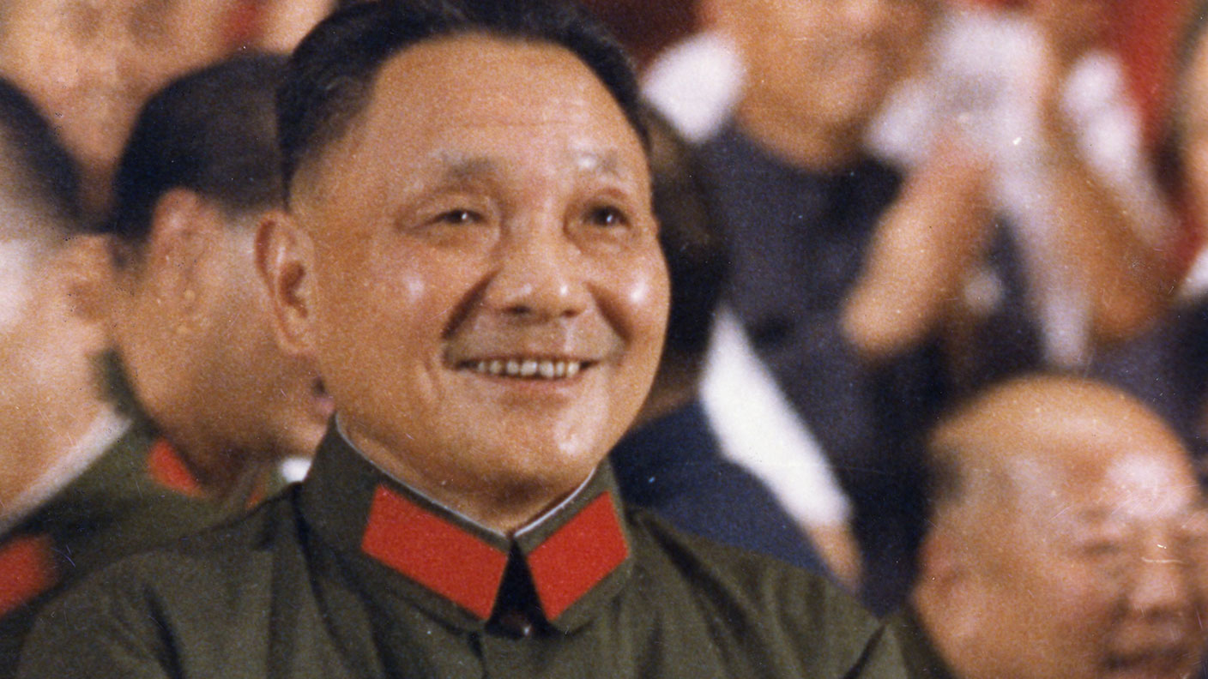
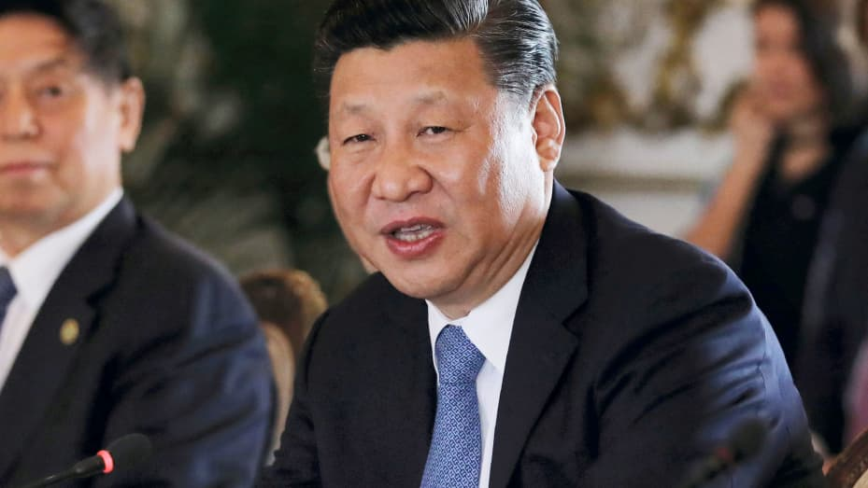
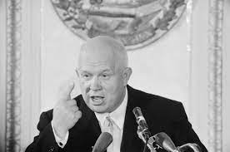
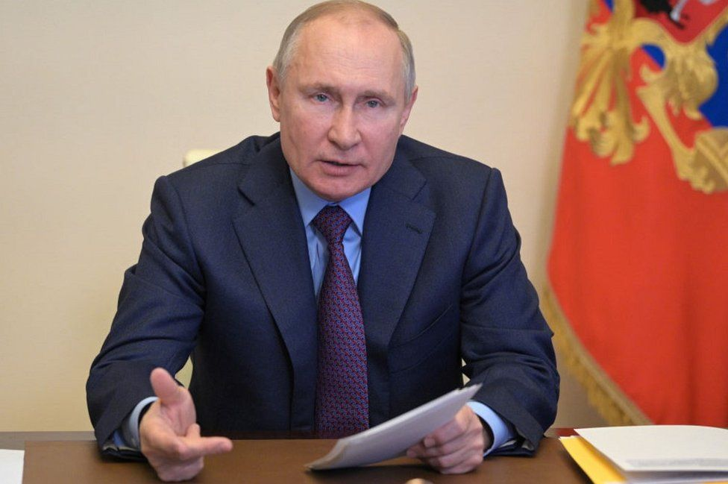
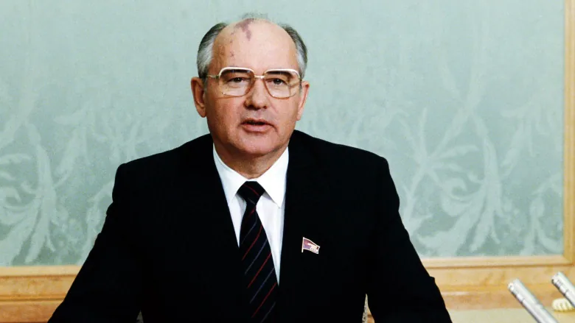
TANGLED TRIANGLE
U.S., China, and Russia

Slide 13
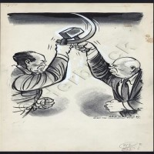
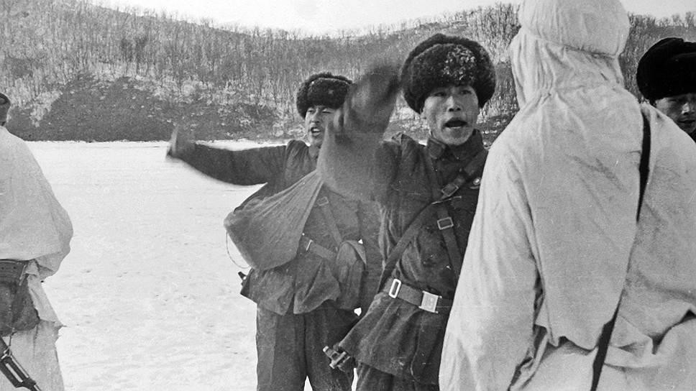
Sino-Soviet Split 1953-1972
Korean War
Stalin’s legacy
Khrushchev and Mao
Taiwan Straits Crises
Communism in the “Third World”
The Bomb
Conflict on the border
Lin Biao

Slide 14
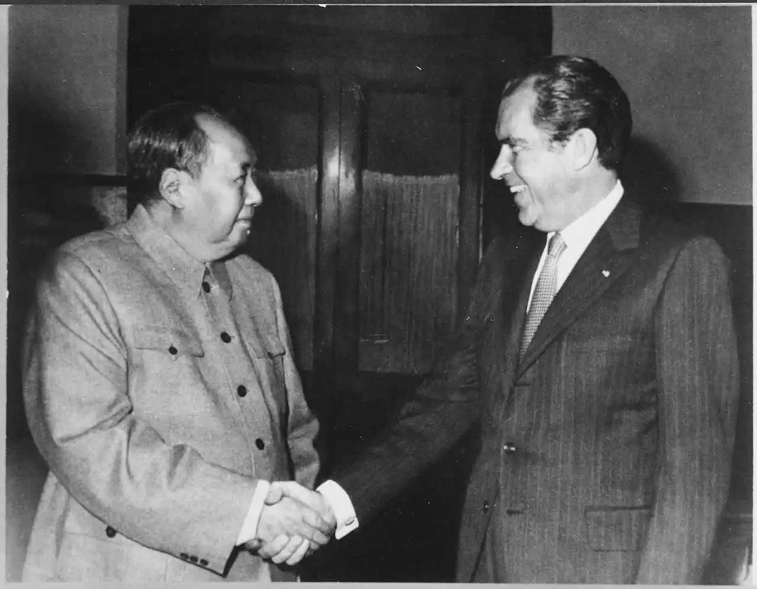
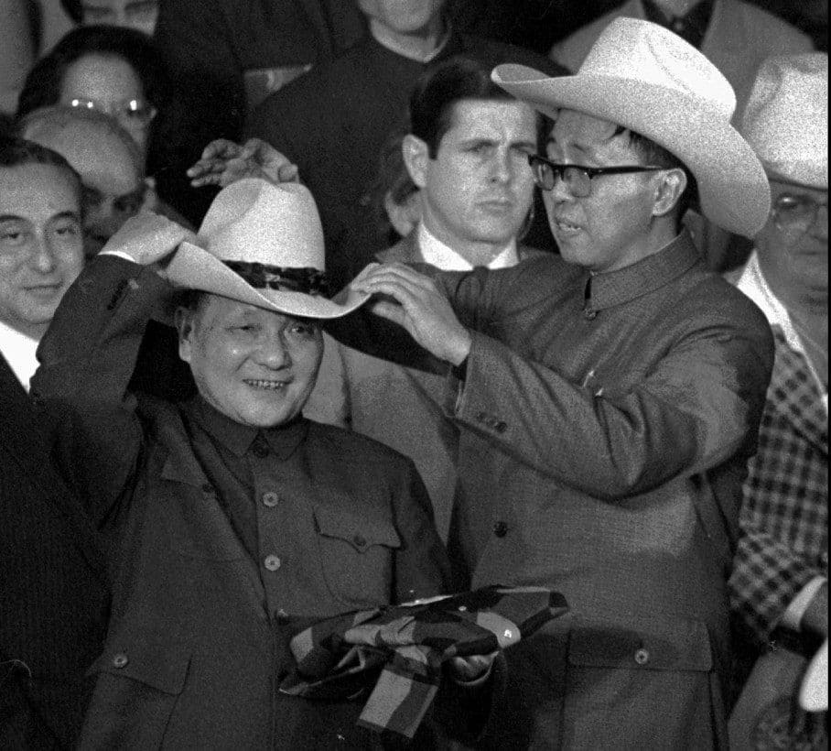
Sino-American Rapprochement 1972-1989
Ping-Pong and B-52 Diplomacy
Nixon article and visit
Three Communiques
Restoration of relations
改革开放 “Reform and Opening Up”
Teaching Vietnam a Lesson
PRC opposes USSR invasion of Afghanistan
Legacy of Tiananmen

Slide 15
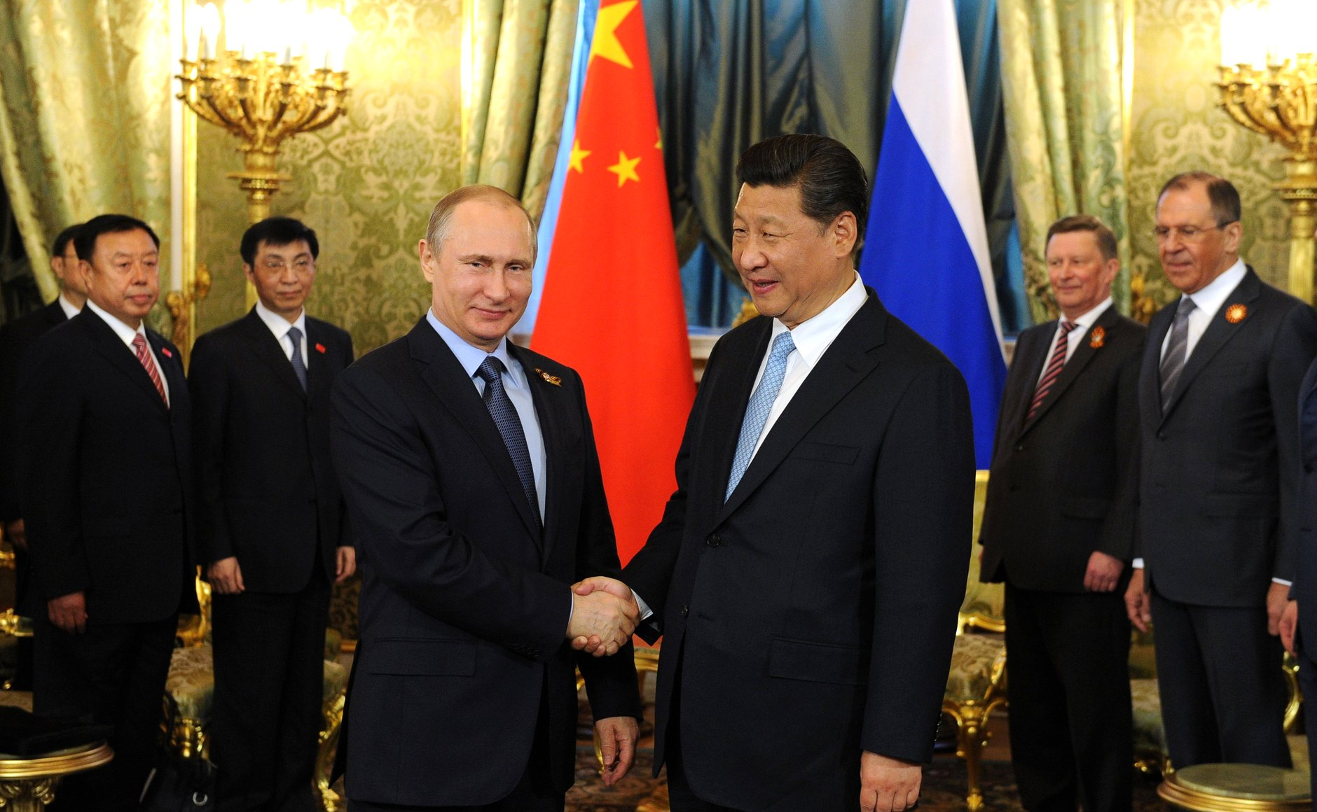
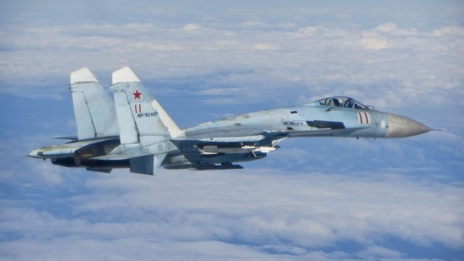
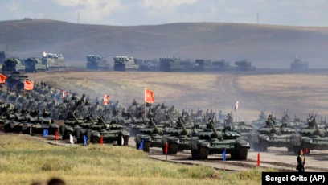
Post-Cold War 1989-
Deng-Gorbachev Summit
Persian Gulf War
Soviet collapse
Taiwan Straits Redux 1996
Shanghai Cooperation Organization
PRC-RUS Security Cooperation
Territorial Assertions and the Gray Zone
What next?

Slide 16
Regional Implications (JAPAN): Sino-Russian Interests
LTC Holly Maness
Department of Joint, Interagency, and Multinational Operations
U.S. Army Command and General Staff College
Presentation for the
Cultural and Area Studies Office
U.S. Army Command and General Staff College
30 November 2021
unclassified

Slide 17
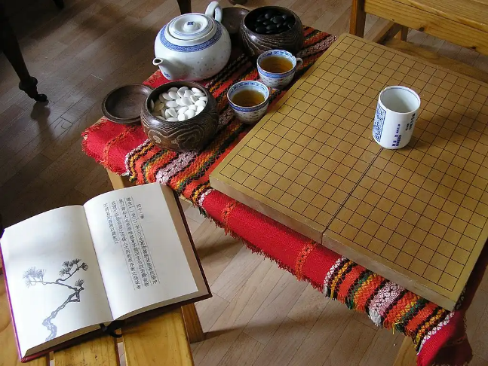
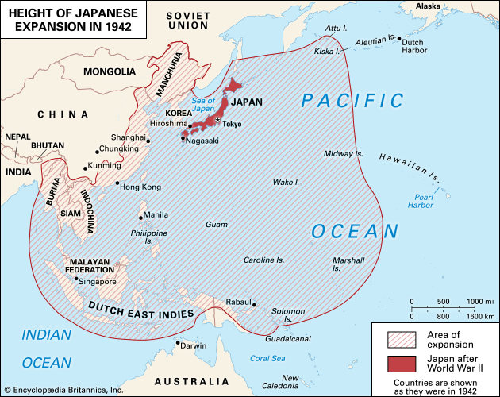
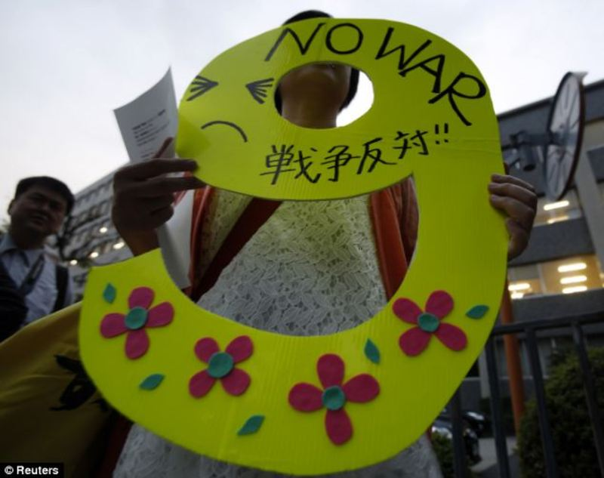
Japan: Historical Context
Long history of Chinese influence
Isolationist foreign policy (~1630s to 1853)
Regional conflicts / Expansionism
WWII Aftermath
Constitution of Japan – Article 9

Slide 18
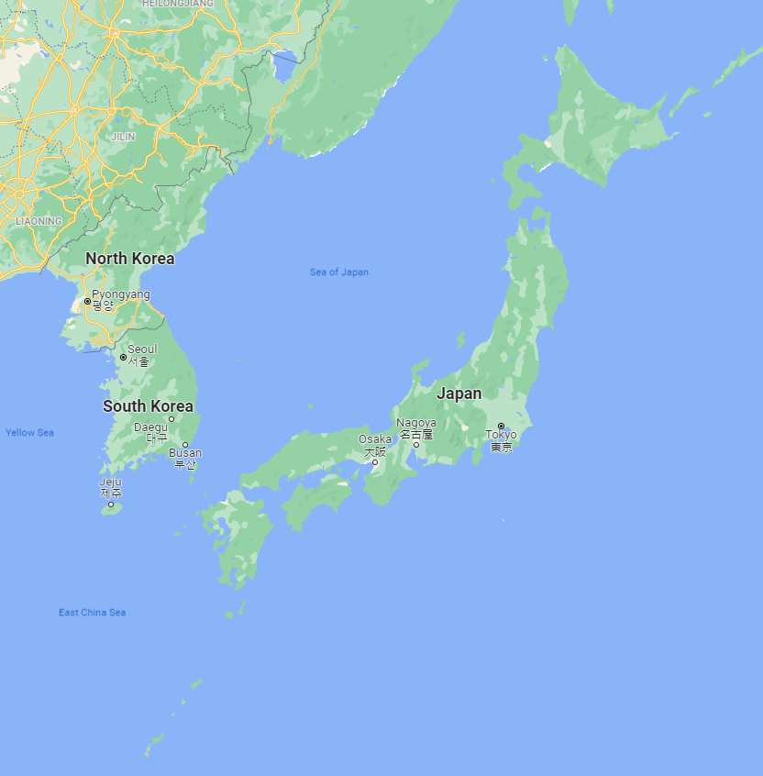
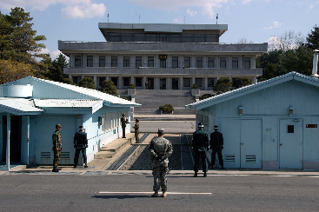
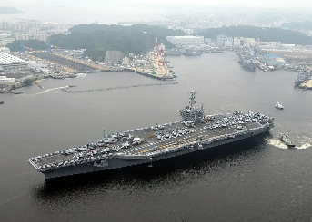
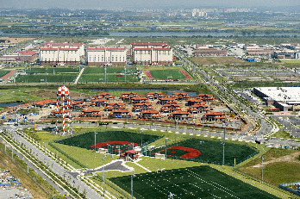
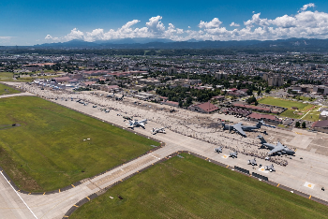
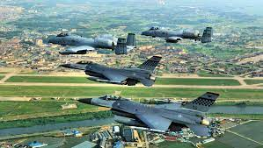
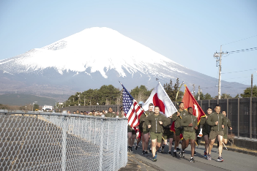
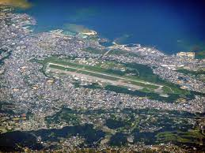
U.S. Military in the region
Demilitarized Zone
JAPAN
Largest US Military presence outside of the US
~55,000 US Military in Japan
>100 Military bases
SOUTH KOREA
3rd largest US Military presence outside of the US
~28,500 US Military in Japan
>70 Military bases
Yokosuka Naval Base
Camp Humphreys
Yokota Air Base
Osan Air Base
Futenma Air Base
Camp Fuji

Slide 19
Current Situation
Relationship: Trust, friendship, cooperation
?
Northern Territories / Kuril Islands dispute
Russia is important for security and counterbalancing China
Senkaku / Diaoyu Islands dispute
Regional threat: military capabilities and assertiveness

Slide 20
The Russian perspective of the INDOPACOM
Major Frederik Wintermans
Royal Netherlands Army
U.S. Army Command and General Staff College
Presentation for the
Cultural and Area Studies Office
U.S. Army Command and General Staff College
30 November 2021
unclassified

Slide 21
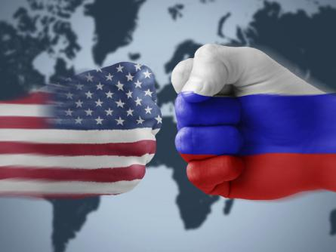
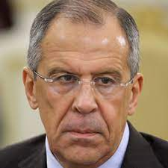
The Russian perspective of the INDOPACOM
“We (Russia and China) noted the destructive character of Washington’s actions that undermine global strategic stability. They are fuelling tensions in various parts of the world, including along the Russian and Chinese borders.”
Key take-away:
Moscow will not pivot to Asia in the medium term. Russian security interests are European. Its diplomatic, military, and economic activities in INDOPACOM revolve around its partnership with China. The rest is of secondary importance. Russian policy collides with U.S. policy in repelling U.S. push for global dominance.
Frederik Wintermans, Royal Netherlands Army

Slide 22
Diplomacy
Russian interests framed by competition with U.S.
Relationship China
BMD
South Chinese Sea
Russian ties with:
ROK
North-Korea
Japan

Slide 23
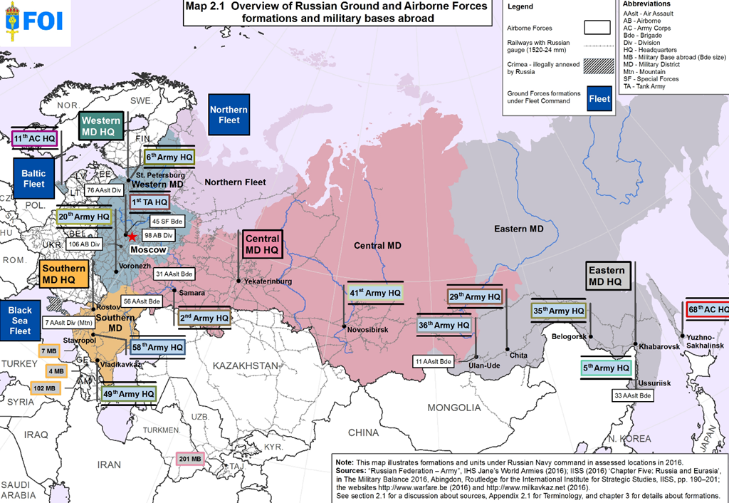
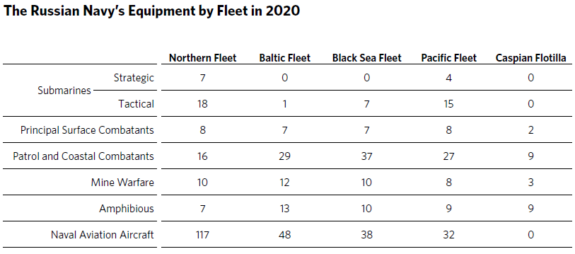
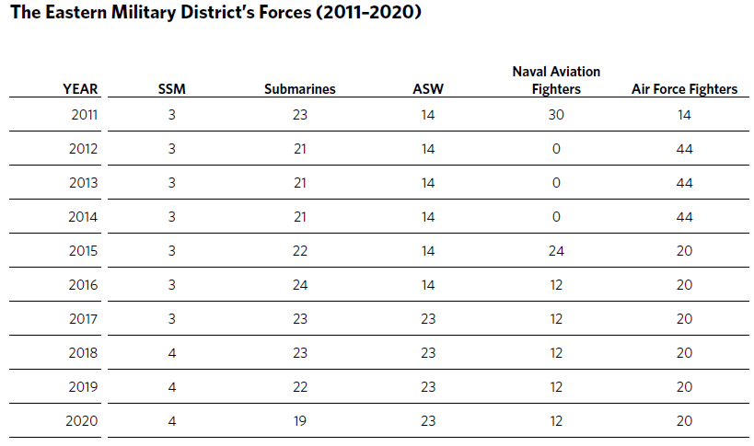
Military
Priorities: no pivot to Asia
Military policy largely determines foreign policy

Slide 24
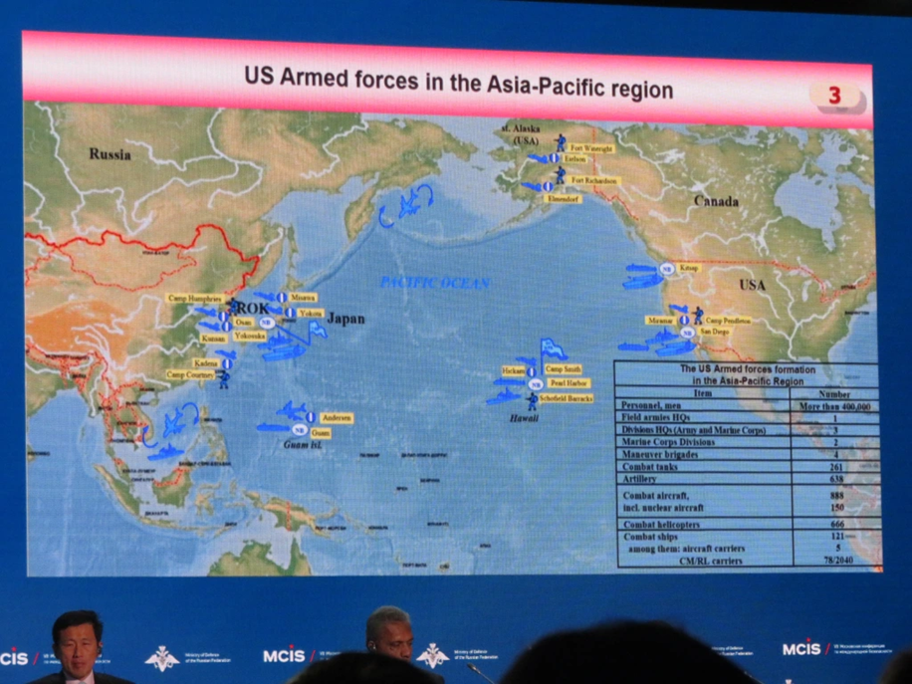
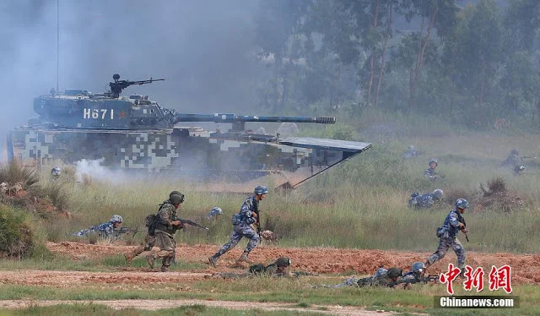
Military
Worries about U.S. military activities
Considers U.S. military presence modern imperialism
Combined training with China

Slide 25
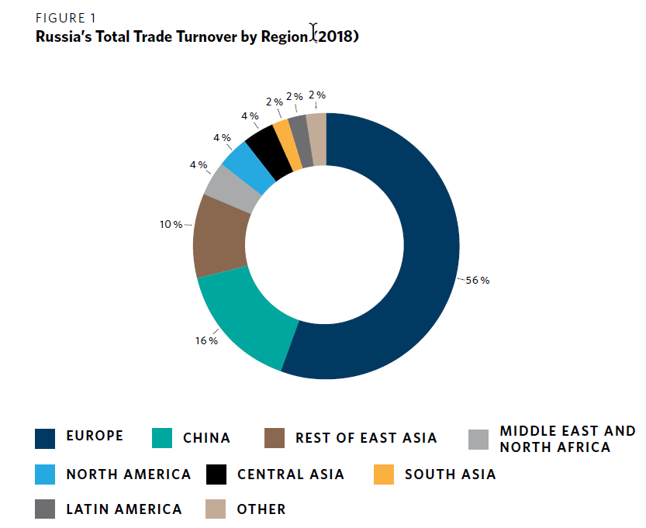
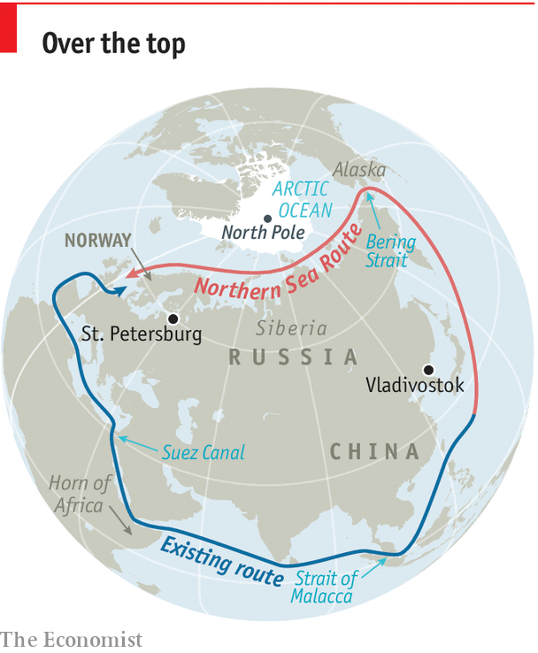
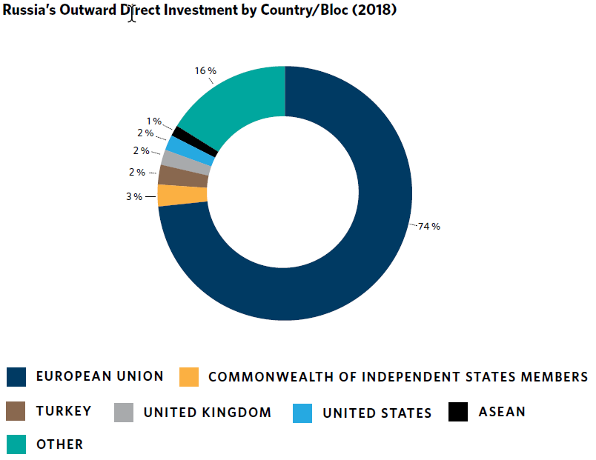
Economy
Economic considerations
Limited trade
Northern route
Defense industry

Slide 26
Key take-away:
Moscow will not pivot to Asia in the medium term. Russian security interests are European. Its diplomatic, military, and economic activities in INDOPACOM revolve around its partnership with China. The rest is of secondary importance. Russian policy collides with U.S. policy in repelling U.S. push for global dominance.
Questions:
What is the effect of U.S. pivot to Asia on NATO cohesion?
What will Moscow do when U.S. and China militarily collide over Taiwan?

Slide 27
Questions/Answers/Comments

Slide 29
Contact:
Dr. Mahir Ibrahimov
Director, Cultural & Area Studies Office (CASO)
U.S. Army Command and General Staff College (CGSC)
Fort Leavenworth, KS 66027-2300
Phone: (913) 684-3345
CASO website: http://usacac.army.mil/organizations/cace/lrec
YouTube link: https://www.youtube.com/playlist?list=PLkGvnfy3IadNRMPT-sNHpAsz8a3npWBH8
CGSC Facebook: https://www.facebook.com/USACGSC
Contact:
Dr. Mahir Ibrahimov, Director, CREL Management Office (CRELMO)
Fort Leavenworth, KS 66027-2300
Phone: (913) 684-3345
DSN: 552-3345Contact:
Dr. Mahir Ibrahimov, Director, CREL Management Office (CRELMO)
Fort Leavenworth, KS 66027-2300
Phone: (913) 684-3345
DSN: 552-3345
CRELMO website: http://usacac.army.mil/organizations/cace/lrec
ATN: https://atn.army.mil/dsp_template.aspx?dpID=102
https://atn.army.mil
YouTube link: https://www.youtube.com/playlist?list=PLkGvnfy3IadNRMPT-sNHpAsz8a3npWBH8
CRELMO website: http://usacac.army.mil/organizations/cace/lrec
ATN: https://atn.army.mil/dsp_template.aspx?dpID=102
https://atn.army.mil
YouTube link: https://www.youtube.com/playlist?list=PLkGvnfy3IadNRMPT-sNHpAsz8a3npWBH8

