Slide 1
Dr. Mahir J. Ibrahimov
Culture, Regional Expertise & Language (CREL)
Management Office (LRECMO)
22 July 2015

Slide 2
Agenda
CAC LREC Management Office (LRECMO)(vision/mission/ key tasks)
Army CREL Strategy
Career Development/PME (CREL GLOs)
Way Ahead/CREL Assessment Visits
BACKUP
Attachments

Slide 3
Culture, Regional Expertise and Language (CREL)
Culture, Regional Expertise and Language (CREL) Vision
CREL creates a sustainable advantage for regionally aligned forces in any combination of indigenous cultures by providing training and education tools that enhance Professional Military Education, Pre-Deployment and Functional Training. CREL is a critical strategic security concept to prepare globally responsive and regionally aligned forces that work with a variety of partners including host nation militaries and populations to execute our Prevent, Shape and Win strategic role.
LRECMO Mission
In conjunction with its subordinate organizations provides daily management oversight in directing, synchronizing, integrating Army's Culture, Regional Expertise and Language (CREL) capabilities and requirements.
Key Tasks of Office:
Define TRADOC’s internal governance requirements for integration and synchronization
Represent TRADOC’s interest to Army Forums
Identify CREL requirements for APLDF decision
Continue work with ALCC to finalize GLOs for PME/CREL
Coordinate stakeholder input to new strategy (CREL)
Coordinate and synchronize T&E support for CREL
QA and validation of requirements

Slide 4
Army CREL Strategy
Language
Regional
Expertise
Culture
Conventional
Forces
Career Long Effort
Basic
select personnel
Basic to Fully Proficient
over the course of a career
ARSOF
Basic
--- Fully Proficient ---
Linguists
Master
Basic
Full
--- Master ---
FAO
Outcomes | Basic | Basic awareness & can apply in simplest situations Individuals still require close & extensive guidance ILR Standard: 0+ / 0+ ILR Goal: 1 / 1
 | Full | Thorough understanding & can apply in routine & non-routine situations Can work independently with minimal guidance & direction ILR Standard: 1+ / 1+ ILR Goal: 2 / 2
 | Master | Extensive depth & breadth of expertise & can apply in highly complex & ambiguous situations across range of disciplines Acknowledged authority, advisor, and key resource in the organization ILR Standard: 2 / 2 / 1+ ILR Goal: 3 / 3 / 3 (Ref: CJCSI 3126.01A)

Slide 5
Career Development / PME
Cross-Cultural and Regional Competencies
Army Learning Coordination Council establishes general learning outcomes across cohorts to ensure sequential and progressive learning
Proponents develop standardized CORE lesson plans (a baseline of Cross Cultural Competency (3C)) and Region Specific Knowledge within the general purpose force
Centers of Excellence/Schools develop specific CREL Branch/MOS learning objectives
Monitor/assess through ALCC process as the ACFLS /ACRELS education implementation governance- continuous
Lesson Plans
CoE Coverage
CAC-E Coverage
USAWC/USASMA
Stage 1
(Recruit – End IMT)
Stage 2
End of IMT -7th Year
Stage 3
8th Year – 16th Year
Stage 4
17th Year and Beyond
Officer
Warrant Officer
Enlisted
Civilian
BOLC
CCC
ILE
SSC
WOCS/WOBC
WOAC
WOILE
WOSSE
AIT
WLC
ALC
SLC
SMA
TBD
Character /Presence/Intellect (over the course of a career)
Basic to Fully Proficient (over the course of a career)

Slide 6
Career Development
(CREL GLOs)
Stage 1
(Recruit – End IMT)
Stage 2
End of IMT -7th Year
Stage 3
8th Year – 16th Year
Stage 4
17th Year and Beyond
Inculcate cultural self-awareness and appreciate the impact of culture on operations. (Presence)
Recognize the importance of cross-cultural competency. (Character)
Describe the relevance of fundamental cross-cultural skills. (Presence)
Implement knowledge of joint force, interagency, & multinational capabilities/limitations, and legal considerations. (Intellect)
Apply cultural considerations when interpreting environment in planning and executing operations. (Character)
Demonstrate enhanced cross-cultural communication and conflict resolution skills. (Character)
Apply knowledge of joint force, interagency, & multinational, capabilities/limitations, and legal considerations in a specific operational environment. (Intellect)
Distinguish cross-cultural competency in planning and executing operations. (Character)
Apply enhanced cross-cultural communication and conflict resolution skills. (Presence)
Perform strategic leadership in a multi-cultural, JIIM environment. (Presence)
Evaluate cross-cultural competency in synthesizing strategies, estimates, and campaign plans employing Unified Partners. (Intellect)
Integrate critical culture elements into all Unified Land Operations. (Intellect)
Assess the implications of a unit’s actions and initiate cultural change to operate effectively within a specific environment. (Intellect)
Character /Presence/Intellect (over the course of a career)
Basic to Fully Proficient (over the course of a career)

Slide 7
Way Ahead / CREL Assessment Visits
What: Conducted CoEs/Schools Culture in PME assessment data collection visits
Purpose: To complete Culture in PME assessment to identify the required level of support to CoEs/Schools
Who: CAC QAO, CAC LREC Management Office (LRECMO).
Date | CoE
24 June 2015 | Cyber CoE
25 June 2015 | Maneuver CoE
26 June 2015 | Aviation CoE and WOCC
29-30 June 2015 | Maneuver Support CoE
1 July 2015 | Fires CoE
TBD | Sustainment CoE
TBD | Intel CoE
TBD | USASMA
TBD | AMEDD C&S
TBD | NCOA

Slide 8
CREL
Questions
Contact:
Program Manager
CAC CREL Management Office (LRECMO)
U.S. Army Combined Arms Center
Fort Leavenworth, KS 66027-2300
P: (913) 684-3345
DSN: 552-3345
http://usacac.army.mil/organizations/cace/lrec

Slide 9
Culture, Regional Expertise and Language (CREL)
BACKUP

Slide 10
Defense Language and National Security Education Office (DLNSEO). Advises the Deputy Assistant Secretary of Defense (Readiness) on policy and programs regarding LREC. Provides strategic direction and programmatic oversight to the Military Departments, Defense field activities and the Combatant Commands on present and future requirements related to LREC
Culture, Regional Expertise/Language Enterprise-Roles
Culture, Regional Expertise/Language Management Office (LRECMO)
Coordinate, integrate, synchronize TRADOC’s support (DOTMLPF) to Army CREL Strategy/Implementation Plan
Coordinate/synchronize Training and Education support for CREL
ALCC SCP3 Chair (Culture and JIIM) /APLDF Lead Agent
TRADOC RAF/7th WFF /CREL Staff lead
HQDA G3/5/7
CREL Policies and Programs
Lead author for base ACRELS Revision
Lead for ALCE forum
DLI FLC
Defense Language Institute Foreign Language Center
Teaches:
23 languages at Monterey
65 languages at other locations
TCC
TRADOC Culture Center
Develops and Trains:
Regional Expertise and Culture training to deploying units
Regional Expertise and Culture material for inclusion in PME
FORSCOM
Policy and Guidance
ASRC (Requirements – Training Solutions – Scheduling)
Regionally Aligned Force (RAF)
Homestation Training (Learning Products)
TRADOC G3/5/7
Provide Policy and Guidance
DCG -Co-Chair ALCC GLOs
TRADOC G2
TRADOC Intelligence Support Activity (TRISA)
Army Foreign Language Program
Others
University of Foreign Military and Culture Studies (UFMCS) - one week program that provides tools for approaching plans and operations through a culturally attuned perspective.
J7 – VCATs (virtual cultural awareness trainers)
Foreign Military Studies Office (FMSO) - Research on unconsidered and understudied topics, regions, issues from the foreign perspective
Center for Army Lessons Learned (CALL) -facilitates rapid adaptation initiatives and conduct focused knowledge sharing and transfer that informs the Army
Asymetric Warfare Group (AWG)- provides operational advisory and Solution Development support globally to the Army and Joint Commanders to enable the defeat of current and emerging threats.
CoEs
Teach core curricula
Develop Branch/MOS LOs
Feedback to Proponent/LRECMO
CoE QAO Assessment [ADDIE]

Slide 11
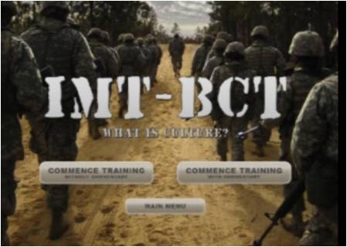
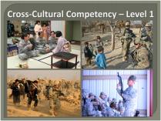
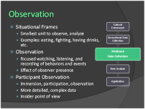
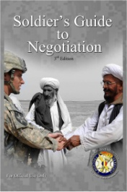
TRADOC Culture Training and Education
Reserve Officers Training Corps
Developed curricula , trained cadets, and mentored them while accompanying cadets to 6 countries for the CULP.
Updated curricula for Warrior Forge 2013
Warrant Officer Career College
8 hour Cross-Cultural Negotiations TSP approved for use in the Warrant Officer Senior Service Education course
Basic Officer Leader Course
Culture Through History IMI product approved for all BOLC-B courses
5 hour Cross-Cultural Competency TSP developed and approved for use by each CoE
Basic Combat Training
IMT-BCT IMI product approved for all Basic Combat Training courses.
Captains Career Course
15 hour Across Cultures block integrated into OC4 common core since 2009
Currently assisting SALT in development of DL products for RC-CCC and OSD.
Cultural Awareness/Cultural Understanding TSPs
Cultural awareness and cultural understanding TSPs
developed and approved by CAC (Mar 12)
Distributed to each CoE to use in WLC, ALC, SLC,
and other relevant courses.
Each CoE was given guidance to modify and
tailor to meet their specific training requirements
Command General Staff Officer College
CGSOC JPME 1 Common Core - 53 hours of education supporting and expanding concepts related to cultural considerations for military plans and operations.
GSOC Advanced Operations Course applies cultural analysis in 108 hours of practical exercise in the planning and execution of military operations (JOPP and MDMP).
Resident CGSOC students have multiple language education opportunities.
4 regional studies programs offer 24 hour core courses combined with focused interdepartmental LREC electives.
Cross-Cultural Negotiation
Negotiations TSPs and training products developed in conjunction with the Air Force Negotiation Center of Excellence
Negotiation guide provided to ILE, CCC, and WOCC; integrated into TCC TTT program for CoEs.

Slide 12
CREL Update
Expected Outcome: A comprehensive and balanced strategy that reflects best practices and is informed by emerging requirements for Foreign Language Proficiency, Regional Expertise & Cultural Capability that supports Army 2020 force structure / mission and “Future Force ARFORGEN
Army Leader Development
Self-Assessment
Current military experiences
Follow-on assignment
Educational background
Learning style
Education
Training
Experience
Assessment
Experiential Learning
Situational Training
Dilemma Exercises
Key Leader Engagements
FTX
FM 6-22 Leadership
Self-awareness
FM 3.0 Operations FM 5.0 The Operations Process FM 7.0 Training for FSO
Army Capstone Concept Capstone Concept for Joint Operations
“What to do”
ALRECS expectations: Emphasis on cultural awareness and understanding; less on language proficiency
Experience
Training
Translate
trained skills
into actions
Skills Development
Embedded in Army / functional tasks
Doctrinal understanding
Elemental language proficiency (Level 0+ / 1)
L
C
Expertise
“How to think”
Advise
Education
Understanding
Apply
Situational Application
Analytical understanding of environment
Critical thinking / problem-solving
Cultural / geo-political / JIIM awareness
Awareness
Learn

Slide 13
Culture, Regional Expertise and Language (CREL)
Measure of Success
CJCSI 3126.01A Proficiency Levels corresponding with ACFLS targeted
proficiency levels/ALDS Leader Attributes
Measure of Effectiveness
Character. Demonstrate interaction and cross-cultural communications skills in order to effectively engage and understand people and their environment.
Presence. Demonstrate communication, influence and negotiation skills essential for leaders to effectively operate in a JIIM environment.
Intellect. Demonstrate a familiarization in a geographic region of current operational significance. In order to achieve this outcome an individual must leverage critical thinking and cognitive skills through organizing information that supports cultural self-awareness
Measure of Performance
Basic proficiency
Demonstrates a basic awareness of concepts and processes
Applies the competency in the simplest situations
Individuals operating at this level of proficiency require close and extensive guidance
Fully proficient
Demonstrates thorough understanding of core concepts and processes
Applies the competency in routine and non-routine situations
Individuals operating at this level of proficiency work independently with minimal guidance and direction
Master
Demonstrates extensive depth and breadth of expertise in advanced concepts and processes
Applies the competency in highly complex and ambiguous situations within and across disciplines
Individuals operating at this level of proficiency serve as an acknowledged authority, advisor, & key resource across the agency

Slide 14
Army Leader Development Strategy
CREL Expectations
 | LT | CPT | MAJ | LTC | COL
Training | Competent in extending influence across cultural boundaries Uses rudimentary foreign language skills Achieved through Rosetta Stone online training | Competent in cross-cultural influence Elementary language proficiency; able to satisfy minimum operational requirements Achieved through self development and home station | Competent coordinator and collaborator across JIIM organizations Elementary language proficiency; can initiate and maintain conversation Achieved through self development and home station | Competent in coordinating across JIIM entities at the national strategic level Elementary language proficiency; can initiate and maintain conversation Achieved through self development and home station | Competent in coordinating across JIIM entities at the geo-political level Elementary language proficiency; can initiate and maintain conversation Achieved through self development and home station
Education | Understands influence of culture and the fundamentals of mission command and what is expected of individual initiative | Develop a “culture of engagement” Achieved through additional academic support Advanced culture, language & information skills Achieved through additional academic support , self development, and home station | Displays judgment and agility in planning tactical operations in JIIM context Achieved through combination of military experience and professional military education | Judgment and innovation in application of design principles to operational art in JIIM context Develops and maintains insight regarding geo-political environment Achieved through additional education | Judgment and innovation in application of design principles to military art at the strategic and geopolitical levels in a JIIM context
Experience | Confident in JIIM capabilities in small unit operations Achieved through multiple tours and additional training | Confident of JIIM capabilities at the operational level Understands how to apply JIIM capabilities | Demonstrates mastery of FSO and ability to leverage JIIM capabilities to achieve operational objectives | Confident operating in a JIIM environment | Applies culture, language, and information thru actions, words and pictures
Desired End-state |  | Confident in cultural and foreign language skills Achieved through combination of experience (deployments), self development, and home station | Confident of cultural, language and information skills Achieved through a combination of experience (deployments), more advanced and consistent self development, and home station | Expert at applying culture, language and information Achieved through additional training and education Capable to serve in a JIIM capacity on a TT, S-TT, IA, Joint or Multi-National Staff | Applies culture, language, and information through interpersonal skills and being culturally astute within other cultures

Slide 15
Army Leader Development Strategy
CREL Expectations
 | WO/CW2 | CW3 | CW4 | CW5
Training | Cultural and Language awareness attained on basic level Achieved through institutional, self development and home station training | Technical/tactical systems competence in FSO in JIIM environment Cultural understanding attained Achieved through additional training Basic language awareness Achieved through additional self development | Rapidly determine innovative, adaptive solutions to address complex, ambiguous problem in a JIIM environment | Understands JIIM complexity across cultures and uncertain coalitions
Education | Enhanced awareness of Cultural, Language, and Information effects on indigenous populations Develops creative and critical thinking skills to solve complex problems | Comprehend systems integration & management role in JIIM environment Develop knowledge of culture, language, and information Achieved through institution, self development and home station | Tactical/Operational art understanding in JIIM environment Culture, language, and information Achieved through institution, self development and home station Attendance at foreign and sister service school exchange program | Complex international, multi-cultural ethical dilemmas Achieved through self development and home station Culture, language, and information skills development Achieved through self development
Experience | Actual and Virtual experience Achieved through deployments, role play scenarios, simulations, virtual reality... | Continued Actual and Virtual experience | Interagency exchange International Officer sponsorship/exchange | Master systems integrator, manager, & advisor at BCT in JIIM operational environment Foreign exchange

Slide 16
Army Leader Development Strategy
CREL Expectations
 | CPL/SGT | SSG | SFC | MSG/1SG | SGM/CSM
Training | Achieved through common core training to obtain TRADOC required Cultural Awareness level | Know how to integrate available JIIM capabilities into mission | Common core training with continuing self development, encouraging additional CA and FL training
Education | Understand the importance of culture and language and their impact on tactical operations | Agile enough to move effectively through other cultures Achieved through institution, self development, and home station | Continue common core training and self development, with academic support, encouraging additional CA and FL training
Experience | Actual and Virtual experience Achieved through deployments, role play scenarios, simulations, virtual reality... | Able to employ JIIM capabilities in support of tactical mission | Continued actual and virtual experience Achieved through deployments, role play scenarios, simulations, virtual reality... |  | Coordinate and synchronize combined arms ops with allied and coalition forces

Slide 17
Example of Captains Career Course (CCC)
Learning Objectives 1 (Character)
Learning Objectives 2 (Presence)
Learning Objective 3 (Intellect)
Assess cultural perspectives and values different from one’s own; compare differences and sensitivities in order to modify one’s behavior, practices and language, and operate in a multi-cultural environment
Cross-cultural skills building
Cultural influence and military operations
ISD briefs “Know Your World”
Apply cross-cultural communication skills
Army 360 Cultural Trainer
Develop communication skills that enable effective cross-cultural persuasion, negotiation, conflict resolution or influence
Local University media training
Cross-cultural negotiations
Apply communications skills during cross-cultural negotiations
Role-play exercises
Key Leader Engagement exercise
Develop confidence in learning and applying language skills
Introduction to a language through Rapport/Headstart 2 software
Additional language training
Apply culturally relevant terms, factors, concepts and regional information in the development of mission plans and orders
Insurgency overview and theory
Pattern and social network analysis and PE
COIN IPB and planning
Assess and describe the effect that culture has on military operations specific to countries or regions of operational significance to the US
SWOT analysis country brief
Writing requirement: Analytical paper
Analytical paper presentation / discussion
CoE CFLP Lecture Series
Professional reading program
Prescriptive [P]
Reinforced / Integrated [R/I]
Professional Development [PD] – optional

Slide 18
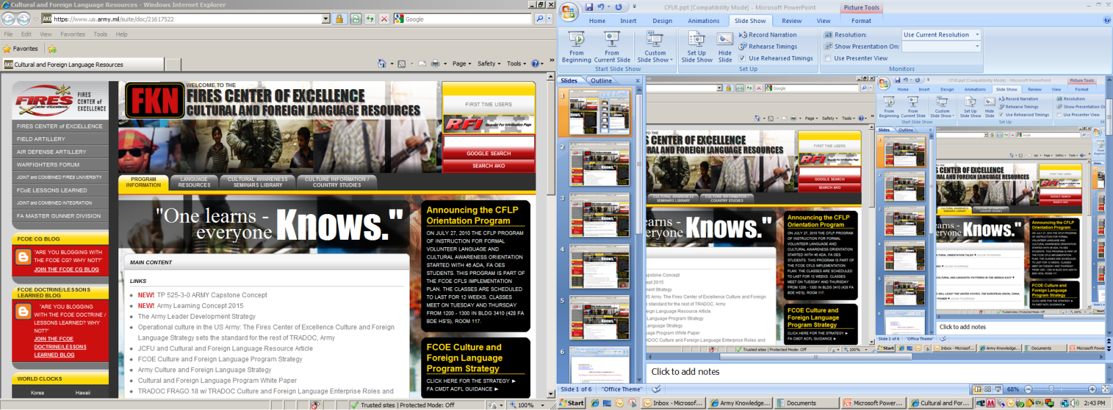
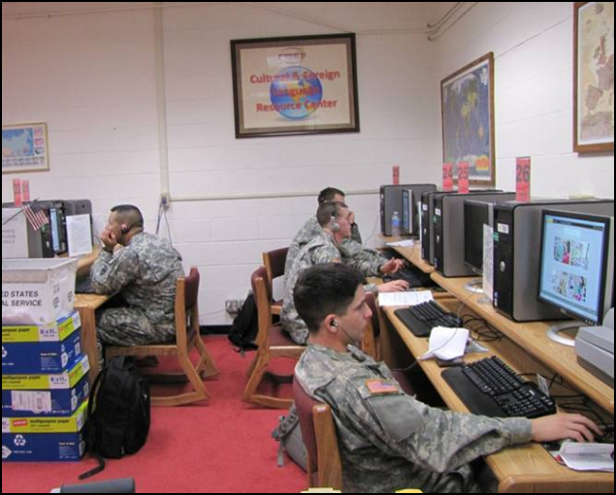
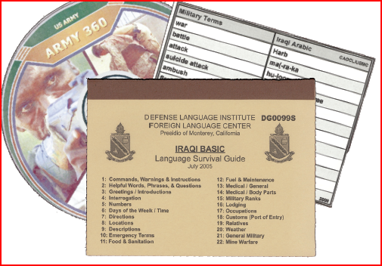
Resource Examples
Websites
Online Lesson Plans
Resource Centers
Training Packages
Dr. Ibrahimov

Slide 19
Way Ahead
Governance Refinement
Per CAC CG guidance-ACFLS/ALRECS Implementation-continues
Feb2016- Brief at the next APLDF/CDOT/ALCC Approval from CG CAC/TRADOC Commander the way ahead
Continue coordinating and synchronizing T&E support for CREL/RAF /7th WFF/CNA-ongoing
Monitor/assess through ALCC process as the ACFLS /ALRECS education implementation governance- continuous _
Evolving process with multiple stakeholders
Coordinating TRADOC CREL stakeholder support for ACRELS campaign plan-ongoing
Developing QAO standard to evaluate CoE compliance with ALCC approved GLOs- ongoing
Established/ continue developing a comprehensive website linked to ATN as a single entry point for CREL capabilities-ongoing
Partnership with universities/DOD conferences/seminars/forums in support of CREL mission-ongoing
Jun–July 2015-Visit to CoEs/Schools to assess ACFLS/ALRECS implementation
November 2014-CAC LRECMO staffed CREL Strategy across TRADOC for HQDA
September-November 2014-Assigning CREL POCs at CoEs/Schools and assessment of Culture in PME across TRADOC
Conducted ALCC GLOs gap analysis based on CJSI 3126.01A LREC Competencies
)
= Coordination
= Decision
= Major Action
September 2014-Supported OSD/DLNSEO/KU sponsored Language Training Center at CGSC/Conducting an assessment to expand its capabilities
August – Briefed CREL implementation at the Training Integration Forum (TIF)
August 2014-Established LRECMO CREL WG
Working
Complete
August 2014-Identified FRAGO key tasks to CAC CFL Implementation OPORD /CFL Implementation Guidance
19

