Slide 1
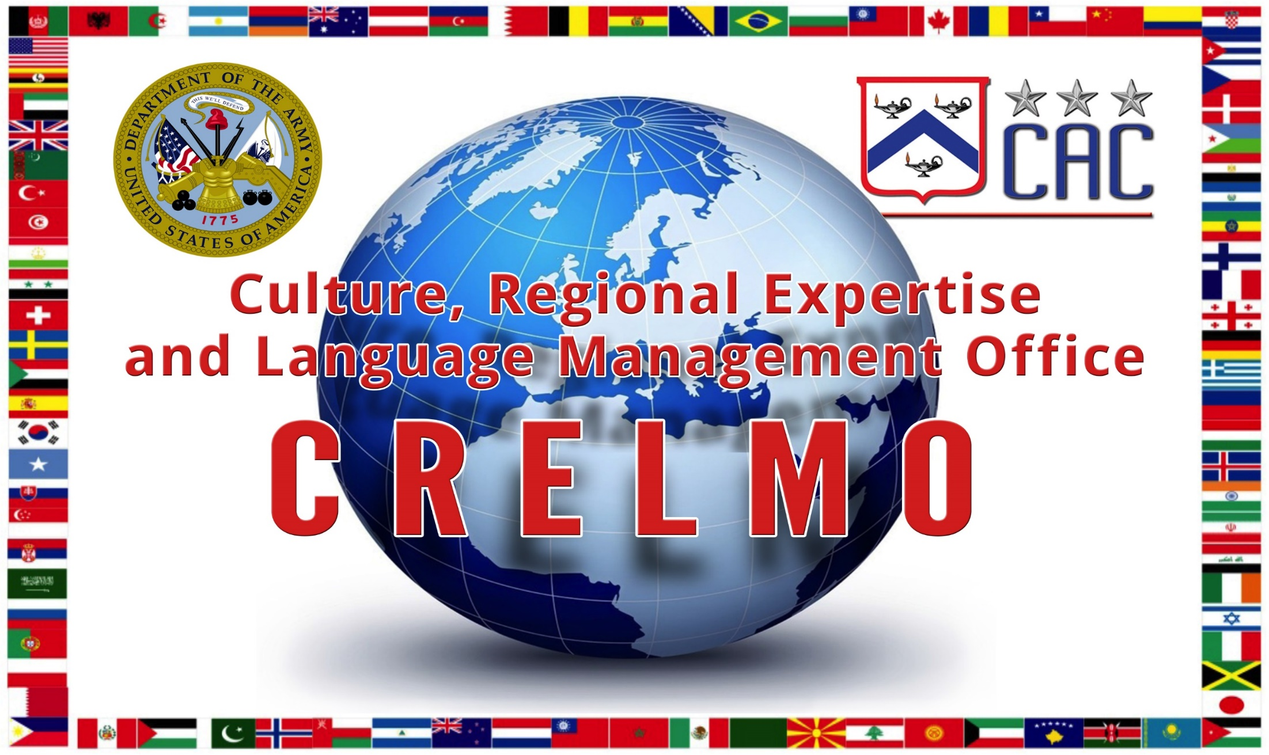
30 April 2018

Slide 2
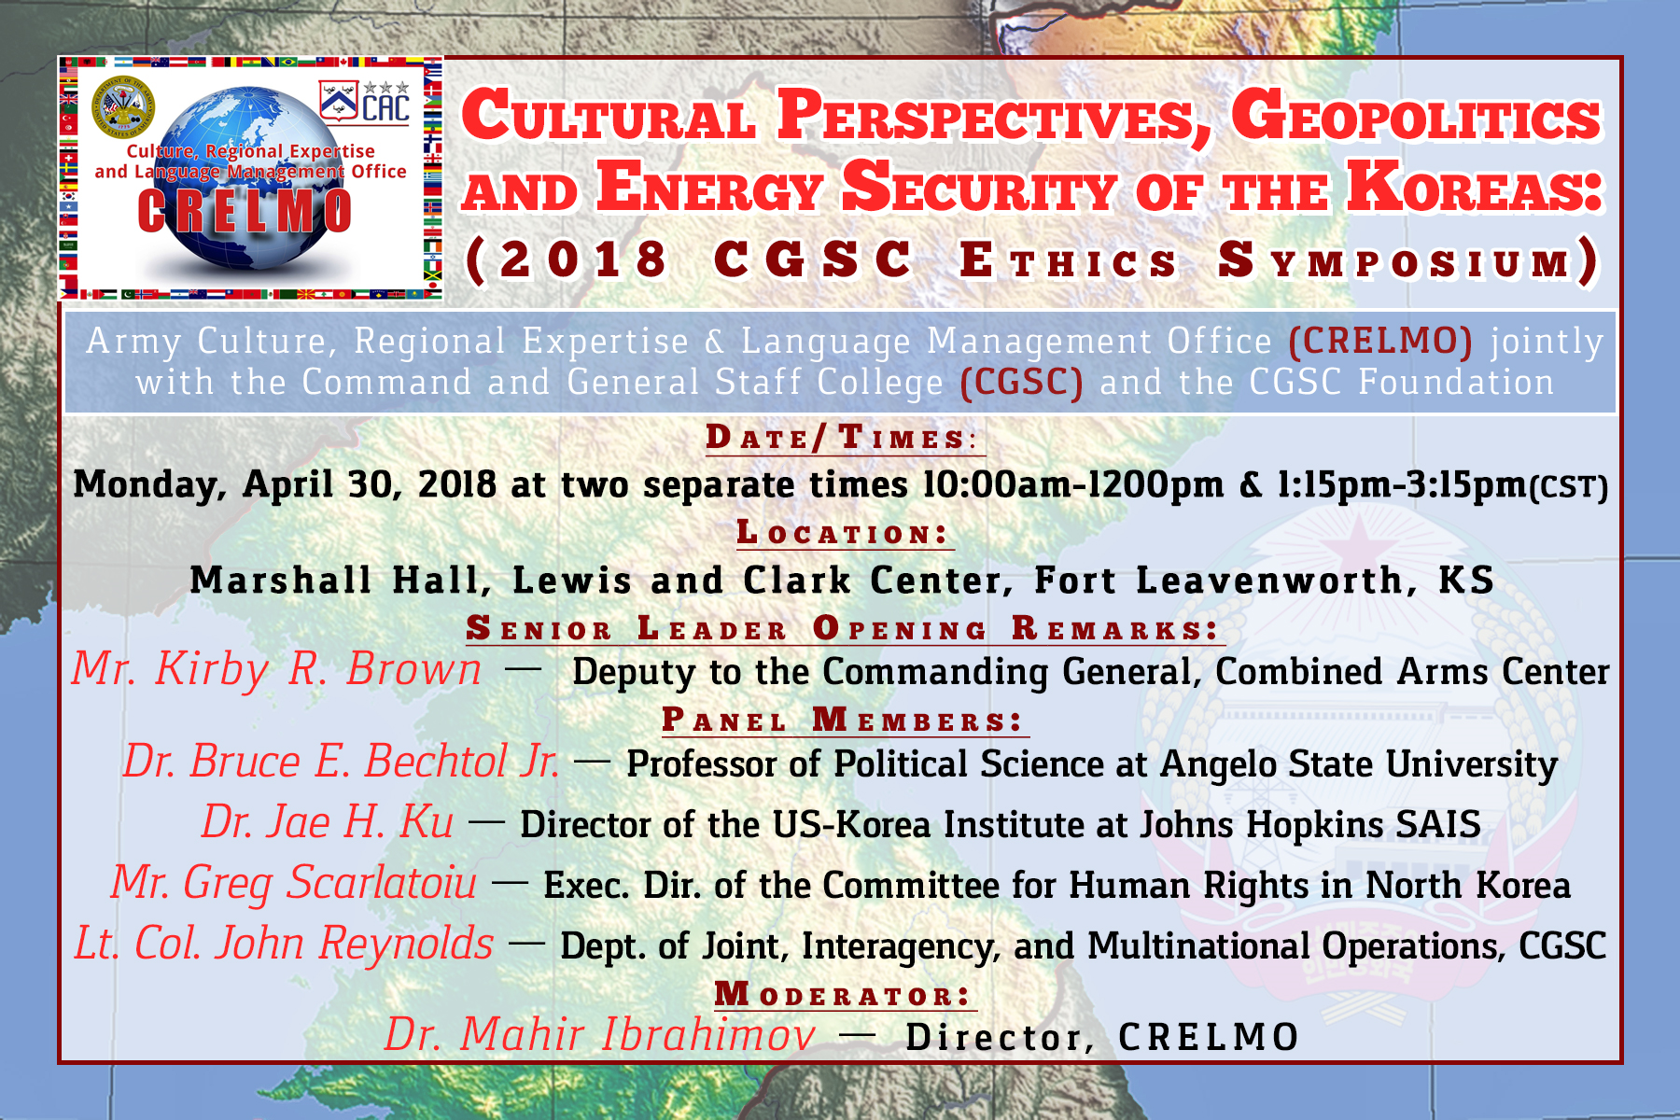

Slide 3
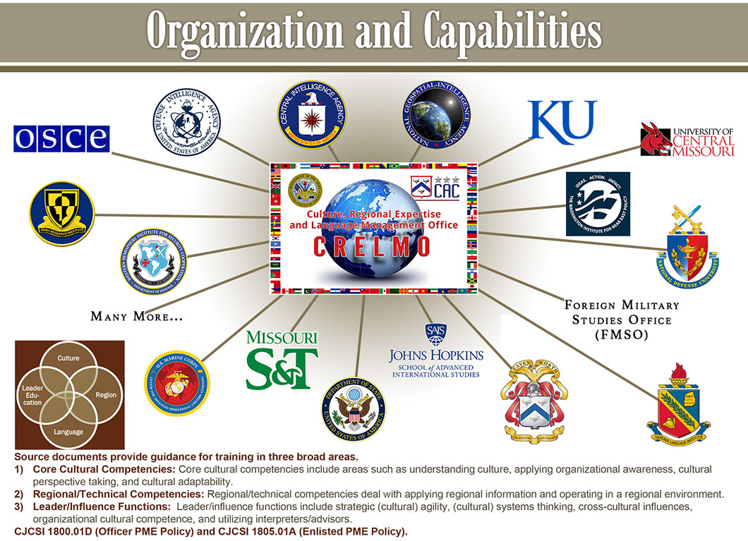

Slide 4
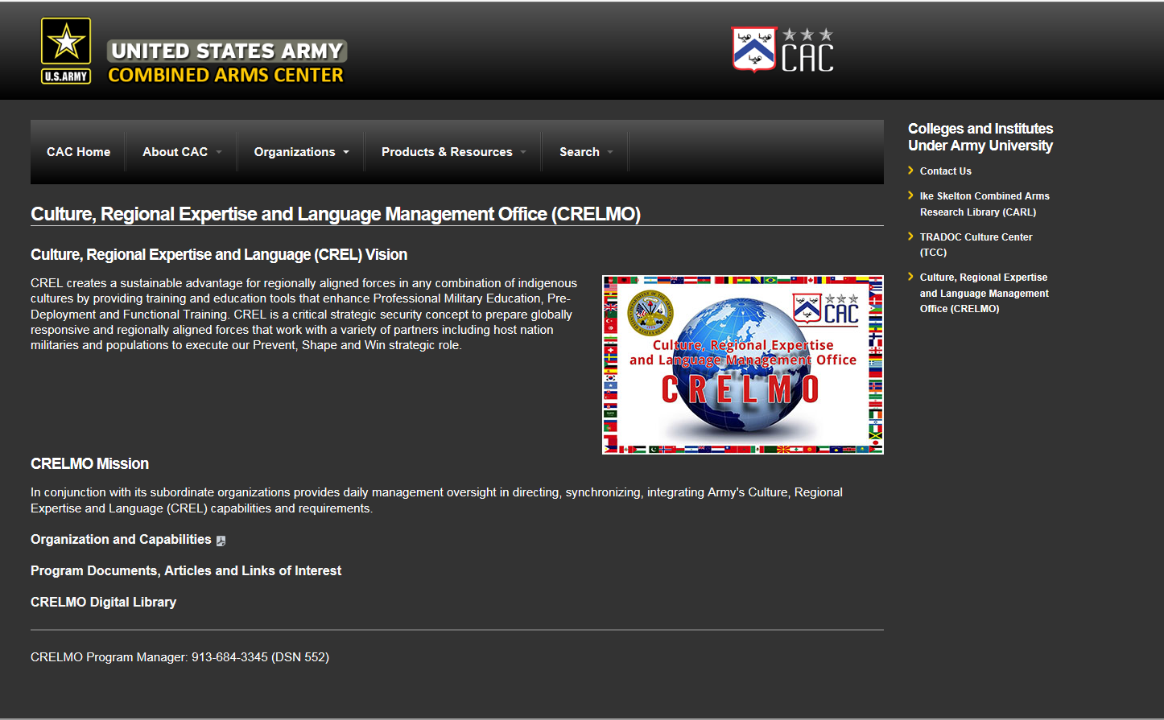

Slide 5
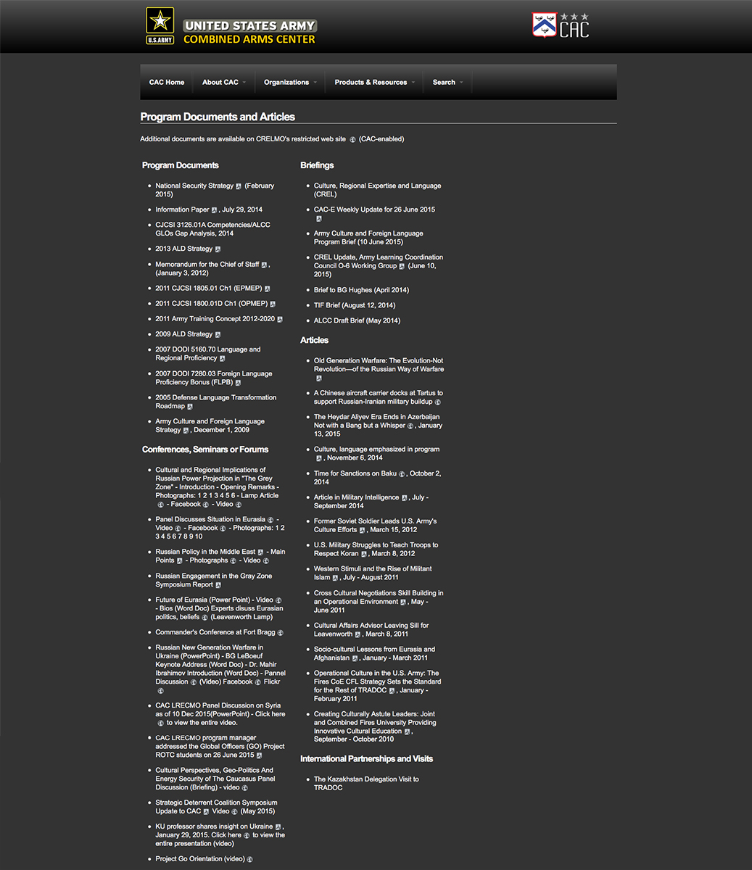
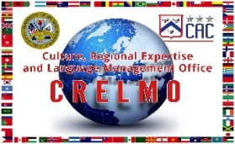
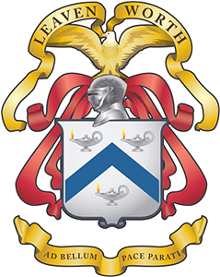
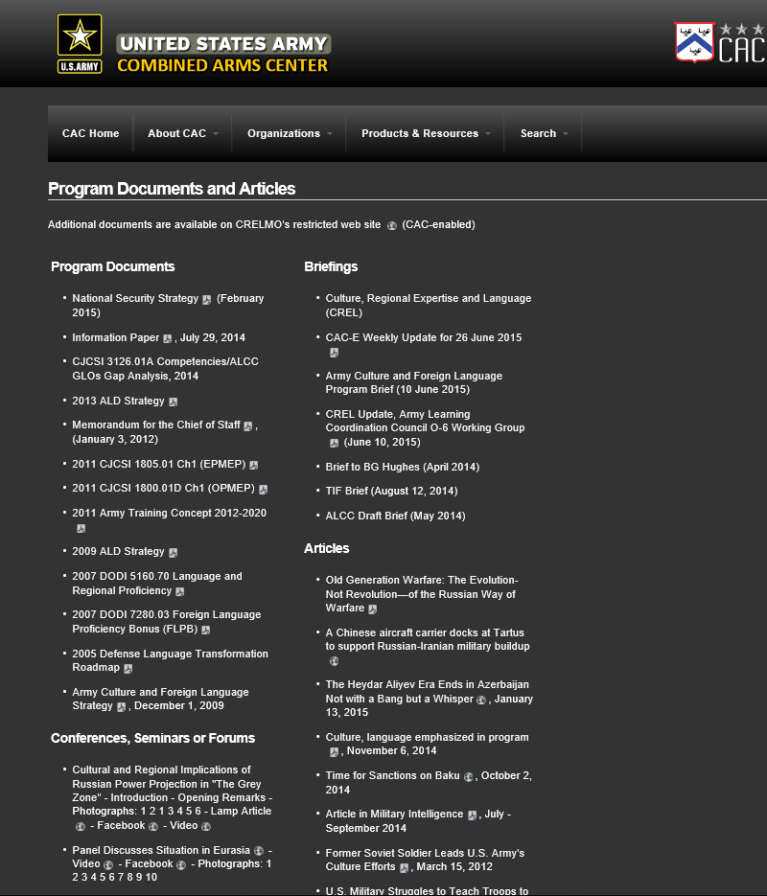

Slide 6
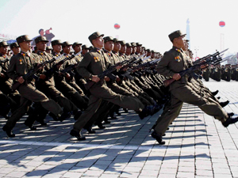
The North Korean Threat to International Security: Government Infrastructure and Proliferation
Presented by Dr. Bruce E. Bechtol Jr.
Angelo State University

Slide 7
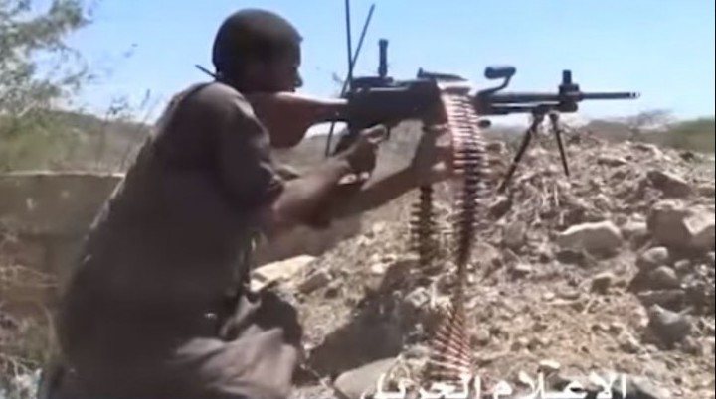
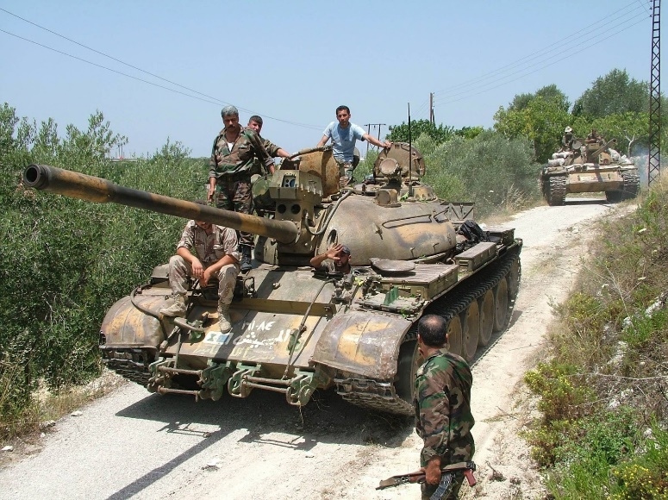
North Korea Threatens U.S. Interests in Middle East, Africa, elsewhere – Through Proliferation
NK proliferation to Syria
- Nuclear, Chemical, Missiles, Conventional weapons
NK proliferation to Iran
- Nuclear, Missiles, conventional weapons (Iran pays for much of Syria, terrorist group armaments)
Conventional weapons
NK also sells conventional weapons all over the African Continent, and elsewhere

Slide 8
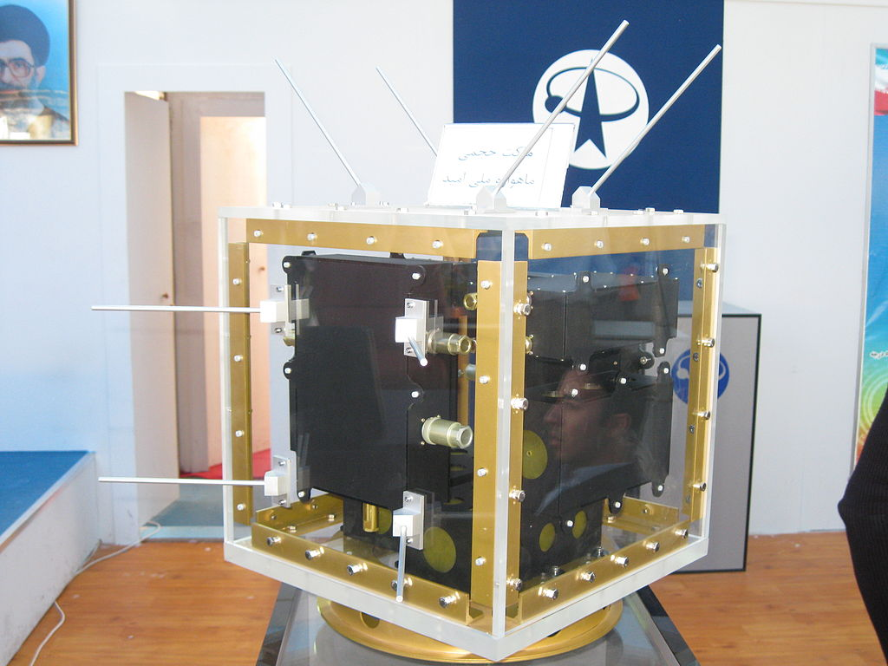
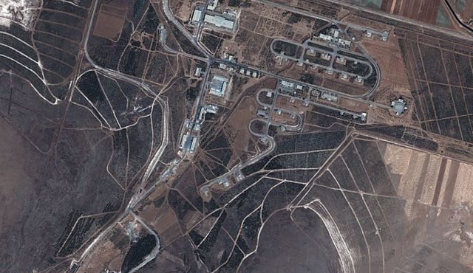
Key North Korean Proliferation Activities
WMD and the platforms to carry it (ballistic missiles)
Conventional Weapons sales
Refurbishment of Soviet era weapons for countries that still use them
Technical and Military assistance and advising.
Key change in proliferation since the early 1990s
- Building facilities to assemble weapons (including missiles)
- Means whole systems don’t have to be proliferated, makes
violating sanctions far easier

Slide 9
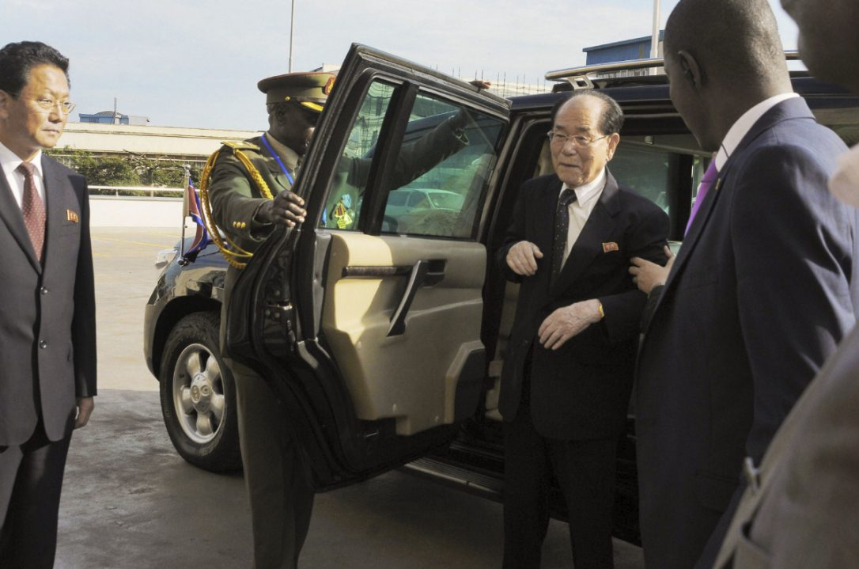
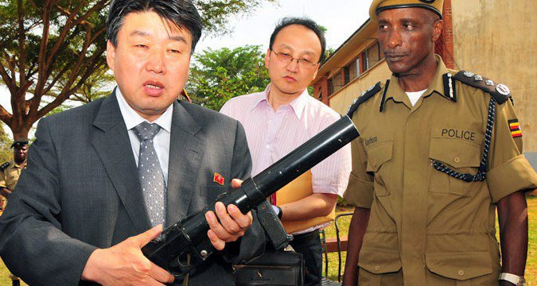
African Nations DPRK Proliferated to in Recent Years (most is ongoing)
Egypt
Namibia
Sudan
Uganda
Angola
Eritrea
Ethiopia
Zimbabwe
Mozambique
Tanzania
DRC Congo
Madagascar

Slide 10
Kim’s Power Circle

Slide 11
What Makes NKPA C2 Unique?
Note: State Affairs Commission has now replaced NDC as highest decision making body in DPRK

Slide 12
“North Korea’s Anti-American Propaganda and the Potential for Popular Resistance During and After the Military Conflict”
2018 CGSC Ethics Symposium
JJae H. Ku
USKI, SAIS of JHU
April 30, 2018
Apri30A,

Slide 13
Popular Resistance and Counter Insurgency
Some Factors
Intense Anti-American Sentiments
Xenophobia
Clear and Focused Ideology: Juche (Self Reliance), Suryong (Supreme Leader), and Songun (Military First)
Population is well trained and armed

Slide 14
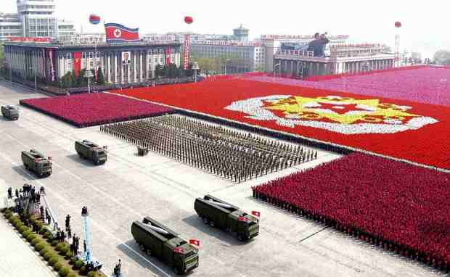
Images North Korea Projects
Google Images

Slide 15
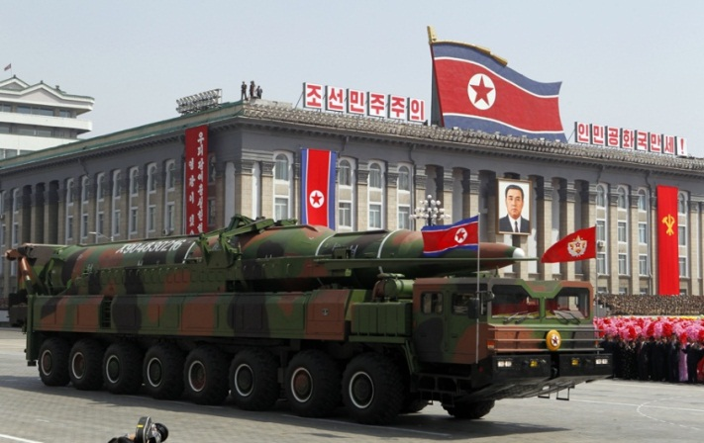
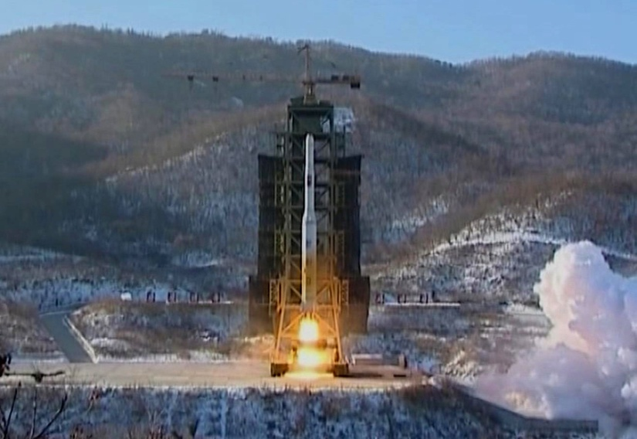
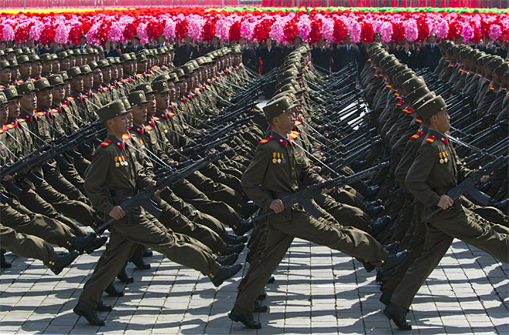
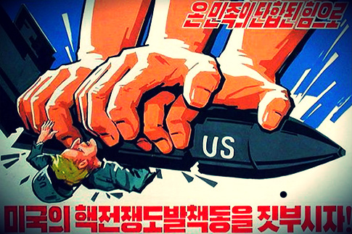
Google Images

Slide 16
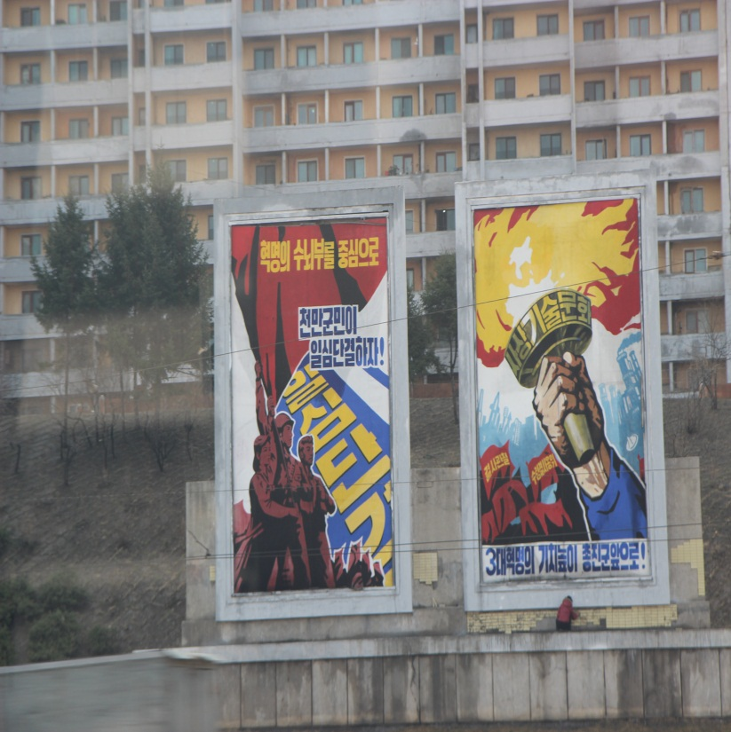
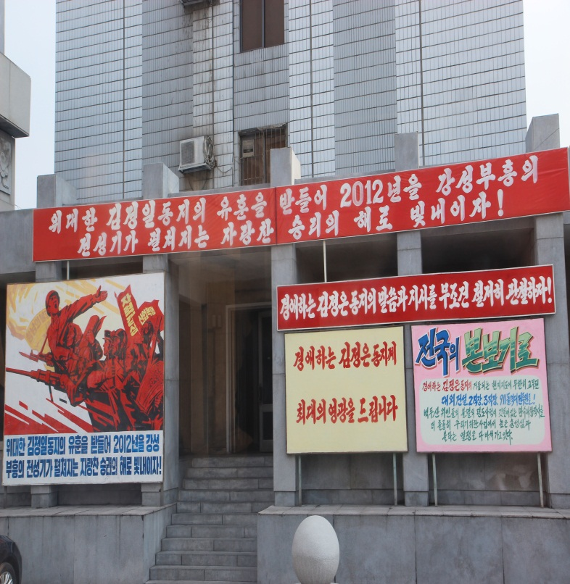
Pyongyang, April 2012

Slide 17
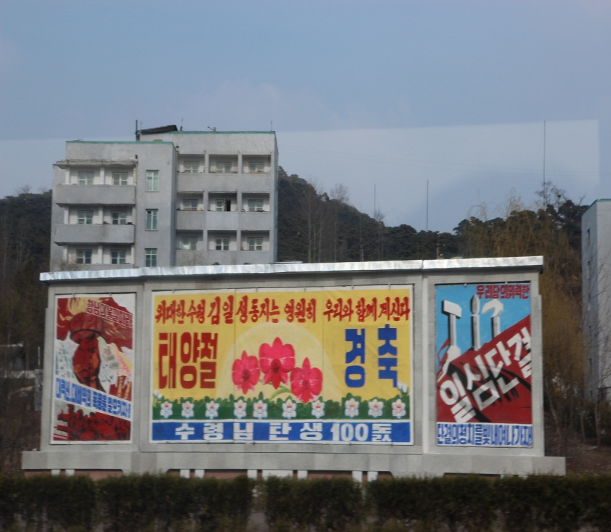
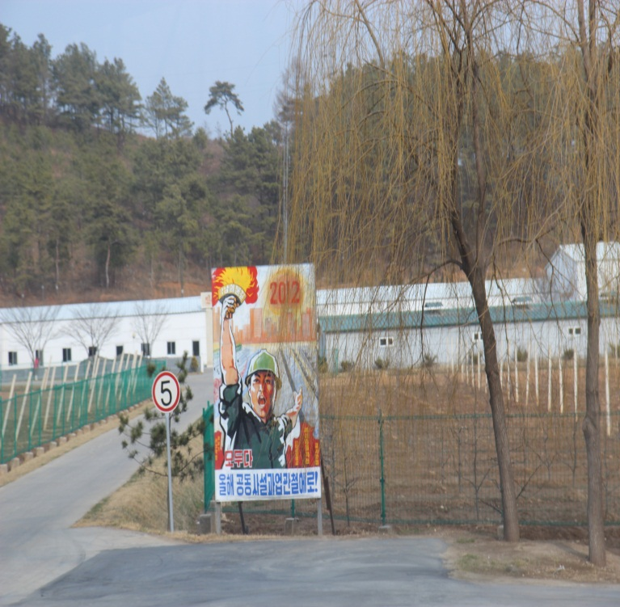
Pyongyang, April 2012

Slide 18
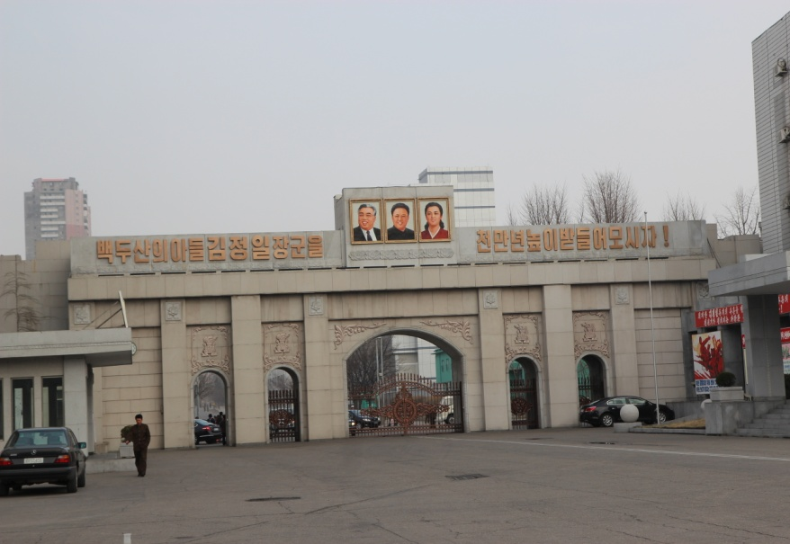
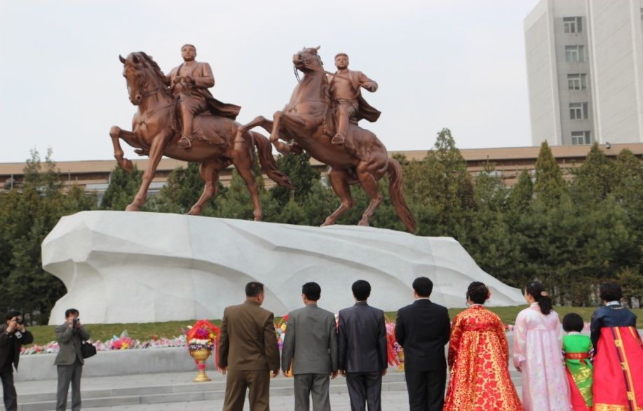
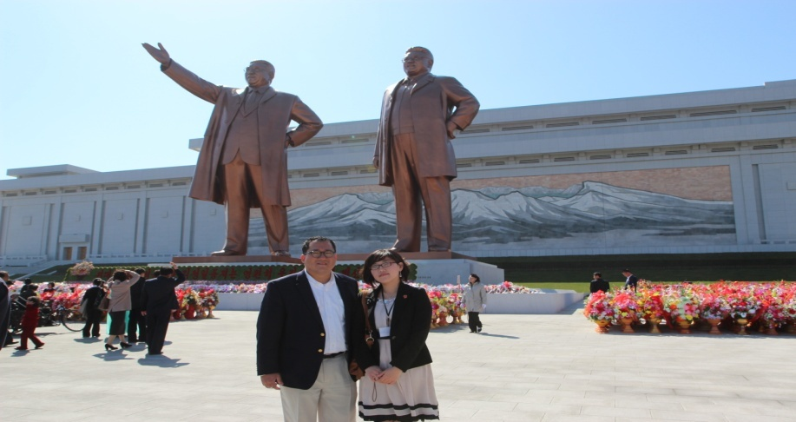
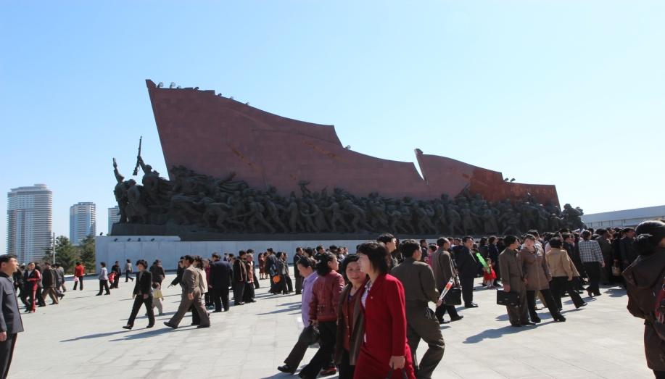

Slide 19
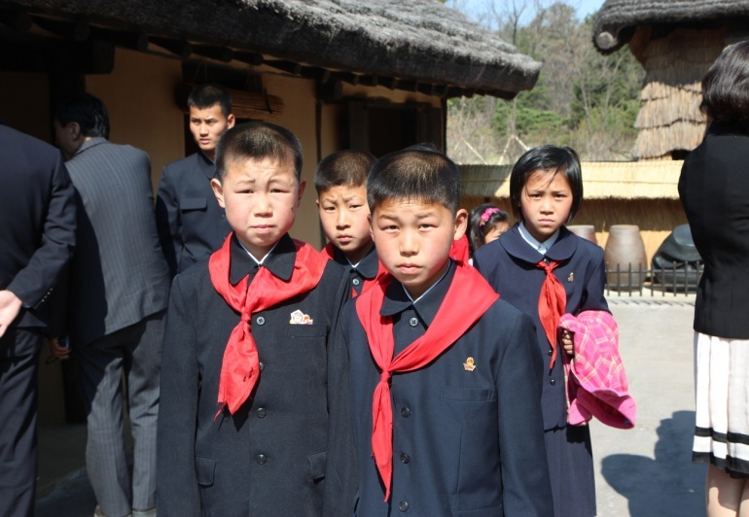
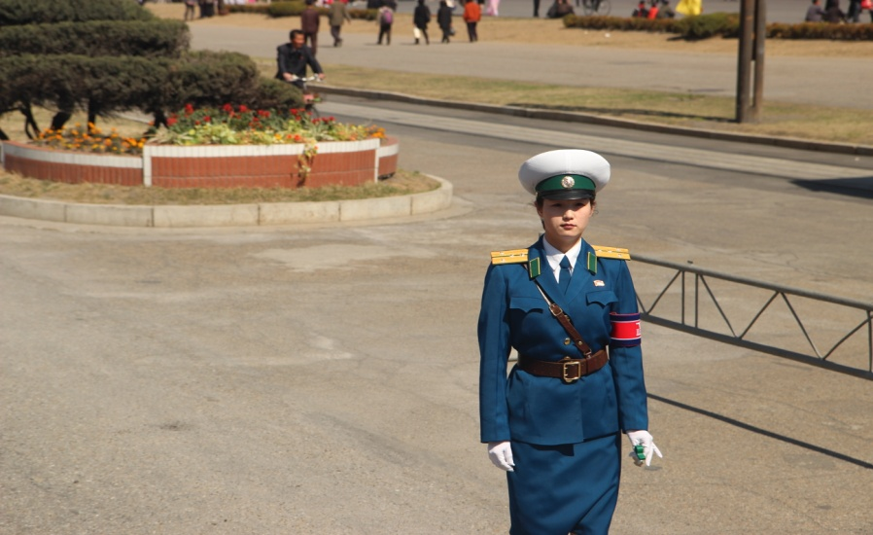
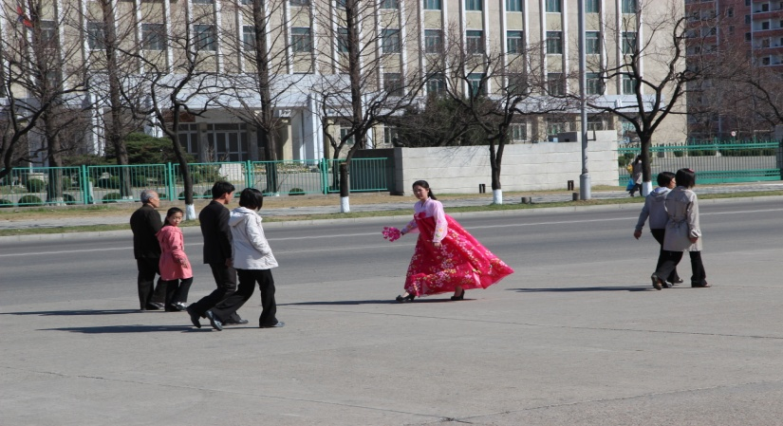
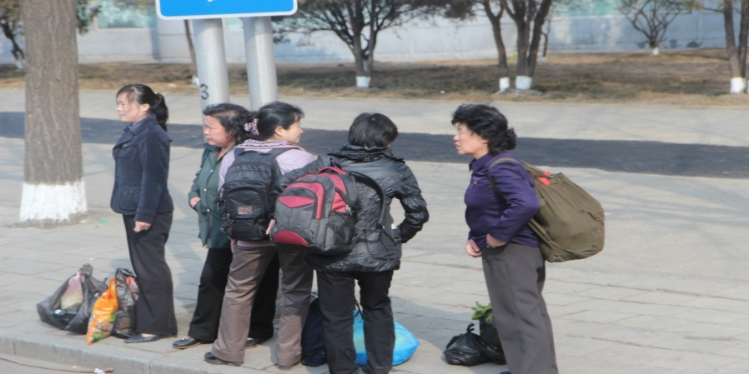

Slide 20
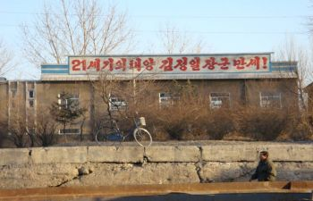
The Reality of North Korea

Slide 21
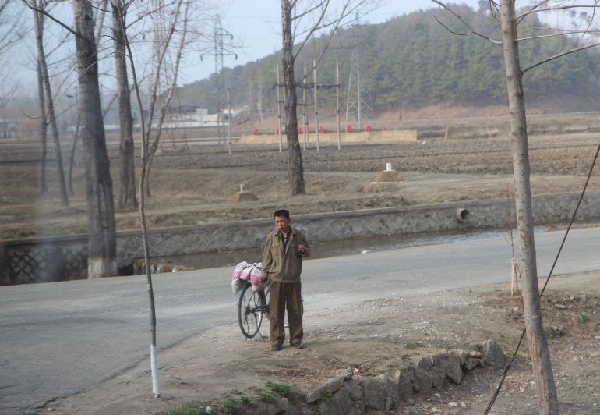
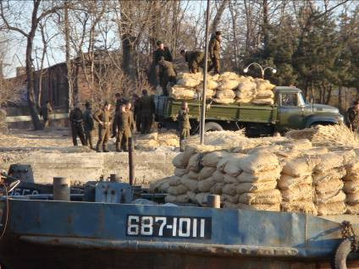
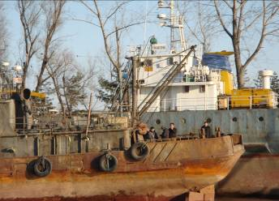

Slide 22
Factors of Resistance Revisited
Anti-American sentiments and xenophobia not sufficient to overcome collective action problem—state coercion responsible for the articulation of anti-American and xenophobic statements
Atomized Society
  Very little pre-existing networks or organizations that can organize a military resistance except for remnants of the military
  Lack of elite control system will work against counter insurgency
Arms for the militants will be limited UNLESS Chinese intervention sustains the counter insurgency
Rational populace—unlikely to provide support for counter insurgency

Slide 23
Conclusion
Popular Resistance and Counter Insurgency will be limited in scope and duration
Sustenance of any kind of armed resistance will depend on third party intervention

Slide 24
The End
Jae H. Ku, Ph.D.
Director
U.S.-Korea Institute
SAIS, Johns Hopkins University
(202- 663-5712)
April 30, 2018

Slide 25
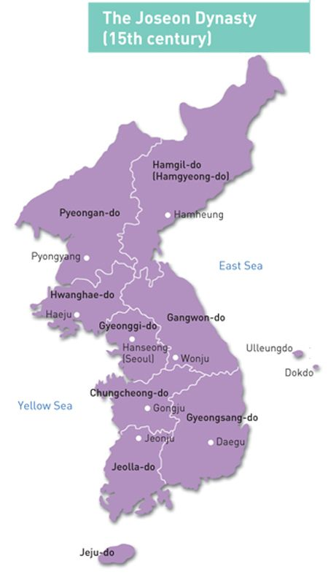
Human Security in North Korea and its Impact on the Korean peninsula.
Presented by Mr. Greg Scarlatoiu, Executive Director of the Committee for Human Rights in North Korea (HRNK)

Slide 26
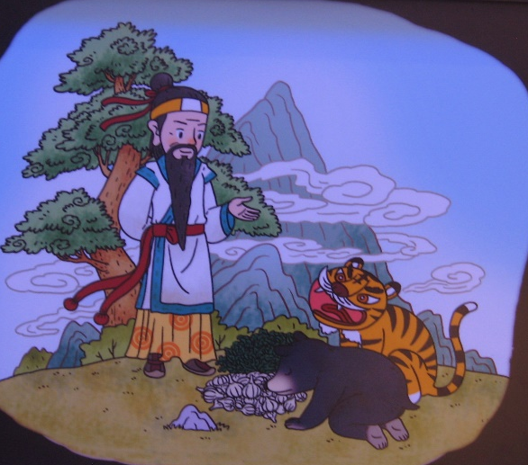
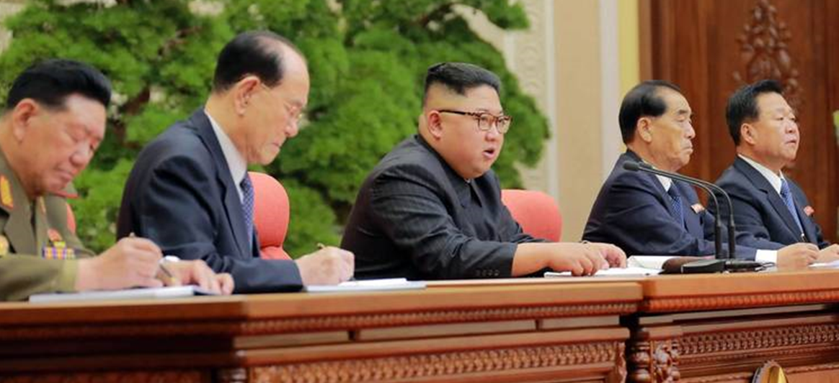
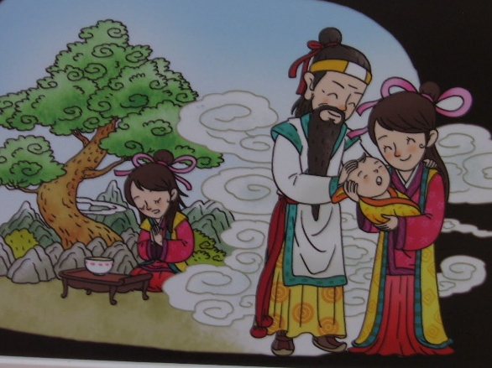
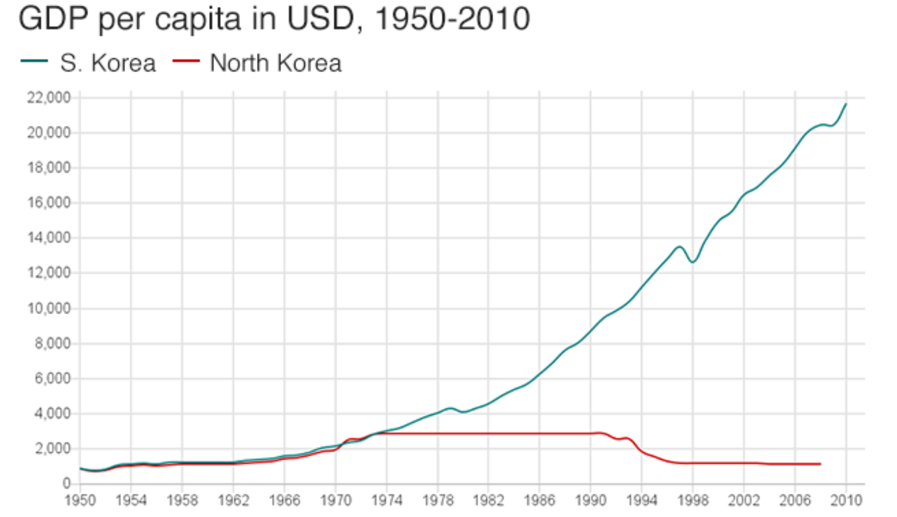
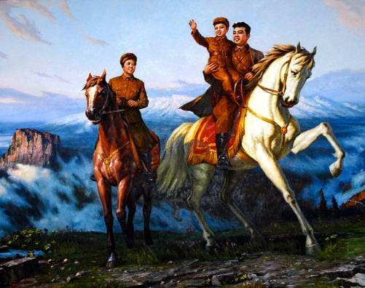
Historical – Economic – Sociocultural
Factors in North Korea
LTC John Reynolds

Slide 27
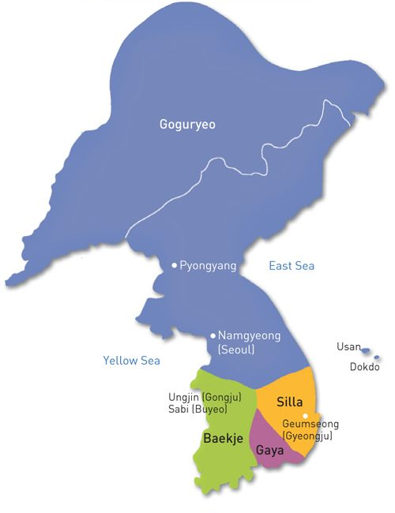
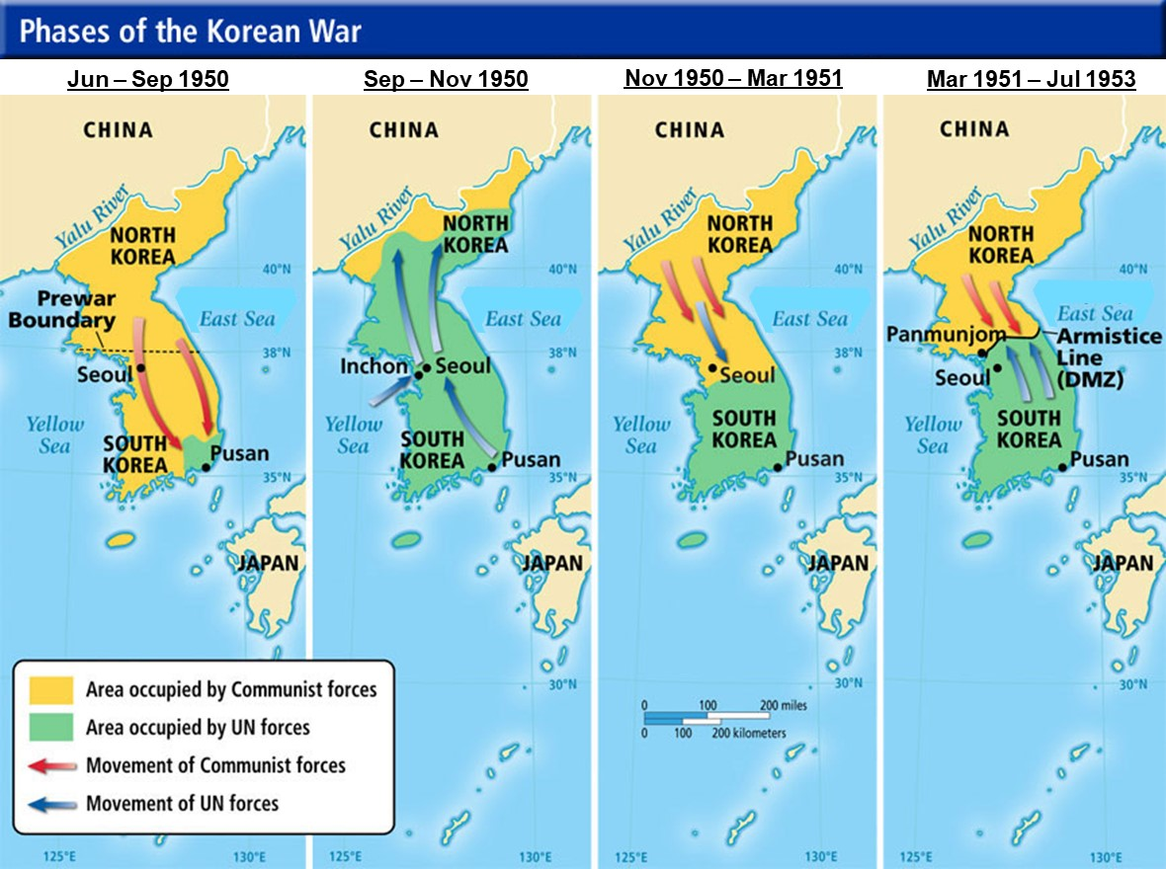
North Korean Historical Considerations
“Dangun Myth” / Gojoseon Kingdom (2333 BC)
Chinese Commanderies (108 BC – 676 AD)
Three Kingdoms (Silla/Gaya, Baekje, Goguryo)
Goryeo Dynasty (918 – 1392)
Chosun Dynasty (1392 – 1897)
Korean Empire (1897 – 1910)
Japanese Colonial Rule (1910 – 1945)
Soviet-occupied North / US-occupied South (1945 – 1948)
Recent History (1953 – Present)
Land & Naval skirmishes, Provocations, Assassination Attempts
North Korea’s History of Broken Promises (1985 – 2005)
South Korea’s Sunshine Policy (1998 – 2008)
Since 2006, North Korea has conducted six nuclear tests and over 100 missile launches (violations of UN resolutions)
Exponential increases to nuclear and missile testing since 2011, when Kim, Jong-un became the leader
North Korea seems to be learning from recent geopolitical events affecting similar regimes like Libya and Iran

Slide 28
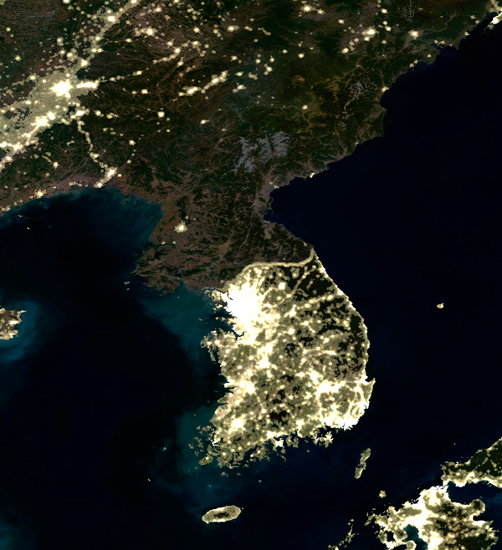
North Korean Economy
Central government-regulated economy, controlled by the regime elites (isolated from global market forces)
Industrial-based economy (factories and equipment suffer from almost nonexistent investment and modernization)
Excessive military / defense spending 15-16% of GDP (nuclear / missile programs)
China: North Korea’s only real trading partner / provider of aid
Corruption, bribery, extreme poverty, underground markets
Latest UN sanctions will further cripple the failing North Korean economy

Slide 29
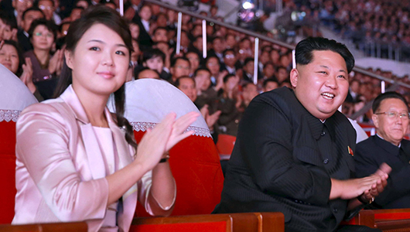
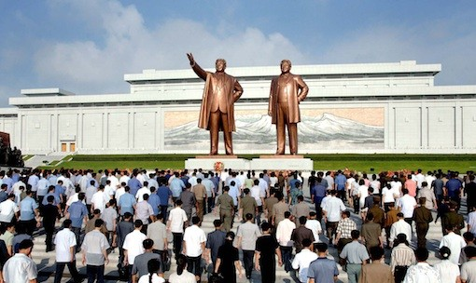
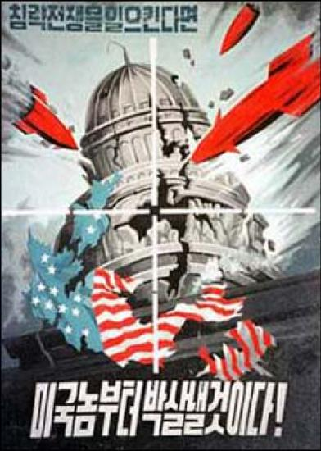
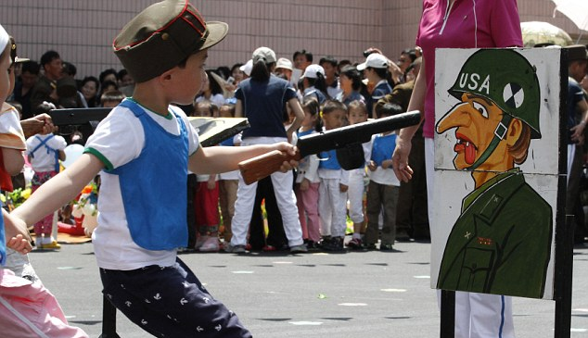
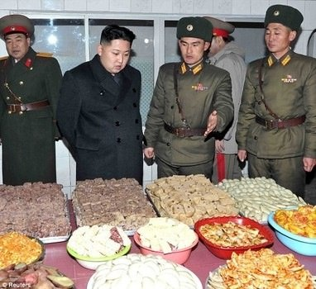



North Korean Sociocultural Factors
Juche Ideology
Political Classifications
Set of principles used by the Kim Regime (Kim Il-sung, Kim Jong-il, Kim Jong-un)
to indoctrinate its people and justify its policies,
decisions, totalitarian rule, and isolationism
Emphasizes nationalism, political independence, self-sufficient economy, and self-reliance in defense to achieve a “North Korean style socialism”
Man is the master of everything, but for the masses to be successful they require a Supreme Leader
Further subdivided into over 50 sub-classes based on status of ancestors (wealth, land owner, profession, religion, government leader, political beliefs)

Slide 30
Questions/Answers/Comments

Slide 31


Contact:
Dr. Mahir Ibrahimov, Director, CREL Management Office (CRELMO)
Fort Leavenworth, KS 66027-2300
Phone: (913) 684-3345
DSN: 552-3345
CRELMO website: http://usacac.army.mil/organizations/cace/lrec
ATN: https://atn.army.mil/dsp_template.aspx?dpID=102
https://atn.army.mil
YouTube link: https://www.youtube.com/playlist?list=PLkGvnfy3IadNRMPT-sNHpAsz8a3npWBH8

