Slide 1
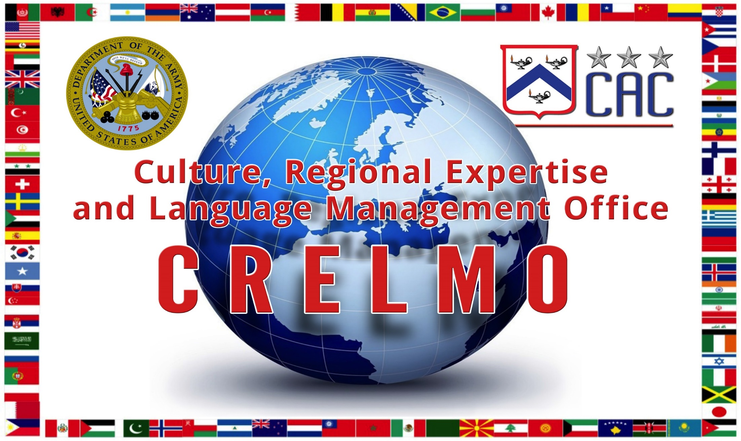
28 Sep 2018

Slide 2
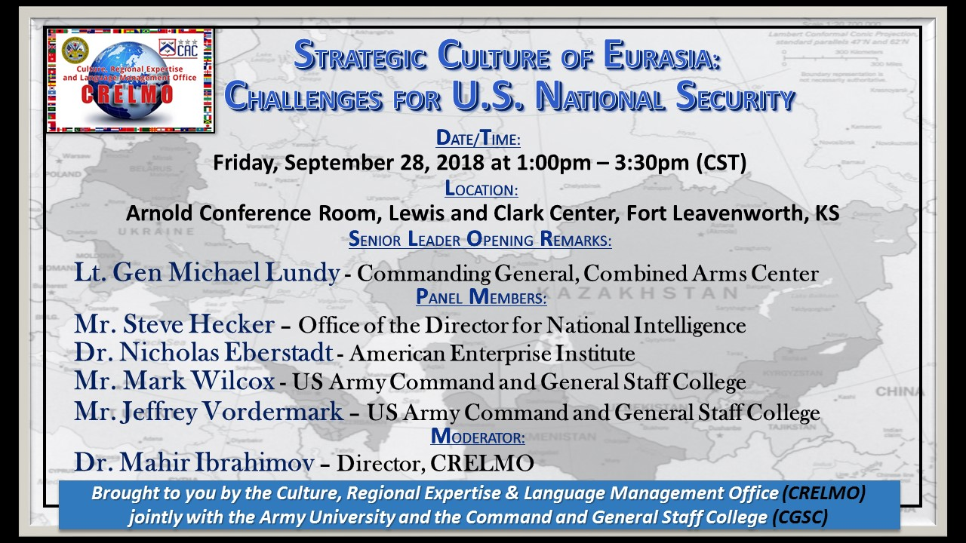

Slide 3
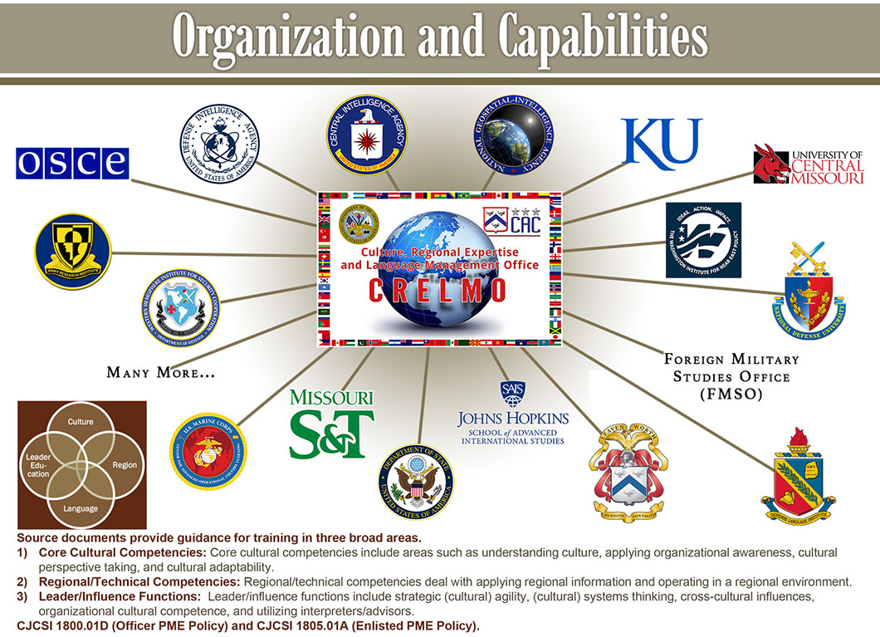

Slide 4
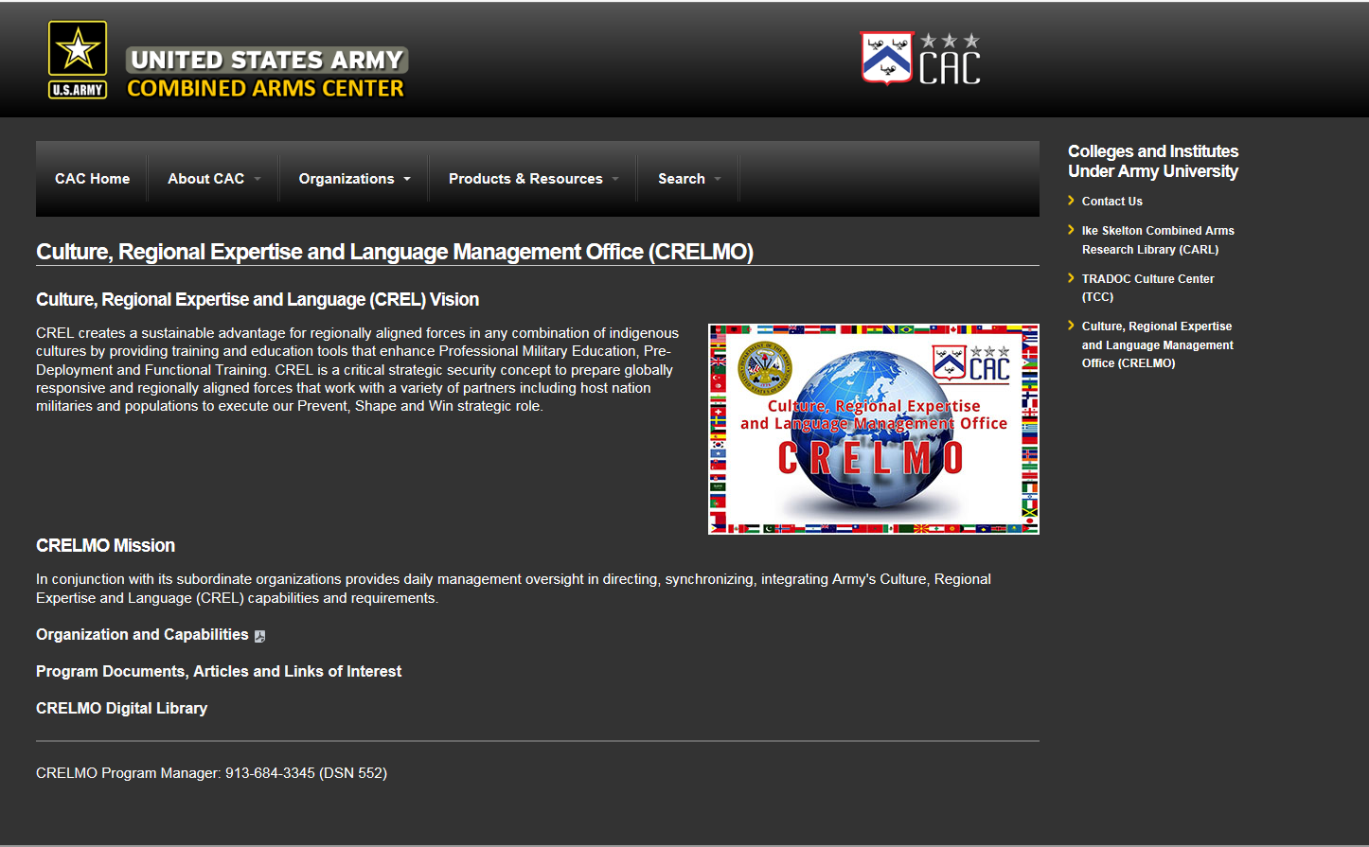

Slide 5
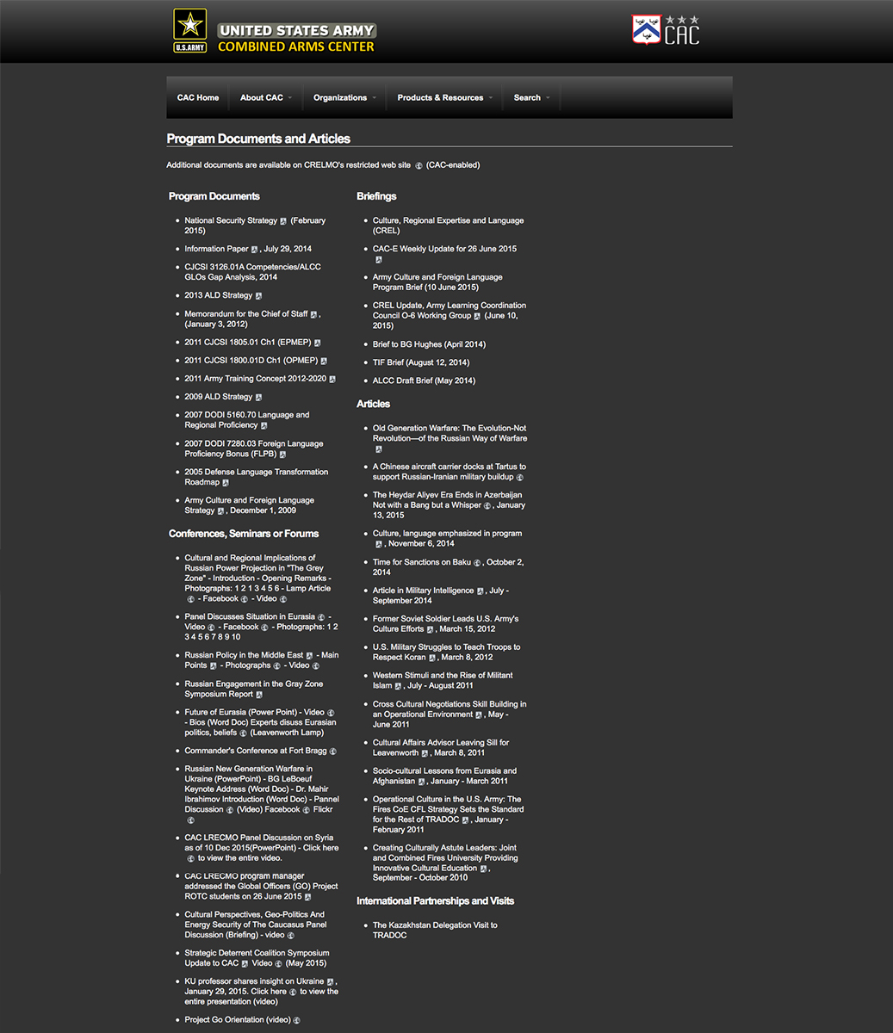
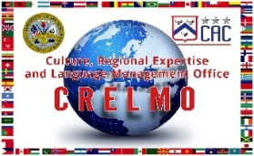

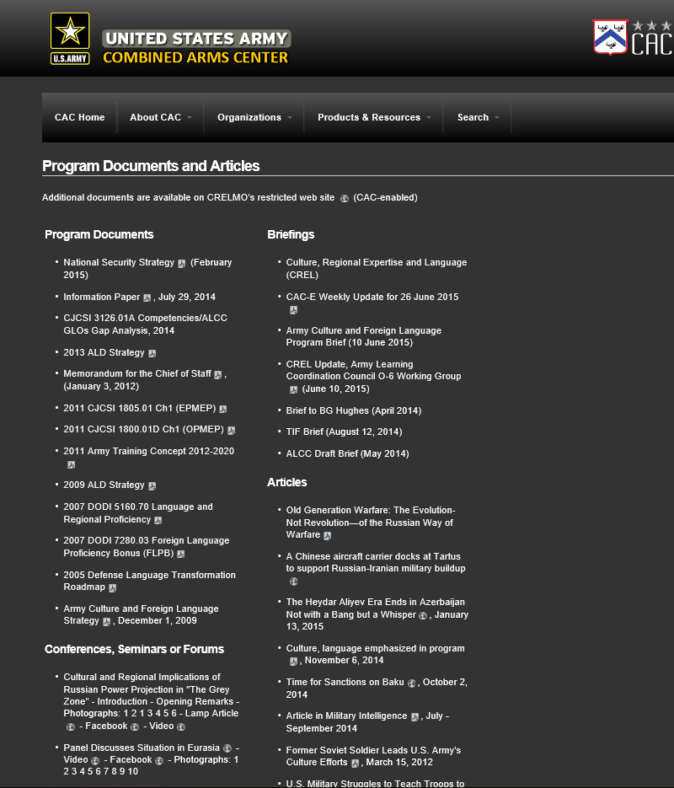

Slide 6


STRATEGIC CULTURE OF IRAN:
OFFICE OF THE DIRECTOR OF NATIONAL INTELLIGENCE
Challenges for US National Security
Steven Hecker
National Intelligence Officer for Iran
28 September 2018

Slide 7
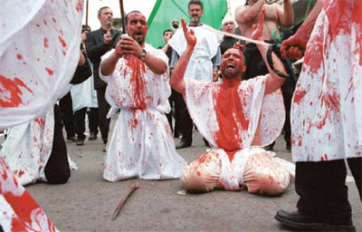
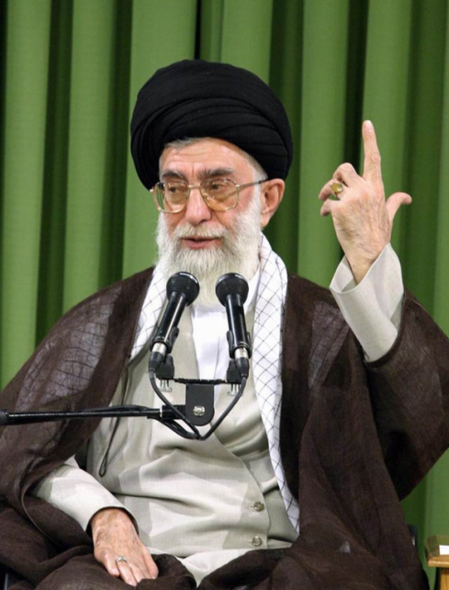
Strategic Culture
Iranian Identity: Persian Nationalism and Shiism
  Glorious history of military conquest, cultural and other achievements
  Large population, geography, resources relative to its neighbors in Arab World
  Ashura Culture and “Shaheeds”
IRI Resistance Doctrine and Revolutionary Ideology
  Defender of the “oppressed” against Western “arrogance”
  Kissinger: A Cause
  Reverse Western dominance and “arrogance” over Muslims
Expediency (“Maslahat-e Nizam”)
  Flexibility and regime survival
  Kissinger: A Nation
Imposed War/Sacred Defense
  Self sufficiency
  Mistrust of international community

Slide 8
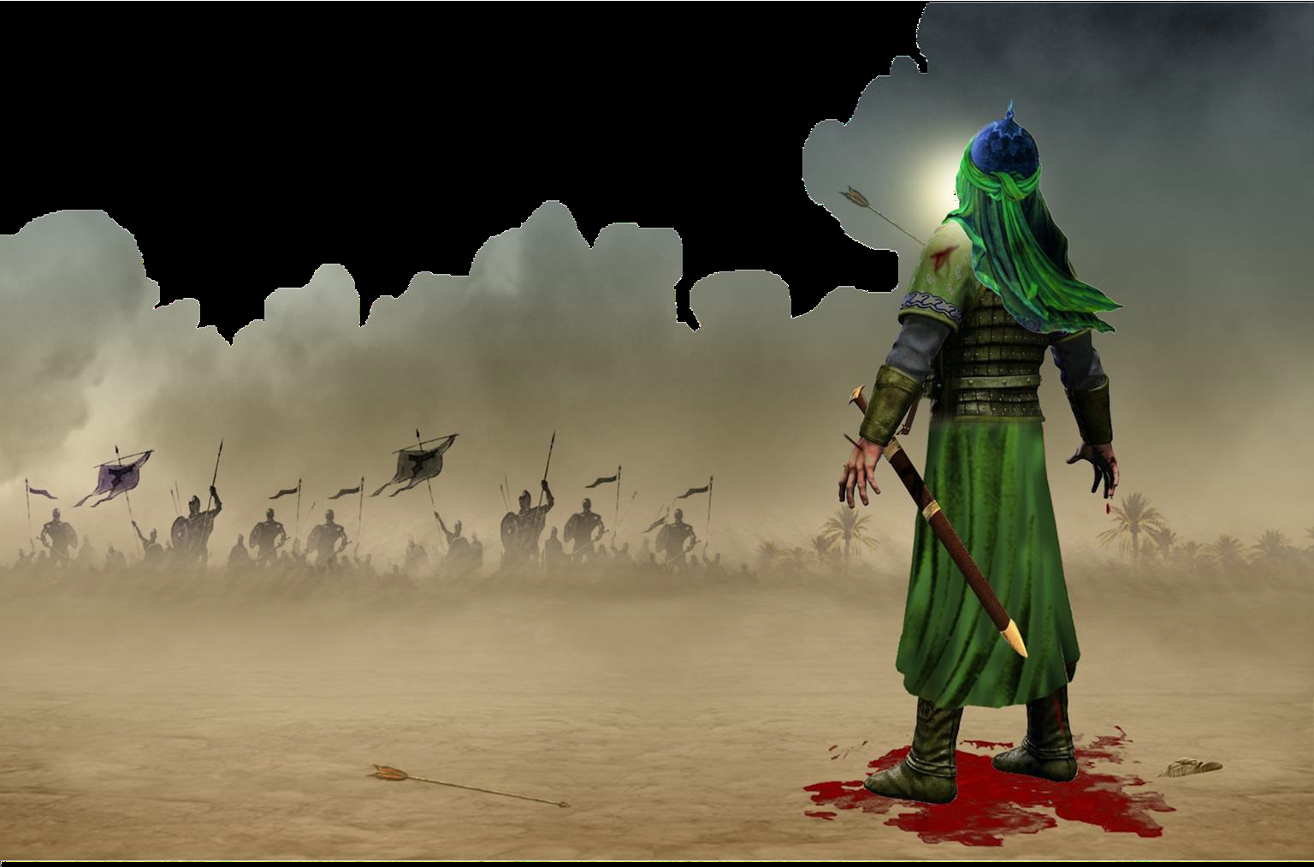
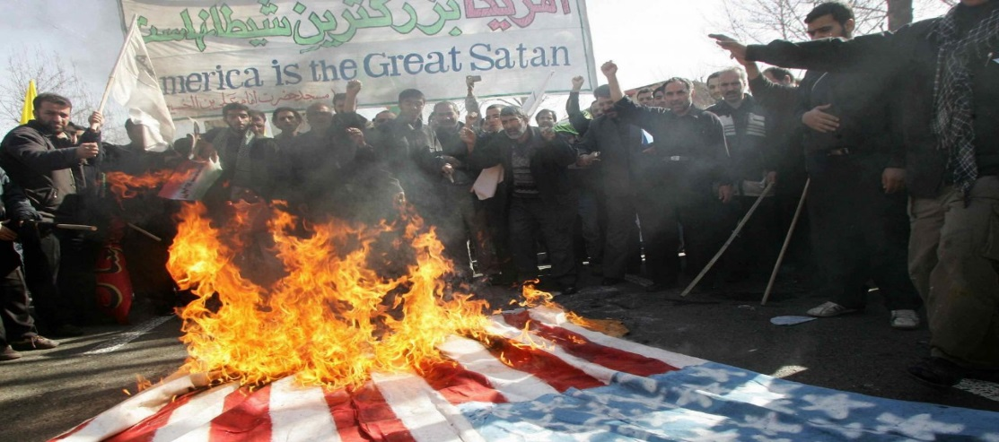
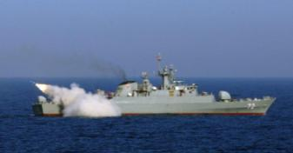
Challenges
Mistrust and Hostility Towards United States
  Zero-Sum Game
  “Axis of Resistance”
“Cultural War”
  Conspiracies about US influence and control over Iranian reformers
Resistance Doctrine could lead to escalation of military conflict
  Resistance = Victory
“Every day is Ashura, every place is Karbala”
--Ayatollah Khomeini

Slide 9
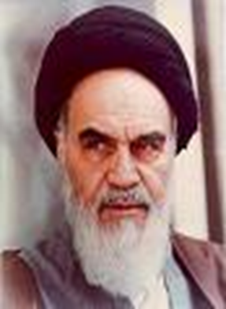

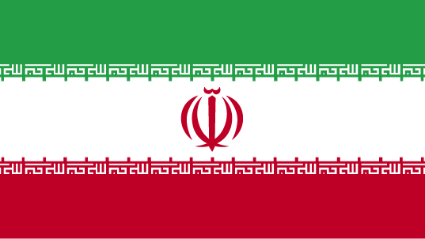
Opportunities
Top Priority: Regime Survival
“Maslahat” allows regime flexibility
  Precedent for strategic shifts
    Ayatollah Khomeini: “Drink from poison chalice”
Proportionality
  Control escalation

Slide 10
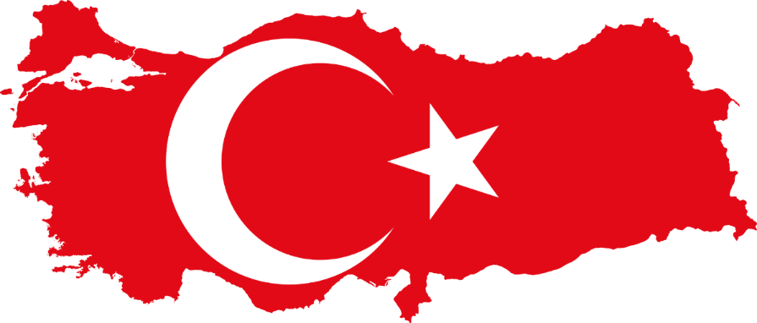
Strategic Culture of Turkey: Challenges for US National Security
Mr. Jeff Vordermark
Department of Joint, Interagency and Multinational Operations (DJIMO) U.S. Army Command and General Staff College (CGSC)
Notes:
https://commons.wikimedia.org/wiki/File:Flag-map_of_Turkey.svg
L’invasion turque de Chypre, également connue sous le nom de code opération Attila ou opération paix pour Chypre (en turc : Atilla Harekâtı ou Kıbrıs Barış Harekâtı) est l'offensive militaire des forces armées turques lancée le 20 juillet 1974 et qui conduisit à l'occupation de 38 % du territoire chypriote par la Turquie

Slide 11
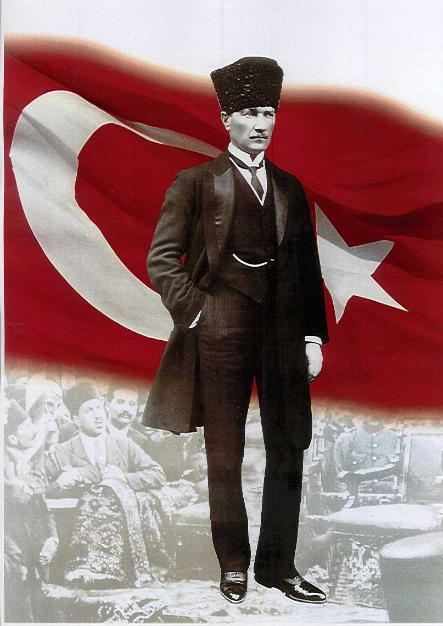
Strategic Culture of Turkey: Challenges for US National Security."
1923-2003
Kemalism’s 6 Arrrows
  Republicanism
  Statism
  Secularism
  Nationalism
  Populism
  Revolutionism
Legacy
An emerging, but imperfect democracy
NATO Membership
Non-Interventionist foreign policy
“I do not want history to record me as someone
who has bequeathed to his nation the institution
of despotism.”
https://www.brainyquote.com/quotes/mustafa_kemal_ataturk_802828
Notes:
https://commons.wikimedia.org/wiki/File:Flag-map_of_Turkey.svg
L’invasion turque de Chypre, également connue sous le nom de code opération Attila ou opération paix pour Chypre (en turc : Atilla Harekâtı ou Kıbrıs Barış Harekâtı) est l'offensive militaire des forces armées turques lancée le 20 juillet 1974 et qui conduisit à l'occupation de 38 % du territoire chypriote par la Turquie

Slide 12
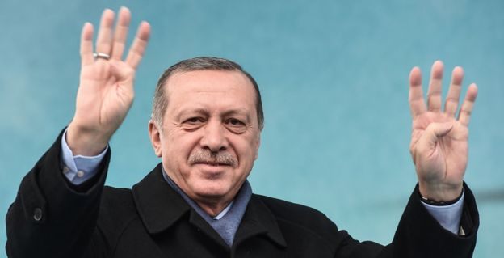
Strategic Culture of Turkey: Challenges for US National Security."
2003 - Present
Erdoganism?
  Neo-Ottomanism
  Conformism
  Conservatism
Emerging Legacy
2016 coup
Constitutional reform - vastly expanded presidential authorities
Strained NATO Membership
Economic woes
“Democracy is merely a train we ride until we reach our goal.”
Notes:
https://commons.wikimedia.org/wiki/File:Flag-map_of_Turkey.svg
L’invasion turque de Chypre, également connue sous le nom de code opération Attila ou opération paix pour Chypre (en turc : Atilla Harekâtı ou Kıbrıs Barış Harekâtı) est l'offensive militaire des forces armées turques lancée le 20 juillet 1974 et qui conduisit à l'occupation de 38 % du territoire chypriote par la Turquie

Slide 13

Demography and Human Resources: Critical Constraints on Russia’s Great Power Ambitions
September 28, 2018
Nicholas Eberstadt
Henry Wendt Chair in Political Economy American Enterprise Institute Eberstadt@aei.org

Slide 14
Stabilized and Recovering--For Now
Russian Federation Population: 1990-2018
(Estimated for New Year’s Day, In Millions)
Copyright Nicholas Eberstadt
Sources: Russian Federation Federal Statistical Service (Goskomstat), The Demographic Yearbook of Russia – 2017, available at http://www.gks.ru/bgd/regl/B17_16/Main.htm accessed February 28th, 2018; Russian Federation Federal State Statistics Service (Goskomstat), http://www.gks.ru/wps/wcm/connect/rosstat_main/rosstat/ru/statistics/population/demography/, retrieved March 1st, 2018.
Notes:
Updated

Slide 15
Who’s The Biggest Loser?
Greatest Global Surfeits of Deaths Over Births, 1992-2012 Period
Copyright Nicholas Eberstadt
Source: United States Census Bureau, “Components of Population Growth 1992-2012,” International Data Base, www.census.gov/population/international/data/idb/region.php. (Date Accessed: April 26, 2014).

Slide 16
(European) Family Values
TFR vs. Percentage Births Outside of Marriage, Russia and Select European Nations, 2015
Copyright Nicholas Eberstadt
Sources: EU data: Eurostat, “Fertility Indicators: Total fertility rate (tsdde220)” http://ec.europa.eu/eurostat/web/products-datasets/-/tsdde220 (accessed February 23, 2018); Eurostat, “Live births outside marriage (tps00018)” http://ec.europa.eu/eurostat/web/products-datasets/-/tps00018 (accessed February 23, 2018). Russia data: Fertility rate, total (births per woman), World Bank Data, https://data.worldbank.org/indicator/SP.DYN.TFRT.IN?locations=RU (Date Accessed: February 26, 2018); Demographic Yearbook of Russia 2017, Fertility, “Live births by mothers marital status, Table 4.5,” http://www.gks.ru/bgd/regl/B17_16/Main.htm (Date Accessed: February 23, 2018).

Slide 17
Source: Religious Composition by Country, 2010-2050, April, 2, 2015, Pew Research Center, available online at http://www.pewforum.org/2015/04/02/religious-projection-table/2010/number/Europe/#, accessed February 28, 2018.

Slide 18
Source: US Census Bureau International Database, https://www.census.gov/data-tools/demo/idb/ (Date Accessed: February 26, 2018)

Slide 19
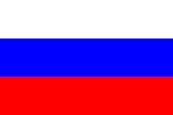
Russian Strategic Culture: Challenges for US National Security
Why Does Russia Behave the Way It Does?
Mr. Mark Wilcox
William Eldridge Odom Chair of Joint, Interagency and Multinational Studies
US Army Command and General Staff College (CGSC)
Notes:
https://en.wikipedia.org/wiki/Flag_of_Russia

Slide 20
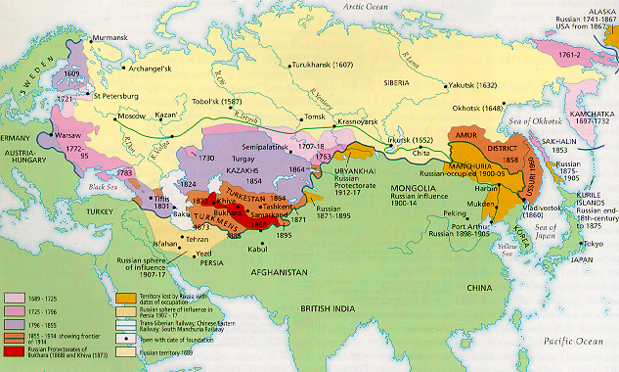
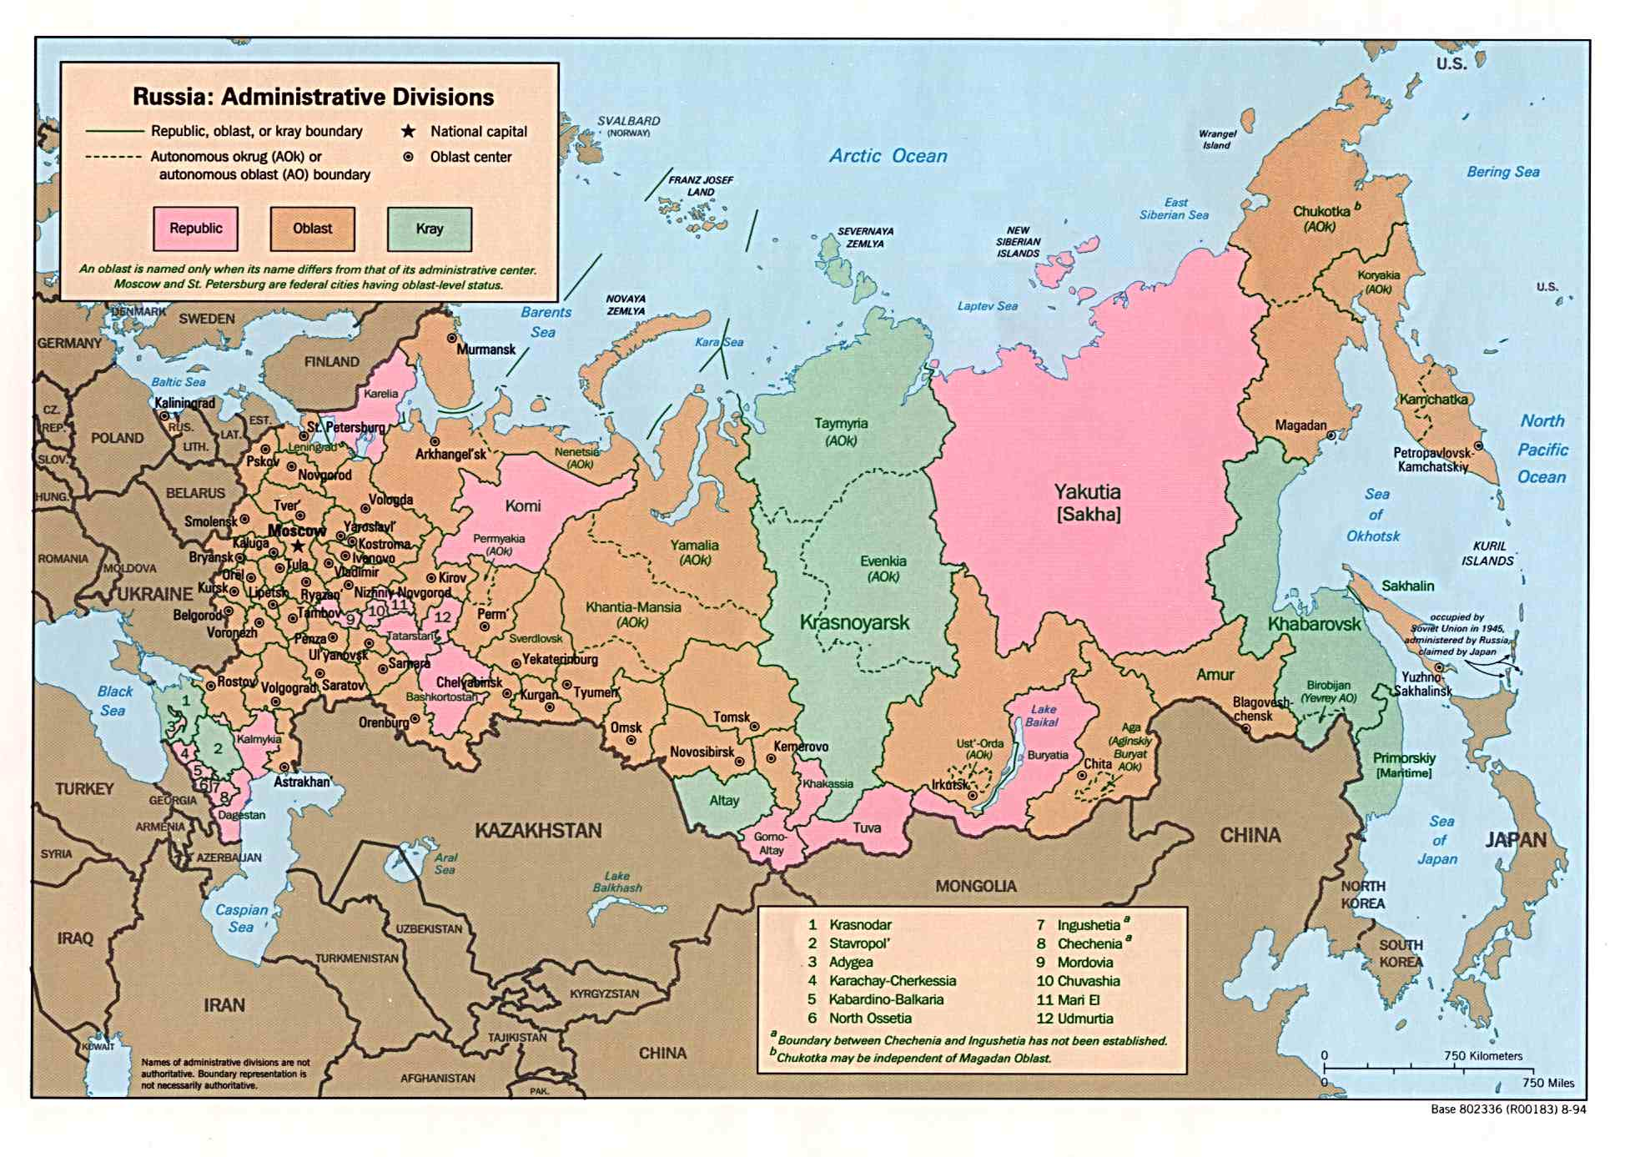
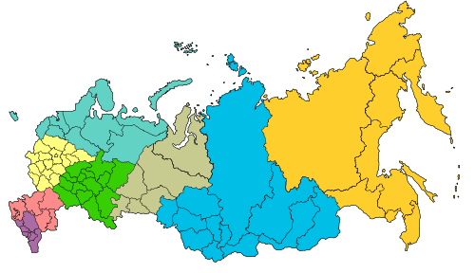
Geography
Governance
Insecurity

Slide 21
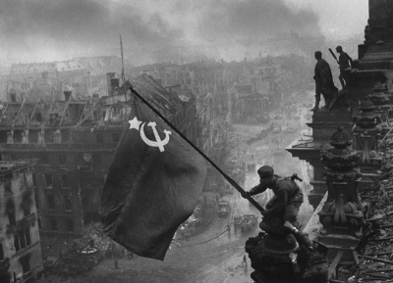
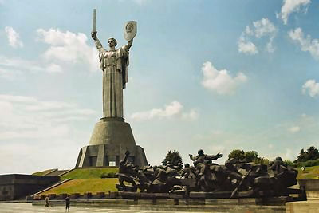
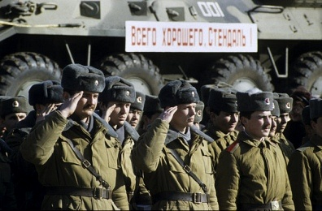
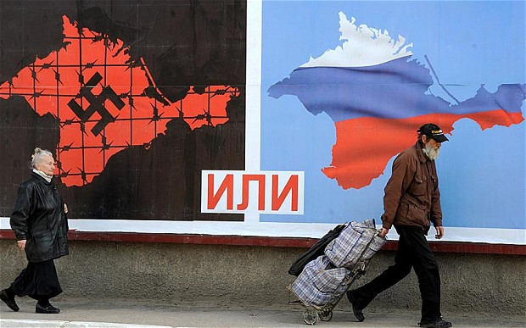
History
19th Century – Gorchakov
  Defeat – Concentration – Rise Again
Bolshevik Revolution
  Revolutionary change is bad
Great Patriotic War
  Glorious victory – being diminished?
Yeltsin Period
  Weakness – origin of unipolar world
Taking Berlin
Leaving East Germany

Slide 22
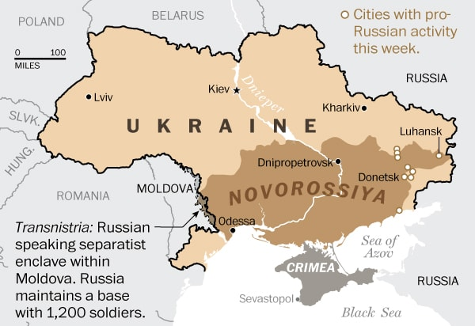
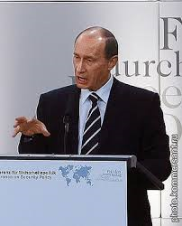
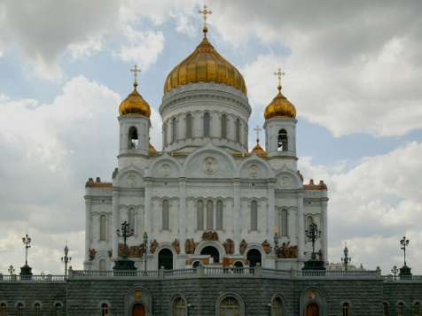
Identity
Russian-ness – Russkiy mir
Eastern? Western? Eurasian?
Great Power – Derzhavnost’

Slide 23
Questions/Answers/Comments

Slide 24


Contact:
Dr. Mahir Ibrahimov, Director, CREL Management Office (CRELMO)
Fort Leavenworth, KS 66027-2300
Phone: (913) 684-3345
DSN: 552-3345
CRELMO website: http://usacac.army.mil/organizations/cace/lrec
ATN: https://atn.army.mil/dsp_template.aspx?dpID=102
https://atn.army.mil
YouTube link: https://www.youtube.com/playlist?list=PLkGvnfy3IadNRMPT-sNHpAsz8a3npWBH8

