Slide 1
Dr. Mahir J. Ibrahimov
29 September 2016

Slide 4
World Bank, “GDP growth (annual %),” World Development Indicators, accessed 12 September 2016 http://databank.worldbank.org/data/reports.aspx?Code=NY.GDP.MKTP.KD.ZG&id=af3ce82b&report_name=Popular_indicators&populartype=series&ispopular=y#

Slide 5
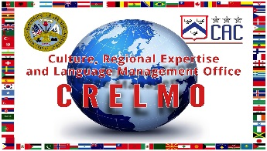
Nagorno-Karabakh Conflict

Slide 6
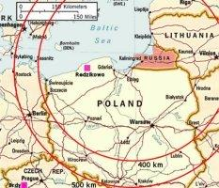
The 9K720 Iskander-M
Known in NATO as the SS-26 Stone—is a short-range ballistic missile. While export versions of the missile have a range of 280 kilometers and payload of 480Kg, the weapons destined for domestic service have a range 500 kilometers. Would certainly have a range to strike the Redzikowo missile defense facility in Poland, which is a bit more than 200 km from Kaliningrad.
Source: Global Security Org..
http://www.globalsecurity.org/jhtml/jframe.html#http://www.globalsecurity.org/wmd/world/russia/images/ss-26-kaliningrad.jpg|||

Slide 7
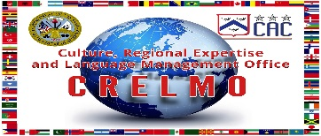
Oil and Gas Pipeline Politics

Slide 8
Russian Army chief of the General Staff General V. “Gerasimov Doctrine” or is it really a Doctrine?
Russia is engaged in a civilizational as well as geopolitical struggle with the West in a continual state of conflict. It’s the war of ideas and values using the asymmetrical operations without the formal declaration of war.
Special forces operating jointly with internal opposition leveraging information operations, cyber, legal, electronic and economic warfare to achieve its strategic outcome.
”Tsenosti Nauki V Predvidenii. Novie Vizovi Trebuyut Pereosmislit Formi I Sposobi Vedenia Boyevikh Deistviy,” ”At The Foresight Of The Value of Science : New Challenges Demand Rethinking the Forms and Methods of Carrying out Combat Operations,“ Voyenno-Promyshlennyy Kurier online, 27 February 2013, issue #8(476), accessed 16 September 2016, http://vpk-news.ru/articles/14632.

Slide 9
OBSERVATIONS FROM UKRAINE:
Ukraine’s Hidden Battlefield
Rob W. Kurz
Foreign Military Studies Office
Open Source - Foreign Perspectives - Understudied Topics
www.leavenworth.fmso.army.mil

Slide 10
OBSERVATIONS FROM UKRAINE:
Ukraine’s Hidden Battlefield
Background of Trip
Brief Background of Conflict in Ukraine
Ukrainian Perspectives
Key Observations – a one-week snapshot

Slide 11
OBSERVATIONS FROM UKRAINE:
Ukraine’s Hidden Battlefield
Ukrainian Perspectives
The Prevalence of Russian Propaganda
Cultural Invasion
Historical Distortion
Centralized Media
Information and Psychological Operations

Slide 12
Russian General-Lieutenant Kartapalov
Early 2015: Published article in Russia’s Bulletin of the
Academy of Military Science; examined changes in
the nature of armed struggle and what is described
as "new-type” war.
Then-Chief of the Main Operations Directorate,
General Staff of Russia
Late 2015: Named as head of Western Military District
Ukraine observations
frequently fell within
these two categories

Slide 13
OBSERVATIONS FROM UKRAINE:
Ukraine’s Hidden Battlefield
Ukrainian Perspectives
Russian Presence / Influence
in Critical Ukrainian Sectors
News Industry – GRU, Reflexive Control
Radio Stations – Seamless transitions
Cyber – Influence Measures or Shut-downs
Ukrainian Orthodox Church - Division

Slide 14
OBSERVATIONS FROM UKRAINE:
Ukraine’s Hidden Battlefield
Ukrainian Perspectives
Russian Presence / Influence
in Critical Ukrainian Sectors
DEFENSE:
On the Front Line
In the Commanders’ Staffs
International Entities: OSCE, JCC

Slide 15
OBSERVATIONS FROM UKRAINE:
Ukraine’s Hidden Battlefield
KEY OBSERVATIONS
One-week Snapshot…
Enduring Undercurrent of Russian Influence
Russia has the Initiative
Russia is using Indirect Methods (“New-Type”)
- Masters of Propaganda / Strategic Communications
- Own Capability to Escalate or De-escalate
- Penetrating / Influencing / Manipulating Ukraine’s Key Sectors
- Intelligence / Influence is Integrated and Ubiquitous
- Impact on Ukrainian Military at All Levels
…A hidden battlefield, extending to nearly every feature on Ukraine’s map.

Slide 16
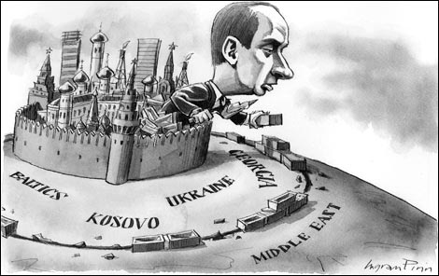
Russian Public Opinion on NATO, War, and Other Events
Dr. Christopher Marsh, SAMS

Slide 17
Resetting US-Russia Relations
Obama Administration and Attempt to “Reset” US-Russia Relations
Let’s not “overcharge” each other!
What are we resetting?
Overall, a complete failure

Slide 18
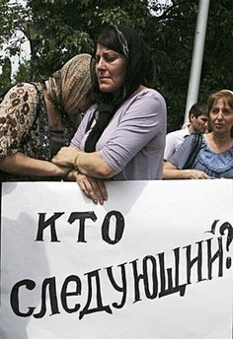
US Engagement of the “New” Russia
Attempt to facilitate rapid political and economic reform
Seen a “foreign agents” involving ourselves in their business
Some successes, some failures, some disenchantment
Who is to blame?

Slide 19
Russian Views on World Affairs
caption: “How the Americans control the territory of Russia.”

Slide 20
Domestic Context to Russian Foreign Policy

Slide 21
Protest and Popular Unrest
Despite the increased wealth in Russia, average Russians suffer
Economic sanctions have hit average Russians hard
anti-Putin movement appears almost gone, infrequent protests
For many Russians, life still a struggle; so why the transition?

Slide 22
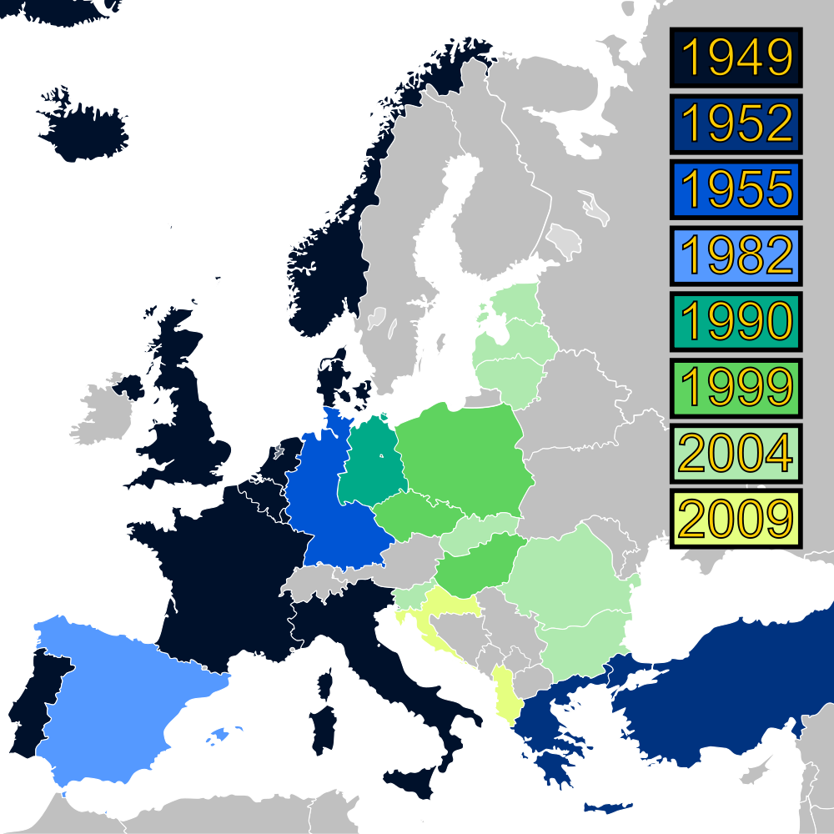
NATO Expansion

Slide 23
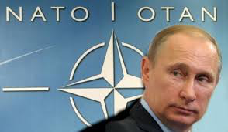
Russian Views on World Affairs: NATO Expansion
Expansion of NATO into Eastern Europe in 1999
Baltics join in 2004
Question of admission of Ukraine and Georgia

Slide 24
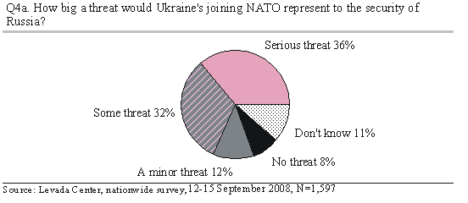
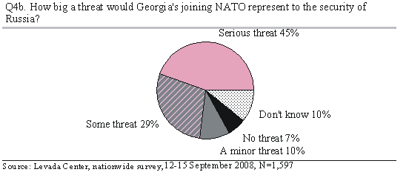
NATO Expansion – Ukraine and Georgia, 2008
Notes:
68% thought Ukraine joining NATO was a threat to Russian security; similar (74%) for Georgia, but even a little higher.

Slide 25
Russian Views on World Affairs: Friends and Enemies
Notes:
Armed conflict with neighboring countries: been asked for a long time; steady rise over the years; now nearly a third see it as likely – and 21% say it’s diffifuclt to say.
War with USNATO? This is a new question only asked beginning in 2015

Slide 26
Likelihood of domestic violence
Notes:
Decreased fear of ethnic conflicts over the past few years

Slide 27
Views on Crimea
Consistently strong support for the annexation of Crimea: definitely yes + probably yes = greater than 80% consistently
Very little opposition to annexation

Slide 28
Threats and Enemies
Biggest threats:
domestic, ethnic conflict erupting (30%) and the North Caucasus flaring up again (28%)
War with a neighboring country just as strong; 29%
But war with NATO/US seen as low (13%)

Slide 29
Views on Annexation of Crimea
Slight decline in number of those who see annexation of Crimea a good thing (drop from 70% to 59% throughout 2015
Majority (60%) see situation in eastern Ukraine as “tense”
Notes:
Though it has declined, still strong support for annexation of Crimea; understanding that situation in eastern Ukraine is tense

Slide 30
Relations with Ukraine?
But we see an increase in those who want to see pro-Russian forces coming to power in Ukraine, and that Russia should take an active role in that (increased from 16% to 29% over the past decade

Slide 31
Areas of Concern for Russian Citizens
Olympics scandal the biggest deal; decision to deploy NATO forces in Poland and Baltics barely registers (3%)
War in Syria much more of a concern to average Russian (14%)
Notes:
Russians don’t seem to care much about NATO and what’s going on at the geostrategic level – more concerend with the Olympics!

Slide 32
Russian Public Opinion and Foreign Policy
What does this tell us about Russian foreign policy?
Putin has a pretty free hand to do as he wishes in the international realm
His vision of geopolitics either resonates with the population (through state-controlled media outlets) or they just don’t care/have other priorities
This is not unique to Russia – in many parts of the world (especially non-democracies) average citizens have low awareness/interest in foreign affairs

Slide 34
Cultural Studies in the Army
The Global Front within the Context of Homefront
Introductory Remarks
Dr. Tseggai Isaac
Associate Professor
Department of History and Political Science
the Missouri University of Science and Technology (MS&T) -Rolla

Slide 35
Defining Culture
Expression of Individual and National Character; the Expressive Psychological Attributes that Identify the Values, Beliefs, Attitudes, and Norms of Societies
Values – Cherished Sentiments
Beliefs – Embraced Faiths
Attitudes – Expressions of Values and Beliefs
Norms – Entrenched Values, Beliefs, and Attitudes

Slide 36
The Universal Context of Cultures
The Human Quest
The Principles of Natural Rights - Indivisible
The Challenges of Objectivity - Rationality
Inalienability as a Context – The Principles of Equality
Pitfalls of Subjectivity – Short selling Objectivity

Slide 37
Attributes of Cultures
Orthodox Cultures
Tradition-bound
Fettered to Scriptures, To Symbols, To Founders
Dogmatic – Averse to Evolutions, Vulnerable to Revolutions
Postpone Inevitable Crippling Revolutions
Example of Orthodox Cultures
Islam in the State – Political Islam
Totalitarianism
Personality Cult Regimes

Slide 38
The Three World Cultures: the Challenge
The Eurasian and Middle East Cultures
Eurasia
The Post-Soviet Cultural Dilemma
The European Pull
The Islamic Push
The Quest for Redemptive Freedoms
The Challenges of Daring Cultural Outreach
The Undeniable Universality of Freedom, Liberty, Justice
Challenging the Enslaving Outreaches of Russian Totalitarianism
Crafting Effective tools of Soft, but Disciplined Power

Slide 39
The Three World Cultures (Cont’d)
Middle East
The Four Centers of Islamic Cultures
Egypt’s Circular Journeys to Governance
The Quest for Democratization
The Decaying Intermediations of Authoritarianism
The Promises of the Impossible Islamism
Back to Decaying Intermediation of Authoritarianism
Turkey’s Democracy
A Front or Genuine Democracy?
Is there “Secular Islam” in Erdogan's Vocabularies?
Iran – The Impossible Islamic State Without Persian Heritage
Saudi Arabia – The Abode of Islam

Slide 40
The Three World Cultures (Cont’d)
Africa – Amenable for Molding Culture of Liberty
The Challenges of African Poverty
The Challenges of Western Undervaluation
Chinese Opportunistic Expansion, and African Delusion
Substitution Western Undervaluation, by Edifying Soft Power
“Those who foolishly sought power by riding on the back of the tiger ended up inside.” President Kennedy in his 1961 Inaugural Address

Slide 41
Crafting Cultural Outreach Endeavors
The Home Front and its Founding Fundamentals
The Army as a Guardian of Liberty – Revolutionary, anti-Reactionary
Radical and Resolute for Democratic Liberty
Priority of Loyalty to the American Text
The Soil, the Soldier, The National Doctrine
Self-Knowledge as a Context for Understanding Other Cultures
Seeing Yourself as Your Admirers See You and Being Emboldened by Second-Guessing and the Jealousies of Adversaries
The Declaration of Independence as a National Doctrine

Slide 42
Conclusion:
Culture to the Soldier is a transitional tool to facilitate the effective conduct of war. To the officer, it is a tool as well as a means for interaction with officers of similar rank in other cultures. Studious reading in sociology will open doors to social groups, such as labor unions, religious groups, professional associations, and organized groups such as political parties. Political Science will assist the soldier and the officer in navigating the political and administrative/ bureaucratic sector of other societies’ cultures. Anthropology will assist the soldier and the officer in interacting with villagers, village elders, women, children, youths and age cohorts.

Slide 43
Some reading sources:
Vladimir V. Putin,“Voyennaya Doctrina Rossiyskoy Federatsii” [The Military Doctrine of the Russian Federation], December 26, 2014.
Vladimir V. Putin, “Ukaz Prezidenta Rossiyskoy Federatsii o Strategii Natsionalnoy Bezopasnosti Rossiyskoy Federatsii” [“The Decree of the President of the Russian Federation on the National Security Strategy of the Russian Federation”], 31 December 2015.
General Valery V. Gerasimov (Вале́рий Васи́льевич Гера́симов), Chief of the General Staff of the Armed Forces of Russia, first Deputy Defence Minister, ”Tsenosti Nauki V Predvidenii. Novie Vizovi Trebuyut Pereosmislit Formi I Sposobi Vedenia Boyevikh Deistviy,” ”At The Foresight Of The Value of Science : New Challenges Demand Rethinking the Forms and Methods of Carrying out Combat Operations,“ Voyenno-Promyshlennyy Kurier online, 27 February 2013, issue #8(476), accessed 16 September 2016, http://vpk-news.ru/articles/14632.
“Azerbaycan 24 sene sonra Ermenistan'dan geri aldı” [“Azerbaijan Returned (lands) from Armenia 24 Years Later”], Milliyet.com in Turkish, April 25, 2016.
“Azerbaijan Halqi Oz Torpaglarinin Ishgal Altinda Galmasi Ila Hech Vaxt Barishmayacag” (“Azerbaijan Will Never Agree Its Lands to Remain Under Occupation”), Ramiz Mehtiyev, Chief of the Staff of the President of Azerbaijan, Halq Gezeti in Azerbaijani, April 6, 2016.
“Armenia Shows Off Powerful Ballistic Missiles At Parade,” Associated Press, September 21, 2016.
Gabrielle Tétrault-Farber, “Putin dismisses powerful chief of staff,” Moscow, Associate France Press, August 12, 2016.
“Nord Stream 2 partners withdraw amid Poland pressure,” The Financial Times Ltd, August 12, 2016.
Darko Janjevic, “NATO leaders meet in Warsaw for key military summit,” Associate Press, July 07, 2016.
“Brexit: Government guarantee for post-EU funds” BBC, 13 August, 2016.
Bartles, Charles K. "Getting Gerasimov Right," Military Review (January-February 2016): 30. http://fmso.leavenworth.army.mil/documents/Regional%20security%20europe/Mili taryReview_20160228_art009.pdf
Thomas, Timothy L. Russia Military Strategy: Impacting 21st Century Reform and Geopolitics. Leavenworth: Foreign Military Studies Office, 2016. http://fmso.leavenworth.army.mil/EPubs/Epubs/Thomas_Russian%20Military%20Strategy_Final_(2%20May%202016).pdf.
Ibrahimov, Mahir J. “Socio-cultural lessons from Eurasia and Afghanistan,” Military Intelligence Professional Bulletin (MIPB), January/March 2011. http://usacac.army.mil/sites/default/files/documents/cace/LREC/2011_Socio-CulturalLessons.pdf
Ibrahimov, Mahir J.“Cross- Cultural Negotiations/Skill Building in an Operational Environment,” Military Intelligence Professional Bulletin (MIPB), April/June 2011. http://usacac.army.mil/sites/default/files/documents/cace/LREC/2011_CrossCulturalNegotiations.pdf
Ibrahimov, Mahir J. “Invitation To Rain, A Story Of The Road Taken Towards Freedom,” Global Scholarly Publications. New York, NY, USA. ISBN: 978-1-59267-0925. October 2008.

Slide 44
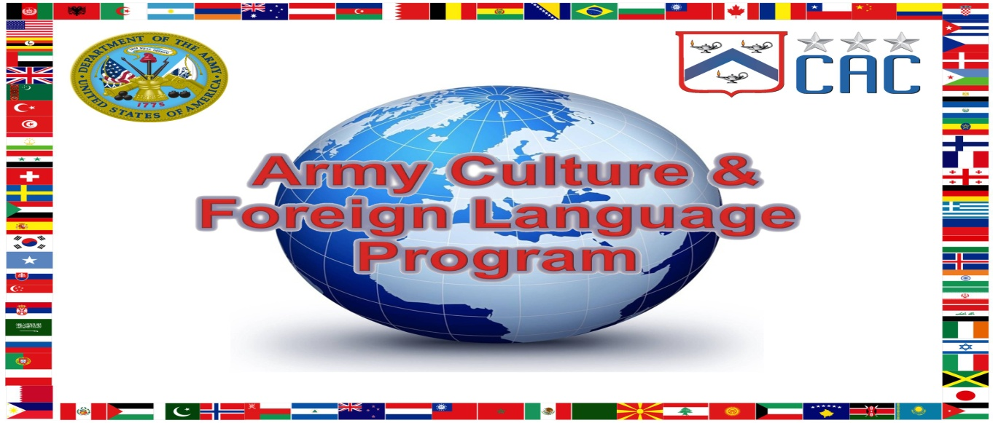
Contact:
Program Manager
CAC CREL Management Office (CRELMO)
Fort Leavenworth, KS 66027-2300
Ph: (913) 684-3345
DSN: 552-3345
http://usacac.army.mil/organizations/cace/lrec

