Slide 1
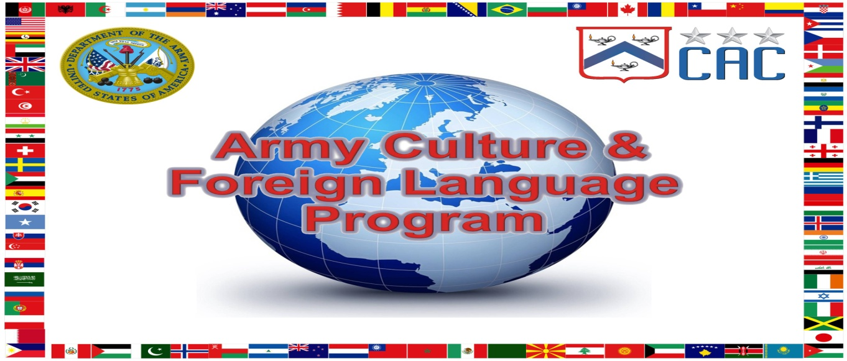
Dr. Mahir J. Ibrahimov
ArmyU Culture, Regional Expertise & Language (CREL)
Management Office (CRELMO)
21 April 2016

Slide 2
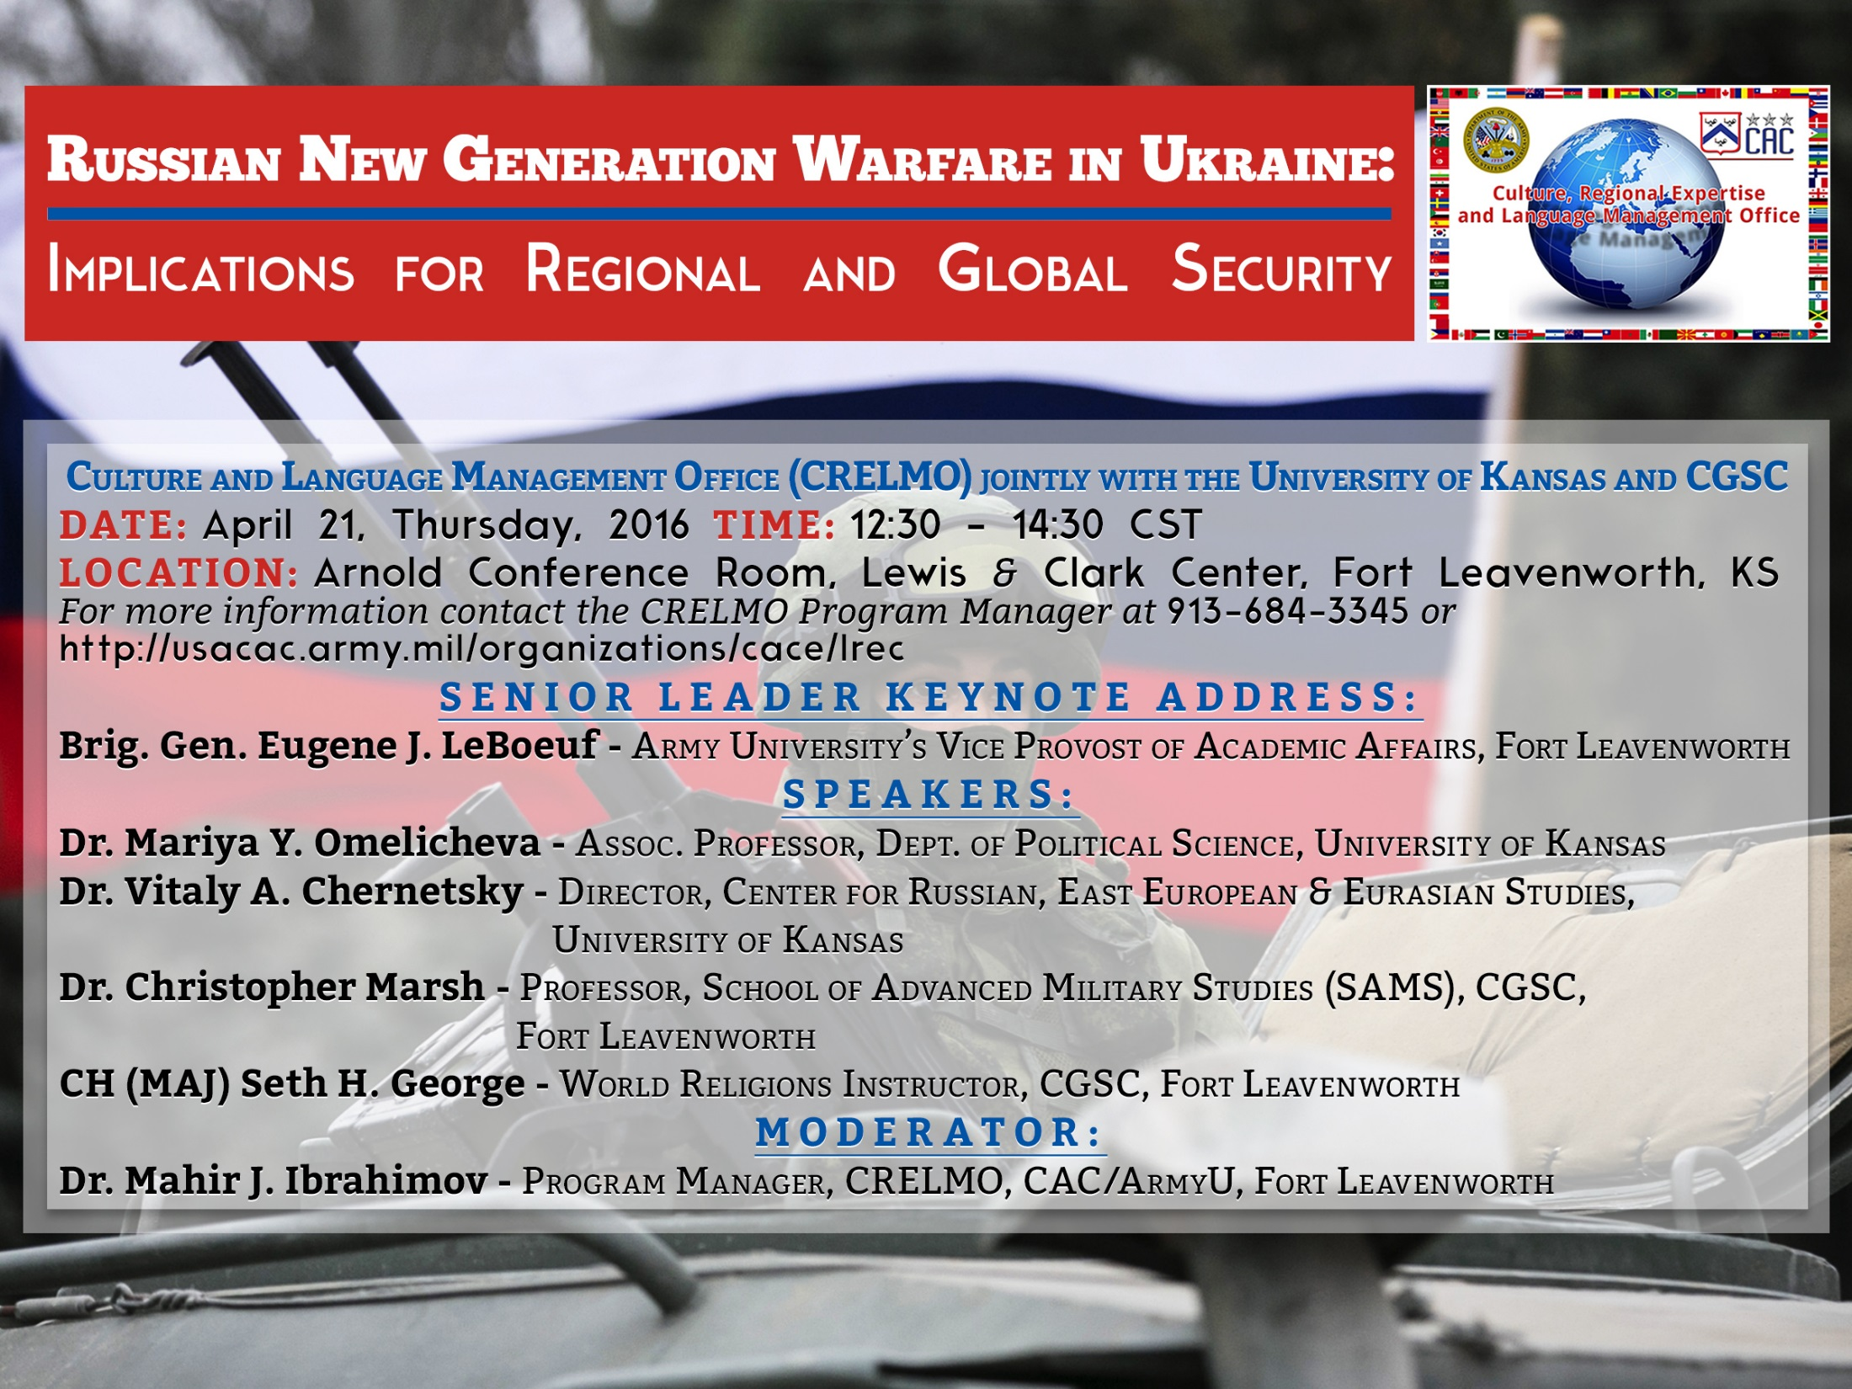

Slide 3
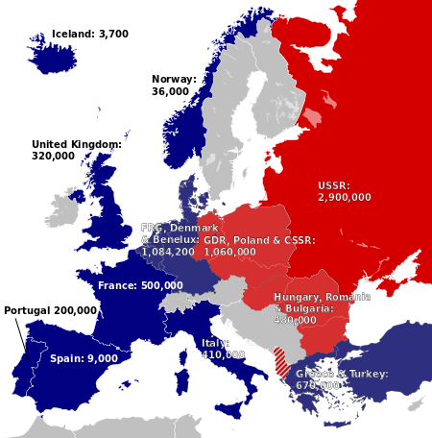
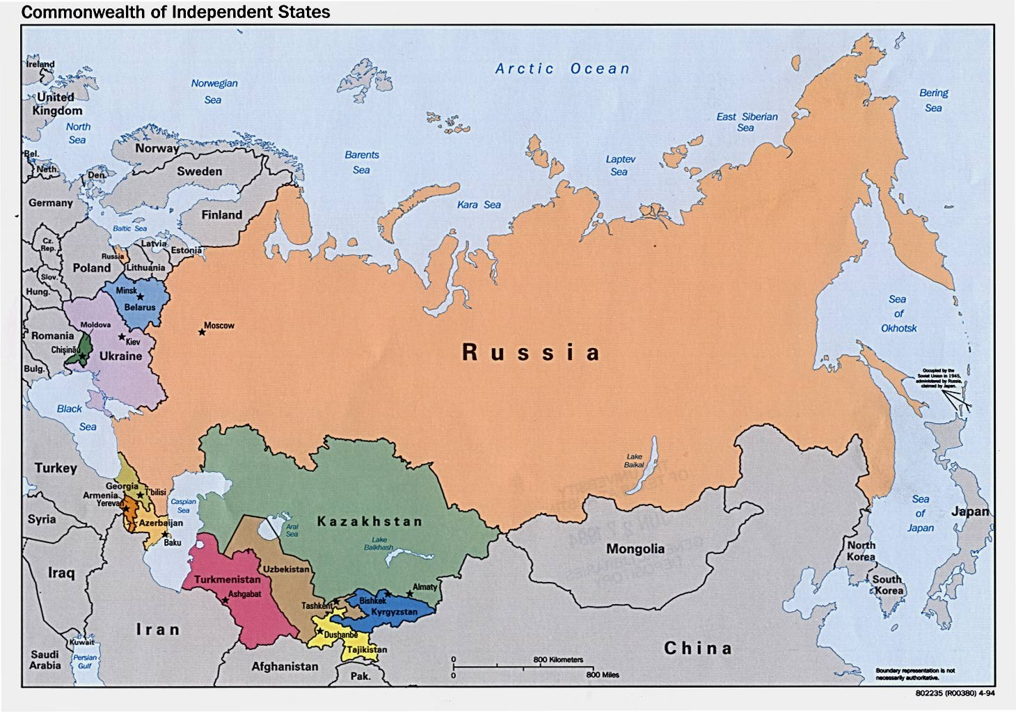
Soviet/Russian Strategic Military Culture:
Eastern Europe & Afghanistan (USSR)
Chechnya/Georgia/Ukraine ( Russia)
- The USSR bipolar international system became unipolar.
Russia ceased to be a great power with significantly less resources.
Russian near abroad is still strategically important (Europe and Asia)

Slide 4
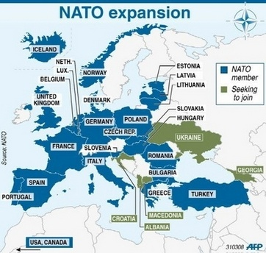
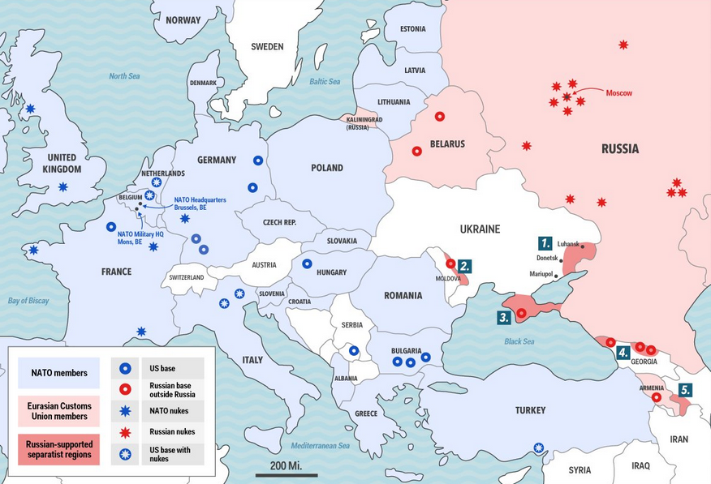
Russia’s Concern over NATO’s Expansion
The Lithuanian and Estonian defense ministries have expressed alarm at the increased military activity, and drawn comparisons with moves prior to the Russian invasion of Crimea.
“Russia’s frequent snap military drills near its eastern European neighbors could be part of a strategy that will open the door for a Russian offensive on the Baltic states” (defense expert Martin Hurt, deputy director at Estonia’s International Centre for Defense and Security).

Slide 5
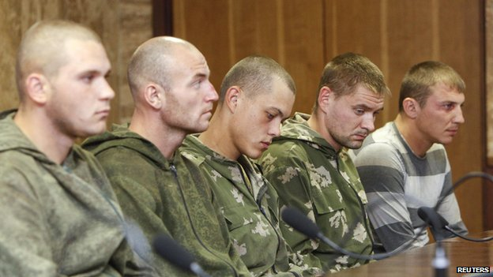
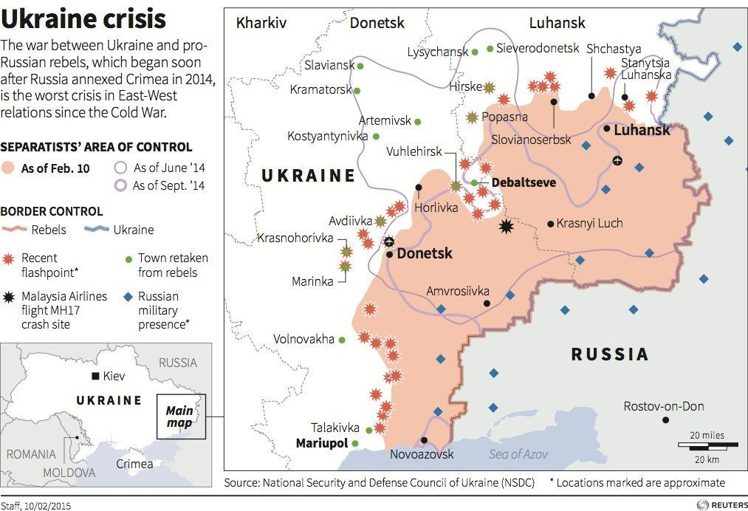
Ukraine Conflict 2014 to present
The real question is the extent to which Russia is prepared to back the rebels' quest for territorial gain.
The Kremlin has repeatedly denied supplying troops and sophisticated military hardware to the rebels.
Russian Soldiers captured by Ukrainian Armed forces, 2014
Ukrainian President Petro Poroshenko estimated that as many as 9,000 Russian troops were backing the rebels.
Ukrainian territory of Crimea
is now part of Russia.
The capture of Mariupol would pave the way for a land corridor to the peninsula.

Slide 6
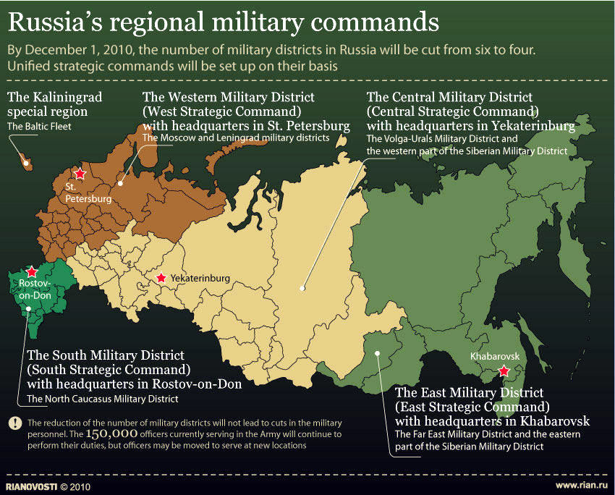
Ukraine Conflict 2014 to present
The real question is the extent to which Russia is prepared to back the rebels' quest for territorial gain.
The Kremlin has repeatedly denied supplying troops and sophisticated military hardware to the rebels.
Russian Soldiers captured by Ukrainian Armed forces, 2014
Ukrainian President Petro Poroshenko estimated that as many as 9,000 Russian troops were backing the rebels.
Ukrainian territory of Crimea
is now part of Russia.
The capture of Mariupol would pave the way for a land corridor to the peninsula.

Slide 7
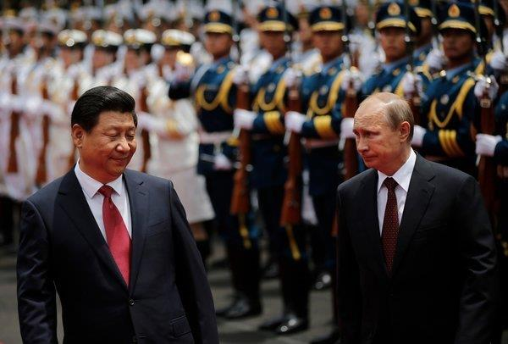
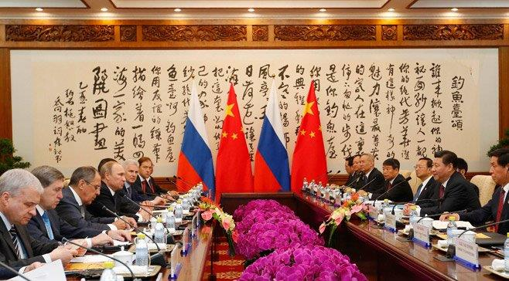
Russia Draws Closer to China: U.S. Faces a New Challenge
Estranged from the West over NATO Expansion, and especially the Ukraine, Russia seeks economic and political support from China.
Mr. Putin trying to fashion a coalition to resist what both countries view as American arrogance (Shanghai Cooperation Organization (SCO),BRICS).
Arms deals between the two at around $2 billion annually, a $3 billion deal being negotiated for S-400 missile systems.
Russia-China rapprochement presents a profound challenge to the United States and Europe.

Slide 8
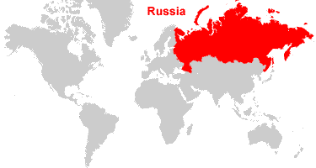
Russia’s “New Generation Warfare”
Mariya Y. Omelicheva
Political Science, University of Kansas

Slide 9
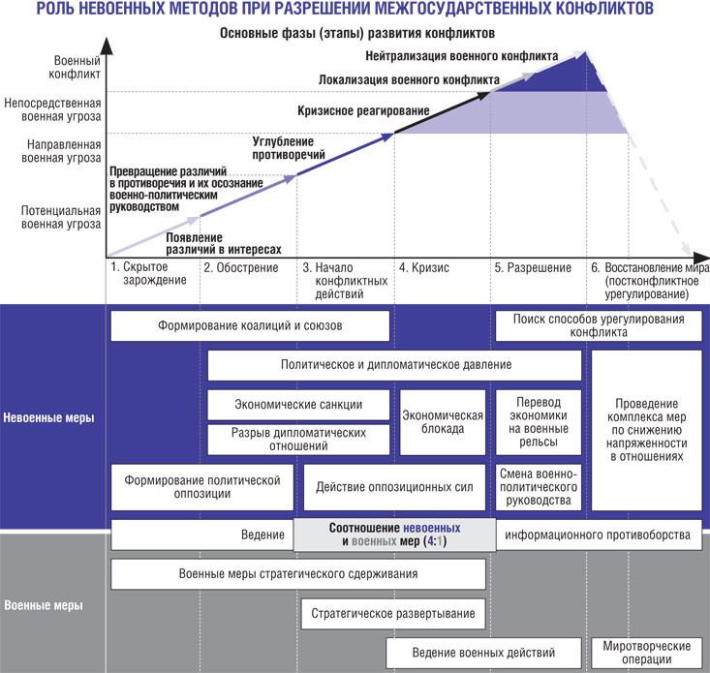
“Hybrid”, “Multi-Dimensional”, “new Generation”, “Irregular”
An approach to conflict that embraces “simultaneous employment of multiple instruments of war, including non-military means where information warfare, such as mass political manipulation, is a major capability”
Lieutenant General Ben Hodges, commander of Army forces in Europe

Slide 10
Change in the Perceptions of Threats
The Russian government believes that Russia is engaged in a civilizational as well as geopolitical struggle with the West. This struggle is no longer about the territorial spaces and resources, but includes the war of ideas and values, the dispute of minds
The Russian army appears to believe that the world is in a continual state of conflict (lines between war and peace are blurred)
Use of asymmetrical operations without the formal declaration of war
General V. Gerasmov,
The chief of the General Staff

Slide 11
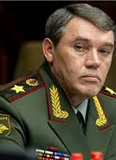
Change in the Perceptions of Capabilities
Specific capabilities The use of Special Forces linked up with internal opposition groups in combination with information operations, cyber warfare, legal warfare, economic war and other activities that are linked to a strategic outcome and constantly modified to meet the specific needs of a particular operation

Slide 12
TRADITIONAL METHODS | “NEW WARFARE”
Military action starts after strategic deployment (declaration of war) | Military action starts by groups of troops during peace time (no war declaration).
Frontal clashes between large units consisting mostly of ground units | Non-contact clashes between highly maneuverable interspecific fighting groups
Defeat of manpower, firepower, taking control of regions and borders to gain territorial control | Shift in focus from direct destruction to direct influence; from direct annihilation of the opponent to its inner decay
Combat operations on land, air, and sea (traditional “3D” battleground” | A combination of political, economic, information, technological, and ecological campaigns. Emphasis on information/psychological warfare
Conventional forces managed by rigid hierarchy and governance | Specially prepared forces and commercial irregular groupings; use of armed civilians
War has spatial and temporal limits | State of permanent war as the natural condition in national life

Slide 13
TRADITIONAL METHODS | “NEW WARFARE”
Military action starts after strategic deployment (declaration of war) | Military action starts by groups of troops during peace time (no war declaration).
Frontal clashes between large units consisting mostly of ground units | Non-contact clashes between highly maneuverable interspecific fighting groups
Defeat of manpower, firepower, taking control of regions and borders to gain territorial control | Shift in focus from direct destruction to direct influence; from direct annihilation of the opponent to its inner decay
Combat operations on land, air, and sea (traditional “3D” battleground” | A combination of political, economic, information, technological, and ecological campaigns. Emphasis on information/psychological warfare
Conventional forces managed by rigid hierarchy and governance | Specially prepared forces and commercial irregular groupings; use of armed civilians
War has spatial and temporal limits | State of permanent war as the natural condition in national life

Slide 14
TRADITIONAL METHODS | “NEW WARFARE”
Military action starts after strategic deployment (declaration of war) | Military action starts by groups of troops during peace time (no war declaration).
Frontal clashes between large units consisting mostly of ground units | Non-contact clashes between highly maneuverable interspecific fighting groups
Defeat of manpower, firepower, taking control of regions and borders to gain territorial control | Shift in focus from direct destruction to direct influence; from direct annihilation of the opponent to its inner decay
Combat operations on land, air, and sea (traditional “3D” battleground” | A combination of political, economic, information, technological, and ecological campaigns. Emphasis on information/psychological warfare
Conventional forces managed by rigid hierarchy and governance | Specially prepared forces and commercial irregular groupings; use of armed civilians
War has spatial and temporal limits | State of permanent war as the natural condition in national life

Slide 15
TRADITIONAL METHODS | “NEW WARFARE”
Military action starts after strategic deployment (declaration of war) | Military action starts by groups of troops during peace time (no war declaration).
Frontal clashes between large units consisting mostly of ground units | Non-contact clashes between highly maneuverable interspecific fighting groups
Defeat of manpower, firepower, taking control of regions and borders to gain territorial control | Shift in focus from direct destruction to direct influence; from direct annihilation of the opponent to its inner decay
Combat operations on land, air, and sea (traditional “3D” battleground”) | A combination of political, economic, information, technological, and ecological campaigns. Emphasis on information/psychological warfare
Conventional forces managed by rigid hierarchy and governance | Specially prepared forces and commercial irregular groupings; use of armed civilians
War has spatial and temporal limits | State of permanent war as the natural condition in national life

Slide 16
TRADITIONAL METHODS | “NEW WARFARE”
Military action starts after strategic deployment (declaration of war) | Military action starts by groups of troops during peace time (no war declaration).
Frontal clashes between large units consisting mostly of ground units | Non-contact clashes between highly maneuverable interspecific fighting groups
Defeat of manpower, firepower, taking control of regions and borders to gain territorial control | Shift in focus from direct destruction to direct influence; from direct annihilation of the opponent to its inner decay
Combat operations on land, air, and sea (traditional “3D” battleground” | A combination of political, economic, information, technological, and ecological campaigns. Emphasis on information/psychological warfare
Conventional forces managed by rigid hierarchy and governance | Specially prepared forces and commercial irregular groupings; use of armed civilians
War has spatial and temporal limits | State of permanent war as the natural condition in national life

Slide 17
TRADITIONAL METHODS | “NEW WARFARE”
Military action starts after strategic deployment (declaration of war) | Military action starts by groups of troops during peace time (no war declaration).
Frontal clashes between large units consisting mostly of ground units | Non-contact clashes between highly maneuverable interspecific fighting groups
Defeat of manpower, firepower, taking control of regions and borders to gain territorial control | Shift in focus from direct destruction to direct influence; from direct annihilation of the opponent to its inner decay
Combat operations on land, air, and sea (traditional “3D” battleground” | A combination of political, economic, information, technological, and ecological campaigns. Emphasis on information/psychological warfare
Conventional forces managed by rigid hierarchy and governance | Specially prepared forces and commercial irregular groupings; use of armed civilians
War has spatial and temporal limits | State of permanent war as the natural condition in national life

Slide 19
Stages of “New Warfare”
I. Non-military asymmetric warfare (encompassing information, moral, psychological, ideological, diplomatic, and economic measures)
II. Special operations to mislead political and military leaders
III. Intimidation, deceiving, and bribing government and military officers, with the objective of making them abandon their service duties.
IV. Destabilizing propaganda to increase discontent among the population
V. Establishment of no-fly zones over the country to be attacked, imposition of blockades, and VI. Commencement of military action, immediately preceded by large-scale recon- naissance and subversive missions
VII. Combination of targeted information operation, electronic warfare operation, aerospace operation, continuous airforce harassment, combined with the use of high- precision weapons launched from various platforms.
VIII. Roll over the remaining points of resistance and destroy surviving enemy units.

Slide 20
Implications for Regional Security
Do not rely on Art. 5 of NATO but develop a more self-reliant approach
Reconsider the strategies and methods used to fight wars
Do not fight the war that fits your organization and weapon, but choose your way of fighting, then build your system
Qiao Liang and Wang Xiangsui, Unrestricted Warfare (Beijing: PLA Literature and Arts Publishing House, 1999)

Slide 21
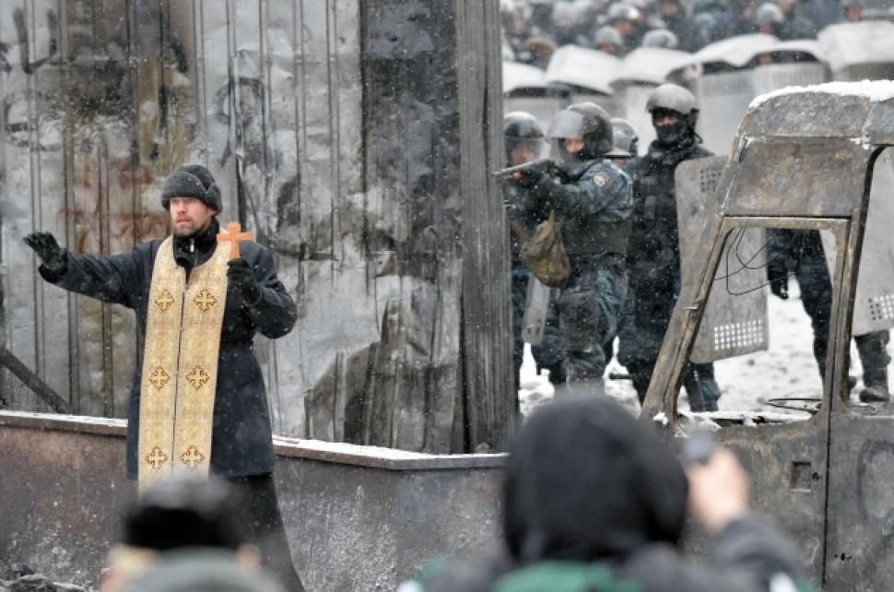
Chaplain Seth H. George
U.S. Army Command and General Staff College
Ukraine Orthodoxy
Symphony Between Church and Society
‘
Notes:
This presentation has been compiled by CH (MAJ) Seth George for the 4th ID and the U.S. Army Chaplain Corps. The Ukrainian Greek Catholic Church has both Byzantine and Roman roots and has many links to western Catholicism to include the Vatican.

Slide 22
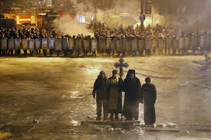
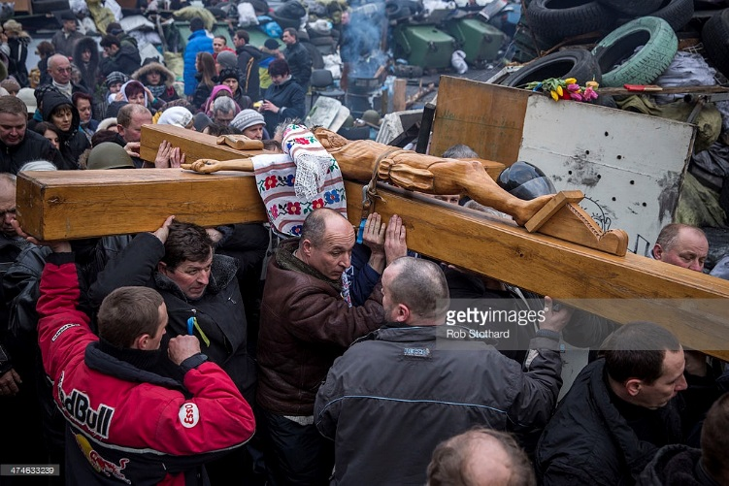
Maidian Square; Kiev, Ukraine

Slide 23
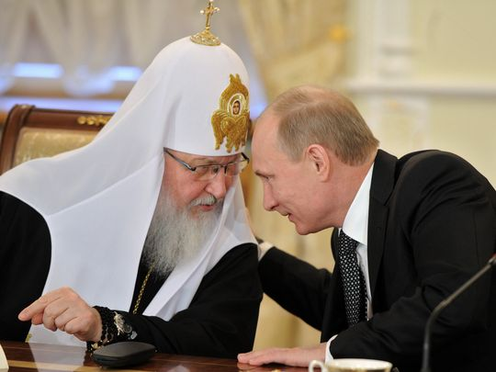
“This close alliance between the government and the Russian Orthodox Church has become a defining characteristic of Mr. Putin’s tenure, a mutually reinforcing choreography that is again described as working “in symphony.” Clifford Levy
Notes:
The Ukrainian Greek Catholic Church has both Byzantine and Roman roots and has many links to western Catholicism to include the Vatican.

Slide 24
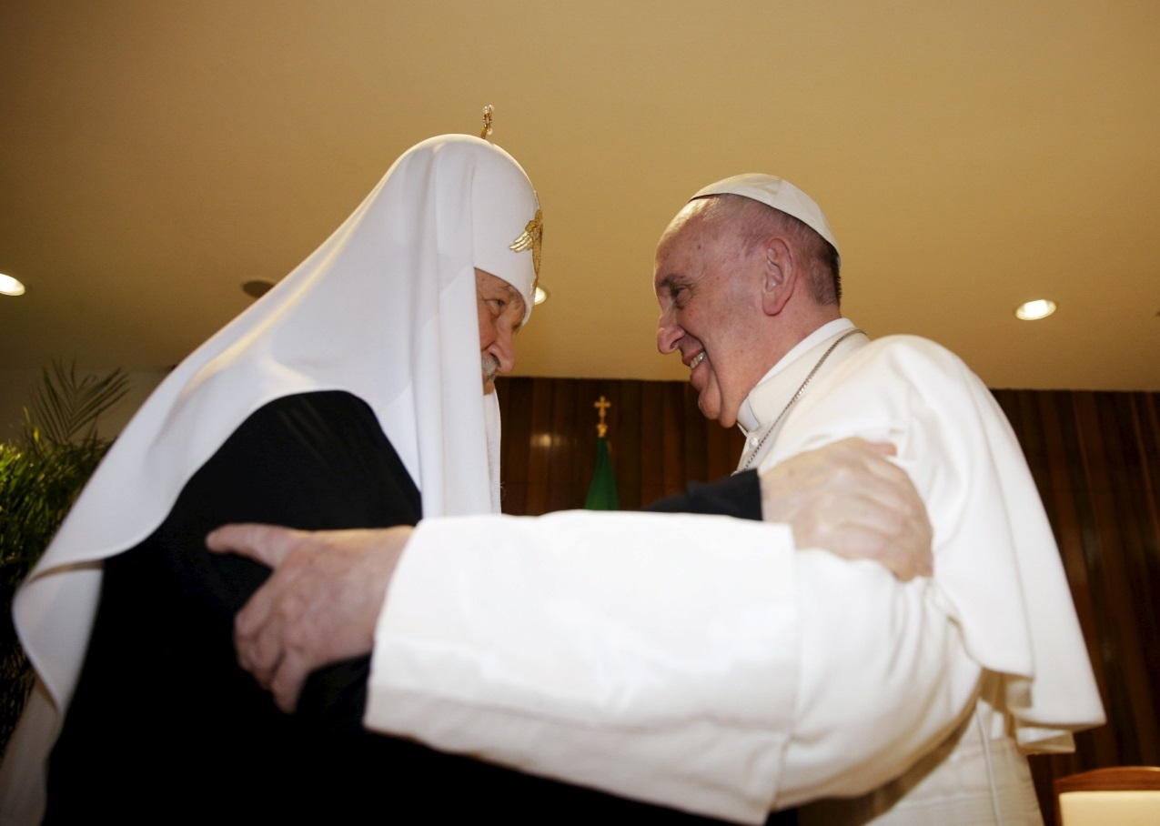
Havana, Cuba;
12 February 2016
48
Notes:
The independence of the Greek Catholic Church and the desire for Patriarch of Kiev to be canonically recognized by the Russian Orthodox Church are two separate factors that cannot be under-estimated.
This text, signed by Metropolitan Anthony of Borispil and Brovary, of the Ukrainian Orthodox Church (patriarchate of Moscow),
Joint Declaration of Pope Francis and Patriarch Kirill, 12 February 2016, Havana, Cuba. **** Pay special attention to declaration #27. The appeal to existing “canonical norms” strikes at the controversy within the Ukrainian churches and does not necessarily represent Ukrianian desires.
25. It is our hope that our meeting may also contribute to reconciliation wherever tensions exist between Greek Catholics and Orthodox. It is today clear that the past method of “uniatism”, understood as the union of one community to the other, separating it from its Church, is not the way to re–establish unity. Nonetheless, the ecclesial communities which emerged in these historical circumstances have the right to exist and to undertake all that is necessary to meet the spiritual needs of their faithful, while seeking to live in peace with their neighbours. Orthodox and Greek Catholics are in need of reconciliation and of mutually acceptable forms of co–existence.
26. We deplore the hostility in Ukraine that has already caused many victims, inflicted innumerable wounds on peaceful inhabitants and thrown society into a deep economic and humanitarian crisis. We invite all the parts involved in the conflict to prudence, to social solidarity and to action aimed at constructing peace. We invite our Churches in Ukraine to work towards social harmony, to refrain from taking part in the confrontation, and to not support any further development of the conflict.
27. It is our hope that the schism between the Orthodox faithful in Ukraine may be overcome through existing canonical norms, that all the Orthodox Christians of Ukraine may live in peace and harmony, and that the Catholic communities in the country may contribute to this, in such a way that our Christian brotherhood may become increasingly evident.
28. In the contemporary world, which is both multiform yet united by a shared destiny, Catholics and Orthodox are called to work together fraternally in proclaiming the Good News of salvation, to testify together to the moral dignity and authentic freedom of the person, “so that the world may believe” (Jn 17:21). This world, in which the spiritual pillars of human existence are progressively disappearing, awaits from us a compelling Christian witness in all spheres of personal and social life. Much of the future of humanity will depend on our capacity to give shared witness to the Spirit of truth in these difficult times.
Joint Declaration of Pope Francis and Patriarch Kirill http://en.radiovaticana.va/news/2016/02/12/joint_declaration_of_pope_francis_and_patriarch_kirill/1208117

Slide 25
Contact:
Program Manager
CAC CREL Management Office (CRELMO)
Fort Leavenworth, KS 66027-2300
Ph: (913) 684-3345
DSN: 552-3345
http://usacac.army.mil/organizations/cace/lrec

