Slide 1
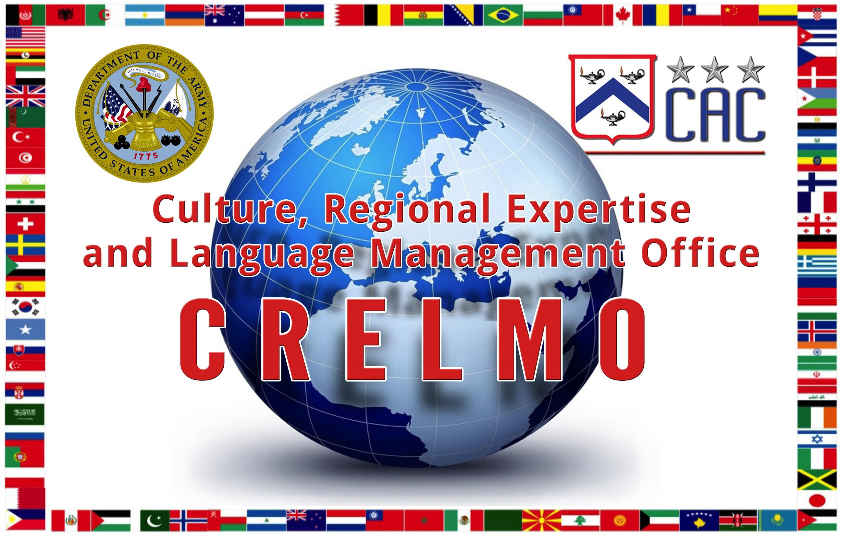
12 September 2017

Slide 2
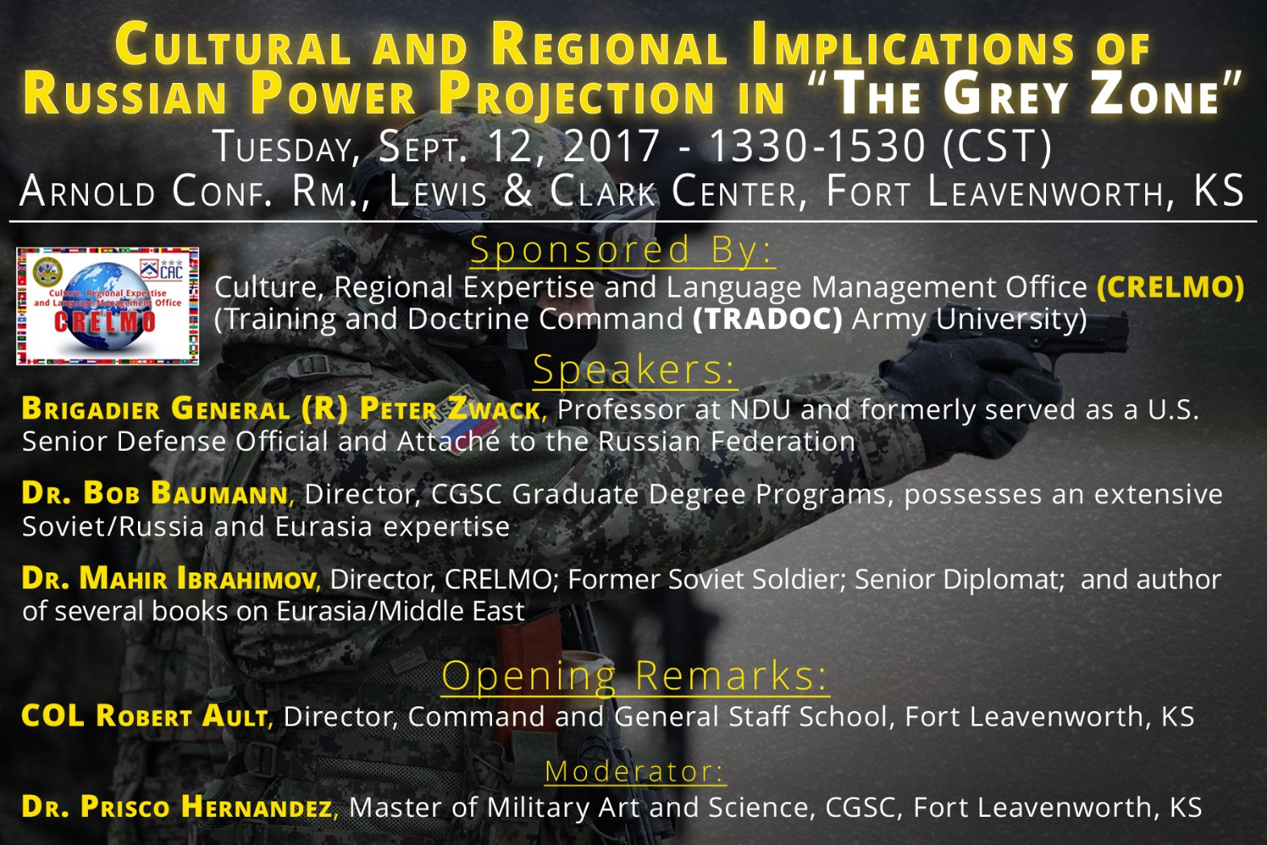

Slide 3
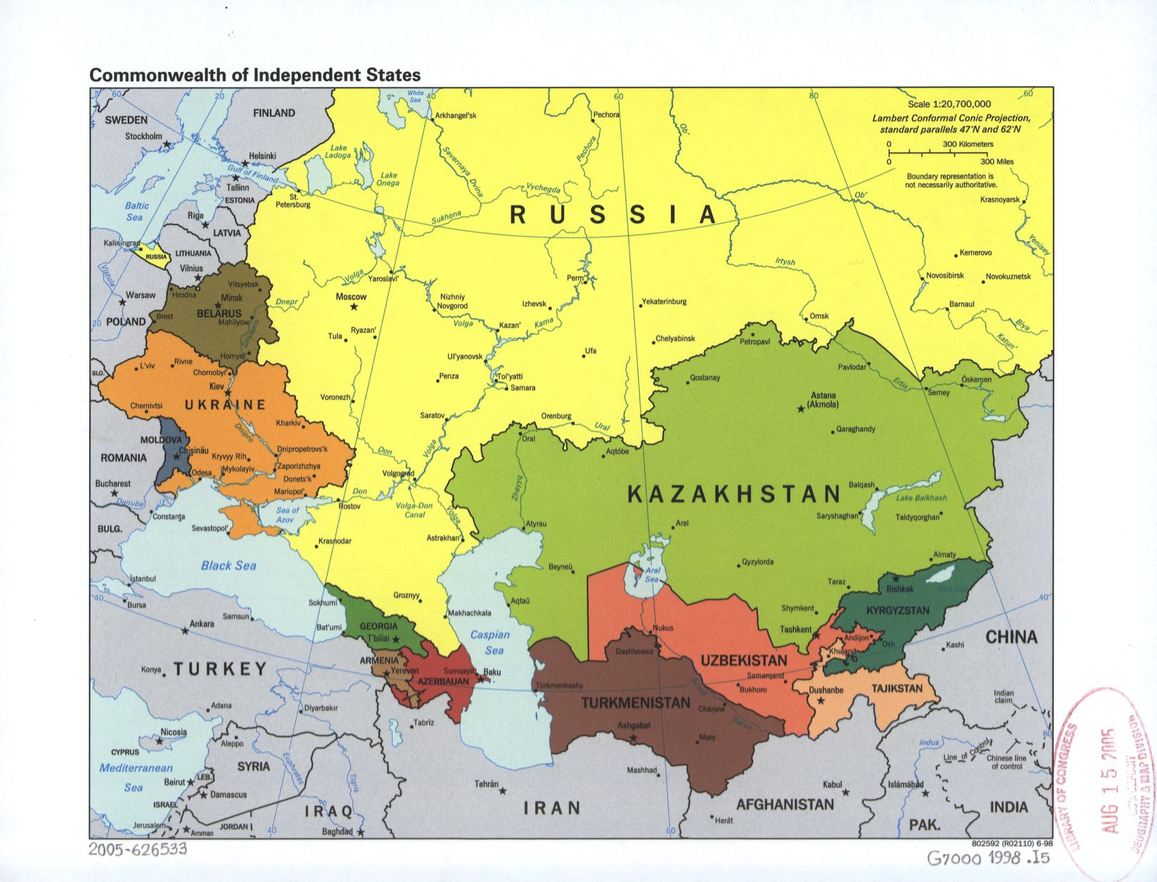
Russian Activity in the “Grey Zone”
(BG (R)Zwack)

Slide 4


Russian Activity in the “Grey Zone”
(Dr. Baumann)
Use of “Soft Power”
Mass media
Film & entertainment
Reaching out into the Russian-speaking regions
Europe and the USA

Slide 5
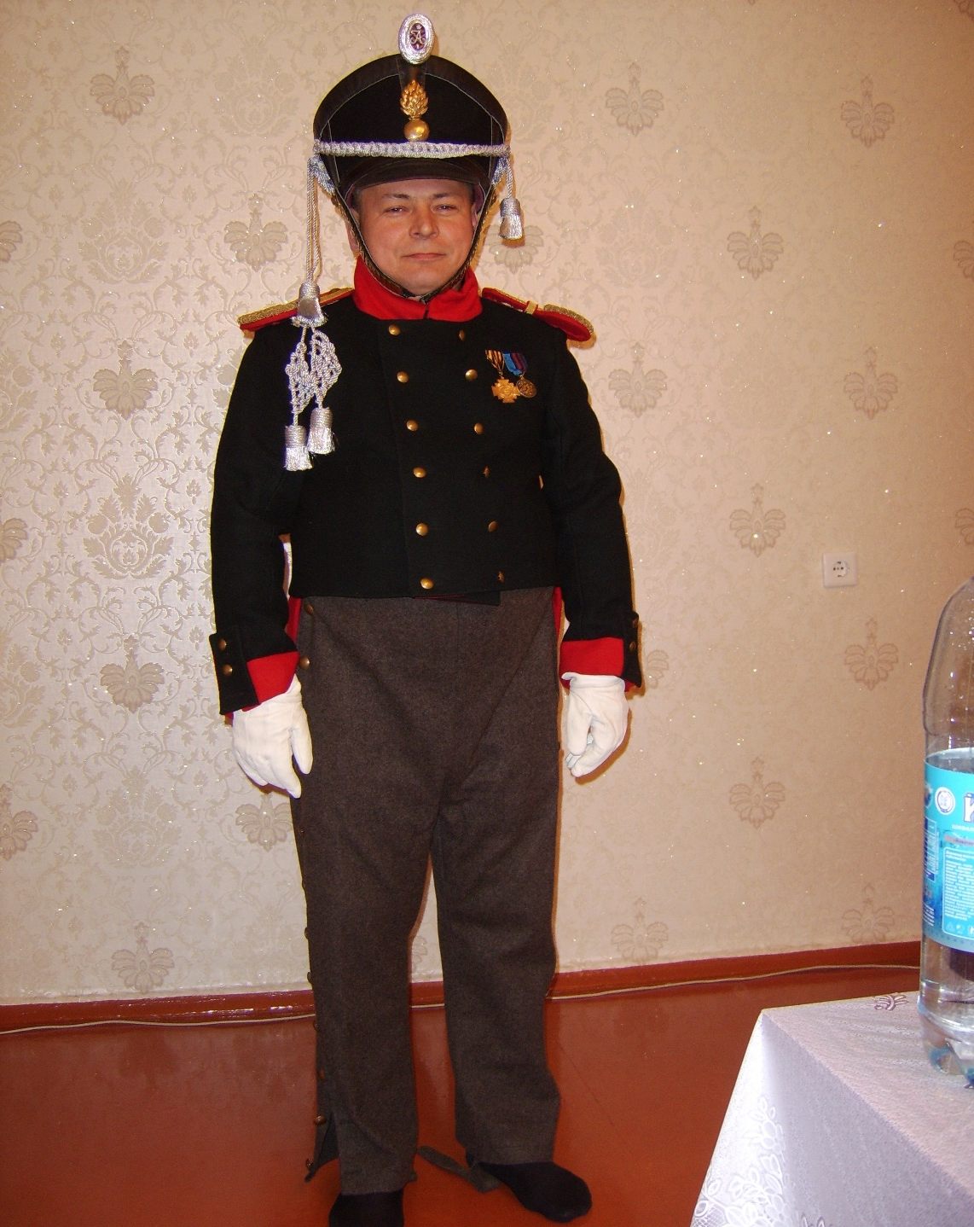
Military History Society

Slide 6
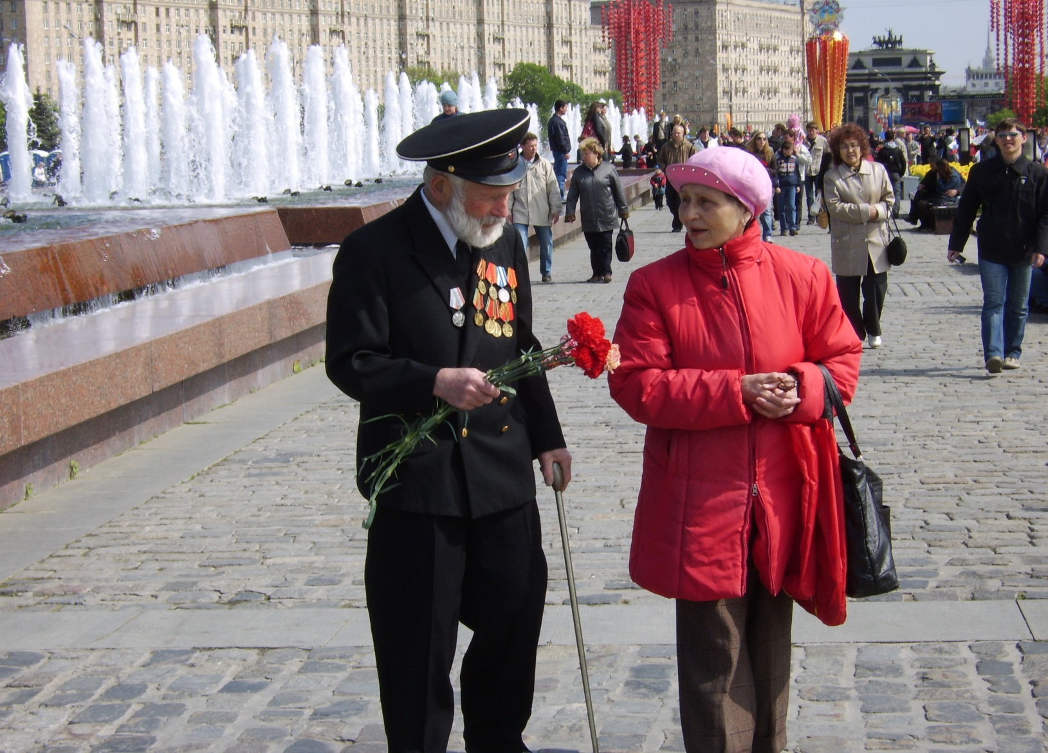
VICTORY DAY

Slide 7
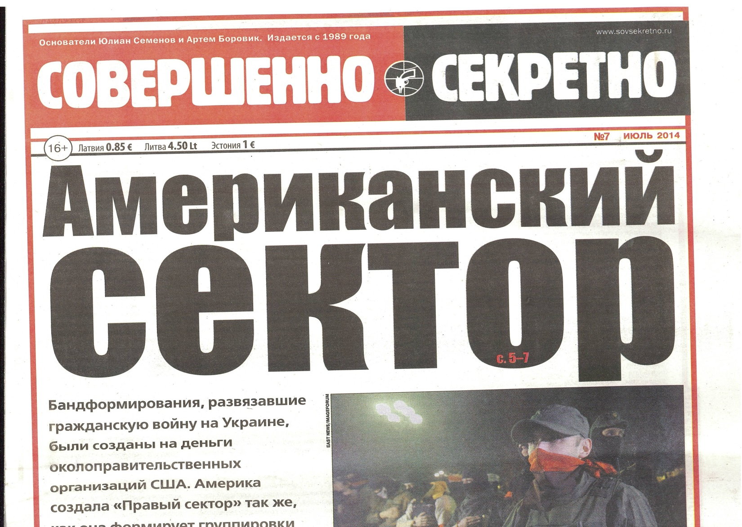
Amerikanskii sektor

Slide 8
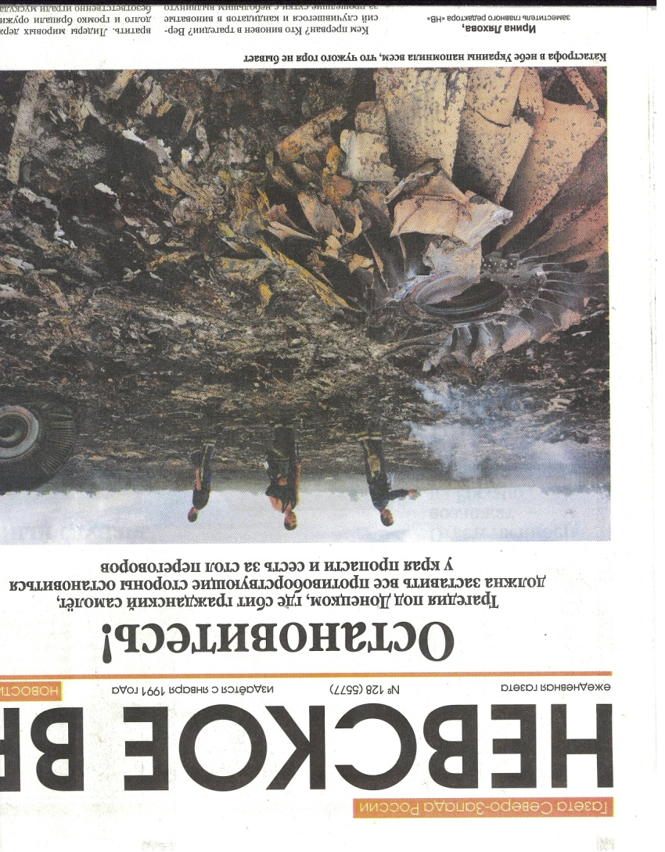
Nevskoe vremya: Stop the Tragedy in Donetsk

Slide 9
"Cultural and Regional Implications of Russian
Power Projection in The "Grey Zone.“
(Dr. Ibrahimov)
Defining the “Grey Zone” and Russian Strategic Military Culture
General V. “Gerasimov “Grey Zone” Concept”
Lessons Learned from Russian Power Projection in The "Grey Zone.“
Examples of pro-Russia propaganda video clips.
Suggested reading sources:

Slide 10
Gas Pipelines to Europe
Graphic courtesy of CIA, located at the Library of Congress:
http://tile.loc.gov/image-services/iiif/service:gmd:gmd5:g5692:g5692c:ct003073/full/pct:12.5/0/default.jpg.

Slide 11
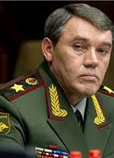
Russian Army chief of the General Staff
General V. “Gerasimov “Grey Zone” Concept”
Russia is engaged in a civilizational as well as geopolitical struggle with the West in a continual state of conflict. It’s the war of ideas and values using the asymmetrical operations without the formal declaration of war.
Special forces operating jointly with internal opposition leveraging information operations, cyber, legal, electronic and economic warfare to achieve its strategic outcome.
”Tsenosti Nauki V Predvidenii. Novie Vizovi Trebuyut Pereosmislit Formi I Sposobi Vedenia Boyevikh Deistviy,” ”At The Foresight Of The Value of Science : New Challenges Demand Rethinking the Forms and Methods of Carrying out Combat Operations,“ Voyenno-Promyshlennyy Kurier online, 27 February 2013, issue #8(476), accessed 16 September 2016, http://vpk-news.ru/articles/14632.

Slide 12
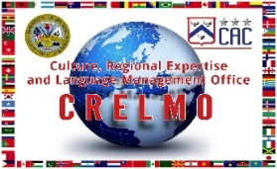
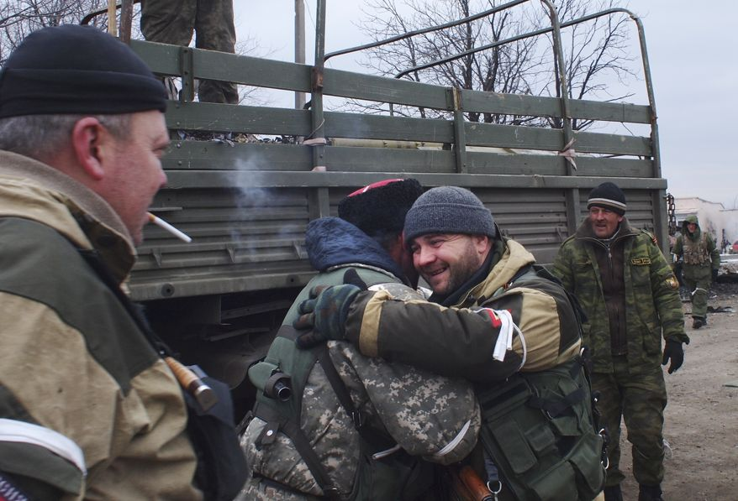
Examples of pro-Russia propaganda video clips
“Dance Russia and Cry Europe” (with a popular Pro-Russia song and video clip on Eastern Ukraine)
https://www.youtube.com/watch?v=SmolVWRS1q4
“Don Cossacks Come to the Aid of their Brothers in the Donbas” (patriotic Cossack traditional song
featuring volunteer Russian Cossacks joining the pro-Russia rebels in Ukraine)
https://www.youtube.com/watch?v=eiIpa42duMA
(A pro-Russia rebel Cossack, second left, hugs another rebel in Debaltsevo, eastern Ukraine, Thursday, Feb. 19, 2015 after taking it
under rebel control):
http://www.washingtontimes.com/multimedia/image/ukraine-jpeg-0c1b7jpg/

Slide 13
Vladimir V. Putin,“Voyennaya Doctrina Rossiyskoy Federatsii” [The Military Doctrine of the Russian Federation], December 26, 2014 (in Russian).
Vladimir V. Putin, “Ukaz Prezidenta Rossiyskoy Federatsii o Strategii Natsionalnoy Bezopasnosti Rossiyskoy Federatsii” [“The Decree of the President of the Russian Federation on the National Security Strategy of the Russian Federation”], 31 December 2015 (in Russian)
General Valery V. Gerasimov (Вале́рий Васи́льевич Гера́симов), Chief of the General Staff of the Armed Forces of Russia, first Deputy Defence Minister, ”Tsenosti Nauki V Predvidenii. Novie Vizovi Trebuyut Pereosmislit Formi I Sposobi Vedenia Boyevikh Deistviy,” ”At The Foresight Of The Value of Science : New Challenges Demand Rethinking the Forms and Methods of Carrying out Combat Operations,“ Voyenno-Promyshlennyy Kurier online, 27 February 2013, issue #8(476), accessed 16 September 2016, http://vpk-news.ru/articles/14632.
Peter Zwack “Zapad 2017: Should We Fear Russia’s Latest Military Dress Rehearsal?” The National Interest , 2017, (http://nationalinterest.org)
“Azerbaycan 24 sene sonra Ermenistan'dan geri aldı” [“Azerbaijan Returned (lands) from Armenia 24 Years Later”], Milliyet.com in Turkish, April 25, 2016.
“Azerbaijan Halqi Oz Torpaglarinin Ishgal Altinda Galmasi Ila Hech Vaxt Barishmayacag” (“Azerbaijan Will Never Agree Its Lands to Remain Under Occupation”), Ramiz Mehtiyev, Chief of the Staff of the President of Azerbaijan, Halq Gezeti in Azerbaijani, April 6, 2016.
Baumann, Robert. “Soviet News Media Performance During the Afghan War: STRATCOM Utopia or Dystopia?” The US Army and the Media in Wartime: Historical Perspectives, the Proceedings of the Combat Studies Institute 2009 Military History Symposium, Kendal Gott, General Editor (Ft. Leavenworth, KS: 2009), 175-186.
Ibrahimov Mahir, Otto Gustav, Gentile Lee "Cultural Perspectives, Geopolitics and Energy Security of Eurasia: Is the Next Global Conflict Imminent?" Volume 1/ Army U Press/ Culture, Regional Expertise/Language Management Office (CRELMO), Fort Leavenworth, Kansas, USA. March 2017. ISBN: 9781940804316.
“Nord Stream 2 partners withdraw amid Poland pressure,” The Financial Times Ltd, August 12, 2016.
Darko Janjevic, “NATO leaders meet in Warsaw for key military summit,” Associate Press, July 07, 2016.
Peter Pomerantsev, NOTHING IS TRUE AND EVERYTHING IS POSSIBLE: The Surreal Heart of the New Russia. New York: Public Affairs, 2014.
„Russkii mir,“(Russian World), http://www.russkiymir.ru/russkiymir/en/.
Ibrahimov, Mahir J. “Socio-cultural lessons from Eurasia and Afghanistan,” Military Intelligence Professional Bulletin (MIPB), January/March 2011. http://usacac.army.mil/sites/default/files/documents/cace/LREC/2011_Socio-CulturalLessons.pdf
Ibrahimov, Mahir J.“Cross- Cultural Negotiations/Skill Building in an Operational Environment,” Military Intelligence Professional Bulletin (MIPB), April/June 2011. http://usacac.army.mil/sites/default/files/documents/cace/LREC/2011_CrossCulturalNegotiations.pdf
Ibrahimov, Mahir J. “Invitation To Rain, A Story Of The Road Taken Towards Freedom,” Global Scholarly Publications. New York, NY, USA. October 2008. ISBN: 978-1-59267-0925.
World Bank, “GDP growth (annual %),” World Development Indicators, accessed 12 September 2016 http://databank.worldbank.org/data/reports.aspx?Code=NY.GDP.MKTP.KD.ZG&id=af3ce82b&report_name=Popular_indicators&populartype=series&ispopular=y#.
Alexander Dugin, “The Fourth Political Theory” Arktos Media Ltd, July 20, 2012 (ISBN-10: 1907166653/ ISBN-13: 978-1907166655);
Alexander Dugin, “Eurasian Mission: An Introduction to Neo-Eurasianism,” Arktos Media Ltd, December 15, 2014 (ISBN-10: 1910524247 ISBN-13: 978-1910524244)
“ O Rossotrudnichestve”, http://rs.gov.ru/node/28132).

Slide 14
Questions/Answers/Comments

Slide 15
Russian Activity in the “Grey Zone”

Slide 16
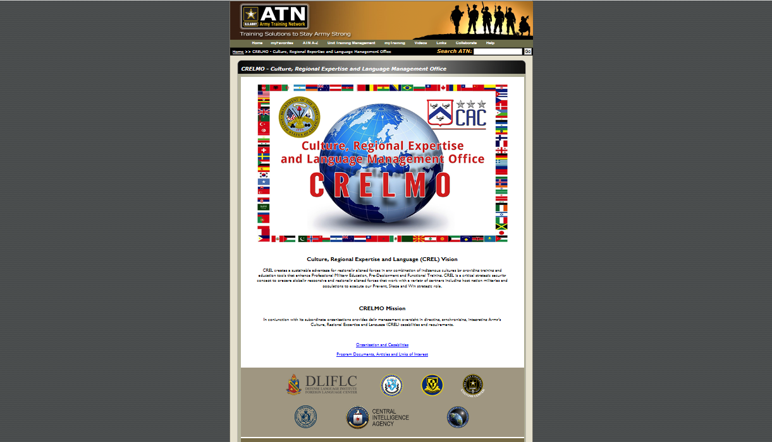

Slide 17
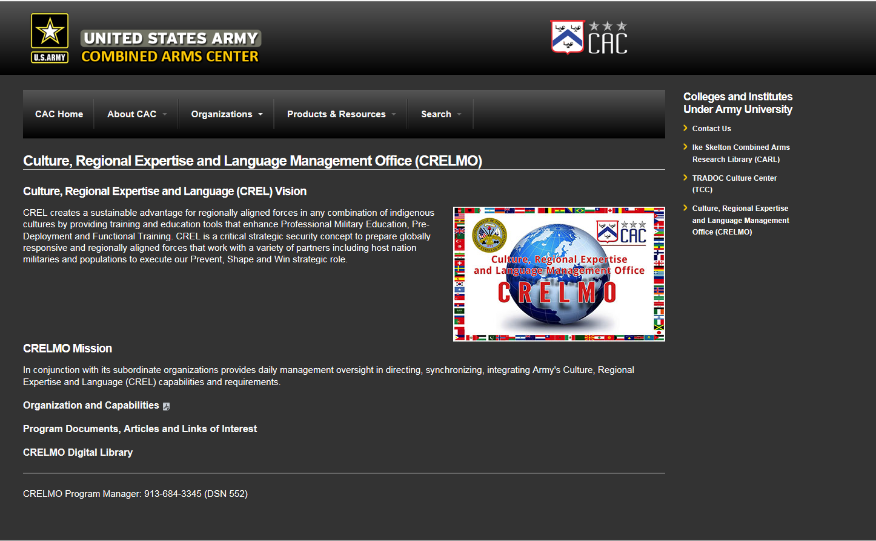

Slide 18
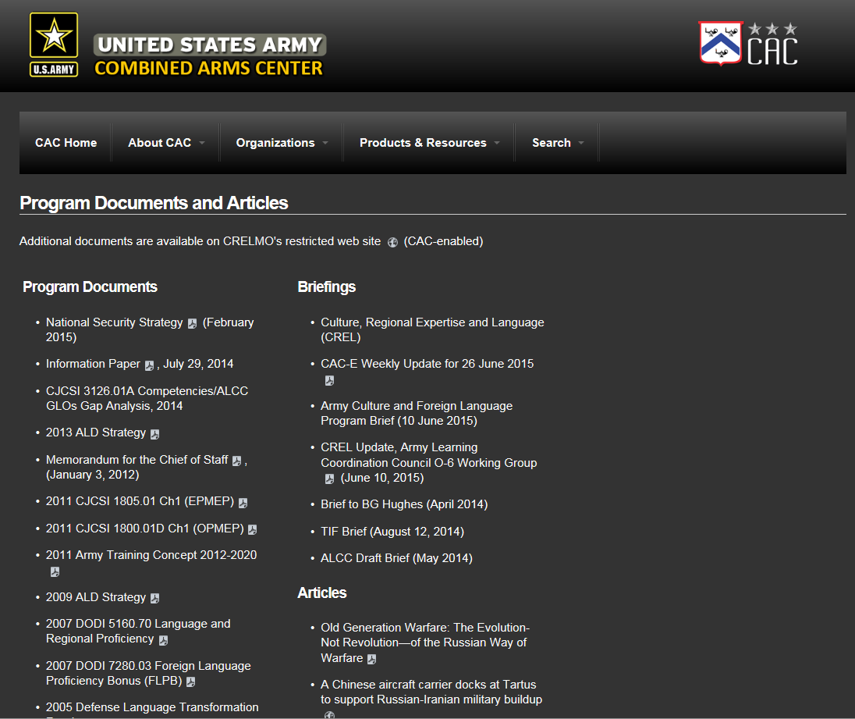

Slide 19
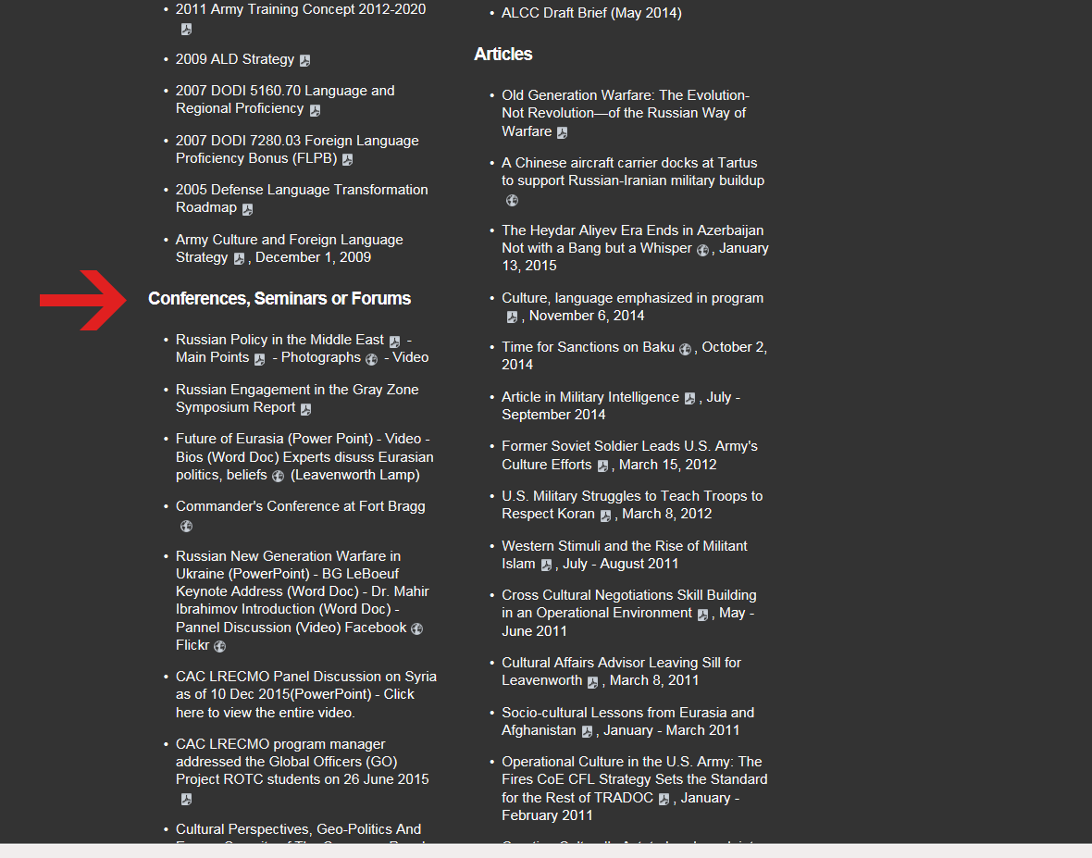

Slide 20


Contact:
Dr. Mahir Ibrahimov
Director
CREL Management Office (CRELMO)
Fort Leavenworth, KS 66027-2300
Ph: (913) 684-3345
DSN: 552-3345
CRELMO website: http://usacac.army.mil/organizations/cace/lrec
ATN: https://atn.army.mil/dsp_template.aspx?dpID=102
https://atn.army.mil
https://atn.army.mil

