Slide 1
LREC Management Office (LRECMO)
(Blended LREC Enterprise)
Dr. Ibrahimov
12 August 2014
LREC Management Office (LRECMO)
(TIF Brief)
Dr. Ibrahimov (12 August 2014)

Slide 2
Blended LREC Approach
Purpose
To provide information on the distinct roles and responsibilities of the Defense Language Institute Foreign Language Center (DLIFLC), TRADOC Culture Center (TCC), and Human Terrain System (HTS) in support of Army’s training requirements
DLIFLC
culturally based foreign language education, training, evaluation and sustainment to all services and interagency partners
LREC
TCC
training and education on cross-cultural competency (3C) and region specific knowledge for Soldiers
LREC is a critical capability required
to conduct Unified Land Operations
and exert influence
LREC is developed and maintained
through Education, Training, and Experience
“The LREC concept creates a sustainable advantage for Regionally Aligned Forces in any combination of indigenous cultures by providing training and educational tools to enhance Professional Military Education, Pre-Deployment, and Functional Training.”
–BG Christopher P. Hughes.
REC
HTS
socio-cultural research and analysis to commanders and staffs in support of information requirements
REC
Continue leveraging existing LREC capabilities to meet Army’s training requirements
Endstate: Ready Forces in support of
CCMD requirements (ACP Obj 3.0)

Slide 3
Current Training Support
Distributed Learning
Mobile Training Teams
Locally Based Assets
-Rapport
-Headstart2
-Cultural Orientations
-Countries in Perspective
-GLOSS
-Virtual Cultural Awareness
Trainer (VCAT)
-Supplemental Resources
- Defense language Institute MTTs
-TRADOC Culture Center MTTs
-FAOs → Division Level by FY15
-MI, MISO, Civ Affairs assets
-Red Teams at BDE, Division, Corps
-Native Heritage Soldiers
-OSD Language Training Centers
-DLI Language Training Detachments
Blended, Varied Delivery of LREC Capabilities

Slide 4
Ms. Clare Bugary
12 August 2014
DLIFLC

Slide 5
Defense Language Institute
Foreign Language Center
To identify how DLIFLC is nested in the Army’s LREC strategy and to describe how the Institute is supporting language life long learning (L4) for the force
www.DLIFLC.edu
Purpose
More than 30 languages
L
> 3,000 basic course graduates
> 2,800 post-basic graduates
> 6,000 pre-deployment graduates
- > 660,000 online students
DLI Supporting the LREC Strategy
RE
More than 70 Countries
C
More than 75 cultures

Slide 6
COL Price
12 August 2014
TRADOC Culture Center

Slide 7
TRADOC Culture Center
To present a brief laydown of the TRADOC Culture Center and its support to both the generating and operational forces.
Established in 2004, TCC provides cultural competency training and education in order to build and sustain an Army with the right blend of cultural competency capabilities to facilitate a wide range of operations, now and in the future. TCC is subordinate to CAC LD&E and actively supports ICoE.
Purpose
Discussion
Purpose-built organization to standardize IMT and PME culture curriculum and conduct pre-deployment training.
Shared ICoE best practices with the Army.
Base-funded Program of Record.
27 Department of the Army Civilians; home-based at the Intelligence Center of Excellence.
Curriculum is shared through ATN, TDC and its CAC enabled portal – https://ikn.army.mil/culturecenter
Units request training through ATRRS – 9E-F36/920-F30 (CT-MTT)
Background
TCC is TRADOC’s training development proponent for IMT and PME.
TCC conducts RAF pre-deployment LREC training ISO FORSCOM requirements – 54 MTTs this FY, supporting all ASCCs.
Tiny program, big bang for the buck.
TRADOC Culture Center’s vision is a better connected Army LREC effort; informed by Lessons Learned and the Army Learning Model; nested in the Army Leader Development Program; supporting the three learning domains.
Endstate

Slide 8
Gary Phillips
12 August 2014
Human Terrain System

Slide 9
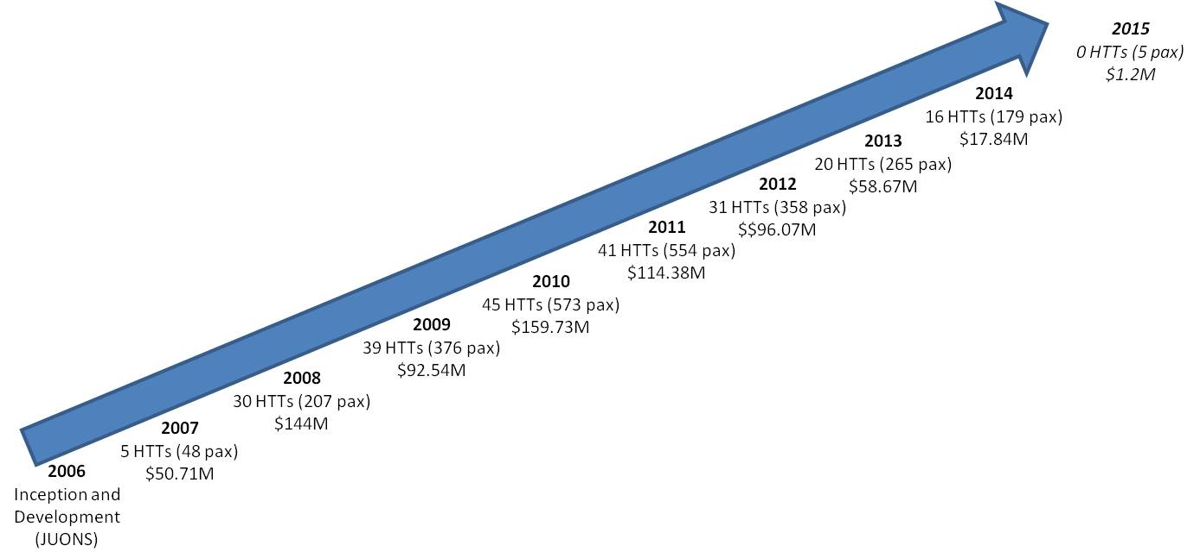
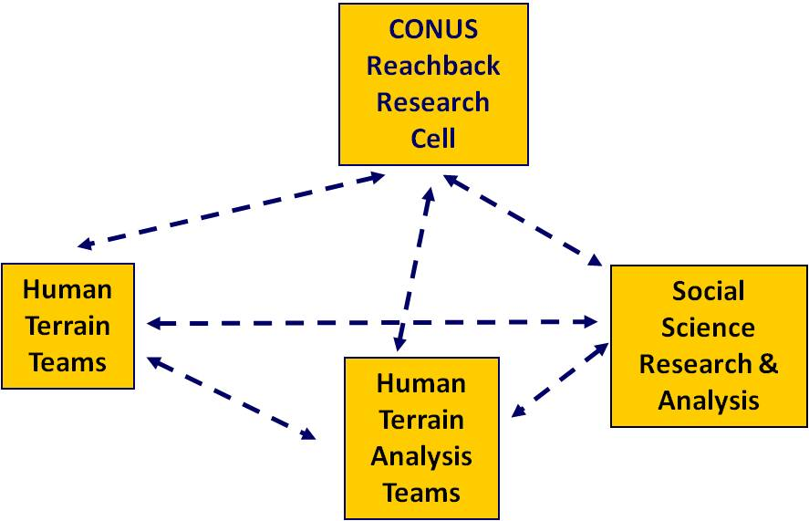
Human Terrain System
Socio-Cultural knowledge at the point of Decision
“Designed as a System”
5 DACs Reachback and SME Support
Enterprise
Army Campaign Plan Tasks
Army Campaign Support Plan Tasks
“Global Landpower Network”
HTS Interwar Requirements
TRADOC has a variety of investments in sensing the Operational Environment with culture and language as a key element. Organizing these “investments” as an enterprise may provide the very limited remaining HTS capability a “platform” to allow satisfaction of at least some of the requirements.
Provide direct support to ASCCs and RAF units.
Conduct socio-cultural research to determine expected conditions requiring representation in Army LDTE activities (UQ/UC, LREC, PME). Enabling leaders for prevent, shape and win.
Maintain a foundation for contingency operations.
Sustain a relevant socio-cultural database and research

Slide 10
Discussion

