Slide 1
LREC Management Office (LRECMO)
(Blended LREC Enterprise)
Dr. Ibrahimov
12 August 2014
LREC Management Office (LRECMO)
(ALCC Draft Brief)
Dr. Ibrahimov (May2014)

Slide 2
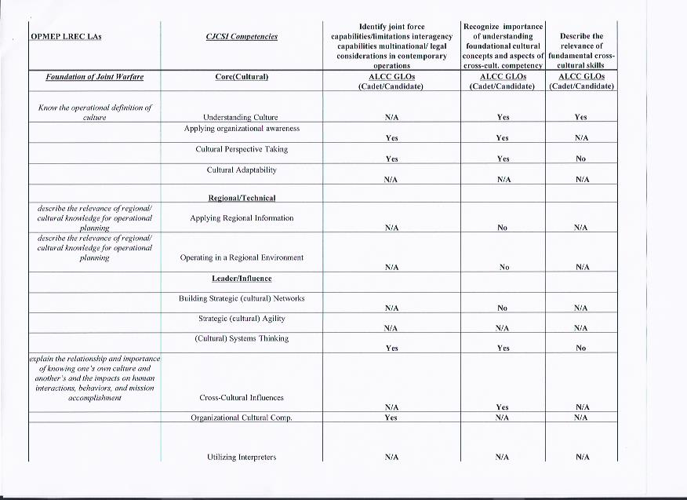
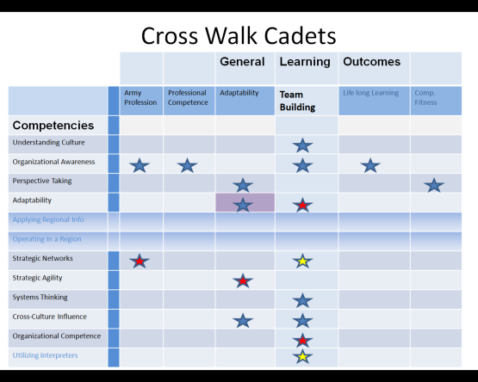
History of Culture Focus
HQDA, US Army Leader Development Strategy
HQDA, Army Culture and Foreign Language Strategy
OPERATIONS ORDER 11305-003
CAC Culture and Foreign Language Strategy Implementation Guidance
ALCC General Learning Outcomes (GLOs) (Culture and JIIM)
Regionally Aligned Forces(RAF)/National Security Strategy (NSS)
Draft Language-Regional Expertise & Culture Strategy (L-REC)
Chairman of the Joint Chiefs of Staff
Instruction (CJCSI 3126.01A)
Cross Walk GLOS with CJCSI
Competencies
Gap Analyses conducted
Self Report data collected
Assessment developed
Recommendations Developed

Slide 3
Recommendations
Update GLOS with CJCSI Competencies
Assessments demonstrate that there are gaps and inconsistencies in the GLOs when cross walked against CJCSI
2. Add L-REC as an Army Learning Outcome
Increased focus on Culture for mission success warrants Culture and JIMM not being limited to the Team Building Area
Culture has become a
significant factor in mission
success that it should be a
separate Army Learning Area
As a Learning Area, L-REC
would more clearly address
the CJCSI Competencies
3. Update Team Building Competencies

Slide 4
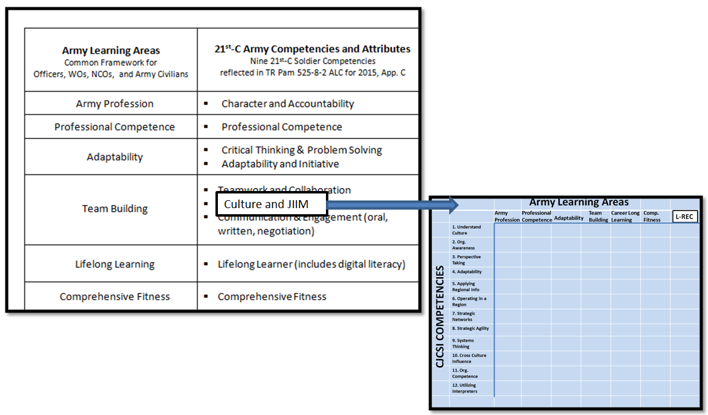

Slide 5
Backup Slides
OPMEP LREC LAs to CJCSI 3126.01A Competencies to ALCC GLOs (Cadet/Candidate)
OPMEP LREC LAs to CJCSI 3126.01A Competencies to ALCC GLOs (Intermediate/Senior)
OPMEP LREC LAs to ALCC GLOs to TLOs CGSOC
Self Report of Compliance- Officer
Self Report of Compliance- NCO
Cross Walk GLOs and CJCSI 3126.01A Competencies: Cadets, LTs, CPTs, MAJs, COLs

Slide 6
Gap Analysis

Slide 7
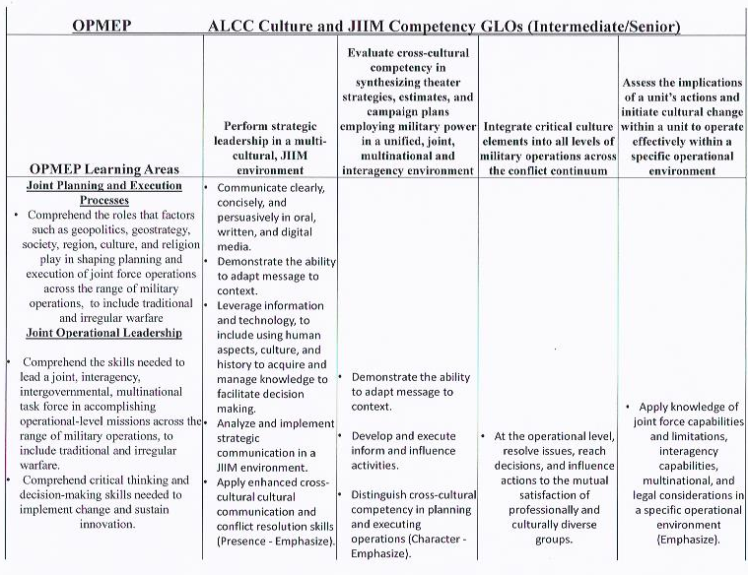
Gap Analysis

Slide 8
Gap Analysis

Slide 9
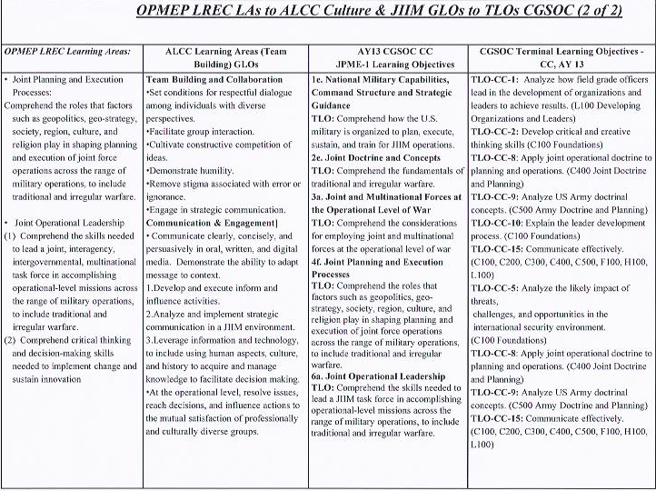
Gap Analysis

Slide 10
Self Report of Compliance

Slide 11
Self Report of Compliance- Officer

Slide 12
Self Report of Compliance- NCO

Slide 13
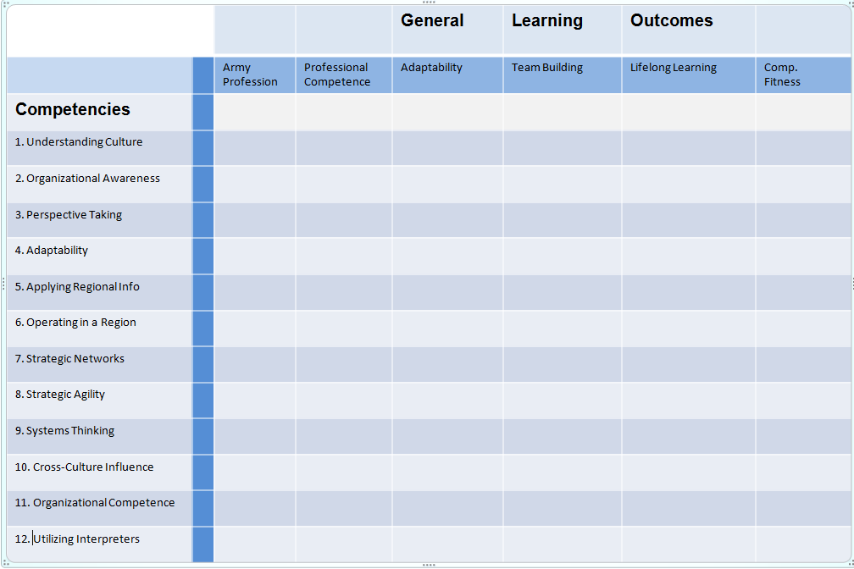
Cross Walk GLOs and CJCSI Competencies
Notes:
Discuss the process of cross walking the GLOs and the Competencies.
Establish the caveats and assumptions for the analysis:
1. The GLOs are focused on all Learning Outcomes not just related to culture and JIIM
2. Both focus on Adaptability, but possibly not in the same manner
3. The GLOs have Team Building outcome divided into Team Work & Collaboration; Culture & JIIM; Communication & Engagement
Possibly need to create a new Learning Outcome to reflect the increased focus on Culture, JIIM, & Engagement
4. Not all of the competencies are relevant for all levels (LT to COL)
5. Learning may not be linear – some competencies may be more important at different levels
6. Are there competencies/ GLOs that you may master early and not train on after the proficiency is achieved?
Assumption: No. Once a category is taught, continued training is needed to reach master.
7. How perishable are these competencies/ GLOs?
Assumption: All competencies/ GLOs are perishable to some degree
8. Different MOSs and job requirements may emphasize some competencies more than others
9. Proficiency for each competency may be demonstrated in different ways: quantity versus quality of learning activities

Slide 14
Cross Walk Cadets
 |  |  |  | General | Learning | Outcomes
 |  | Army Profession | Professional Competence | Adaptability | Team Building | Life long Learning | Comp. Fitness
Competencies
Understanding Culture
Organizational Awareness
Perspective Taking
Adaptability
Applying Regional Info
Operating in a Region
Strategic Networks
Strategic Agility
Systems Thinking
Cross-Culture Influence
Organizational Competence
Utilizing Interpreters
Notes:
A solid blue star means that the current General Learning Outcomes addresses at some level the particular CJCSI Competency.
A yellow star means that the current General Learning Outcomes does not address the CJCSI Competency very well. Some discussion needs to be had to evaluate whether or not a slight modification of wording is needed or if the category should be N/A.
N/A meaning not applicable at this time.
A red star means that the General Learning Outcomes do not address at any level the particular CJCSI Competency and needs to be added.
For Cadets, it is likely that the competencies “Applying Regional Information” and “Operating in a Region” do not readily apply to their training, unless they have had deployment experiences, immersion opportunities, or other unique training for a specific region.
For Cadets, the most important training to meet the Competencies might be those related to understanding the Army as an Organization and what it means to be a Soldier. The higher level capabilities will develop later as the cadets progress through their Army career.
Which skills should a cadet actually have before becoming a LT?
How important is it that a cadet can be cultural adaptable?
Are there competencies that cadets should be more than basically proficient?
Should there be basic exposure to building strategic networks? Developing strategic agility? Using interpreters?

Slide 15
Cross Walk LTs
 |  |  |  | General | Learning | Outcomes
 |  | Army Profession | Professional Competence | Adaptability | Team Building | Life long Learning | Comp. Fitness
Competencies
Understanding Culture
Organizational Awareness
Perspective Taking
Adaptability
Applying Regional Info
Operating in a Region
Strategic Networks
Strategic Agility
Systems Thinking
Cross-Culture Influence
Organizational Competence
Utilizing Interpreters
Notes:
A solid blue star means that the current General Learning Outcomes addresses at some level the particular CJCSI Competency.
A yellow star means that the current General Learning Outcomes does not address the CJCSI Competency. Some discussion needs to be had to evaluate whether or not a slight modification of wording is needed or if the category should be N/A.
N/A meaning not applicable at this time.
A red star means that the General Learning Outcomes do not address at any level the particular CJCSI Competency and needs to be added.

Slide 16
Cross Walk CPTs
 |  |  |  | General | Learning | Outcomes
 |  | Army Profession | Professional Competence | Adaptability | Team Building | Life long Learning | Comp. Fitness
Competencies
Understanding Culture
Organizational Awareness
Perspective Taking
Adaptability
Applying Regional Info
Operating in a Region
Strategic Networks
Strategic Agility
Systems Thinking
Cross-Culture Influence
Organizational Competence
Utilizing Interpreters
Notes:
A solid blue star means that the current General Learning Outcomes addresses at some level the particular CJCSI Competency.
A yellow star means that the current General Learning Outcomes does not address the CJCSI Competency. Some discussion needs to be had to evaluate whether or not a slight modification of wording is needed or if the category should be N/A.
N/A meaning not applicable at this time.
A red star means that the General Learning Outcomes do not address at any level the particular CJCSI Competency and needs to be added.

Slide 17
Cross Walk MAJs
 |  |  |  | General | Learning | Outcomes
 |  | Army Profession | Professional Competence | Adaptability | Team Building | Life long Learning | Comp. Fitness
Competencies
Understanding Culture
Organizational Awareness
Perspective Taking
Adaptability
Applying Regional Info
Operating in a Region
Strategic Networks
Strategic Agility
Systems Thinking
Cross-Culture Influence
Organizational Competence
Utilizing Interpreters
Notes:
A solid blue star means that the current General Learning Outcomes addresses at some level the particular CJCSI Competency.
A yellow star means that the current General Learning Outcomes does not address the CJCSI Competency. Some discussion needs to be had to evaluate whether or not a slight modification of wording is needed or if the category should be N/A.
N/A meaning not applicable at this time.
A red star means that the General Learning Outcomes do not address at any level the particular CJCSI Competency and needs to be added.

Slide 18
Cross Walk COLs
 |  |  |  | General | Learning | Outcomes
 |  | Army Profession | Professional Competence | Adaptability | Team Building | Life long Learning | Comp. Fitness
Competencies
Understanding Culture
Organizational Awareness
Perspective Taking
Adaptability
Applying Regional Info
Operating in a Region
Strategic Networks
Strategic Agility
Systems Thinking
Cross-Culture Influence
Organizational Competence
Utilizing Interpreters
Notes:
A solid blue star means that the current General Learning Outcomes addresses at some level the particular CJCSI Competency.
A yellow star means that the current General Learning Outcomes does not address the CJCSI Competency. Some discussion needs to be had to evaluate whether or not a slight modification of wording is needed or if the category should be N/A.
N/A meaning not applicable at this time.
A red star means that the General Learning Outcomes do not address at any level the particular CJCSI Competency and needs to be added.

